Slide 1
Micro-Certifications Findings
Jaskirat Singh, TSDSI Marcom Team
28 June 2023
© 2023 oneM2M

Slide 2
Micro-Certifications Mechanism (Findings)
Micro-Certifications:
Smaller set of courses/modules designed to provide learners with knowledge, skills, and competencies in the area of study.
More flexible, focused, more targeted learning.
Helps to fill the gaps and provide upskilling in short duration.
Provide Industry relevant professional growth.
More the no. of learners & certificates issued, more will be the visibility of the organization.
Examples:
Microsoft, IBM, Google etc. offer some free online courses and learners get certificate of completion/digital credentials.
The ITU Academy (for ITU’s capacity development activities) offers a wide range of training courses like ITU A.1 with different delivery modes (online self-paced, online instructor-led, face-to-face, and blended)
IIIT-H has been running a oneM2M MOOC course prepared under the India-EU PP.

Slide 3
Platforms to start online course
Self Hosting
Need to set up everything -to build webpage,
domain name, LMS, place to host the course, email automation etc.
There are many Softwares/Tools available for that e.g.
a) Teachable:
Teachable - upload text, presentations, videos, audios etc.
b) Thinkific
Free Trial Plan: free 30-day trial of our Start Plan.
Some Features:
Drag and drop course builder/Full video & content hosting
Digital Certificates are automatically issued after completion of the course.
Market Place platforms
LinkedIn Learning, Udemy, Coursera etc.-Courses are uploaded on their platform
e.g.- LinkedIn Learning, Udemy etc
Uploaded course materials can include a brochure about the course, PowerPoint presentations, course handouts (PDFs), videos or graphics etc.
Hosting Course on Udemy Platform- Anyone can create a custom course for their Udemy Business account , however, will need to submit the custom course for review and an admin will need to approve it before it’s published.

Slide 4
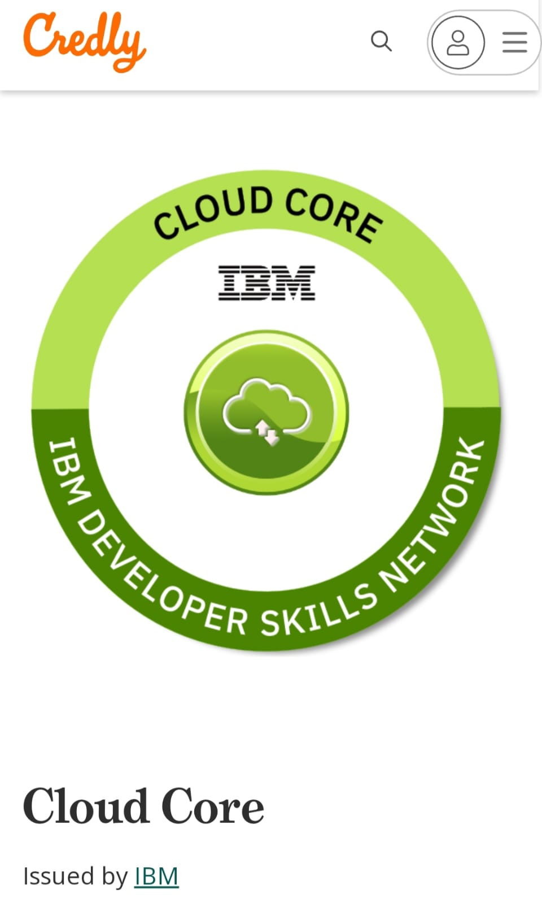
Key Considerations
Features for online course:
Type- course to be webinar/text-based/ video-based
Assessment- can be through quizzes/Self-assessment questions/Exercises etc.
Flexibility- Can be provided by offering a variety of delivery methods, such as online, in-person, or self-paced.
Mentoring- It gives online learners the opportunity to benefit from more experienced peers
Different ways to deliver course material:
By Creating articles, videos, and other materials that can be stored online.
Through PowerPoint Slideshows
Recordings of a webinar can be added to collection of permanent training material. Having a store of permanent training materials makes self-paced learning easier
By Animated training videos
Pathways to get Micro Certification Accredited: Partnering with University- course to be set by organization & University to deliver the course and issue certificates.
Partnering with Professional Organisation- can partner with Professional organisation like Microsoft, IBM, Cisco, Apple, Intel etc. for content creation or issuing certificates.
Issuing Digital Badges
A digital badge has all the information to verify the credential - name of the issuing organization, date, holder’s name and proof of acquisition. There are many platforms to issue digital badges e.g. Credly
https://info.credly.com/product/acclaim

Slide 5
Thank You
© 2023 oneM2M

