Slide 1
Lightweight and dynamic MN profile for Edge
TP-2023-0080-Lightweight_MN
Group Name: TP
Source: Jieun Lee, Jiho Lee, JaeSeung Song (Sejong Univ. )
Meeting Date: 2023-08-16

Slide 2
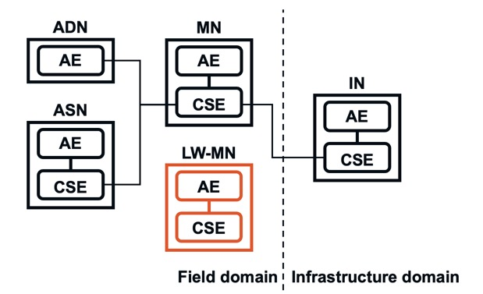
What is Lightweight & Dynamic MN?
Lightweight & Dynamic MN refers to a simplified or reduced profile of MN (Middle Node) within the oneM2M architecture.
The concept aims to fit scenarios that require less complexity, fewer resources, and more flexibility, especially in edge computing environments or small-scale IoT deployments.

Slide 3
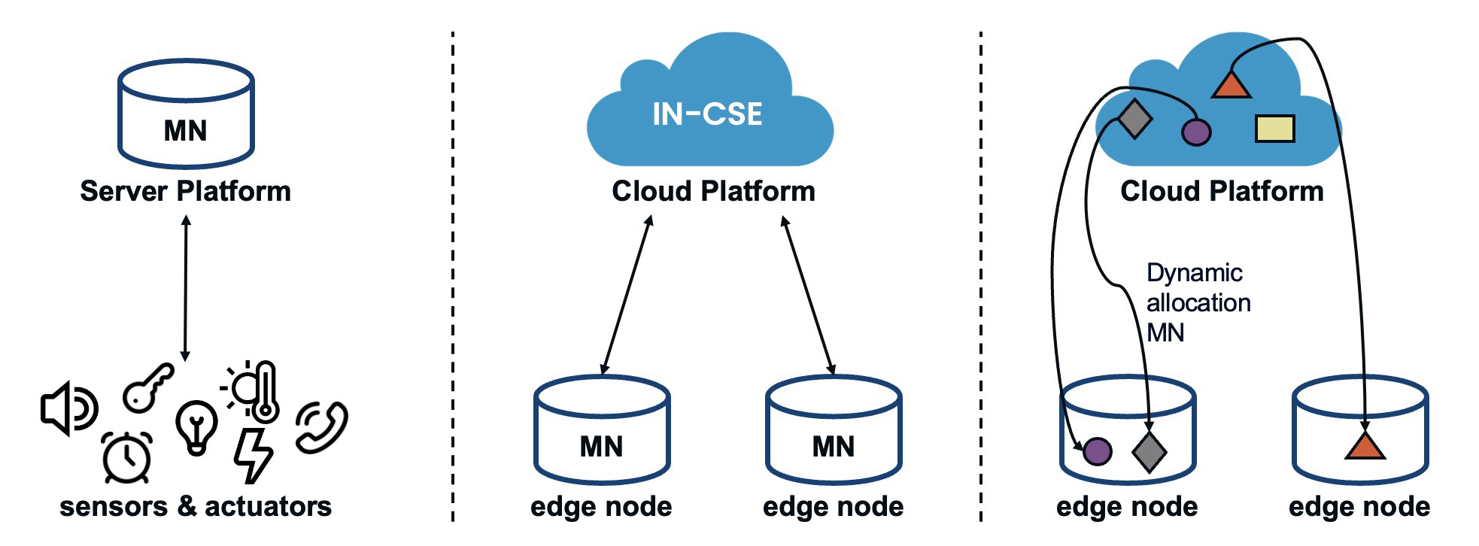
What is Lightweight & Dynamic MN?
Possible scenarios with Lightweight MN deployment
[single action]
[edge node with cloud]
[dynamic allocation]

Slide 4
Why is Lightweight & Dynamic MN needed?
oneM2M has been developing TS-0025 on Product profiles
TR-0025 specifies the detailed defined product profiles
AND, IN, ASN, MN, etc.
Necessity of Lightweight MN profile
A lighter MN profile could be considered that is more suited to the EDGE node
An edge node serves as a point where data is collected and processed, eliminating the need for sending it to a centralized, cloud-based IoT platform.
To fulfill the role of an edge node effectively, a lightweight profile that incorporates only the necessary subset of features might be more flexible and streamlined for the MN.
This can enhance the efficiency of data processing at the edge, offering improved performance in edge computing scenarios.
Then, How do define the scope of the Lightweight MN profile?

Slide 5
What is different with MN?
Functionality:
MN: Offers full functionalities, catering to multiple different area network technologies and connecting devices across networks.
Lightweight MN: Contains only the necessary subset of features tailored to specific needs such as localized IoT services within an edge node.
Resource Requirements:
MN: Requires more computational resources, memory, and processing power.
Lightweight MN: Designed to be more resource efficient and operate with minimal hardware requirements.
Flexibility:
MN: Generally works with the full set of oneM2M defined protocols and standards.
Lightweight MN: Increase adaptability and agility by allowing more flexibility in choosing only the features you need, such as supporting only a single binding or only structured identifier options.
Deployment Example:
MN: A home gateway for a smart home or head unit in a connected vehicle connecting various sensors, actuators, and devices.
Lightweight MN: IoT gateways within edge/fog nodes or small smart factories that do not rely on centralized, cloud-based IoT services.

Slide 6
Analysis of Fundamental Feature Sets for MN
MN:
Lightweight MN:
Feature regarding the support for an Unstructured resource identifier: Given that the MN could only manage devices as the edge node, it would be acceptable for the Lightweight MN to support only Structured resources.

Slide 7
Analysis of Fundamental Feature Sets for MN
MN:
Lightweight MN:
Feature about the nodeLink attribute of <CSEBase>: The <node> resource represents specific information, detailing properties of an M2M Node that other oneM2M operations might utilize. Support for device management is not mandatory for the Lightweight MN, especially for <mgmtObj>.

Slide 8
Analysis of Fundamental Feature Sets for MN
MN:
Lightweight MN:
Feature concerning the applicationName attribute of <AE>: As appName attribute is not a mandatory attribute of <AE>, the Lightweight MN is not required to support it.

Slide 9
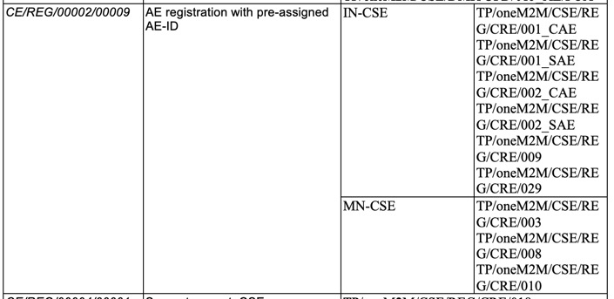
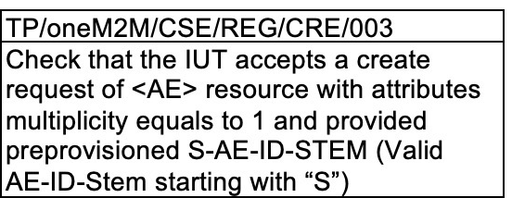
Analysis of Fundamental Feature Sets for MN
MN:
Q) Feature only about when AE-ID-STEM with “S”, not about “C” like IN-CSE. Is it enough testing only with “S”?
Feature about supporting the re-registration of AE that Lightweight MN doesn’t need to support it.

Slide 10
Analysis of Fundamental Feature Sets for MN
MN:
Lightweight MN:
Feature about supporting the nodeLink attribute of <CSEBase>. Same as previous feature set.

Slide 11
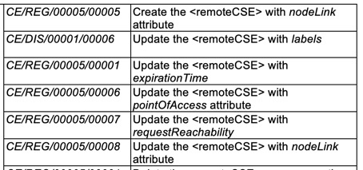
Analysis of Fundamental Feature Sets for MN
MN:
Lightweight MN:
Feature about supporting the nodeLink attribute of <CSEBase>. Same as previous feature set.

Slide 12
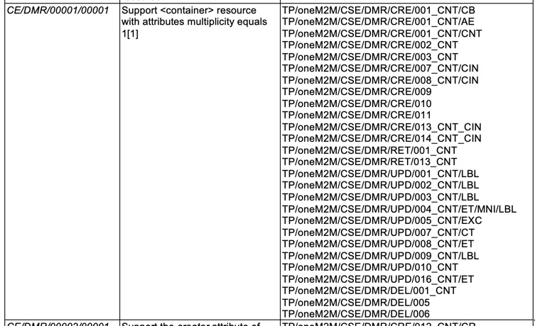
Analysis of Fundamental Feature Sets for MN
MN:
Feature about supporting the expirationCounter attribute which is not mandatory, the Lightweight MN is not required to support it.

Slide 13
Analysis of Fundamental Feature Sets for MN
MN:
Lightweight MN:
Feature about supporting the contentInfo attribute of <contentInstance> which is not mandatory, the Lightweight MN is not required to support it.

Slide 14
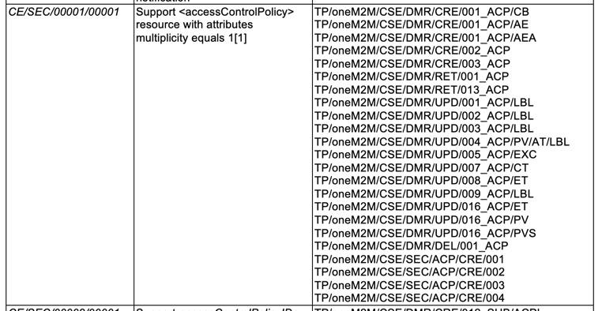
Analysis of Fundamental Feature Sets for MN
MN:
NOTE: Not in TTCN. Lightweight MN also doesn’t need to support.

Slide 15
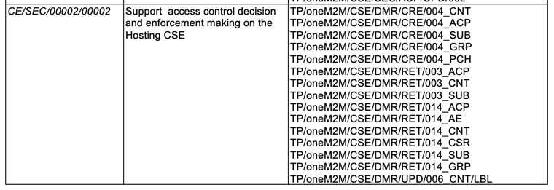
Analysis of Fundamental Feature Sets for MN
MN:
Feature about supporting the <pollingChannel> resource type which Lightweight MN doesn’t need to support.

Slide 16
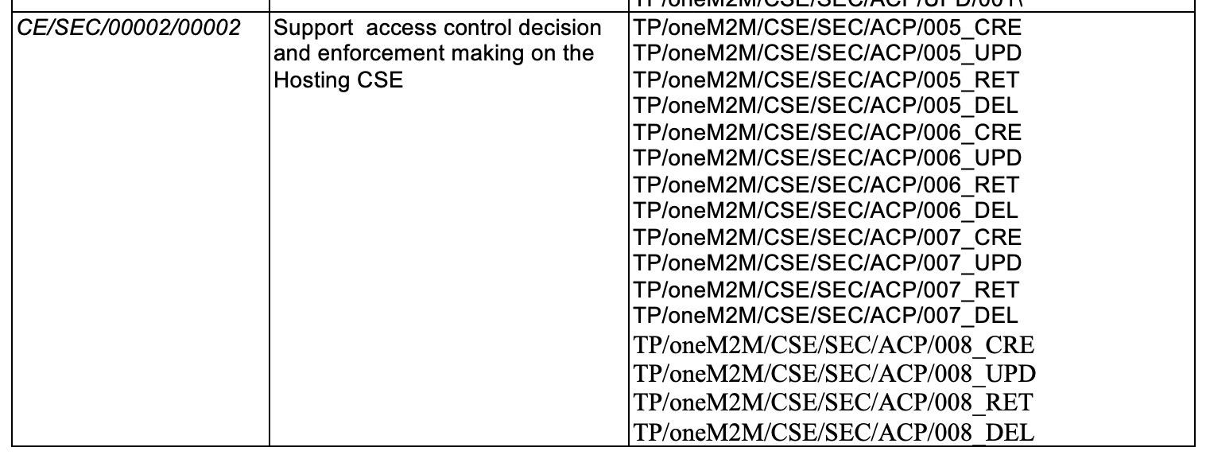
Analysis of Fundamental Feature Sets for MN
MN:
Feature about supporting the accessControlTimeWindow, accessControlLocationRegion which Lightweight MN doesn’t need to support.

Slide 17
Analysis of Fundamental Feature Sets for MN
MN:
Feature may not be required this additional validation check for Lightweight MN

Slide 18
Analysis of Fundamental Feature Sets for MN
MN:
Feature about supporting the Non-hierarchical addressing
which Lightweight MN doesn’t need to support.

Slide 19
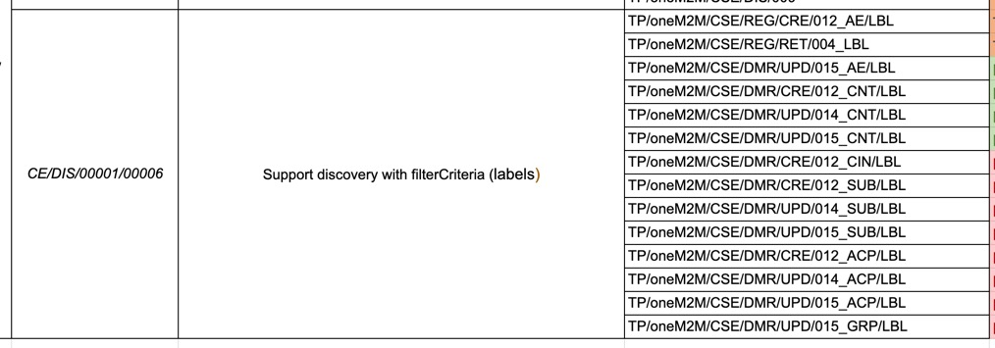
Analysis of Fundamental Feature Sets for MN
MN:
Feature about supporting the label attribute of CIN, SUB, ACP, GRP which is not mandatory, Lightweight MN doesn’t need to support it.

Slide 20
Proposal Contents for Lightweight MN
oneM2M has been developing TS-0025 on Product profiles
TR-0025 specifies the detailed defined product profiles
AND, IN, ASN, MN, etc.
Propose the additional section as a flexible MN profile for edge computing
Another thing to consider is, How to set dynamic MN profiles that change their feature sets on demand dynamically creating and unloading an MN from the cloud.

Slide 21
Thank you!

