Slide 1
Use of open data for oneM2M hackathon
TP-2023-0081
Group Name: TP#61
Source: Jungmin Lee, Yoonmee Park, JaeSeung Song (Sejong University)
Meeting Date: 2023-08-15

Slide 2
Background
oneM2M hackathons so far focus on:
  the development of small Arduino devices
  smart IoT services or applications
Many participants spend time and effort on device connection and service decorations
Could we enhance or introduce something new??

Slide 3
oneM2M as a data platform
There exist many open data available
  Solar energy related
  Traffics
  Air quality
  etc.
What about allow participants to develop algorithm or services using such open data
  Configure oneM2M to store all available open data for hackathon
  Allow participants to use such data
  Ask participants to develop algorithms using AI, ML, Blockchain, etc.. to save energy, protect security issue, etc.

Slide 4
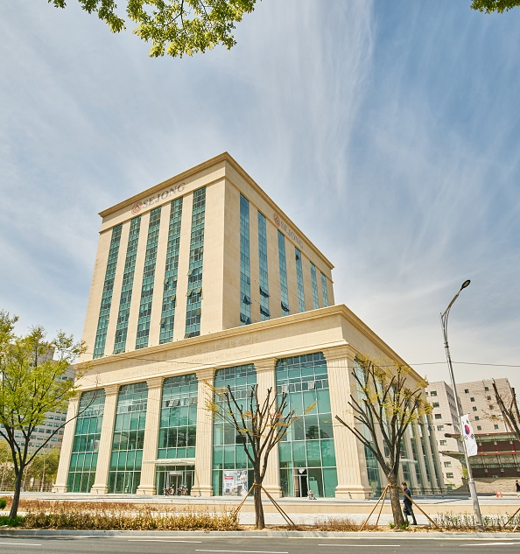
An example – development of smart elevator algorithms
Development of a smart elevator system for energy saving
Collect user data
  Who pressed button?
  Which level a button pressed?
  Which level the passenger moved?
Final expected dataset
  Statistic of passengers
  Actual elevator movement with time stamp
  Energy usage (based on ISO standardized algorithm)
AI center bld at Sejong Univ.
8 elevators

Slide 5
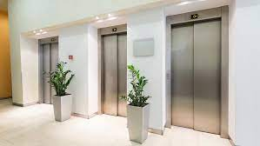
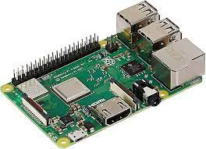
How to collect actual data
Collect data from elevator
Input to the elevator
Actual movement of the elevator
Request #1
Start level
Target level
Timestamp
Movement #1
Current level
Initial level
Target level
Energy usage per movement
Notes:
표준 제안의 핵심??
특정 데이터를 블록체인에 저장함으로써 IoT platform인 oneM2M에 블록체인을 활용하는 표준 제안.
- 필요성을 강조
이점을 강조
표준이 아직 없음을 강조
사용 예시?
표준 적용 예시?

Slide 6
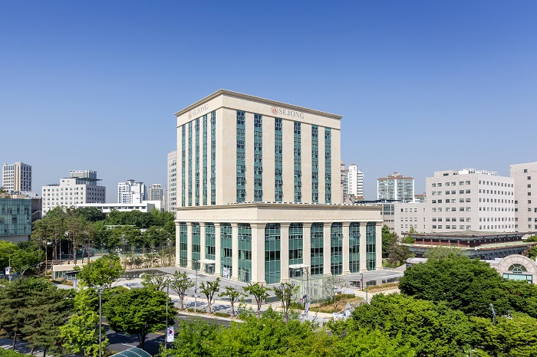
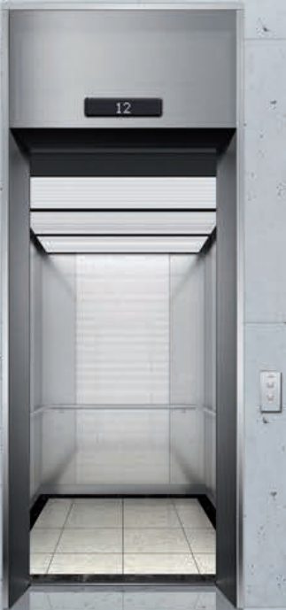
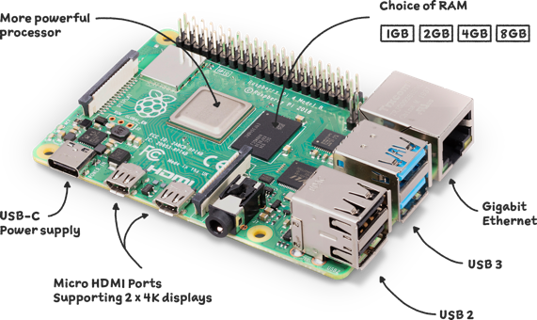
How to collect actual data
Sejong Univ. AI Center
Real-World
Deploy a device to collect data
Rapsberry pi with various sensors
Accelerator
Altimeter
Camera
Notes:
표준 제안의 핵심??
특정 데이터를 블록체인에 저장함으로써 IoT platform인 oneM2M에 블록체인을 활용하는 표준 제안.
- 필요성을 강조
이점을 강조
표준이 아직 없음을 강조
사용 예시?
표준 적용 예시?

Slide 7
How to collect actual data
Velocity Detection
Height Detection
Button Detection
Velocity
Elevator Direction
Elevator height
Current Floor
Button List
Elevator Trip List
Trip End Floor
Container Instance
Container
IMU Sensor Container
Camera Container
Elevator Energy Consumption
Elevator Ascend(Descend) Order
Elevator Emergency
Elevator Algorithm Minimizes CO2 Emissions
AE

Slide 8
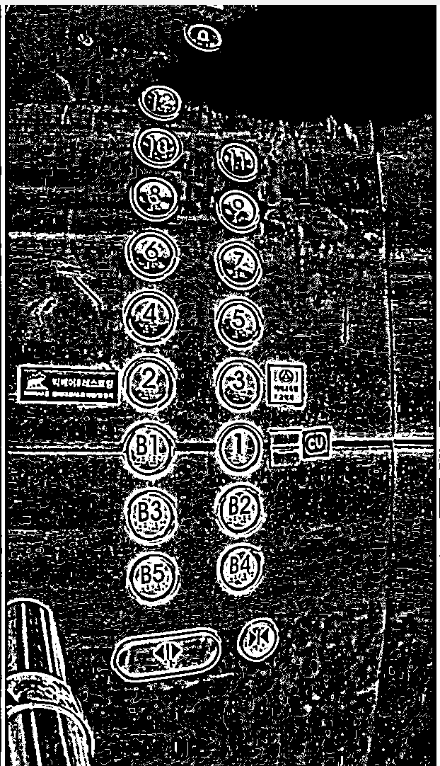
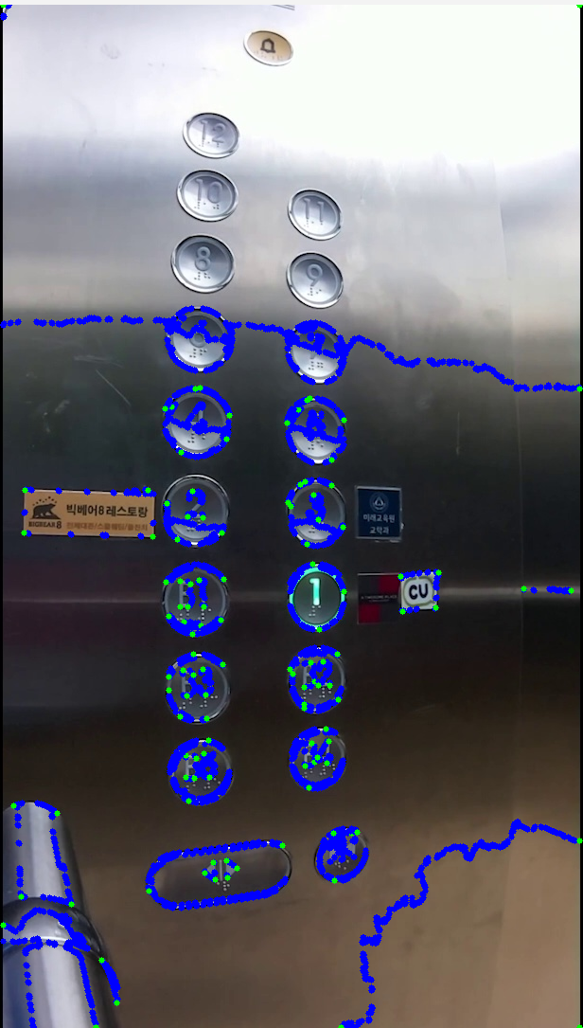
Image processing to collect data

Slide 9
Resource tree for elevator

Slide 10
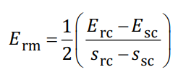

Energy usage algorithms
Possible to calculate various power usage of elevators
  Daily power usage
  Annual power usage
ISO-25745 provides a basic algorithm for the power usage of elevators

Slide 11
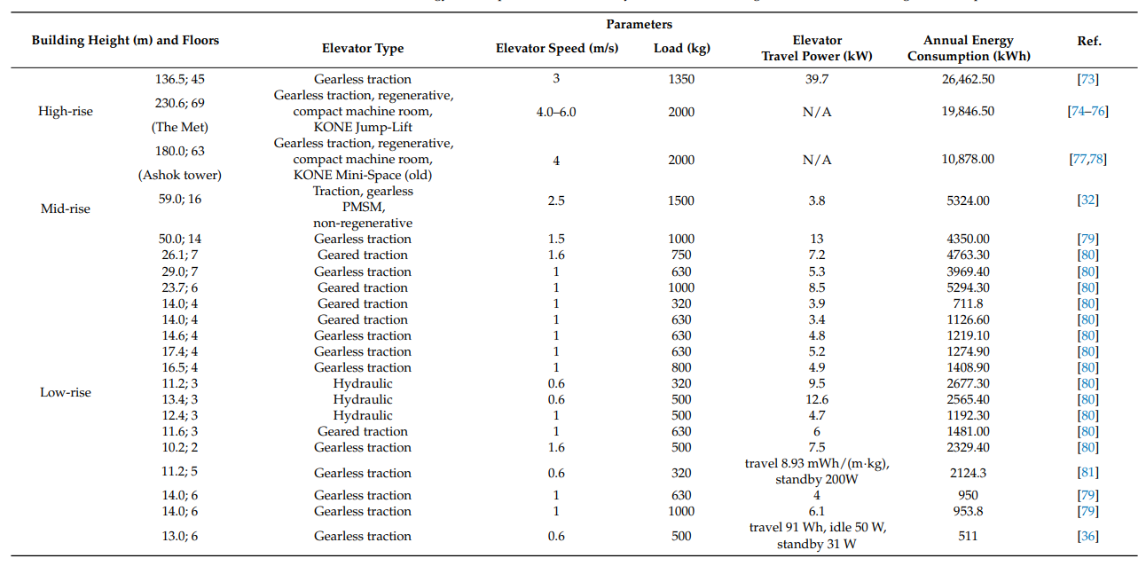
Energy usage algorithms

Slide 12


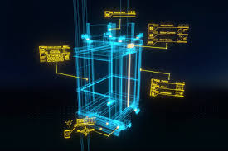

Hackathon usage
oneM2M Crawler
Developer
Open data
(Elevator)
oneM2M
Platform
For
Hackathon
Green Elevator
Using AI/ML
AI
Open data
(Air quality)
Trust & Secure data
Using Blockchain
Open data
(parking)
BL

Slide 13
Thank you!

