Slide 1

STF 628: Digital Twin Modelling, Interoperability and Standardization Opportunities
Massimo Vanetti (SBS / European Digital SME Alliance) on behalf of STF 628
oneM2M TP#61
Penn State College, 2023-08-17

Slide 2
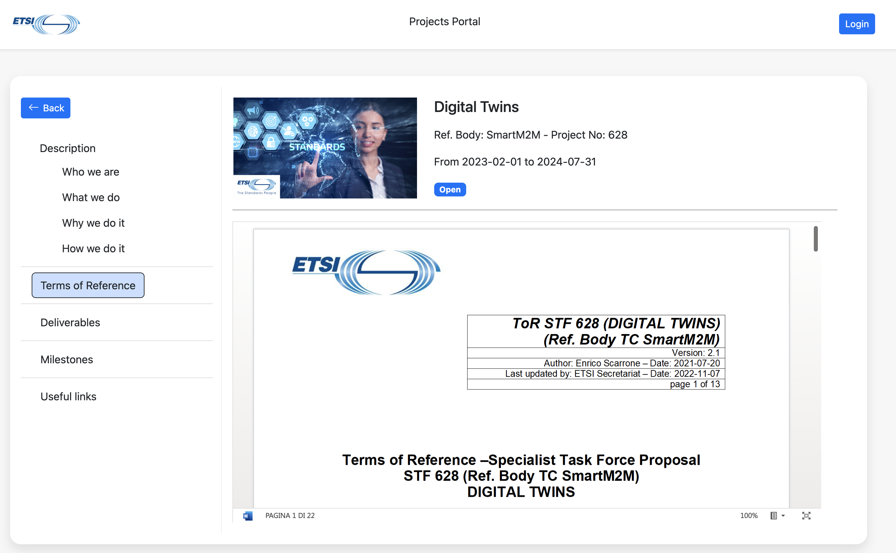
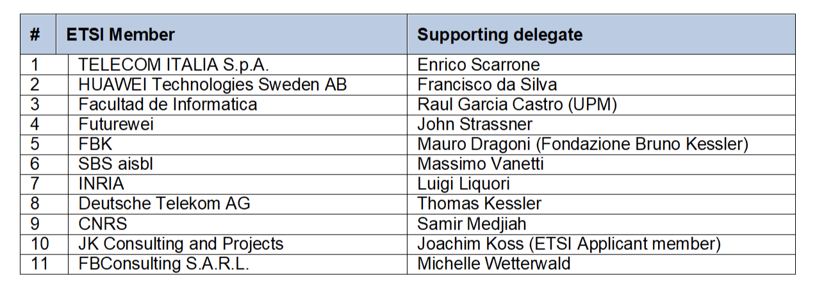
ETSI STF 628 - at a Glance
Ref. Body: TC SmartM2M
ETSI Members Support
Experts Team
AI4 People
European DIGITAL SME Alliance
Exacta GlobalSMart Solution
University of Modena and Reggio Emilia
Gabriele Casalini (Project Leader)
Marco Picone (Expert)
Massimo Vanetti (Expert)
Mauro Dragoni (Expert)
William R. Flynn, IV (Expert)
https://portal.etsi.org/XTFs/#/xTF/628

Slide 3
ETSI STF 628 - What we do
STF 628, financed entirely by ETSI, has been tasked to cover the missing key elements of modelling and making uniform the communication concept IoT Digital Twins and their blueprint communication reference architecture
Identify use cases and deployments where IoT Digital Twins can be effectively adopted in order to identify all the requirements and specifications associated to the definition of their functionalities and specifications
Derive requirements and guidelines towards a horizontal cross-domain interoperability and standard, with the specification of minimum requirements for usability of professional and general public IoT services
Based on these use cases, requirements and guidelines, map IoT Digital Twins within the oneM2M framework
Contribute to ISO/JTC1/SC41 through the definition of a set of new specifications in order to both embrace new functionalities and to effectively exploit the existing features (e.g., discoverability, security, modularity, etc.)

Slide 4
ETSI STF 628 – Why we do it
ETSI has determined that:
There is the concrete need to support a cross-domain and cross-vendor DT interoperability in order to avoid closed siloes solutions. It is not reasonable to think that each country, company or service will design a new and different DT by creating a plethora of heterogeneous implementations, thus opening the way to lack of interoperability. oneM2M and SAREF already provide a good basis for that, but the peculiarity of DT requires specific additional work to complete the interoperability framework offered by standardization.
Nevertheless, DTs interoperability potential is still underexplored and represents a relevant opportunity to design a new and shared approach aiming to achieve the seamless integration of data and services in heterogeneous IoT edge deployments. Through a last-mile DT digitalization it will be possible to handle physical heterogeneity as close as possible to the devices and to simplify the interaction and cooperation with upper layers

Slide 5
ETSI STF 628 – Goals
The technical work is developed in 2 technical tasks, covering:
  Analysis, Use Cases and Requirements for Digital Twins in IoT
  Standardization of functionalities, communication reference architecture and guidelines for Digital Twins
These tasks will provide a general solution as Digital Twins reference architecture. The instantiation of such general solution in the oneM2M context is also included. So that these tasks also include the preparation of the technical solution to be exported in oneM2M.
A third task covers the dissemination towards oneM2M and other associations/fora representing potential stakeholders of the proposed standard.

Slide 6

ETSI STF 628 – Timeframe
Work Started on 2023-02-01
7 Milestones defined
Work completion scheduled for 2024-07-31
Currently in the early stages of work
First milestone achieved

Slide 7
An “Extended” Digital Twin Definition
“A Digital Twin is a comprehensive software representation of an individual physical object. It includes the properties, conditions, and behavior(s) of the real-life object through models and data. A Digital Twin is a set of realistic models that can simulate an object’s behavior in the deployed environment. The Digital Twin represents and reflects its physical twin and remains its virtual counterpart across the object’s entire lifecycle. [1]”
S. Haag, and R. Anderl. "Digital Twin–Proof of concept." Manufacturing Letters 15 (2018)
properties, conditions, relationships and behavior(s)
DTs may also be responsible to model and characterize existing relationships in the physical world in order to map them also in the digital world.

Slide 8
An “Extended” Digital Twin Definition
“A Digital Twin is a comprehensive software representation of an individual physical object. It includes the properties, conditions, and behavior(s) of the real-life object through models and data. A Digital Twin is a set of realistic models that can simulate an object’s behavior in the deployed environment. The Digital Twin represents and reflects its physical twin and remains its virtual counterpart across the object’s entire lifecycle. [1]”
S. Haag, and R. Anderl. "Digital Twin–Proof of concept." Manufacturing Letters 15 (2018)
A Digital Twin is a set of realistic models that can digitalize an object’s behavior in the deployed environment.
The recent shared idea is that DTs can be used not only for simulation purposes but to support and enable any digital services or application

Slide 9
Digital Twin’s Pillars

Slide 10
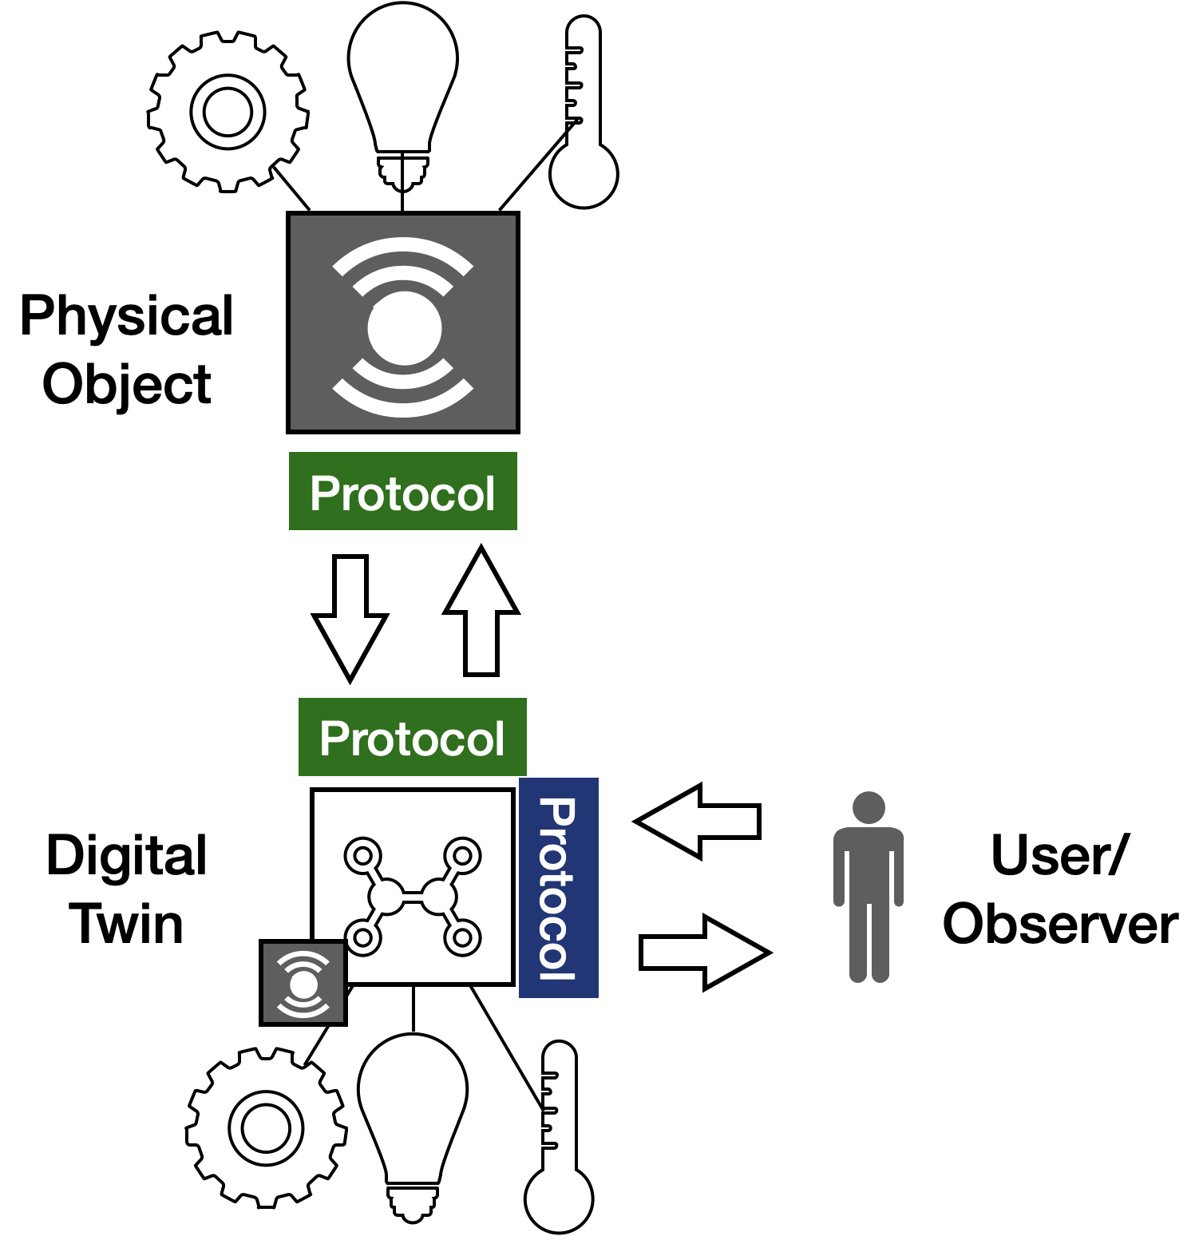
Internet of Things & Digital Twins
It’s only thanks to the Internet of Things that the idea of Digital Twins has become cost-effective to implement thanks to the possibility to “easily” communicate with a physical connected device
IoT technologies represent the strategic enablers to design and build DT’s physical interfaces allowing twins to talks through multiple languages and data formats with the aim to read information, synchronize the state, and interact with the environment
At the same time, DTs represents an appealing opportunity to digitalize/softwarize the physical world (composed by a multitude of heterogeneous assets) and simplify its complexity to digital applications

Slide 11
Internet of Things & Digital Twins

Slide 12
Internet of Things & Digital Twins

Slide 13
oneM2M & Digital Twins
Integration Opportunities

