Slide 1
Marcom Report to TP62 Closing Plenary
Bindoo Srivastava, Marcom Chair
08 December 2023

Slide 2
Outline
Key highlights
oneM2M Industry Day organised with ARIB and TTC in Tokyo – 6th Dec’23
oneM2M Brochure
Traction in regions
oneM2M Champions - LinkedIn Campaign
Developer Resources - update
MEC White Paper promotion
Speaking Opportunities
CY’23 Activities
Plan for CY’24
Leadership positions open for Vice Chair

Slide 3
Key Highlights (YTD CY’23)
External Publications: 11
oneM2M Developers Resources – 8 videos published on YouTube and Wiki. More in pipeline
Engagement: 14 Executive Insights
Visibility:
Total Events organized (nil@oneM2M, 7@Partner, 1@Regional level)
Speaking Opportunities (availed) – Total 7
Social Media (Till Nov’23): LinkedIn 1420 followers (▲120), 70 total posts CY’23; Twitter 1452 followers (▲5), 325 total posts CY’23
Communiques & PRs:
PRs – 1 issued (in May on oneM2M Security Specs)
Refer oneM2M Promotions Tracker
Notes:
External Publications:
ETSI Enjoy Jan
The Fast Mode - Metaverse standards
Pipeline Magazine (2023 predictions)
ATIS blog (Metaverse standardization)
ETSI Enjoy Mar (Sustainability)
IoT sustainabilty interview for Journal du Net
ETSI MEC oneM2M White Paper
ETSI Enjoy - Continuity and Technology Strategy in IoT Standardization
Pipeline Magazine How connected Devices will Remake IoT Systems
Pipeline Magazine - AI and Analytics for IoT
ETSI Enjoy - APIs for IoT
Executive Interviews:
nTels (Korea)
TRE-E Anthony C (Italy)
TRE-E Marco C (Italy)
Poornima (C-DOT)
India Dept of Telecoms
TP #58
Andre Dutra (Deutsche Telekom IoT Hub)
TP #59
Ray Bell (Aetheros)
Sachin Chaudry - student outreach
TP#60
Rana Kamill ITU-T and IoT security
TP#61 - Roland Hechwartner
CReDo - Jethro Akroyd
Partner events
oneM2M stakeholders' day 24 Feb23 New Delhi, India
ETSI Sustainability event
TTA International oneM2M hackathon Award & Workshop (Mar - May)
TTA - oneM2M Global seminar - 13 June 2023
ETSI IoT Week (Post TP 60)
AIOT Week Korea – 11th to 13th Oct’23
Regional Event –
March - 2nd IoT and oneM2M outreach for academia (IIIT-H) closed door (18-19 March) Prof Sachin Chaudhari
Speaking Opportunities –
ETSI Sustainability event – Dale Seed
Telesemana webinar via PPR (17 May)
IoT Tech Expo & Edge Computing Expo - North America (17-18 May 2023) – Santa Clara, CA - Bob Flynn
M2M & IoT security & use cases organized by Mumbai LSA, Department of Telecommunications 26 May 2023 - By Aurindam Bhattacharya
WTISD celebration (Speaking Opportunity) 8 June 2023- Bindoo Srivastava
Global Conference on "IoT Security and Standards based IoT/M2M Practical Implementations of Solutions" | 25-26 Sep'23| New Delhi | Aurindam Bhattacharya
IoT Tech Expo - Global (30th November – 1st December) – London: Rana

Slide 4
oneM2M Industry Day – 6th Dec’23
oneM2M Industry Day organized with ARIB and TTC on 6th Dec’23 in TTC, Tokyo/online
Salient Topics:
Remarks by Nishioka San, ARIB and Roland Hechwartner
oneM2M Features and Benefits - Jaeseung Song, Andreas Neubacher, Bob Flynn, Massimo Vanetti
oneM2M Adoption & Deployments – Andreas Kraft, Miguel Angel Reina Ortega, Rana Kamill, Poornima Shandilya, Jaeseung Song
Panel Discussion on “oneM2M as an Interoperability Framework”
Approx 52 online participants apart from in-person delegates
Key Takeaways:
The discussions affirmed oneM2M as an Interoperability Framework that goes beyond the “connectivity layer”. Its common service functions enable exchange of information (rather than mere data) among entities, that may include external systems, taking advantage of semantics principles.
Visit here for details of the Industry Day
Notes:
External Publications:
ETSI Enjoy Jan
The Fast Mode - Metaverse standards
Pipeline Magazine (2023 predictions)
ATIS blog (Metaverse standardization)
ETSI Enjoy Mar (Sustainability)
IoT sustainabilty interview for Journal du Net
ETSI MEC oneM2M White Paper
ETSI Enjoy - Continuity and Technology Strategy in IoT Standardization
Pipeline Magazine How connected Devices will Remake IoT Systems
Pipeline Magazine - AI and Analytics for IoT
ETSI Enjoy - APIs for IoT
Executive Interviews:
nTels (Korea)
TRE-E Anthony C (Italy)
TRE-E Marco C (Italy)
Poornima (C-DOT)
India Dept of Telecoms
TP #58
Andre Dutra (Deutsche Telekom IoT Hub)
TP #59
Ray Bell (Aetheros)
Sachin Chaudry - student outreach
TP#60
Rana Kamill ITU-T and IoT security
TP#61 - Roland Hechwartner
CReDo - Jethro Akroyd
Partner events
oneM2M stakeholders' day 24 Feb23 New Delhi, India
ETSI Sustainability event
TTA International oneM2M hackathon Award & Workshop (Mar - May)
TTA - oneM2M Global seminar - 13 June 2023
ETSI IoT Week (Post TP 60)
AIOT Week Korea – 11th to 13th Oct’23
Regional Event –
March - 2nd IoT and oneM2M outreach for academia (IIIT-H) closed door (18-19 March) Prof Sachin Chaudhari
Speaking Opportunities –
ETSI Sustainability event – Dale Seed
Telesemana webinar via PPR (17 May)
IoT Tech Expo & Edge Computing Expo - North America (17-18 May 2023) – Santa Clara, CA - Bob Flynn
M2M & IoT security & use cases organized by Mumbai LSA, Department of Telecommunications 26 May 2023 - By Aurindam Bhattacharya
WTISD celebration (Speaking Opportunity) 8 June 2023- Bindoo Srivastava
Global Conference on "IoT Security and Standards based IoT/M2M Practical Implementations of Solutions" | 25-26 Sep'23| New Delhi | Aurindam Bhattacharya
IoT Tech Expo - Global (30th November – 1st December) – London: Rana

Slide 5
oneM2M Brochure
Approved in
MARCOM 123 Meeting

Slide 6
Website Visits
VISITS
Overall increase in 2023 till Oct’23 after which dipped below ‘22?
Spike in May-Jun from US
PAGES
Generally: What is oneM2M/basics/published Specs
May- published specs top page
COUNTRY
Russia- Jan’23
Taiwan – Apr, Oct
Vietnam: Apr, Aug
Singapore - Jun
Japan: Jul-Oct
Australia: May, Jun
Portugal: Mar
Finland: May-Aug

Slide 7
oneM2M Visits from Countries
To be correlated with the Hackathons

Slide 8
oneM2M Champions - Sponsored Campaign
Campaigns 1&2: Impressions: 47,290 Clicks: 409 Cost per Click: $0.73
Key locations reached: India, United States, Canada, Colombia, Mexico, UK, Australia

Slide 9
oneM2M Champions - Sponsored Campaign (upcoming)
Campaign running till 8th December

Slide 10
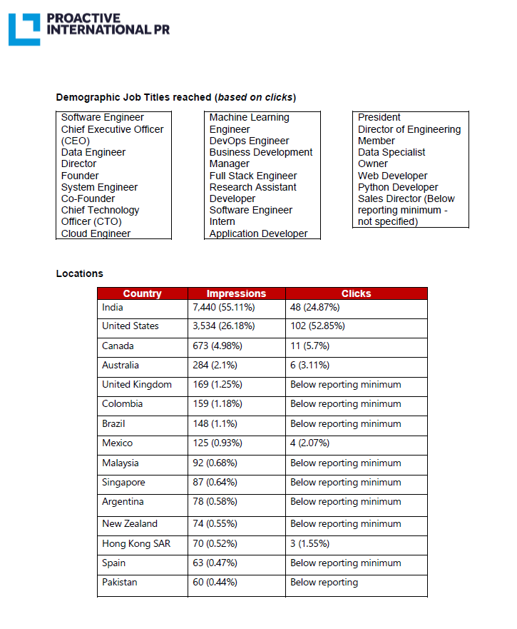
MEC White Paper Sponsored Post (12 -21 July 23)

Slide 11
CY’23 Focus Activities (1 of 2)
PR on oneM2M Approval by ITU-T
oneM2M Brochure
Celebrating oneM2M Veterans –Sponsored LinkedIn Campaign
Analysed Micro-certifications mechanism
Regional Engagement:
WTISD event in Peru
LATAM - Telesemana Webinar || 17 May 23 || Rana Kamill || mobile security, covering how M2M/IoT will be a major disruptor in telecom networks as many new devices may interact with the network.
Workshop in Taipei with TAICS

Slide 12
CY’23 Focus Activities (2 of 2)
Retain mindshare in the ecosystem and keep promoting new information around relevant oneM2M milestones and Region relevant engagement
LinkedIn
Website posts
Promote workshops and hackathons and ACR work
Deferred:
A white paper or Executive Insight into how oneM2M goes beyond mere pure IoT/M2M and goes all the way up to Metaverse
oneM2M White paper on MEC (JaeSeung Song)
Promoting the oneM2M icons library
Capacity Building on oneM2M

Slide 13
Plan for CY’2024
How to conserve (and expand) Membership
Retain mindshare in the ecosystem on the pillars of maturity, relevance and forward thinking
Positioning of oneM2M: connects systems/sources that go beyond pure IoT as an Interoperability Framework (White Paper?)
Proposed Activities
Keep promoting new information around relevant oneM2M milestones
Hosting TP Meetings in diverse new Regions
Capacity Building
Support Academia Outreach
Proposed Vehicles:
Host meetings in new locations for local engagement
LinkedIn
Exec insights/Blogs/Social Media
Feature articles
Events/speaking opportunities
PR/media interactions
Continue to leverage MARCOM Consultant and PR Agency Partners

Slide 14
Reference Slides

Slide 15
Engagement – Executive Insights (CY23) from MARCOM 123 and upcoming
Executive Insights
IoT systems and the evolution of solution requirements by nTels – 9th Jan’23
Standardization in Smart Elevator by Patrick Cox (TRE-E scrl) – 16th Jan’23
Standardization in Smart Lift Sector by Marco Cogliati (TRE-E scrl) – 1st Feb’23
CDOT’s Common Service Platform – 22nd Feb’23
India’s Standard Based IoT Ecosystem – 23rd Feb’23
TP#58 and Release 5 Standardization Activities – 22nd Mar’23
DT IoT Hub – 4th May’23
TP#59 – 11th May’23
oneM2M in Utilities by Atheros – 5th Jun’23
IIT Hyderabad – Dr. Sachin Chaudhari 22nd Jun’23
TP#60 – 17th Jul’23
ITU-oneM2M Collab (Rana Kamill) – 22nd Aug’23
TP#61 – 21st Sep’23
Climate Resilience Demonstrator – Dr. Jethro Akroyd - 9th Nov’23
TP#62
oneM2M in the News – 1210 Subscribers
Press Releases – 1
Media queries to oneM2M_PressMedia@list.onem2m.org being forwarded to Bindoo, Aurindam, Ken, Akash
Activities Tracker link
Notes:
Interview in pipeline –
https://futureiot.tech/

Slide 16
Speaking Opportunities
ETSI Sustainability event || 30 Mar’23 || ETSI, Sophia Antipolis : Dale Seed
Telesemana webinar on 5G Security || 17 May’23 || Rana spoke on Securing the IoT segment with oneM2M security
IoT Tech Expo & Edge Computing Expo - North America || 17-18 May 23 || Santa Clara, CA :: Bob Flynn
M2M & IoT security & use cases organized by Mumbai LSA, Department of Telecommunications || 26 May 2023 - By Aurindam Bhattacharya
WTISD celebration || 8 June 2023: Hideyuki Iwata, Roland Hechwartner, Bindoo Srivastava
ETSI IoT Week
Global Conference on "IoT Security and Standards based IoT/M2M Practical Implementations of Solutions" || 25-26 Sep’23 || New Delhi by Aurindam Bhattacharya
Korea IoT week (11-13 Oct’23): NTELS and SyncTechno exhibited
IoT Tech Expo - Global || 30th November – 1st December || London: Rana Kamill

Slide 17
Thought Leadership – Articles CY’23 & upcoming
Global Journals
IEEE Network Magazine - JaeSeung Song (team preparing to submit article)
Trade Journals
The Fast Mode - Metaverse standards
The Fast Mode - Metaverse standards
Pipeline Magazine (2023 predictions)
Pipeline Magazine How connected Devices will Remake IoT SystemsPipeline Magazine - AI and Analytics for IoT
IoT sustainabilty interview for Journal du Net
Regional
Partner Communiques
ETSI Enjoy Jan
ATIS blog (Metaverse standardization)
ETSI Enjoy Mar (Sustainability)
ETSI MEC oneM2M White Paper
ETSI Enjoy - Continuity and Technology Strategy in IoT Standardization
ETSI Enjoy - APIs for IoT
ETSI ENJOY Jan (JaeSeung on AI for IoT)
Activities Tracker link
Notes:
2023 IoT trends for A&G via PrPR

Slide 18
oneM2M in Press – from MARCOM 123 (oct 23)
Economic Times (India) October 2023 | Oct 2023 | Vodafone India completes testing of over 50 IoT devices and certification based on oneM2M and 3GPP standards at the IoT Lab that it has set up with the Centre for Development of Telematics (C-DOT)
Electronic Times Internet (S. Korea) October 2023 | Oct 2023 | Korea Telecommunications Technology Association (TTA) will introduce achievements related to oneM2M at S. Korea's 2023 AIoT Promotion Week.
Pipeline Publishing September 2023 | Sept 2023 | AI and Analytics for IoT
Pipeline Publishing July 2023 | July 2023 | How Connected Devices will Remake IoT Systems
Information and Communication Newspaper (Korea Information and Communication Corporation Association) | June 2023 | KETI Completes 'Mobius Developer Competition' and 22 Teams Showcase IoT Application Services
BizWire Express | May 2023 | oneM2M SPECIFICATIONS APPROVED BY MORE THAN 190 ITU MEMBER COUNTRIES AS ITU STANDARD TO SIMPLIFY IOT ADOPTION
EE News Europe | April 2023 | 'Horizontal' IoT Implementations
Journal du Net | March 2023 | L'IoT, barrière aux catastrophes naturelles
International Institute of Information Technology (Hyderabad) | January 2023 | IITH's Smart City team wins Best Technology award in Korean hackathon
ETSI Enjoy! | January 2023 | Research and Innovation in IoT Standardization
The Fast Mode | January 2023 | Standardization is Key for Metaverse Success
Notes:
International Institute of Information Technology (Hyderabad) blog post (January 2023) - IITH's Smart City team wins Best Technology award in Korean hackathon ETSI Enjoy! January 2023Research and Innovation in IoT Standardization
ETSI Enjoy! January 2023Research and Innovation in IoT Standardization

Slide 19
oneM2M in News – from MARCOM 123
18 July 2023 | Enabling Multi-access Edge Computing in the Internet-of-Things
16 March 2023 | In Anticipation of Metaverse Standardization
7 February 2023 | Security for oneM2M based smart city network
2 February 2023 | The Journey to Massive IoT Through Interoperable and Open Standards

Slide 20
Page View Comparison CY2023

Slide 21
ATIS Blog related to oneM2M

Slide 22
oneM2M comms strategy
Like all membership organisations it is vital that oneM2M keeps its current and potential future members informed about what is has done, what it is doing and what it will be doing in the future.
The communications strategy could therefore be built upon three pillars.
Pillar 1 - Maturity
Aim – ensure stakeholders understand oneM2M’s rich heritage and the maturity of its technology.
Pillar 2 - Relevance
Aim – ensure stakeholders know that oneM2M is still supporting the global IoT community.
Pillar 3 - Forward Thinking
Aim – ensure stakeholders see that oneM2M is looking beyond today’s needs and already thinking about emerging trends and technologies
Notes:
Case studies

Slide 23
oneM2M comms strategy
The goal of oneM2M’s communications strategy is to deliver relevant content to the following audiences:
Standardization experts
Business decision makers and IoT product managers
Organizations wanting to build oneM2M solutions
Organizations wanting to deploy systems that make use of oneM2M components
Government agencies, policy makers & regulators
Academic institutions (inc. universities)
Notes:
Case studies

Slide 24
oneM2M comms strategy
Delivering the right content to the right audience relies on telling compelling stories using the right channels.
Anniversaries
Exec viewpoints
Releases Events
Publications Spec updates
White papers
Webinars
Speeches and presentations
Content
Features
Interviews
Press releases
Social media
Thought leadership features
Comment opportunities
Channel
Notes:
Case studies

Slide 25
Thank You

