Slide 1
oneM2M Academia Relationship (ACR) ad-hoc Group
Luigi Liquori, Inria
2024-02-2X

Slide 2
Once upon a time in oneM2M TP 59...61
ACT 61 contribution: by Andrew Han, Hansung University, Korea, Roland Hechwartner, DT, Germany, Luigi Liquori, Inria, France, Enrico Scarrone, TIM, ...
A bylaw was presented in TP 59, voted in TP 61 (ACR 61)
TP-ACR-2023-0001R03-Proposed_ToR_for_Academia_Relationship_gr.doc
A mailing list was bootstrapped by Anna Karditzas and Karen Hugues (who is in?)
ONEM2M_ACR@list.onem2m.org
Three convenors for three area, namely
Dr Luigi Liquori, Inria for Europe
Pr. Kwanghyun Ro, Hansung University for Korea
Pr. Kyusun Choi, Penn State University for North America
But it should be open *as much as possible* to all oneM2M actors

Slide 3
ToR in a nutshell 1/2
The oneM2M ACR is assigned the responsibility to foster the relationship of oneM2M with Universities, public and private Research Centers, Educational organizations and Public Communities potentially using oneM2M, and Industry with a particular focus on start-ups.
The main objectives of the ACR are
1) promote teaching and research about the oneM2M standard;
2) establish closer connections & partnership between groups in Academia and Research centers involved in oneM2M applications and facilitate the emergence of new ones;
3) increase awareness of oneM2M standards in Academia and Research centers at large;
4) foster development of oneM2M-based applications and implementations;
5) foster development of oneM2M open-source implementations by Academia, Research Centers, and Industry.

Slide 4
ToR in a nutshell 2/2
The ACR can be participated in by all interested members and Partners Type 2 as well as attended by non-members.
The ACR group may use any form of communication and collaboration adopted by consensus within the group, including face-to-face meetings and video conferencing.
Areas of collaboration may include tasks, such as the development and maintenance of open-source platforms for oneM2M projects, oneM2M developer tools, oneM2M educational and tutorial materials (e.g. oneM2M tutorials hosted on various media such as e.g. Jupyter notebook, youTube, Coursera, etc.), and promote seminars, workshops and conferences related to oneM2M standard.
oneM2M together with the Academia and Research Centers may create and issue a proof of activity to volunteers. e.g. signed by oneM2M, University and Research Center officers.
The ACR will work following a Simplified Operational Mode (SOM) inspired by the ETSI/oneM2M Working Groups to be defined in another document
Results and running projects will be logged, regularly reported in oneM2M TP, and will be also published and linked by ETSI and oneM2M.

Slide 5
Short term goals (6-12 months)
Short Team
Set up a wiki? Set up a git? Where to host? oneM2M? github?
Populate this/those space/s
Exhaustive (best effort) list of courses, universities and material available
Exhaustive (best effort) list of open source oneM2M implem. with examples
Exhaustive (best effort) list of open source oneM2M implem. with examples
Persons (academia/research/industry) involved in oneM2M
Careful about IPR
all written material (slides, doc, images, diagrams,...) should be e.g. Creative Common
all software material (implementation, case study) should be open source license, e.g. GPL V3, Apache V2, MIT
Set up a Mooc and offers it on the oneM2M web page

Slide 6
Liaison with WI 089?
TP-2018-0241R02

Slide 7
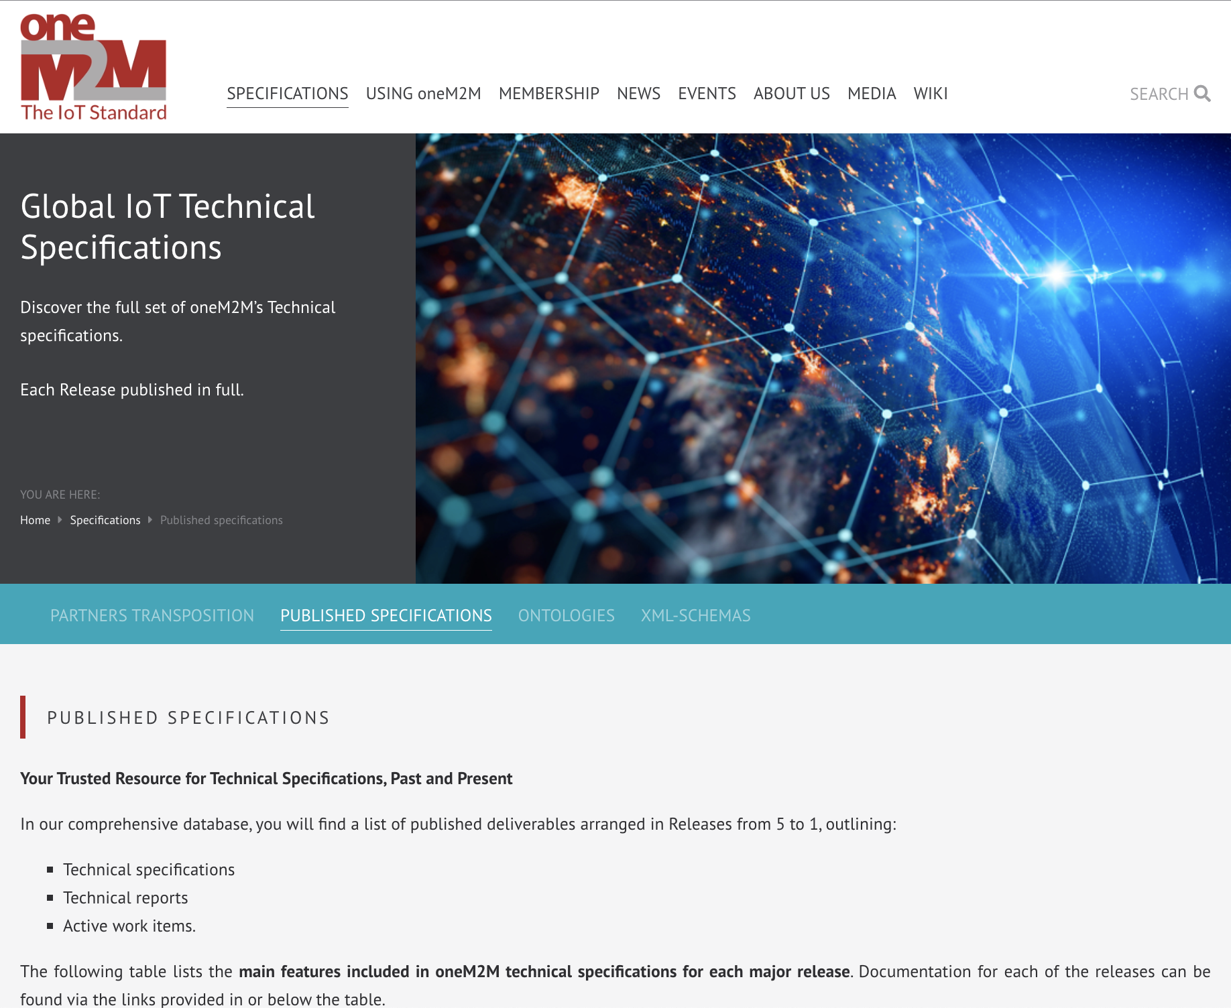
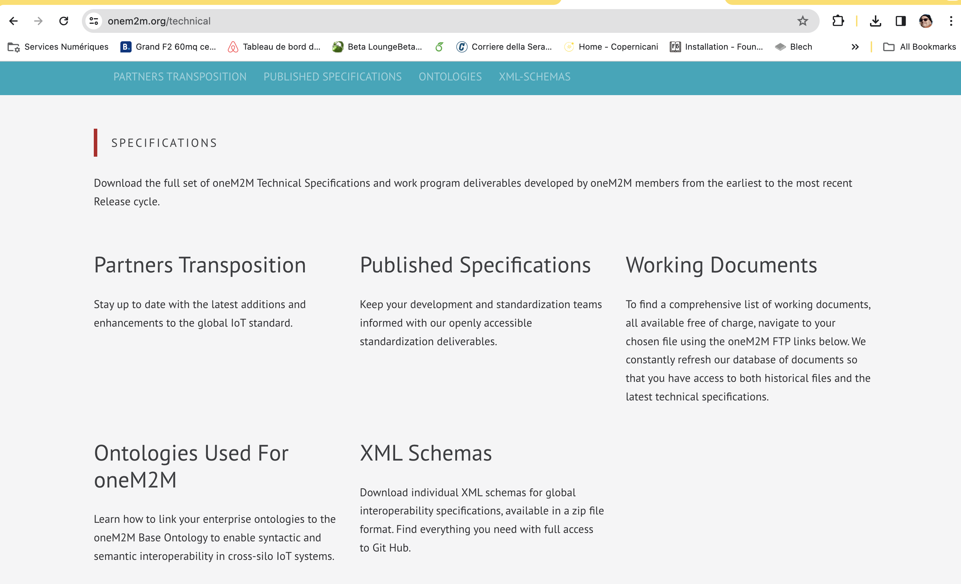
Mid term goals (1-2 yy)
About the oneM2M web page

Slide 8
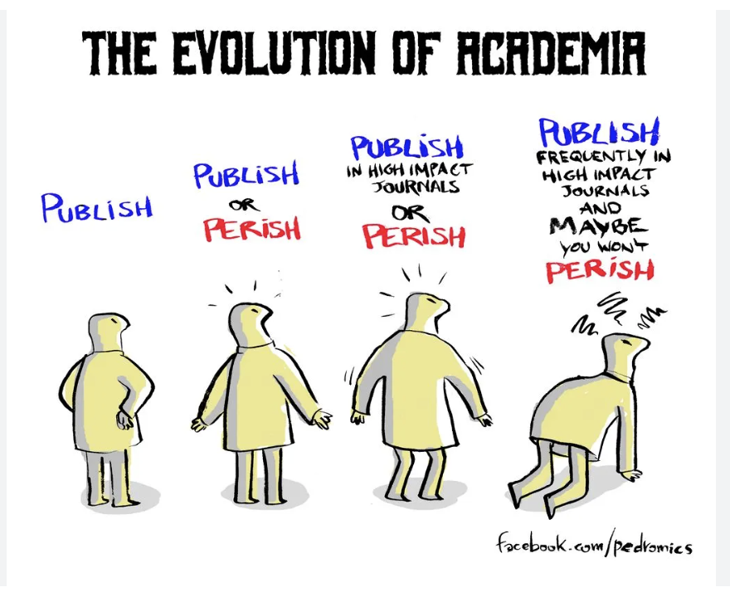
Publish or perish (concern also ETSI)

Slide 9
Long term goals (2++ yy)
oneM2M for the masses
Set of built-in applications to customize
...

Slide 10
Thank You

