Slide 1
SDS Status Report to TP63
Group Name: oneM2M SDS
Source: Peter Niblett, SeungMyeong Jeong, Wei Zhou
Meeting Date: 2024-02-26 to 2023-02-29

Slide 2
Summary
13 new CRs have been agreed for TS-0001, TS-0004, TS-0022 and TS-0041
14 agreed contributions are now pending waiting for Rel-5 specs to be started:
Work has started on TS-0041
New Git process being used for TS-0020, TS-0041 and TR-0071
CR for changes to CoAP binding is being worked
114 issues currently open, 77 have been closed
SDS-2024-0027R02 | SDS 63 Document Allocation

Slide 3
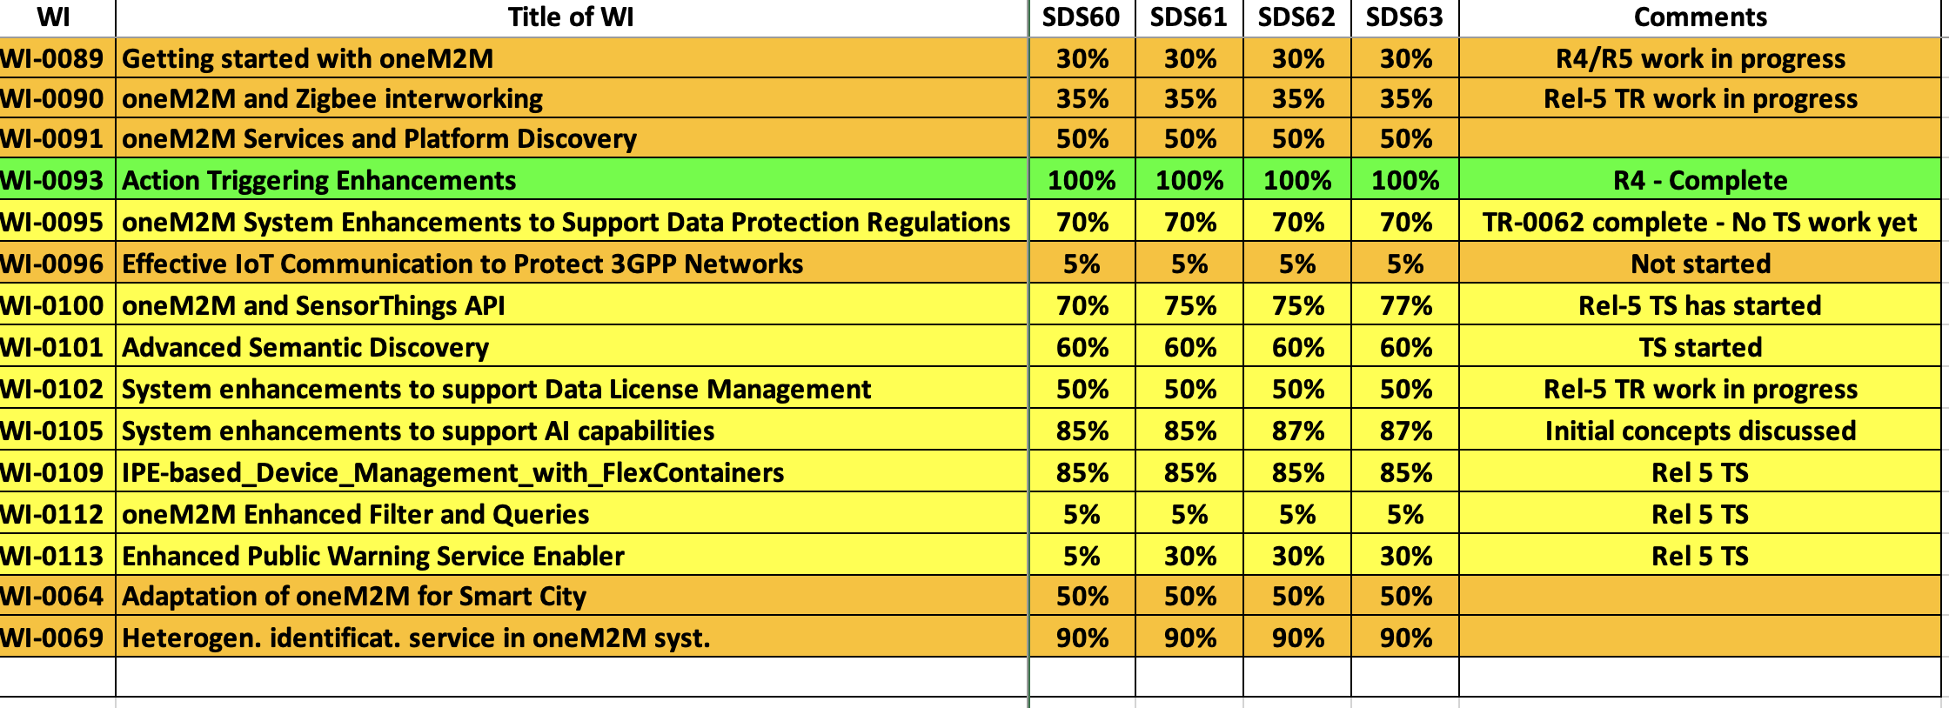
SDS WI Status
Complete
On track
Running behind schedule
Work has stalled

Slide 4
Items for Decision
CR Packs:
TS-0001 – TP-2024-0017 – 00-R2, 01-R3, 01-R4, 01-R5 = 2
TS-0004 – TP-2024-0018 – 01-R2, 02-R3, 02-R4, 00-R5 = 3
TS-0022 – TP-2024-0019 – 02-R2, 02-R3, 00-R4, 00-R5 = 4
TS-0041 – TP-2024-0020 – 00-R2, 00-R3, 02-R4, 01-R5 = 1

Slide 5
Conference Calls
Meeting | Date | Time (UTC)
SDS 63.1 | Mon 11 Mar 2024 | 12:00-13:30
SDS 63.2 | Mon 25 Mar 2024 | 12:00-13:30
SDS 63.3 | Mon 15 Apr 2024 | 12:00-13:30
SDS 63.4 | Mon 29 Apr 2024 | 12:00-13:30

