Slide 1
Marcom Report to TP64
Bindoo Srivastava, Marcom Chair
26 April 2024

Slide 2
Outline
oneM2M Response to NIST on their Smart City Strategy Consultation Paper
Recent Executive Insight Publications
Sponsored Campaigns
TP hosting in Malaysia
Speaking Opps
Upcoming Activities
Performance Highlights

Slide 3
oneM2M’s submission to NIST’s public consultation on their Smart City Strategy
NIST issued a public consultation call on their Smart City Strategy, open till 1 Mar 2024.
Ken drafted a submission from oneM2M on the same – which was approved over email by TP Chair and SC.
The same was submitted to NIST: Submission to NIST on Smart City Strategy
A new oneM2M Contact email – contact@oneM2M.org created to handle communications with external agencies

Slide 4
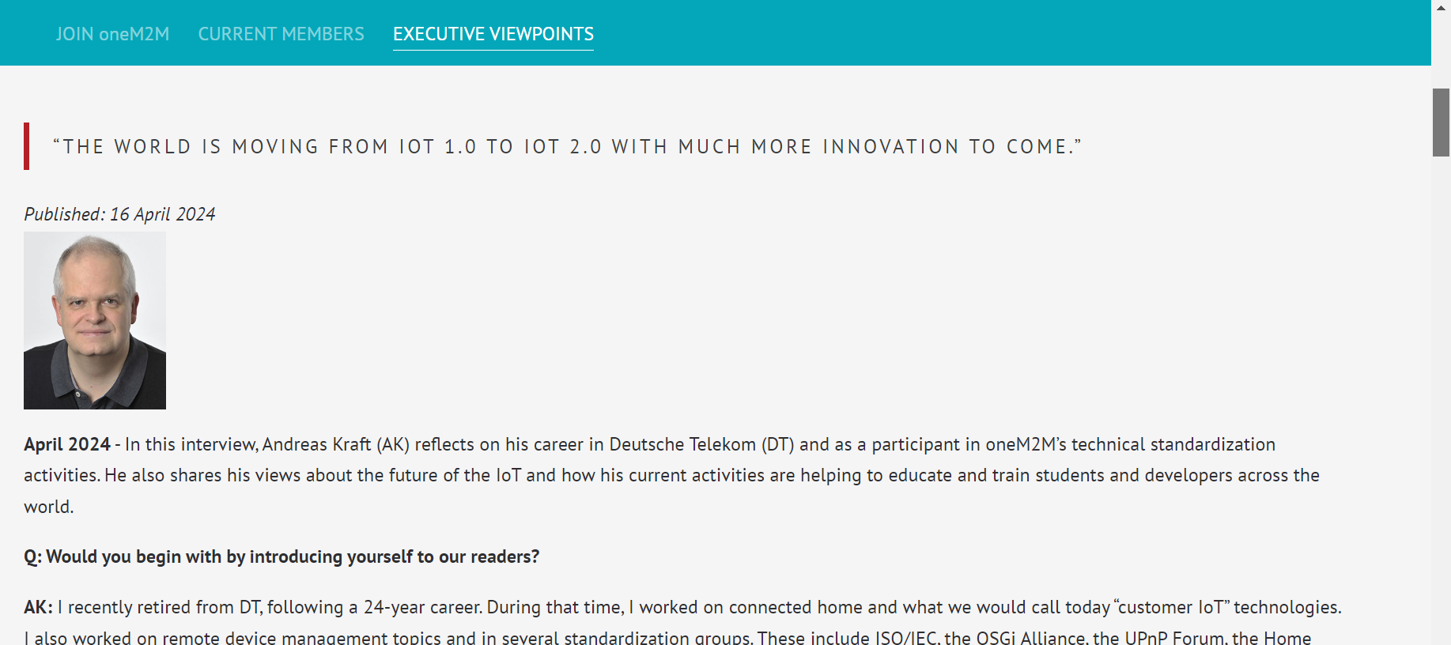
Executive Insight with Andreas Kraft : from IoT1.0 → IoT 2.0
Andreas Kraft reflects on his multiyear involvement in the IoT industry and his efforts to help developers and students learn about IoT and the benefits of standardization.
Current market can be likened to “IoT 1.0” similar to the Web in the late 1990s.
…..
There is also a need to exchange data across vertical-industry data silos. In the “IoT 2.0” phase, technologies will allow this integration of old and new by technical means.
To help IoT newcomers understand and experiment with a standards-based system, Andreas describes his open source ACME CSE which commercial and research organizations across the world are using.

Slide 5
Executive Insight with Roland Hechwartner – post TP63

Slide 6
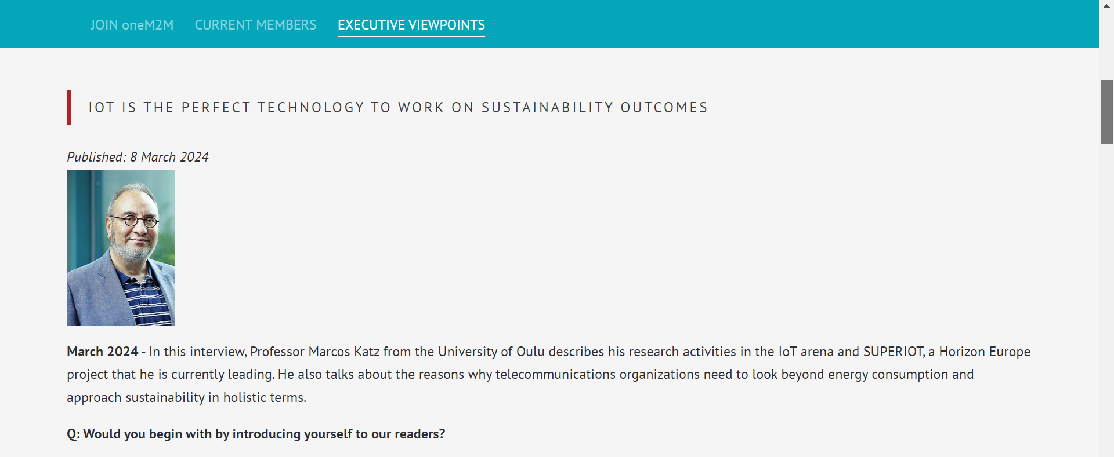
Executive Insight with Marcos Katz

Slide 7
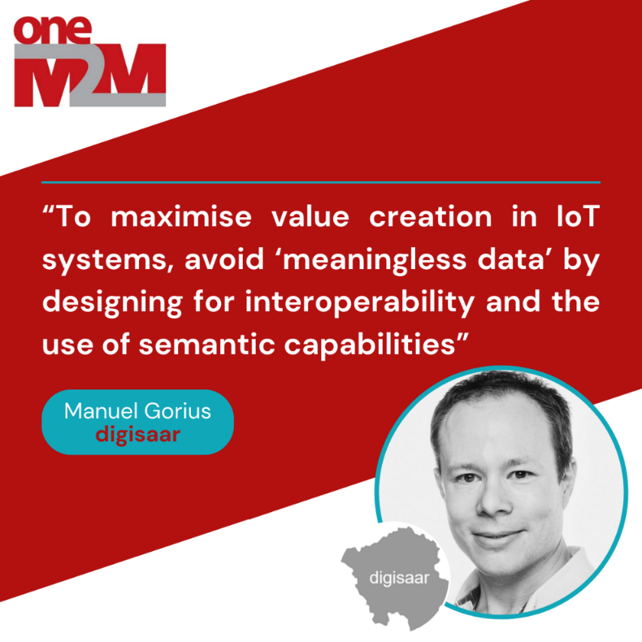
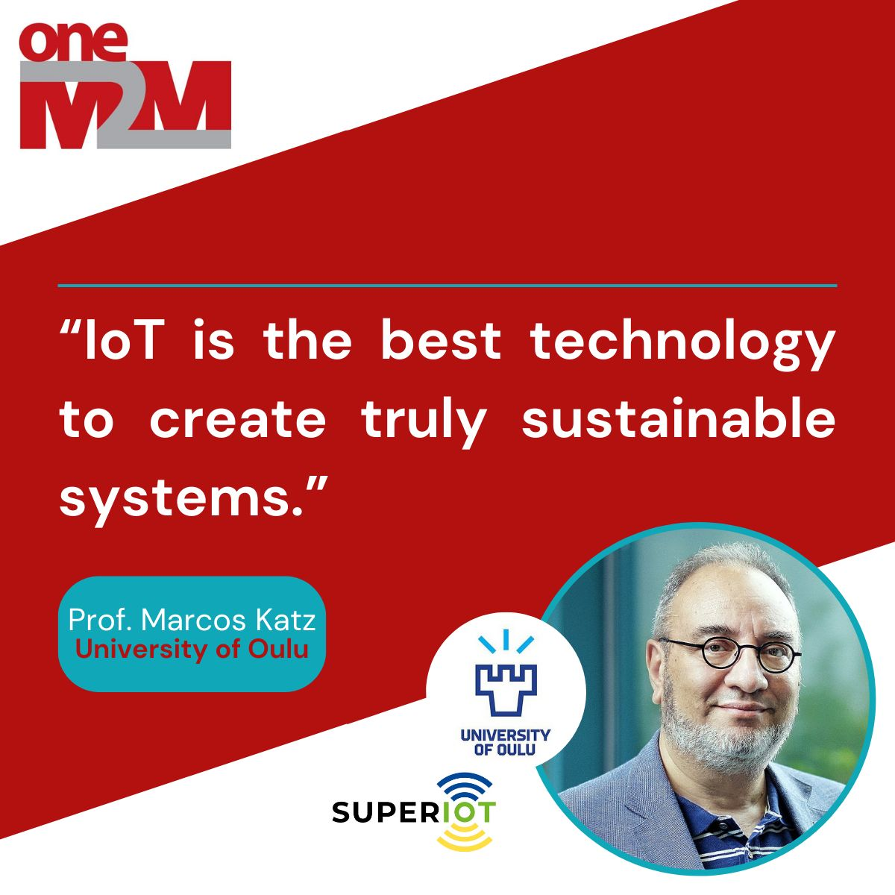
Sponsored LinkedIn Campaigns
Agritech
An Sponsored LinkedIn campaign to promote the Executive Insight Interview with Manuel Gorius, Founder- Digisaar (published on 21 Feb’24) launched in the last week of Feb’24.
IoT for Sustainability
Campaign to promote Executive Insight Interview with Prof. Marcos Katz, University of Oulu (published on 8 Mar’24) launched on 13 Mar 2024.
Refer oneM2M Promotions Tracker

Slide 8
oneM2M TP in Malaysia?
TSDSI is exploring interest from Malaysia for hosting a TP in the country
Expecting a response on the same in end May 2024

Slide 9
Speaking Opportunities
Edge Computing Expo is part of the TechEx brand which sees 7 co-located events, 700+ speakers, 30,000+ attendees, and some of the world’s leading brands as partners
Conferences in 2024:
5-6 June 2024 at the Santa Clara Convention Center, California – North America : Bob is slated to speak
1-2 October 2024 at the RAI in Amsterdam, Europe
oneM2M talk in upcoming ASTAP36 workshop – Sushil Kumar

Slide 10
Upcoming Activities
On standby to promote oneM2M Engagement activities with IEEE IoT WF
Executive Insights in progress/proposed with Andre Dutra (DT), Luigi (INRIA), Neeraj Dhawan (INVAS)…

Slide 11
Key highlights (April’24)
External Publications: 2 (ETSI Enjoy, Submission to NIST Consultation)
Engagement: *4 Executive Insights (12 more planned)
*2 Exec insights promoted through Sponsored LinkedIn posts.
Regional Outreach: Malaysia - Developer tutorial proposed in first half of CY’24; TP being explored in Sep; promotional event after the hackathon in Nov. or Dec.
Visibility:
Total Events organized – N/A
Opportunities –
Edge Computing Expo & IoT Tech Expo 2024 in Santa Clara 5-6 Jun’24;
RAI, Amsterdam on 1-2 Oct 24;
oneM2M talk in upcoming ASTAP36 workshop;
Social Media: LinkedIn 1479 followers (▲39 from Jan’24), 17 total posts; Twitter 1451 followers, 86 total posts
Communiques & PRs: 2 Sponsored LinkedIn posts in Q1 of CY’24
Refer oneM2M Promotions Tracker
Notes:
Executive Insights ->
TP 62
Manuel Gorius (Digisaar)
TP 63
Marcos Katz (Oulu)

Slide 12
Thank You

