Slide 1
GlobalPlatform’s Modular Approach to its Compliance and certification program
Gil Bernabeu
GlobalPlatform Technical Director
January 2016

Slide 2
The Value Proposal of GlobalPlatform
Cross-industry interoperability, which allows for portability of services across platforms
Service providers now focus on convenience and functionality
Scalable security that remains robust as the number of devices, applications and services proliferate
Real proof (certificate) of the interoperability and security
End-to-end security and interoperability that leverages existing and proven methods and technologies
No barriers for deploying innovative services thanks to the remote update of the secure component

Slide 3
GlobalPlatform Members
eID
Notes:
For member max 2 x 6 cm
For participant max 0,9 x 4 cm

Slide 4
Our Collaborative Industry Partners
Secure Content Storage Association

Slide 5
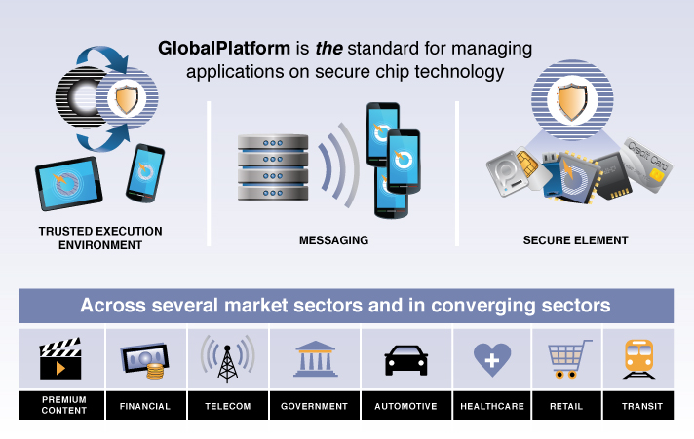
GlobalPlatform Positioning

Slide 6
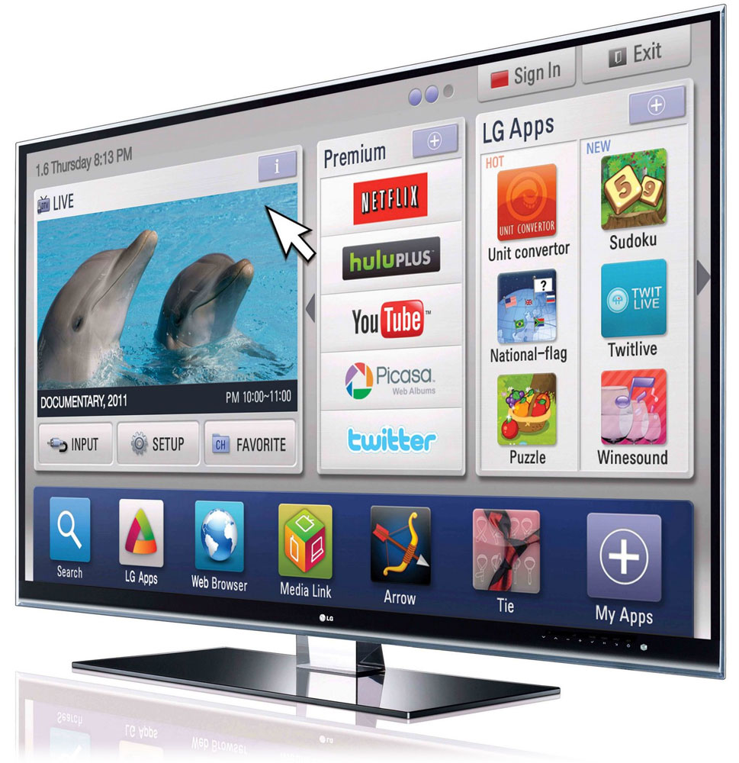
Variety of Devices

Slide 7
Variety of Market Requirements

Slide 8
The Killing Situation
Security
Requirements
for
MY
Service
APPLICATION
APPLICATION
Security
Requirements
for
MY
Service
PLATFORM
Notes:
Title changed
Colors changed since too similar

Slide 9
Solution
Standardize platform interface layer
Control the requirements for the platform
Develop cross-market platform Protection Profile (PP)
Ensure consistency of markets’ demands
Promote cross-market PP endorsement
Develop dedicated PP-modules for each market
Comply with stakeholders requirements

Slide 10
Helping a new complete solution
GlobalPlatform
Compliance
GlobalPlatform
Security
Evaluation
Market Certification
Scheme
Mass Market
Qualified
Certified

Slide 11
Sustainable Ecosystem for Interoperability
GlobalPlatform Compliance Program provides common core interoperable solutions
An eco-system built around:
Test Suite
Qualified Test Tool
Qualified Test Laboratories
Qualified Product
Specification
Configuration

Slide 12
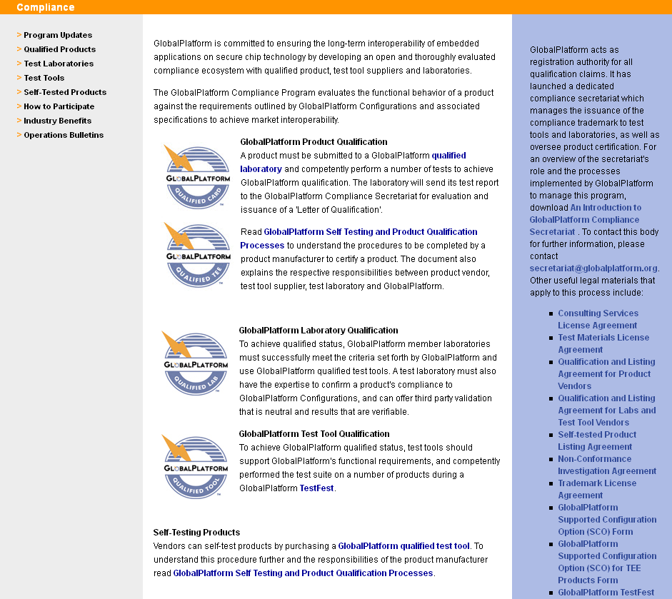
Compliance Program Web Portal
Public Workspace
http://globalplatform.org/compliance.asp
Qualified Products:
Cards, SEs, TEE…!
Qualified Labs
Qualified Test Tools

Slide 13
Model-Based Testing (MBT) compliance program
GlobalPlatform
Specification
Is abstractly implemented with
Is concretely implemented with
MBT
Model
Is tested by
Is used to generate
GlobalPlatform
Qualified Lab
Is used by
Test
Suite
Test tool
Are implemented in

Slide 14
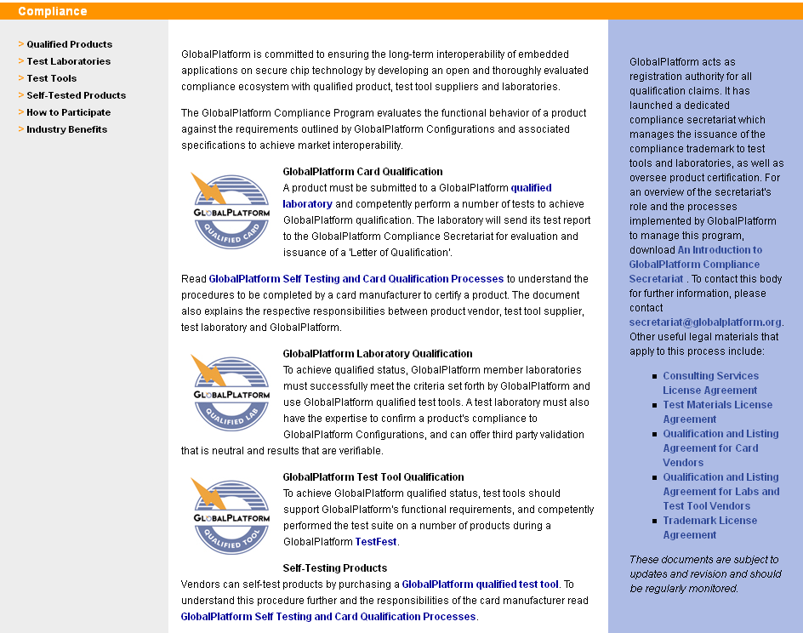
GlobalPlatform Compliance Program
58 Test Tools from
5 member companies
14 Qualified Test Labs
operated by
8 member companies
150 Qualified Products
card and TEE from
25 different companies
Notes:
C’est en place – le framework functione bien

Slide 15
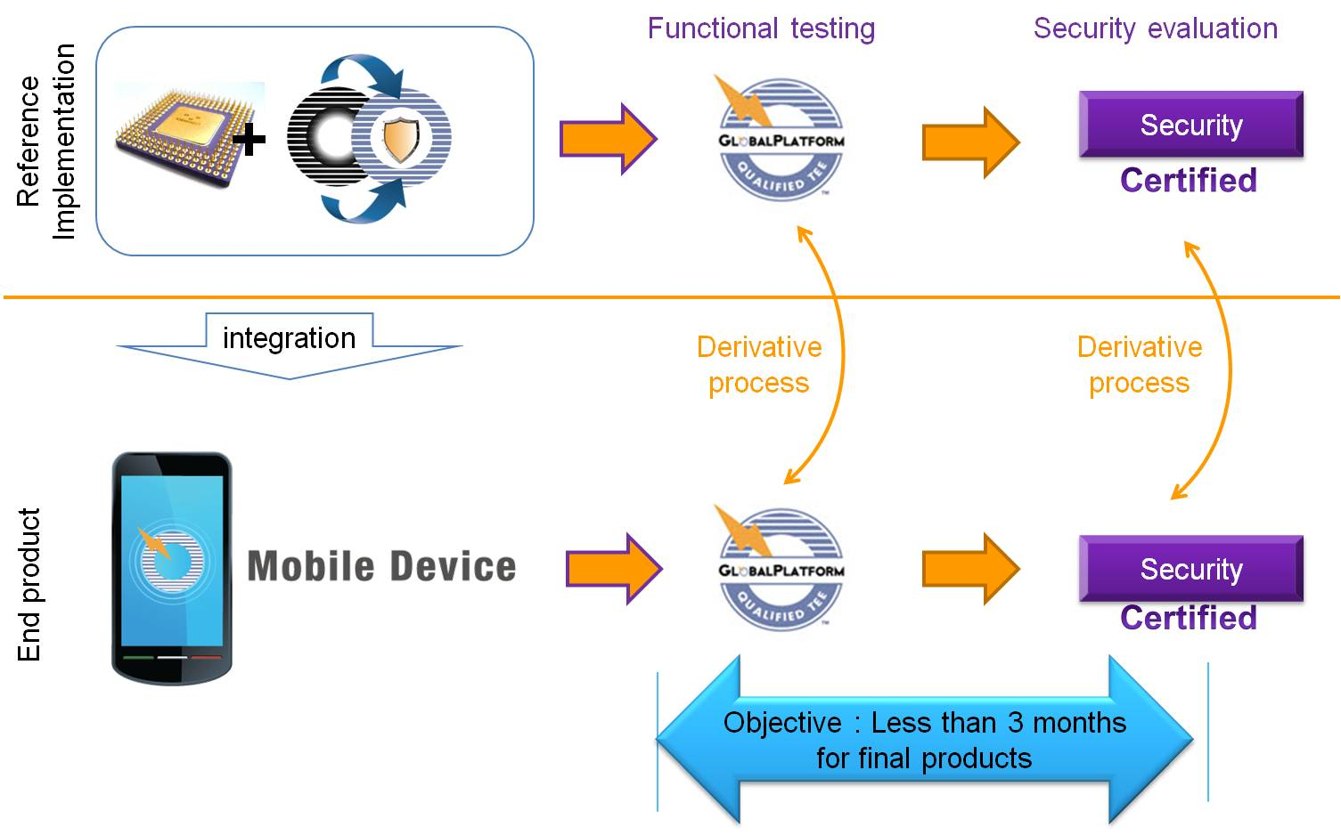
TEE certification initiative
Multi market recognized certification scheme
Adapted to an heterogeneous set of market requirements
Facilitate procurement rules (e.g. Common Criteria based)
Two phased process
Certification of the TEE in a reference board implementing the complete architecture
Second phase on the final device
Evaluation scope
Trusted OS
HW features
Secure boot

Slide 16
Typical collaboration with a vertical organization on Compliance & Certification
GP qualified ?
Reuse the result of a GP qualification / Certification into a Associated organization scheme
In place
with EMVCO for any secure element
with GSMA on UICC for NFC
with GSMA for M2M eUICC
Official endorsement of the GP compliance/certification program also provides direct access to the road map of these programs
No
Yes

Slide 17
Proposed Collaboration: oneM2M & GlobalPlatform
Evolution to provide additional services – Include oneM2M specific requirements in future GP specifications
On TEE
On SE
Create specialized GP configuration for oneM2M deployments
Minimum functional requirements for secure components in one M2M deployments
E.g. for SE in oneM2M Gateway
Include oneM2M security requirements into the GP security specifications
in TEE Protection profile
TEE protection is built in the device/module (e.g. GP has a configuration for device with biometric UI)
Specific module may be created for oneM2M ex security functions for LwM2M
IoT specific requirements for SE

Slide 18
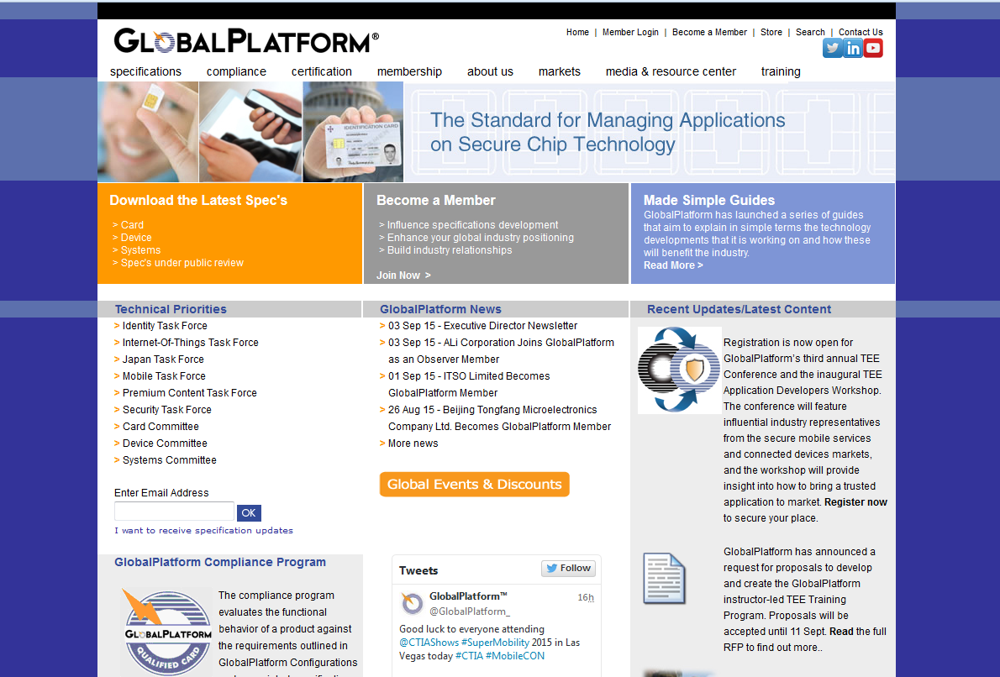
Thank you!

