Slide 1
Proposal for Semantic interop event
Group Name: TST
Source: Mengxuan Zhao, Easy Global Market, mengxuan.zhao@eglobalmark.com
Philippe Cousin, Easy Global Market, philippe.cousin@eglobalmark.com
JaeSeung Song, Sejong University, jssong@sejong.ac.kr
Meeting Date: TST/MAS 32
Agenda Item: TST-2017-0263R02-semantic_testing_for_interop5_proposal

Slide 2
Proposal for Semantic interop event

Slide 3
oneM2M semantic enablement
Resource level (TS0001)
Semantic Descriptor
Semantic FanOut point
Ontology Repository
Other?
Model level (TS 0012)
Reference ontology(ies)
Operation level (TS0001)
Semantic discovery procedure
Semantic query procedure
Semantic validation procedure
Other?
Semantic testing needs to cover all the levels above
Conformance testing
Interoperability testing

Slide 4
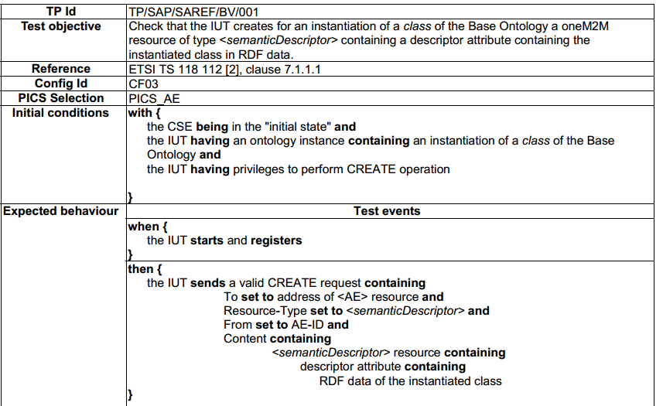
Semantic testing on resource level
oneM2M testing framework has been focusing on resource level testing so far
Quite similar to classic oneM2M test cases
A SmartM2M TP on SAREF

Slide 5
Proposal for interop event Resource level tests
Example: CRUD on « semanticDescriptor » Resource
Conformance tests
TP and TTCN-3 tests to be developed
Interoperability tests
CRUD scenarios available on TS0013
We can begin with some interoperability test scenarios for the event. Configurations are similar to previous interop test configurations

Slide 6
Semantic testing on model level
Main target: the content of « descriptor » of semanticDescriptor, semantic annotation in RDF triples
Tested against the reference ontology specified in the resource
Reference: TS-0034 7.10
Tester
Tester
Issuer
Ontology hosting CSE
Linked <semanticDescriptor> hosting CSE
1. request to validate a <semanticDescriptor> resource
(Update <semanticValidation>)
2. retrieve linked <semanticDescriptor>
IUT
Semantic model Conformance testing
3. validate <semanticDescriptor> against referenced ontology
4. validation response

Slide 7
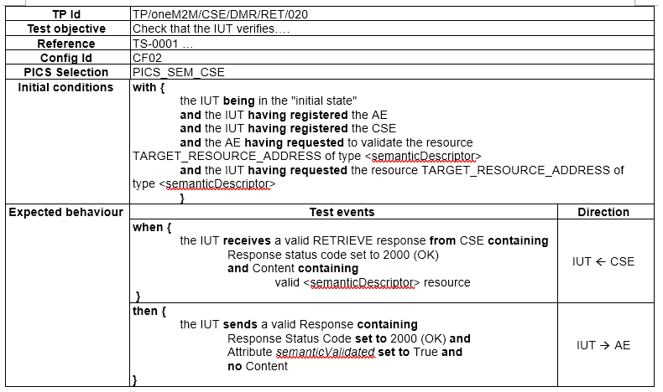
TP proposal based on previous workflow and test configuration

Slide 8
Basic aspects and potential semantic tests on model level
Lexical tests
(test1) Ill-formed RDF serialization format (XML, JSON, etc.)
Syntactic tests
(test2) Untyped resources and literal
(test3) Ill-formed URIs and language tags on literals
(test4) Problematic prefix namespaces
(test5) Unknown properties and classes
Semantic tests
(test6) Problematic Inheritance relationships for classes and properties
(test7) Inconsistency of classes and individuals (instances)
Cardinality tests
(test8) Cardinality inconsistency regarding the ontology

Slide 9
Proposal for interop event Semantic conformance test on model level
Test on the workflow (operation supporting the model level validation)
Test on the semantic data
Choose the reference ontology
The hosting CSE uses the reference ontology to validate the semantic description
Tester validates the listed aspects on semantic model level (in slide 6)

Slide 10
Proposal for interop event Semantic conformance test on model level
Release 3 functionality
Need OntologyRepository and SemanticValidation resource supported to be enabled (Resource-level)
Need semantic validation operation supported (operational-level)
Need semantic data validation against reference ontology (model-level)
Current implementation status
Semantic data validation has one implementation (EGM)
Semantic validation operation is not yet supported in an implementation

Slide 11
Semantic testing on operation level
Semantic discovery procedure specified in TS0001 10.2.35
Semantic queries to find matched descriptors in semanticDescriptor
For testing purpose, dedicated semantic resources may be needed to check the procedure execution result
Interop test for semantic discovery available in TS 0013

Slide 12
Proposal for interop event Semantic interop test
Preconditions:
Semantic descriptions are correct annotation (validated at the model level)
AE submits resources with semantic description D
AE fomulates a SPARQL query Q to discover semantic resources based on « type » or « phenomena » or other criteria
Check the discovery result R with the initial resources submitted by AE
Similar scenario for semantic query operation interop test
D, Q
AE
CSE
R

Slide 13
Organization proposal
We can have both conformance test and interoperability test sessions
Conformance test (if available):
Resource level: CRUD(N) operations about semantic capability related resources (semantic descriptor, ontology repository)
Model level: check the correctness of semantic descriptor to enable the semantic capability in interop tests (one implementation is available)
Operational level
Interoperability test:
Resource level: CRUD(N) operations about semantic capability related resources (semantic descriptor, ontology repository)
Operational level: check if the semantic capability is correctly implemented in CSE (semantic discovery, semantic query, semantic validation workflow)

Slide 14
Information needed for organization
Participant components
Convida: IN-CSE, AE
KETI: IN-CSE
EGM: AE
Others?
To be checked: which features are implemented actually?
How long and when?
Half-day (?)
On Tuesday (?)
To be checked with Keebum & Laurent

