Slide 1
SDT 4.0 Proposed Multiplicity for ModuleClasses and SubDevices
Andreas Kraft, Deutsche Telekom, Andreas.Kraft@t-systems.com
Cyrille Bareau, Orange, cyrille.bareau@orange.com

Slide 2
Problem Description
SDT < 4.0 support only specific ModuleClass and SubDevice definitions. This leads to „hacks“ to support multiple definitions of the same ModuleClass or SubDevice.
Example: SubDevices of the DeviceBloodPressureMonitor Device.
New definitions for abstract device management, e.g. multiple firmwares, require to support multiplicity.

Slide 3
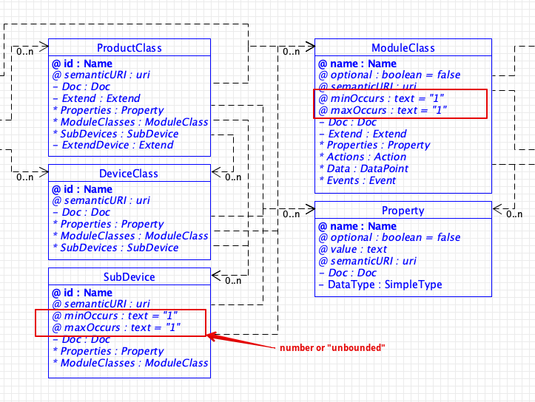
Proposal
Introduce 2 new properties to ModuleClass and SubDevice definitions: minOccurs, maxOccurs
Defaults to 1 (backward compatible)
Unlimited: unbounded
Aligns with XML Schema definition

