Slide 1
SDT 4.0 Proposed Changes to XSD
Andreas Kraft – Deutsche Telekom
Andreas Neubacher – Deutsche Telekom

Slide 2
Status April, 2020 | RDM #45
URL to GitLab: https://git.onem2m.org/MAS/SDT (master)
Branches for SDT 4.0
WI-0081-Smart_Device_Template_4_0
For integrating agreed changes / CRs
Will be finally merged into master branches
RDM/MAS-20yy-nnnn- …
One branch per CR
Will be integrated into WI-0081-Smart_Device_Template_4_0
RDM-2020-0021-SDT_4_0_-_New_documentation
RDM-2020-0024-SDT_4_0_-_Renaming_Data_Types
RDM-2020-0025-SDT_4_0_-_Removing_optional_from_ModuleClass
RDM-2020-0026-SDT_4_0_–_Introducing_Referenced_SubDevices
Next steps
Integrate new CRs
Update documentation and examples, XSD’s
Finalize WI-0081

Slide 3
XSD
Source: Relax NG definition
XSD generated with SDT build tool
Located in „src“ directory
Added test cases and examples for new features
Validation after build
Located in „test“ directory
Questions / Todos
One SDT definition and one XSD per TS-0023 Domain?
Domain identifiers missing in TS-0023, only “home” yet

Slide 4
Git Source Tree

Slide 5
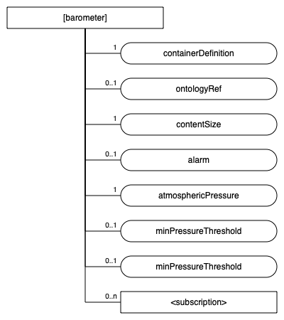
SDTTool
New version of the SDTTool is available
Support for SDT 4.0
Generate XSD, SVG, Markdown
Currently in its own branch until WI-0081 is finished: https://github.com/Homegateway/SDTTool/tree/sdt4
Question
Governance still under HGI GitHub repository. Move / fork to oneM2M GitLab?
<xs:schema xmlns="http://www.w3.org/2001/XMLSchema" targetNamespace="http://www.onem2m.org/xml/protocols/homedomain"
xmlns:m2m="http://www.onem2m.org/xml/protocols" xmlns:hd="http://www.onem2m.org/xml/protocols/homedomain"
elementFormDefault="unqualified" attributeFormDefault="unqualified"
xmlns:xs="http://www.w3.org/2001/XMLSchema">
<xs:import namespace="http://www.onem2m.org/xml/protocols" schemaLocation="CDT-subscription-v3_7_0.xsd" />
<xs:import namespace="http://www.onem2m.org/xml/protocols" schemaLocation="CDT-commonTypes-v3_7_0.xsd" />
<xs:include schemaLocation="HD-enumerationTypes-v4_1_0.xsd" />
<xs:include schemaLocation="HD-commonTypes-v4_1_0.xsd" />
<xs:element name="barometer" type="hd:barometer" substitutionGroup="m2m:sg_flexContainerResource" />
<xs:complexType name="barometer" >
<xs:complexContent>
<!-- Inherit Common Attributes from data type "flexContainerResource" -->
<xs:extension base="m2m:flexContainerResource">
<xs:sequence>
<!-- Resource Specific Attributes -->
<xs:element name="alarm" minOccurs="0" type="xs:boolean" />
<xs:element name="atmosphericPressure" type="xs:float" />
<xs:element name="minPressureThreshold" minOccurs="0" type="xs:integer" />
<xs:element name="minPressureThreshold" minOccurs="0" type="xs:integer" />
<!-- Child Resources -->
<xs:choice minOccurs="0" maxOccurs="1">
<xs:element name="childResource" type="m2m:childResourceRef" minOccurs="1" maxOccurs="unbounded" />
<xs:choice minOccurs="1" maxOccurs="unbounded">
<xs:element ref="m2m:subscription" />
</xs:choice>
</xs:choice>
</xs:sequence>
</xs:extension>
</xs:complexContent>
</xs:complexType>

Slide 6
Thank you

