Slide 1
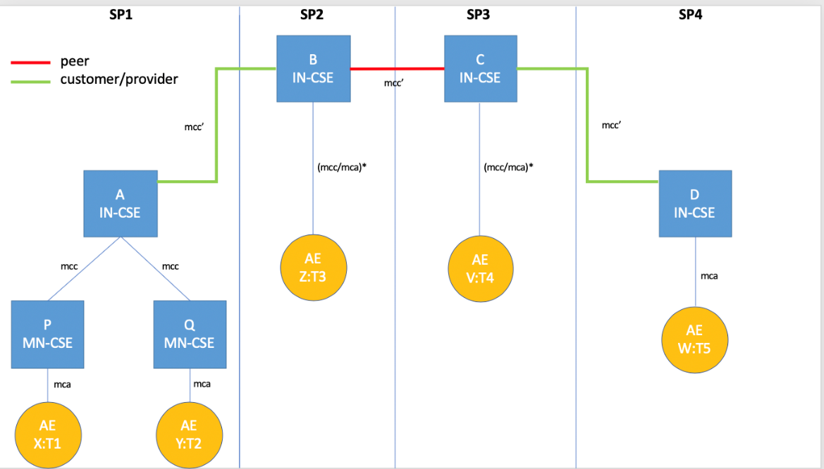
Semantic Discovery in Presence of a “network” of M2M Service Providers
Luigi Liquori and Marie-Agnès Peraldi Frati
Inria Sophia Antipolis – Méditerranée
&
STF 589 Team
RDM 45 oneM2M Web Seminar, 23 April 2020

Slide 2
Use-Case Zero / Parametric Use-Case
Cover many cases
Advanced Semantic Discovery
Graph Topologies
Semantic Discovery Routing Mechanism (SDRM)
Semantic Discovery Query Language (SDQL)
Semantic Resolution Query Mechanism (SRQM)
Luigi Liquori, Marie-Agnès Peraldi Frati
Notes:
Formal Graph Topologies to capture most common scenarios involving networks of M2MSP;
Formal Semantic Discovery Routing Mechanism (SDRM) to route a Semantic Query between M2MSP with exhaustivity/non exhaustivity constraints and iterative vs. recursive routing modality;
Formal Semantic Discovery Query Language (SDQL) to express a large type of queries;
Formal Semantic Resolution Query Mechanism (SRQM) necessary to reduce locally a complex query into a number of simpler queries.

Slide 3
Actors 5 AE + 2 MN-CSE + 4 IN-CSE
Luigi Liquori, Marie-Agnès Peraldi Frati
Notes:
5 Application Entities (AE) X of type T1, Y of type T2, Z of type T3, V of type T4, and W of type T5.
2 Middle Node Common Service Entities (MN-CSE) P, and Q.
A MN-CSE has a local database containing information on their registered AE. The local database includes location information (where each device is currently located), the device type, etc.
4 Infrastructure Node Common Service Entities (IN-CSE) A, B, C, and D.
A IN-CSE has a local database containing information on their registered MN-CSE and AE. The local database includes location information (where each device is currently located), the device type, etc.
Let P and Q have some “Contractual Regulatory and Security Relationship” (CRSR) with A. CRSR can be relaxed inside a single Service Provider, see Note 2 in Subsection 12.1.4.
Let A,B,C, and D have some “Contractual Regulatory and Security Relationship” (CRSR) each other’s.

Slide 4
Semantic Discovery Agreements (SDA)
SDA $∈$ {CUSTOMER, PROVIDER, PEER}
Luigi Liquori, Marie-Agnès Peraldi Frati
Notes:
CSE1 CUSTOMER of CSE2: CSE1 takes advantage of the infrastructure, MN-CSE, and AE registered in CSE2, and also shares security policies of CSE2.
CSE2 PROVIDER of CSE1: conversely, CSE2 offer usage of its infrastructure, and registered MN-CSE, and AE to CSE1. CSE1 again shares security policies of CSE2.
CSE1 PEER CSE2: CSE1 and CSE2 mutually shares infrastructure, MN-CSE, and AE and common security policies.
Note 1. CUSTOMER and PROVIDER SDAs are asymmetric relations, while PEER SDA is a symmetric relation one.
Note 2. Inside a single Service Provider SDA is not required (i.e. SDA=PEER).

Slide 5
Semantic Discovery Query Language (SDQL)
AND, OR, NOT be nonterminals, T be Types, and FC be Filter Criteria
?T2|FC2 AND ?T3|FC3 AND ?T4|FC4 AND ?T5|FC5
?T2|FC2 OR ?T3|FC3 OR ?T4|FC4 OR ?T5|FC5
(?T2|FC2 OR ?T3|FC3) AND (?T4|FC4 OR ?T5|FC5)
(?T2|FC2 AND ?T3|FC3) OR (?T4|FC4 AND ?T5|FC5)
(?T2|FC2 AND ?T3|FC3) OR (?T4|FC4 AND (NOT ?T5|FC5))
Luigi Liquori, Marie-Agnès Peraldi Frati
Notes:
The query can be intuitively read as looking for
some AE of type T2 registered in any CSE satisfying the filter criteria FC2, AND
some AE of type T3 registered in any CSE satisfying the filter criteria FC3, AND
some AE of type T4 registered in any CSE satisfying the filter criteria FC4, AND
some AE of type T5 registered in any CSE satisfying the filter criteria FC5
Let OR be a nonterminal. Consider queries such as
SDREQ1’ = ?T2|FC2 OR ?T3|FC3 OR ?T4|FC4 OR ?T5|FC5
The query can be intuitively read as looking for
some AE of type T2 registered in any CSE satisfying the filter criteria FC2, OR
some AE of type T3 registered in any CSE satisfying the filter criteria FC3, OR
some AE of type T4 registered in any CSE satisfying the filter criteria FC4, OR
some AE of type T5 registered in any CSE satisfying the filter criteria FC5
By combining AND and OR, it is possible to consider semantic queries such as:

Slide 6
Semantic Routing Directives
ANY =search in all CSE databases
CURRENT =search in the current CSE database
CUSTOMER[N]= search in the databases of N CUSTOMER CSE
PROVIDER[N] =search in the databases of N PROVIDER CSE
PEER[N] = search start on the databases of N PEER CSE
Luigi Liquori, Marie-Agnès Peraldi Frati
Notes:
It is also possible to consider other restricted semantic routing directives such as (list not exhaustive):

Slide 7
SDREQ1 ?T2|FC2 AND ?T3|FC3 AND ?T4|FC4 AND ?T5|FC5
?T3|FC3 AND
?T4|FC4 AND
?T5|FC5
?T3|FC3
?T4|FC4
?T4|FC4 AND
?T5|FC5
SDREQ1
?T5|FC5
SDREQ1
?T2|FC2
?T3|FC3
?T4|FC4
?T5|FC5
The moral is: B and C are acknowledged for their “routing job”
?T2|FC2
!!START!!
Luigi Liquori, Marie-Agnès Peraldi Frati
Notes:
A starts lookups in its local database, trying to solve {SDREQ2,3,4,5} but fail
A down-forwards SQREQ1 to Q via an mcc pointer
Q solve the subquery SQREQ2 ?T2|FC2 in its local database returning Y to A
A send back Y to P and X
A up-forwards SQREQ3 & SQREQ4 & SQREQ5 to B via an mcc’ pointer
B solve the SQREQ3 ?T3|FC3 in its local database returning Z to A (and back to P and X)
B side-forwards SQREQ4 & SQREQ5 to C via an mcc’ pointer
C solve the SQREQ4 ?T4|FC2 in its local database returning V to B (and back to A, P and X)
C down-forwards SQREQ5 to D via an mcc’ pointer
D solve the SQREQ5 ?T5|FC5 in its local database returning W to C (and back to B, A, P and X)

Slide 8
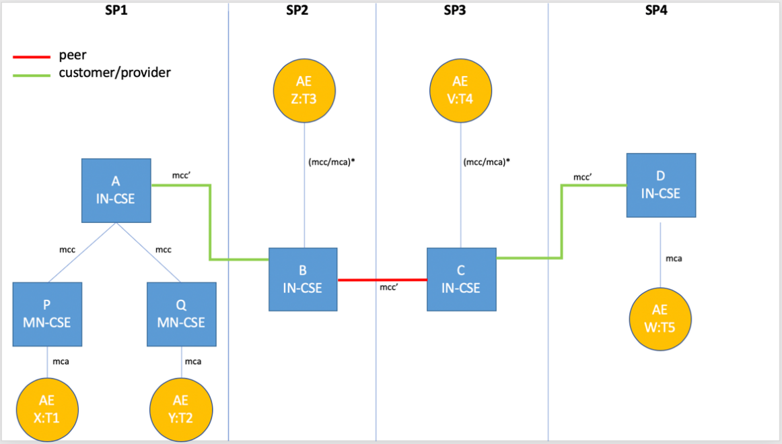
SDREQ1 ?T2|FC2 AND ?T3|FC3 AND ?T4|FC4 AND ?T5|FC5
?T3|FC3
?T4|FC4
SDREQ1
?T5|FC5
?T3|FC3 AND
?T4|FC4 AND
?T5|FC5
?T4|FC4 AND
?T5|FC5
?T3|FC3
?T4|FC4
SDREQ1
?T2|FC2
The moral is: B and C does some job
for their providers A and D and, sadly, they also have to acknowledge for their “routing job”
?T5|FC5
?T2|FC2
Luigi Liquori, Marie-Agnès Peraldi Frati
Notes:
Caveat. When A down-forwards to B, it follows that B should respect the provider-customer SDA with A (e.g. B should acknowledge A. This is not intuitive since B do a favour to A and moreover have also acknowledge A). When B side-forwards to C, it follows that B and C have a common SDA agreement and, as such, they not acknowledge it each other. When C up-forwards to D, it follows that C and D have a common SDA agreement (e.g. C should acknowledge D). This is not intuitive since C do a favour to D and moreover have also acknowledge D).

Slide 9
Potential Requirements
The M2M system SHALL provide
SEMANTIC DISCOVERY QUERY LANGUAGE (SDQL)
The M2M system SHALL provide
SEMANTIC DISCOVER RESOLUTION QUERY MECHANISM (SDQM)
The M2M system SHALL provide mechanism
SEMANTIC DISCOVERY AGREEMENTS (SDA)
The M2M system SHALL provide a
SEMANTIC DISCOVERY ROUTING MECHANISM (SDRM)
Luigi Liquori, Marie-Agnès Peraldi Frati
Notes:
It is also possible to consider other restricted semantic routing directives such as (list not exhaustive):

Slide 10
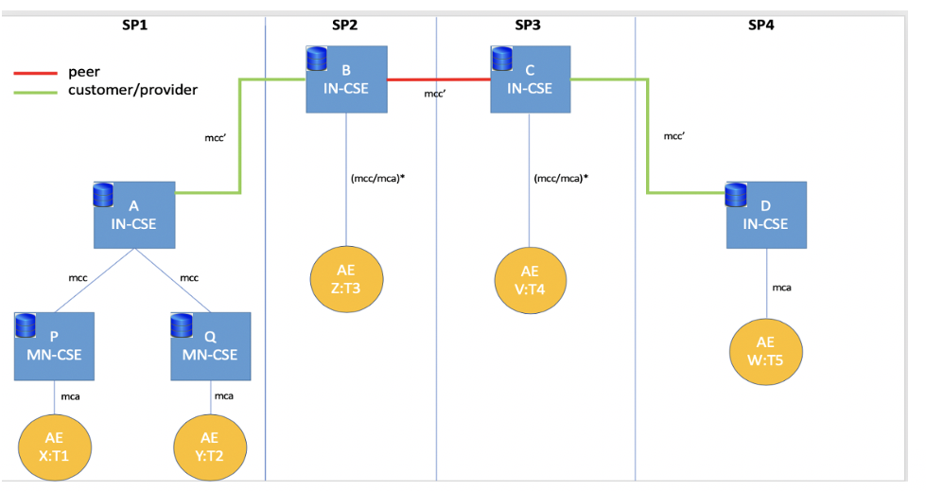
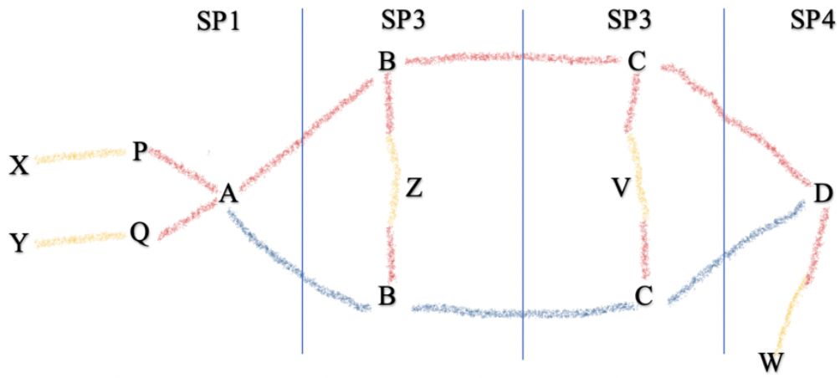
Semantic thank’s
Luigi Liquori, Marie-Agnès Peraldi Frati
Notes:
It is also possible to consider other restricted semantic routing directives such as (list not exhaustive):

