Slide 1
SDT - Support for Relations
Andreas Kraft – Deutsche Telekom
Bob Flynn – Exacta
Cyrille Bareau – Orange

Slide 2
Issue
In the last couple of months some requirements came up to express relationship between SDT entities. For example, currently it cannot be expressed that a light switch controls a number of connected lights.
More complex use cases may come from more traditional data-oriented technologies, such as OGC.

Slide 3
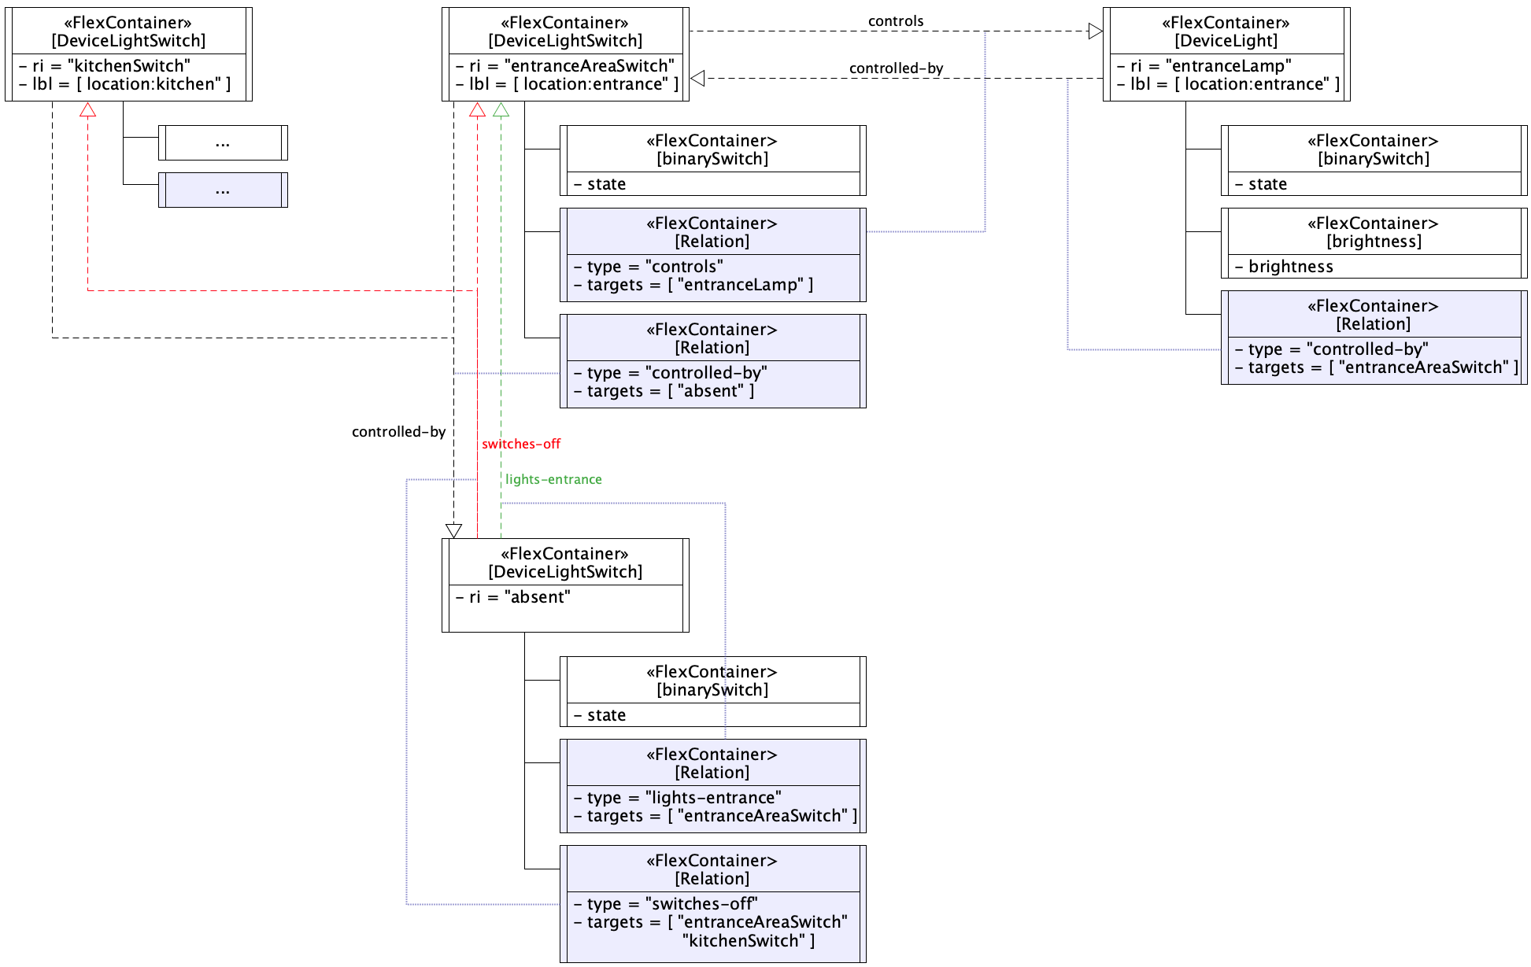
Example

Slide 4
Possible Solution
Introduce a new element to the SDT that stores a number of relations.
An entity may have 0,1, or n Relations
A relation may look like this:
Attribute | Multiplicity | Description
name | 1 | Mandatory name or identifier of a relation.
optional | 0..1 | The optionality of a Relation
semanticURI | 0..1 | A semantic description/link,
doc | 0..1 | The usual documentation string.
type | 1 | The kind of relation.
targets | 1..n | Name/ID of the target entity.

Slide 5
Possible Solution
A Relation is a flexContainer specialization defined by oneM2M.
ModuleClasses and (Sub)Devices may have Relations as child resources.
A possible mapping from SDT may look like this: A <flexContainer> specialization with custom attributes
Type (1) : type of the relation (string)
Targets (1L): list of resourceIDs to the target resources of a relation
targetedResourceTypes (0..1L) : list of target resource types
targetedSpecializationTypes (0..1L) : list of containerDefinitions or mgmtDefinitions

Slide 6
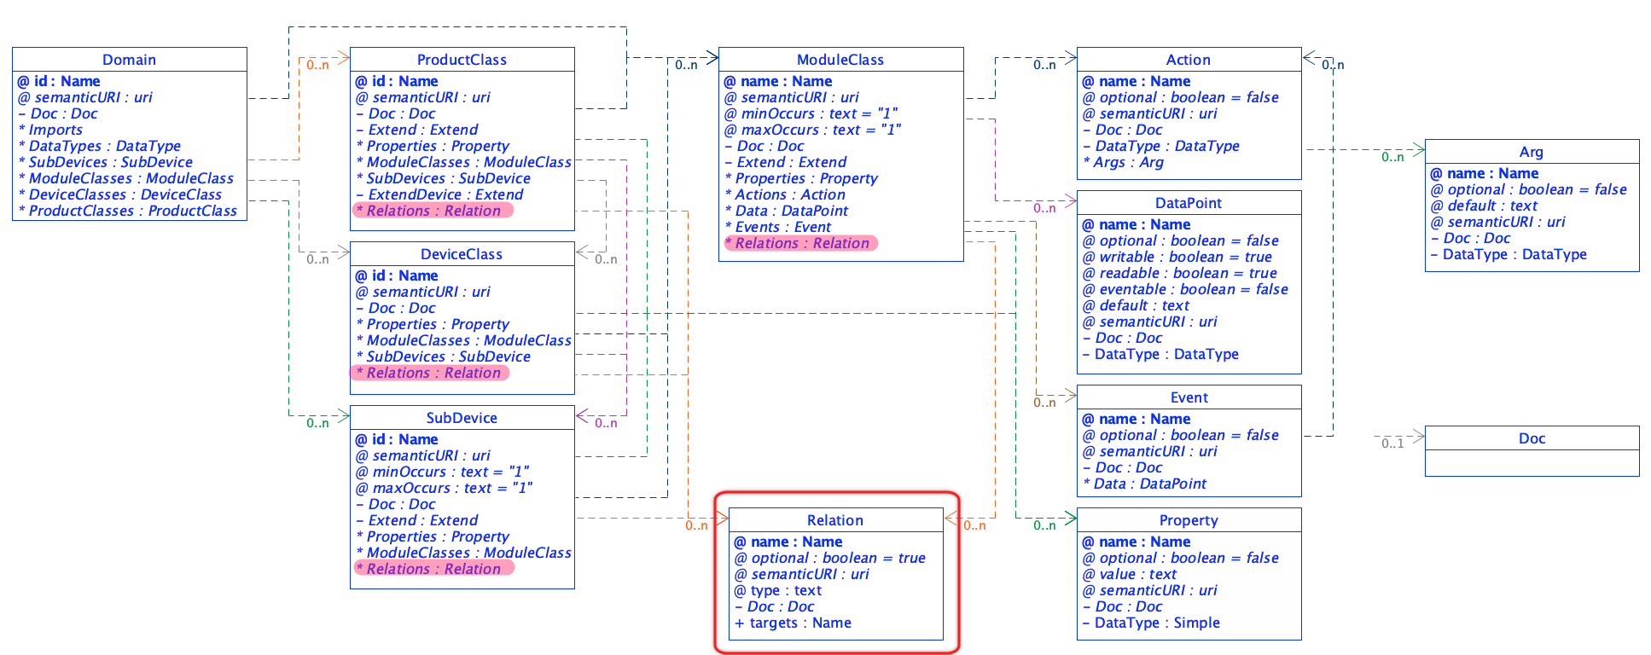
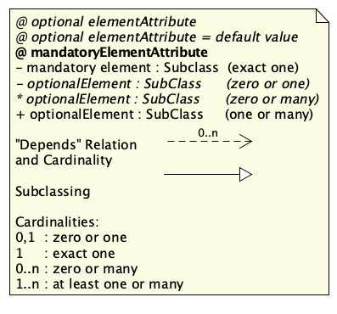
Possible Solution

Slide 7
Thank you

