Slide 1
oneM2M Virtual Store AI/ML data functions
RDM-2022-0042-Virtual_store_use_case_with_data_augmentation
JaeSeung Song (KETI) together with
Minjun Kim (Sejong University, gregmj@naver.com) &
Yoonmi Park (Sejong University, yoommooya@gmail.com)

Slide 2
Metaverse virtual store using oneM2M
Connecting a virtual store and a real store using oneM2M
https://www.hackster.io/meta-express-bus/virtual-store-system-using-digital-twins-and-onem2m-22d0ac
Combining two use cases in TR-0068:
Use case #1 – Data Augmentation for Autonomous Driving
Use case #3 – Smart Virtual Store using Metaverse

Slide 3
Demo Scenario
AI/ML application
Request data augmentation
1
Return data augmentation results
3
Virtual Store App
AI-enabled IoT platform
4
2
Perform data augmentation
Download AI/ML model
DB

Slide 4
Demo architecture
< Python Scripts >
< AI-enabled IoT platform >
CSE
(oneM2M platform)
AE Admin
AE VirtualStore
CSF
(Image augmentation service using Python)
AE AI/ML

Slide 5
Prerequisite procedure
AI-enabled IoT platform
AE Admin
AE VirtualStore
AE AI/ML
IN-CSE
Image augmentation service
CREATE AE & CNT
Prerequisites
SUBSCRIBE to AE
Send captured image
Request data augmentation
Perform data augmentation
Train AI Model
Publish trained AI model

Slide 6
Demo procedure
AI-enabled IoT platform
AE Admin
AE VirtualStore
AE AI/ML
IN-CSE
Image augmentation service
CREATE AE & CNT
SUBSCRIBE to AE
Send captured image
Request data augmentation
Demo
Perform data augmentation
Train AI Model
Publish trained AI model

Slide 7
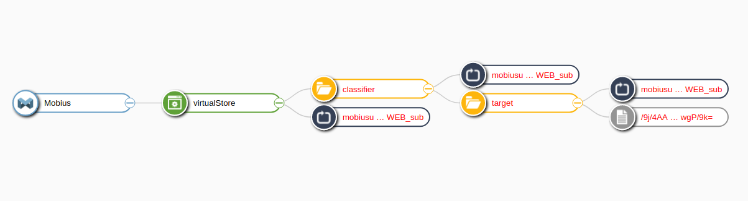
Prerequisites
virtualStore
Create Parent Resources
Create Data Augmentation Source Resource
Run Data Augmentation Service
classifier
target
water_img1

Slide 8
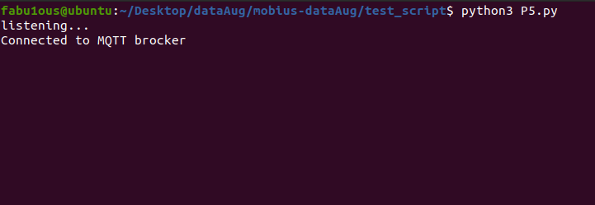
Prerequisites
Run data augmentation service

Slide 9
Procedures for demo
AI-enabled IoT platform
AE Admin
AE Device
AE AI/ML
IN-CSE
Image augmentation service
CREATE AE & trainingData
SUBSCRIBE to AE
Send captured image
Request data augmentation
1
Perform data augmentation
2
Train AI model
Publish trained AI model
3
4

Slide 10
Step 1: request data augmentation
virtualStore
1
Request data augmentation
classifier
POST /Mobius/AI HTTP/1.1
Host: xxx.xxx.xxx.xxx:7579
Accept: application/json
X-M2M-RI: 12345
X-M2M-Origin: SvirtualStore
Content-Type: application/vnd.onem2m-res+json; ty=50
{
"m2m:da": {
"rn": "rotate_water_img1",
"augty": "rotate",
"srsrc": "/virtualStore/classifier/target/water_img1",
"augprm": {
"max_left_rotation": "20",
"max_right_rotation": "20",
"sample": "20",
"label": "water"
},
"trgrsrc": "/virtualStore/classifier/target”
}
}
target
water_img1
0...n
rotate_water_img1
1
augmentType
1
sourceResource
1
augmentParameter
1
targetResource

Slide 11
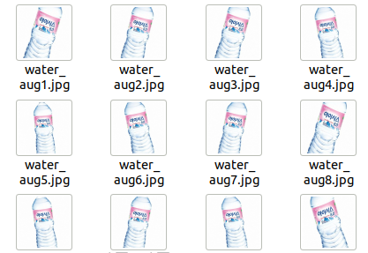
Step 2: perform data augmentation
2
Perform data augmentation

Slide 12
Step 3: data augmentation results
3
Return data augmentation results & Train AI model
virtualStore
classifier
POST /Mobius/AI/trainingData HTTP/1.1
Host: xxx.xxx.xxx.xxx:7579
Accept: application/json
X-M2M-RI: 12345
X-M2M-Origin: SvirtualStore
Content-Type: application/vnd.onem2m-res+json; ty=4
{
"m2m:cin": {
"rn": "water_aug1",
“con”: “XXXXXXXXXXXX...”,
“auginfo”: “/Mobuis/virtualStore/classifier/target”
}
}
target
water_img1
0…n
water_augN
0...n
rotate_water_img1
1
augmentType
1
sourceResource
1
augmentParameter
1
targetResource

Slide 13
Demo

Slide 14
Thank you

