Slide 1
Discussion on WI for oneM2M and Metaverse
2022.09.27
Andrew Min-gyu Han, Hansung University
(andyhan@hansung.ac.kr)

Slide 2
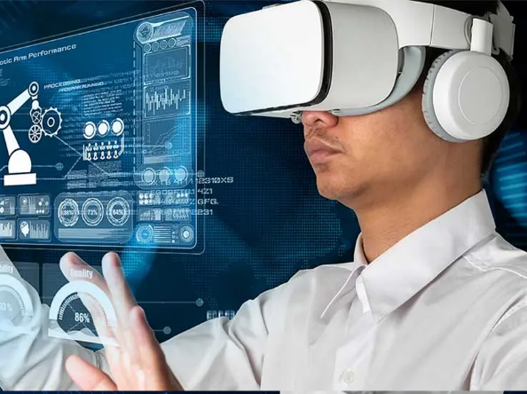
Why oneM2M and Metaverse?
Current Metaverse services are focusing contents. It looks like the early stage of internet.
As the internet has been extended to Internet of Things, the Metaverse will expand its scope to O2O. It means oneM2M could be on the connecting point between the Metaverse services and the real world.
oneM2M shows its new features of IoT now, e.g. AIoT. Metaverse is good keyword as an additional new features.
If oneM2M adopt Metaverse, it may be the one of key features of oneM2M Rel-5.

Slide 3
Discussion points
What is “Metaverse-IoT”?
The “Metaverse-IoT” is in scope of oneM2M standardization?
How we handle the Metaverse services in the oneM2M world?
Common Service Element
Interworking
Information Model
Who will join this work? Hansung university, Nokia, KETI, Sejong university do. And?
“Let’s get into the Metaverse-IoT World!”

