Slide 1
oneM2M for AI/ML
Ingo Friese / September 2024
RDM-2024-0031-oneM2MforAI

Slide 2
10 Ever Day ML Use-Cases
Typical use cases where ML is recognizing patterns and making predictions
Predicted* to be a 200 billion (200.000.000.000 $) industry in 2029
Customer service (chat bots)
Voice assistance (siri, alexa…)
Mobile Apps (spotify recommendations…)
Mobile devices (facial recognition…)
Financial transactions (fraud detection..)
Cyber Security
Email filtering and classification
Transportation (maps, traffic…)
HealthCare (marmogram analyses…)
Marketing and Sales
*Source: IBM https://www.youtube.com/watch?v=CiSaY2xl9V4

Slide 3
Example use-case:
In the field of (functional) security
« vital » parameters of a PC (could be any IT-System) are measured every 10 sec
ML-based service tries to identify patterns showing an unusual situation:
- heavy system / CPU load
- memory or hard drive issues
- network problems
In case of a problem the service indicates a “stress” situation
Additionally, the potential source of problems is shown
By examining the example, we will see situations where oneM2M might fit in

Slide 4

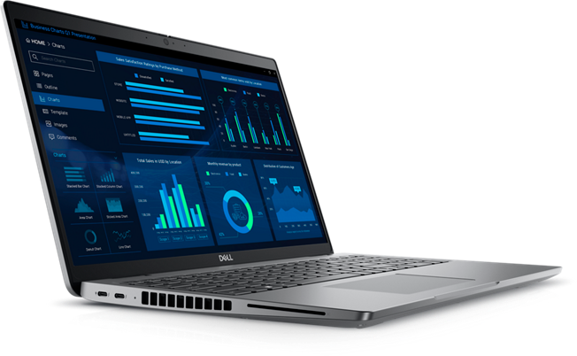
System Monitoring
usage_idle_cpu
usage_system_cpu
usage_user_cpu
load1_system
load15_system
load5_system
Context_Switches_persec_win_system
Processor_Queue_Length_win_system
System_Calls_persec_win_system
used_percent_disk
used_percent_mem
used_percent_swap
read_time_diskio
write_time_diskio
Bytes_Received_persec_win_net
Bytes_Sent_persec_win_net
Packets_Outbound_Discarded_win_net
Packets_Outbound_Errors_win_net
Packets_Received_Discarded_win_net
Packets_Received_Errors_win_net
Packets_Received_persec_win_net
Packets_Sent_persec_win_net
Source: dell.com
PC is just an example for an IT- System

Slide 5


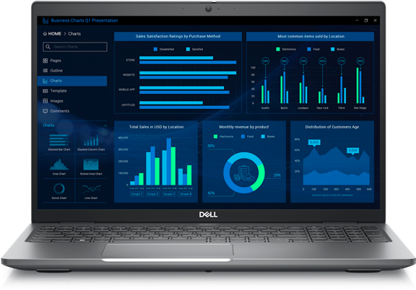
Data Sources
cpu
Telegraf
Server
InFlux
Database
system
10 sec
Monitoring
disk
mem
Source: dell.com
net
InfluDB 2.0 Open Source
https://www.influxdata.com/blog/influxdb-2-0-open-source-is-generally-available/

Slide 6
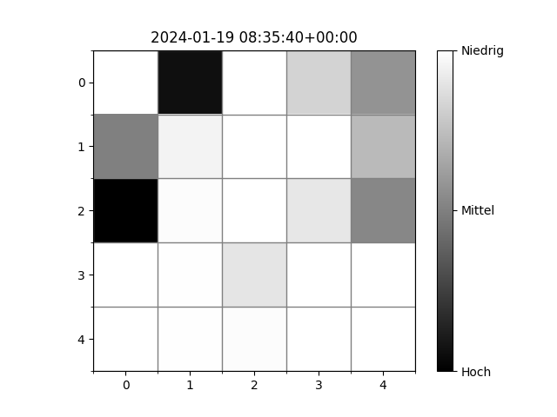
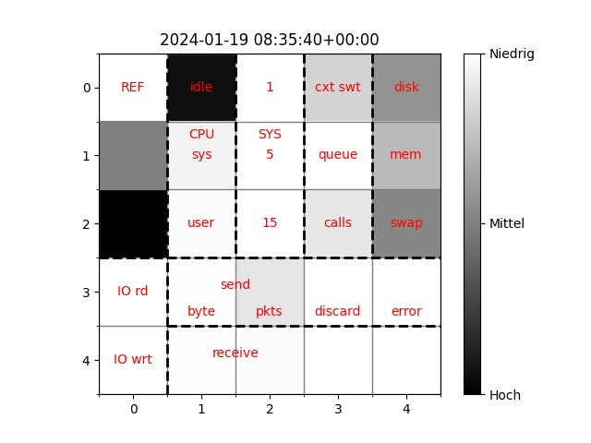
A graphical representation for Humans and AI
_time 2024-01-19 08:35:40+00:00
usage_idle_cpu 94.131915
usage_system_cpu 4.772709
usage_user_cpu 1.095376
load1_system 0.750372
load15_system 0.060299
load5_system 0.176122
Context_Switches_persec_win_system 16959.171089
Processor_Queue_Length_win_system 0.0
System_Calls_persec_win_system 91067.584744
used_percent_disk 42.685631
used_percent_mem 27.82294
used_percent_swap 47.418071
read_time_diskio 1002
write_time_diskio 629
Bytes_Received_persec_win_net 6130.973525
Bytes_Sent_persec_win_net 2329.468035
Packets_Outbound_Discarded_win_net0.0
Packets_Outbound_Errors_win_net 0.0
Packets_Received_Discarded_win_net 0.0
Packets_Received_Errors_win_net 0.0
Packets_Received_persec_win_net 8.49733
Packets_Sent_persec_win_net 10.696639

Slide 7
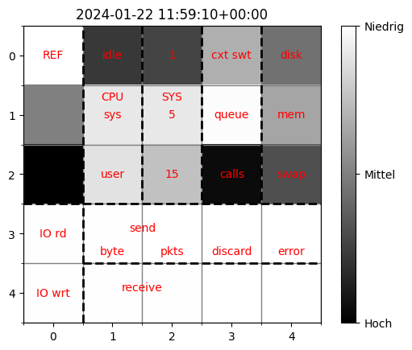
System Status
normal
stress

Slide 8
Three ML service steps
Collecting
Training Data
Train
ML Model
Anomaly
Detection
Service
using
the
ML model

Slide 9
Collection Data
“normal data” are easy to get, just recording the day-to-day use
“stress data” might be induced through benchmarking tools (Clumsy/HeavyLoad)
It’s still a challenge to get enough “stress data” – data augmentation might be an option. It needs a balanced data-set for a high-quality model.
Training data sets need to be managed

Slide 10
What could be oneM2M improvements?
Is it possible to download a complete container-structure incl all sub-containers and contentInstances?
It would be great to have a more sophisticated version
of a label (version, train/validation/test, trainings-label, model name etc.)
usable for search and retrieval
Compressed download possible e.g. with an
additional attribute ?
(MPEG is working on a Tensor-Codec)
CNT
xyz-data set
CNT
test
CNT
validation
CNT
training
CNT
(„normal“)
CNT
(„stress“)
CIN
CIN

Slide 11
Three ML service steps
Collecting
Training Data
Train
ML Model
Anomaly
Detection
Service
using
the
ML model

Slide 12
Train (a) model(s)
Base-Features
Network-Features

Slide 13
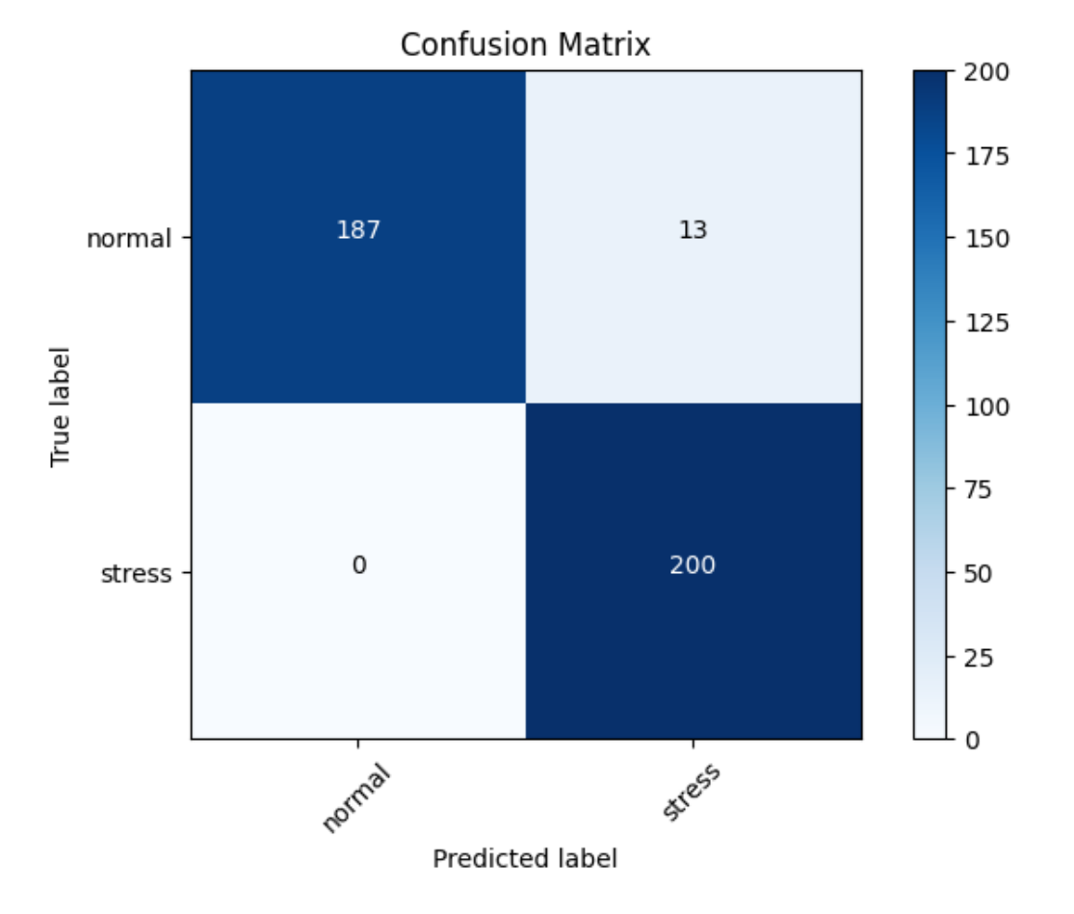
Model Quality
Accuracy = True Positives (TP)+True Negatives (TN)
Total Predictions (TP + TN + FP + FN)​
Precision = True Positives (TP)
True Positives (TP) + False Positives (FP)
Recall, F1 score……
​
Basic Data Set
Network Data Set
train
train
Basic Data
Model
Network Data
Model
Optimized with:
dropout, Kernelregulizer, BatchNormalization

Slide 14
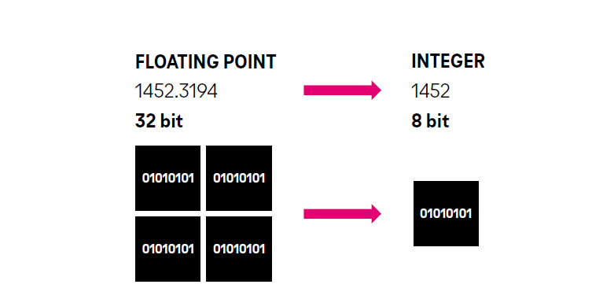
Model compression
Quantization
Pruning

Slide 15
Model compression
Source: Figure 4: Typical test error vs. sparsity showing Occam’s hill (results: ResNet-50 on Top-1 ImageNet)
Source :followed by a period of synaptic elimination through synaptic pruning. Image shows
stained neurons from the same area of the brain through embryogenesis and
the first 6 years of live [4]

Slide 16
MPEG NNCodec
MPEG NNCodec might be used
for compression only
But also for pruning* and
quantization
Source: https://github.com/fraunhoferhhi/nncodec/tree/master
*in the next version

Slide 17
What could be oneM2M improvements?
Access to various versions of one model
- time/version-wise, compressed, quantization,
pruned, fine-tuned etc.
Needs a sophisticated label-structure
Model distribution (in case of new version) (pub/sub)
Standard mpeg compression while downloading with an extra -attribute
Might be also possible to optimize
while downloading(?)
CNT
models
model A
model A‘
model A‘
model A‘
model A‘

Slide 18
Three ML service steps
Collecting
Training Data
Train
ML Model
Anomaly
Detection
Service
using
the
ML model

Slide 19
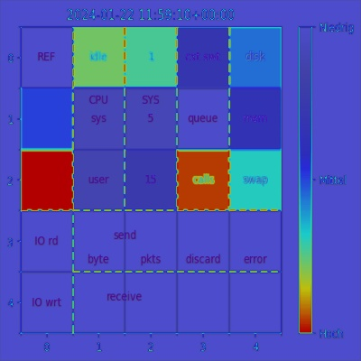
Running ML service
alarm and present pic
identify crucial
areas in pic
stress
AI
normal
ask me in
10 sec
again

Slide 20
What could be oneM2M improvements?
Adding new “stress”-situation (with - rolling file retention) easily for the next training phase
Model updates need to be announced and distributed on a regular base
e.g. in case of a “poisoned” model the download of the previous version of the model is needed
CNT
models
model A
model A‘
model A‘
model A‘
model A‘

Slide 21
Summary
Day-to-day management of training data and models
CRUD-functions (also for more complex structures)
Sophisticated labeling incl. search and retrieval functions (former models, certain training data sets or models, updates of training data)
Compression switches or attributes during download
Federated learning (with incremental features) not even touched here but potential source for further oneM2M fit

