Slide 1
MALICIOUS AE AND BLOCKED ORIGINATOR
SDS-2019-0096-Maclicious_AE_Blocked_Originator(R3)

Slide 2
New definitions introduced in CR
Malicious AE Request : An AE request with an intent to perform operations on a CSE to gain unauthorized access to information or perform unauthorized operations
Blocked Originator: Hosting CSE should be able to identify any incoming Malicious AE Request and block the AE-Id of the malicious request from performing any other requests

Slide 3
Why block an AE ?
If an AE is sending a malformed request to perform some unauthorized action, then the AE should be marked as MALICIOUS and blocked from performing any future operations.
Other examples for blocking an AE are when the AE is not following a set of defined policies while sending request like: Overdue Payment Date, Very high Request Rate etc.

Slide 4
Example of Malicious AE Request
Consider the below example: AE1 → MN-CSE1 → IN-CSE → MN-CSE2
In the example
AE1 sends a malicious request to MN-CSE2
The MN-CSE2 is able to identify the malicious nature of the request
MN-CSE2 should add the AE to the Blocked AE List
3 scenarios are possible

Slide 5
Example Case
3 scenarios are possible

Slide 6
Scenario 1 – Local AE Blocked List
AE1 → MN-CSE1 → IN-CSE → MN-CSE2
MN-CSE2 maintains independent LocalBlockedAEList.
MN-CSE2 shall add /MN-CSE1/AE1 in its Blocked AE List that shall be maintained locally
Features:
Every Hosting CSE shall maintain their independent Blocked Originator List and shall update them based on the malicious operation detected on their node
An AE blocked by one CSE may be operational on other CSE. This is because the AE might have only attempted malicious activity on one of the CSE’s

Slide 8
Scenario 2 – Notify IN & Local AE Block List
AE1 → MN-CSE1 → IN-CSE → MN-CSE2
Local AE Blocked List with IN Notify
MNCSE2 notifies IN-CSE with the SP Relative AE-ID in the content
IN-CSE shall notify request to all CSE’s with the above SP Relative AE-ID’s to update their Local Blocked AE ID List
Features:
Every CSE should update their Local Blocked AE List based on the Notification received from IN-CSE
All CSE should have the same Local AE Blocked List.

Slide 9
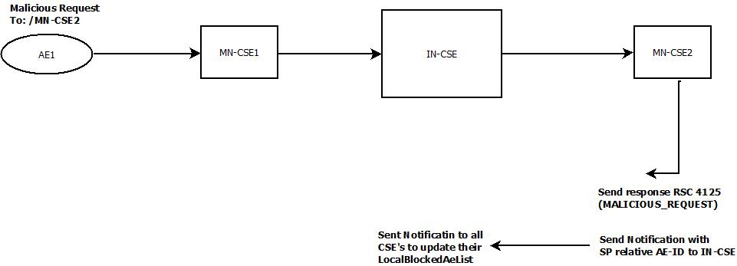

Slide 10
Scenario 3 – BlockedAEList at IN
AE1 → MN-CSE1 → IN-CSE → MN-CSE2
BlockedAEList at IN
MNCSE2 notifies IN-CSE with the SP Relative AE-ID in the content
IN-CSE should update the BlockedAEList (maintained at IN only). It should map the Blocked AE-ID List against its Registrar CSE.
IN-CSE should notify the registrar CSE of the blocked AE to update its local Blocked AE List
Features:
Every CSE should update their Local Blocked AE List based on the Notification received from IN-CSE
Each CSE shall have their own blocked list with their registered AE only

Slide 11
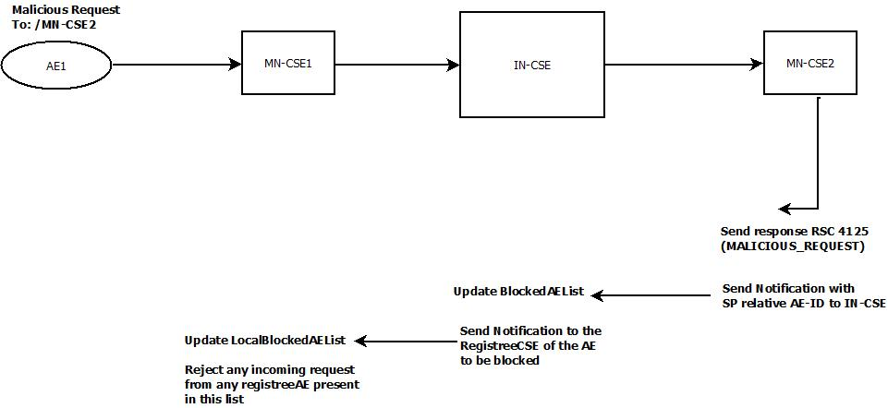

Slide 12
Why Scenario 3 ?
Once the originator is blocked, the request shall be reject at the Registrar CSE itself.
Efficient as LocalAEBlockedList only updated at the Registrar CSE of the originator to be blocked

Slide 13
PROPOSED SOLUTION
When a Malicious AE Request is identified at the Hosting CSE, the Hosting CSE shall send a response with RSC 4125 (MALICIOUS_REQUEST)
For any subsequent request from the AE, the Registrar CSE of the AE shall reject the request with RSC 4126 (BLOCKED_ORIGINATOR)

Slide 14
Blocked List as a Resource
Blocked List of all AE-ID’s across all CSE’s should be maintained at the IN
<BlockedAEList>
<BlockedAEListAsPerCSE>

Slide 15
<BlockedAEList>
Attributes
numberImpactedCSEs the number of CSEs that have at least one of their registree AE being blocked due to some form of malicious activity by the AE
Child Resources
<subscription>
<BlockedOriginatorListPerCSE>

Slide 16
<BlockedAEListPerCSE>
Attributes
CSE-ID the identifier of the Registrar CSE of the AE to be blocked
AE-IDList the list of Registree AE-ID’s of the CSE-ID attribute be blocked
No Child Resources

Slide 17
<LocalBlockedAEList>
Attributes
AE-IDList the list of Registree AE-ID’s to be blocked

Slide 18
Future Enhancements
Definition of Policies that could be defined in the system for blocking AE
Reason for Blocking AE i.e. defining the malicious behaviour for which the AE was blocked

