Slide 1
Dynamic Authorization Enhancement nested token introduction
Group Name: SDS
Source: mailto: Leila Le Brun (Orange), Chrystel Gaber (Orange)
Meeting Date: 2019-xx-xx
Agenda Item: TS-0003 and TS-0004 related

Slide 2
Agenda
1. European ODSI project presentation
2. Mapping between ODSI architecture and oneM2M architecture
3. Enhancement proposed in oneM2M security

Slide 3
European ODSI project
overview
The “On Demand Secure Isolation” (ODSI) project defines a new security model with isolation mechanisms.
ODSI proposes to use virtualization to isolate tenants from each other and tokens to authorize access to resources:
- Sensitive functions are isolated in the owner domain
- Sensitive functions are exposed through less sensitive functions to other tenants
- Resources proper to a tenant are under its sole responsibility.
This addresses attacks on IOT devices using an actor’s access to target another stakeholder.
More info: https://www.celticnext.eu/project-odsi/

Slide 4
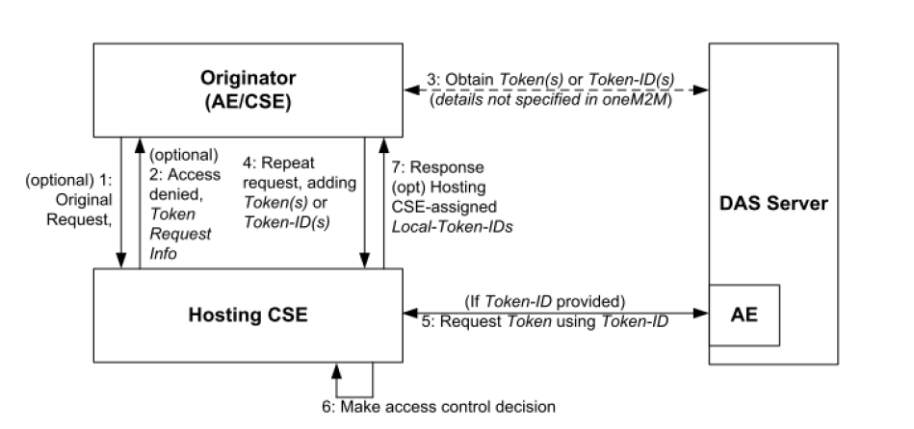
Mapping between
ODSI & oneM2M
Indirect Dynamic Authorization mapping:
- ODSI: the token contains a security policy which indicates whether a token should be verified to access a token or not.
It can also define local access control rules. An example for such a local rule is to forbid a firmware update if the battery level is too low.
- oneM2M: the security policy does not identify whether a token is requested to verify a token or not.
oneM2M TS0003: Indirect dynamic authorization
Proposal is that the access control policy element (TS 0004) also checks whether a particular resource requires a token verification or not. For that, nestedToken field is introduced in oneM2M token

Slide 5
Enhancement
Proposed in oneM2M
To address the case where a user or CSE or another AE performs requests of a device resource authorized by a token, we propose to add an optional element, nestedToken to the oneM2M tokenClaimSet defined in TS 0004.
The first token proves that the tenant authorization server has authorized the action. The nested token proves that the owner authorization server has authorized the access to the device resource.
The nested token can either be a full token (serialized JWT or other relevant format) or a tokenID, which is used to request the token from the DAS server.

Slide 6
Enhancement
Proposed in oneM2M
The additional elements proposed to oneM2M token (tokenClaimSet)
Token Claimset Object Element Path | Token Claimset Object Element Short Name | oneM2M JWT claim name
version | tkvr | "tkvr"
tokenID | tkid | "jti"
issuer | tkis | "iss"
holder | tkhd | "azp"
notBefore | tknb | "nbf"
notAfter | tkna | "exp"
tokenName | tknm | "tknm"
audience | tkau | "aud"
permissions | tkps | "tkps"
extension | tkex | "tkex"
nestedToken | tkobj | “tkobj”

Slide 7
Thank you

