Slide 1
Dynamic Authorization Enhancement nested token introduction
Group Name: SDS
Source: mailto: Leila Le Brun (Orange), Chrystel Gaber (Orange)
Meeting Date: 2019-xx-xx
Agenda Item: TS-0003 and TS-0004 related

Slide 2
Agenda
1. European ODSI project presentation
2. Mapping between ODSI architecture and oneM2M architecture
3. Enhancement proposed in oneM2M security
4. Multi-tenant Use Case
5. Single-tenant Use Case

Slide 3
European ODSI project
overview
The “On Demand Secure Isolation” (ODSI) project defines a new security model with isolation mechanisms.
ODSI proposes to use virtualization to isolate tenants from each other and tokens to authorize access to resources:
- Sensitive functions are isolated in the owner domain
- Sensitive functions are exposed through less sensitive functions to other tenants
- Resources proper to a tenant are under its sole responsibility.
This addresses attacks on IOT devices using an actor’s access to target another stakeholder.
More info: https://www.celticnext.eu/project-odsi/

Slide 4
Agenda
1. European ODSI project presentation
2. Mapping between ODSI architecture and oneM2M architecture
3. Enhancement proposed in oneM2M security
4. Multi-tenant Use Case
5. Single-tenant Use Case

Slide 5
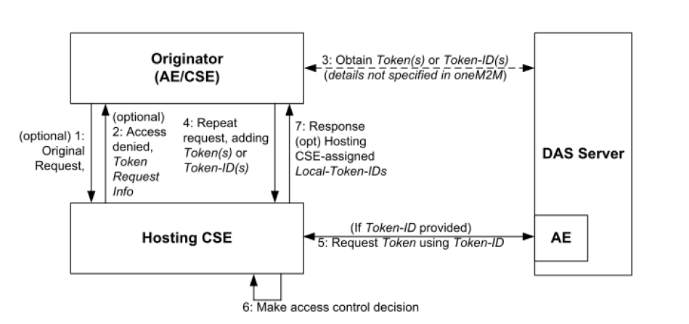
Mapping between
ODSI & oneM2M
Indirect Dynamic Authorization mapping:
- ODSI: the token contains a security policy which indicates whether a token should be verified to access a resorce or not.
It can also define local access control rules. An example for such a local rule is to forbid a firmware update if the battery level is too low.
- oneM2M: the security policy does not identify whether a token is requested to verify a resource or not.
oneM2M TS0003: Indirect dynamic authorization
Proposal is that the access control policy element (TS 0004) also checks whether a particular resource requires a token verification or not. For that, nestedToken field is introduced in oneM2M token

Slide 6
Agenda
1. European ODSI project presentation
2. Mapping between ODSI architecture and oneM2M architecture
3. Enhancement proposed in oneM2M security
4. Multi-tenant Use Case
5. Single-tenant Use Case

Slide 7
Enhancement
Proposed in oneM2M
To address the case where a user or CSE or another AE performs requests of a device resource authorized by a token, we propose to add an optional element, nestedToken to the oneM2M tokenClaimSet defined in TS 0004.
The first token proves that the tenant authorization server has authorized the action. The nested token proves that the owner authorization server has authorized the access to the device resource.
The nested token can either be a full token (serialized JWT or other relevant format) or a tokenID, which is used to request the token from the DAS server.

Slide 8
Enhancement
Proposed in oneM2M
The additional elements proposed to oneM2M token (tokenClaimSet)
Token Claimset Object Element Path | Token Claimset Object Element Short Name | oneM2M JWT claim name
version | tkvr | "tkvr"
tokenID | tkid | "jti"
issuer | tkis | "iss"
holder | tkhd | "azp"
notBefore | tknb | "nbf"
notAfter | tkna | "exp"
tokenName | tknm | "tknm"
audience | tkau | "aud"
permissions | tkps | "tkps"
extension | tkex | "tkex"
nestedToken | tkobj | “tkobj”

Slide 9
Agenda
1. European ODSI project presentation
2. Mapping between ODSI architecture and oneM2M architecture
3. Enhancement proposed in oneM2M security
4. Multi-tenant Use Case
5. Single-tenant Use Case

Slide 10
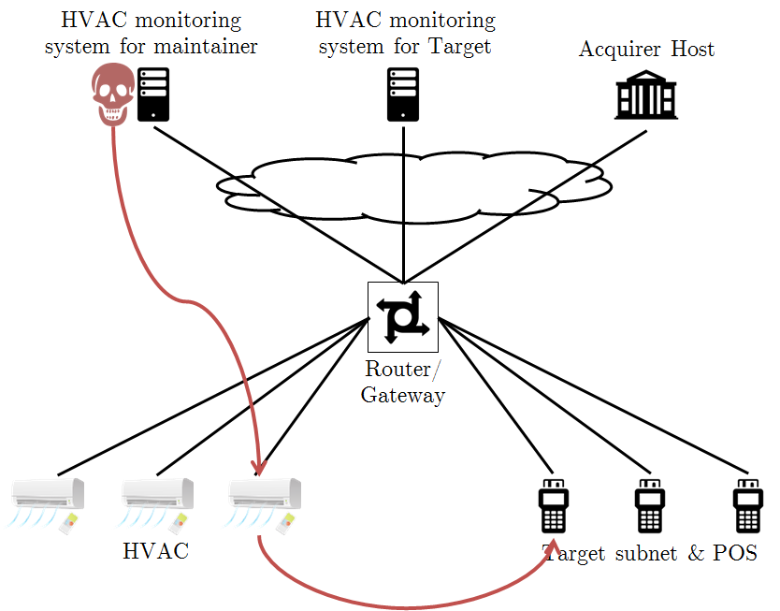
Multi-tenant object proposition
Several attacks show that some IoTs need to be connected to multiple networks.
Example Target attack using HVAC
ODSI proposes to use virtualization to create multi-tenant objects
AC Mgt Unit
HW
VM0 (privileged) –
Target device ressources access control
VM1 – maintainer
Temp Sensor
Maintener traffic
Eth2
Owner traffic
Eth1
Hypervisor

Slide 11
Air Conditioner multi-tenant Use Case
Air Conditioners are installed as part of Smart Office.
Maintenance of Air Conditioners is subcontracted to a maintainer (M) which manage the device resources remotely (humidity level, temperature, on/off, power consumption, firmware version,…).
Owner (O) is also able to manage the device remotely (humidity level, temperature,…)
Each actor is associated to a Domain or VM in the device. The hypervisor & owner privileged VM manage the “real” resources and expose “virtual resources” to tenants (M).
Each Domain is associated to a MN-CSE (MN-CSE_O, MN-CSE_M).
M has an algorithm for maintenance deployed on the HVAC. M therefore has access to device resources & domain resources (version, results of processing, alerts)
Owner, Maintainer each have their own DAS (DAS_O & DAS_M). MN-CSE_O validates tokens emitted by DAS_O and MN-CSE_M validates tokens emitted by DAS_M.

Slide 12
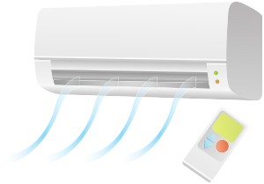
Air Conditioner multi-tenant Use Case
AC Management Hub (ASN)
HW
VM0 (privileged) –
Owner device ressources access control
VM1 – maintainer
Originator CSE/AE (maintenance company remote access tool)
Maintainer traffic
Eth2
AE_M
v_getTemperature() - dev
v_getBatteryStatus() - dev
v_updateFirmware() - dev
sendMaintAlert() -dom
AE_O
getTemperature() - u
getBatteryStatus() - u
updateFirmware() - s
Owner traffic
Owner traffic
Originator CSE/AE (owner company remote access tool)
Owner traffic
Eth1
Owner traffic
Owner traffic
CSE_O
CSE_M
AEs, Non-OneM2M AC devices
Hypervisor
Onem2M Gateway or other edge node

Slide 13
Device / domain, sensitive/unsensitive resources - Cases
- Case 1: if an administrator from O wants to modify temperature (device resource), he needs to collect a token from DAS_O
- Case 2: if an administrator from M wants to update some AI parameters (M domain ressource), he needs to collect a token from DAS_M
- Case 3: if an administrator from M wants to modify the temperature (unsensitive device resource) he needs to collect a token from DAS_M
- Case 4: if an administrator from M wants to modify the firmware (sensitive device resource), he needs to collect a token from DAS_M which will collect a token from DAS_O and include it as a nested token.
For each request from M related to a device resource :
- DAS_M needs to know whether a DAS_O token is needed or not. DAS_O can communicate this information through a security policy, documentation or a specific API.
- CSE_M sends to the hypervisor & CSE_O a request to read/modify t

Slide 14
Air Conditioner multi-tenant Use Case – Case 1
Originator_O (AE/CSE)
3
1
2
4
6
AC ASN
CSE_O
DAS_O Server
5
AE
Case 1: same as current Dynamic Authorization Schema
no need for nested token

Slide 15
Air Conditioner multi-tenant Use Case – Case 2
Originator_O (AE/CSE)
3
1
2
4
6
ASNce
CSE_M
DAS_M Server
5
AE
Case 2: same as current Dynamic Authorization Schema
no need for nested token

Slide 16
Air Conditioner multi-tenant Use Case – Case 3
Originator_M (AE/CSE)
3,9
1
2
4
8
ACASN Device
DAS_M Server
CSE_M
5
AE
6
7
CSE_O
DAS_O Server
AE
Case 3: same as current Dynamic Authorization Schema
no need for nested token

Slide 17
Air Conditioner multi-tenant Use Case – Case 4
Originator_M (AE/CSE)
5
12
7
1
4
8
ASNvice
DAS_M Server
CSE_M
5
AE
Nested token request
2
3
9
6
11
CSE_O
DAS_O Server
AE
10
Case 4: nested token needed

Slide 18
Air Conditioner multi-tenant Use Case
Originator CSE/AE (maintenance company remote access tool)
AC Management Hub (ASN)
Maintainer resources DAS
Owner resources DAS
CSE_M
CSE_O
1.0 Maintenance requests firmware update
1.1 CSE detects a request that requires M authorization & device ressource
1.2 CSE detects that Owner authorization is required
2.0 Request is rejected: Token & nestedToken is required (Indirect Authorisation schema)
2.1 nestedToken shall be requested to DAS responsible for M&O resources access
Here Token ID also can be requested
Here nestedToken ID also can be requested
3.0 Token & nestedToken request
3.1 nestesToken request
3.2 nestedToken is provided
3.3 Token is provided and nestedToken is nested in Token
4.0 requests firmware update (Token + nestedToken)
4.1 verify Token provided by DAS_M, extract nestedToken
4.2 request firmware update (nestedToken)
4.3 Owner verifies nestedToken provided by Owner DAS
4.4 Firmware updated

Slide 19
Agenda
1. European ODSI project presentation
2. Mapping between ODSI architecture and oneM2M architecture
3. Enhancement proposed in oneM2M security
4. Multi-tenant Use Case
5. Single-tenant Use Case

Slide 20
Single-tenant use case
The owner is the only entity which accesses the device
The device contains 3rd party code (untrusted code) that needs to be isolated from other code
Or the device is pre-provisioned and the VM contains code which will need to access to the personalized data.
AC Management Hub (ASN)
HW
VM0 (privileged) –
Owner device resources access control
VM1 – 3rd party code or non-personalized code
Temp Sensor
AE_3PC
getTemperature() - dev
getBatteryStatus() - dev
Originator CSE/AE (owner company remote access tool)
AE_O
getTemperature() - u
getBatteryStatus() - u
updateFirmware() - s
Owner traffic
Eth1
Hypervisor

Slide 21
Thank you

