Slide 1
oneM2M – Modbus Interworking
SDS-2019-0367
Group Name: SDS #41
Source: JaeSeung Song (KETI), JongGwan An(KETI), Hyeonseo Son (KETI), Sherzod (KETI)
Meeting Date: 2019-07-09

Slide 2
Outline
Scope
Modbus & oneM2M characteristics
  Topology & simplified examples
  How IPE works
oneM2M-Modbus Interworking overview
  Examples Scenario
  Interworking functions and procedures
  Flow for example scenario
Vision of Interworking

Slide 3










Scope
Enhancements for oneM2M system support interworking with Modbus device, such as supporting Master-slaver communication method
Modbus data model is mapped to oneM2M resources
Instantiating Modbus data model by usage of oneM2M base ontology
Interworking procedure by operating oneM2M resource and reusing Gerneric Interworking
Custom IoT Application
CoAP
HTTP
Interworking

Slide 4

Modbus Topology
M: Modbus Master (Client), Only one in a network, Readable, Writable
S: Modbus Slave (Server), Passively respond to master request
Modbus-S
Modbus-M
Modbus-S
S
M
S
RS-485 Bus (RTU)
Modbus-S
Modbus-S
S
S
< Industrial Communication Protocol >

Slide 5

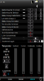

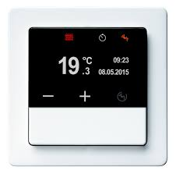

Modbus Example
Update Lock Status to “Open”
UPDATE
Modbus-M
Unlock
M
Modbus-S
Modbus-S
S
S
RS-485 Bus (RTU)
Modbus-S
Modbus-S
S
S

Slide 6
oneM2M Topology
AE: Application Entity
CSE: Common Services Entity
AE
AE
AE
Infrastructure Node
CSE
Middle Node
Middle Node
CSE
CSE
Middle Node
Application
Dedicated
Node
CSE
AE
AE
Application
Dedicated
Node
Application
Service
Node
AE
AE
Application
Dedicated
Node
CSE
AE
CSE

Slide 7



oneM2M Example
AE
AE
AE
Update Lock Status to “Open”
UPDATE
Infrastructure Node
CSE
Middle Node
Middle Node
CSE
CSE
Middle Node
Application
Dedicated
Node
CSE
AE
AE
Unlock
Application
Dedicated
Node
Actuator
Sensors
Keypad
AE
AE
Application
Dedicated
Node
CSE
CSE
AE
NOTIFY
Door Lock

Slide 8
How IPE works
Resources in CSE are fully abstracted from underlying technology e.g. Modbus
TS-0023 was used as a reference to build resource tree from SDT objects
To convert oneM2M resources to Modbus objects IPE stores mapping tables for Devices and Data Points of Modules
Data points are mapped according to their data type and read&write properties to 4 Modbus object types
Primary tables | Object type | Type of access | Comments
Discretes Input | Single bit | Read-Only | This type of data can be provided by an I/O system, e.g. read the status of switch
Coils | Single bit | Read-Write | This type of data can be alterable by an application program, e.g. switch on a transducer
Input Registers | 16-bit word | Read-Only | This type of data can be provided by an I/O system, e.g. read temperature on a sensor
Holding Registers | 16-bit word | Read-Write | This type of data can be alterable by an application, e.g. set value to a controller.
oneM2M data type | Mapping to data type in OMA DWAPI | Description
xs:integer | int, number, string | Data type for 32-bit signed integer. For indicating 3D printerState, the integer value should be interpreted into string by referring the tables in clause 7.2.2.1.
xs:string | string, array | Data type for text. The length limitation should be considered for the mapping.
xs:float | float | Data type for a single precision 32-bit floating point type as defined in XML Schema 1.0 [13] as the float primitive type.
xs:boolean | boolean | Data type for Boolean.
< Modbus >
< oneM2M >

Slide 9
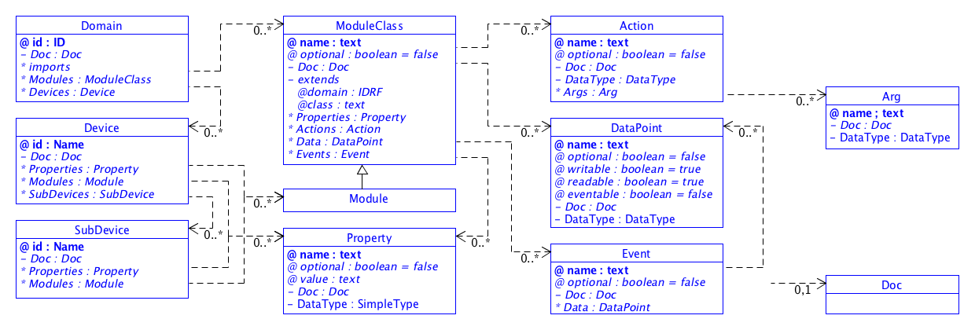
Smart Device Template (SDT)
The Smart Device Template (SDT) is a template which is used to model the capabilities, actions and events of connected devices.
SDT can be applied to build oneM2M resource tree structure for connected devices
SDT has one-to-one mapping between its data points and Modbus Objects types

Slide 10
Mapping between SDT Data points types and Modbus object types
oneM2M Data type | Readable | Writable
xs:Boolean (1 byte) | True | True
xs:Boolean (1 byte) | True | False
xs:integer (4 bytes) | True | True
xs:integer (4 bytes) | True | False
xs:float (4 bytes) | True | True
xs:float (4 bytes) | True | False
xs:double (8 bytes) | True | True
xs:double (8 bytes) | True | False
xs:string | True | True
xs:string | True | False
Modbus object type | Number of required registers
Coil (Single bit), Read-Write | 1 (8bit)
Discrete Input (Single bit), Read-Only | 1 (8bit)
Holding Register (16-bit word), Read-Write | 2 (32bit)
Input Register (16-bit word), Read-Only | 2 (32bit)
Holding Register (16-bit word), Read-Write | 2 (32bit)
Input Register (16-bit word), Read-Only | 2 (32bit)
Holding Register (16-bit word), Read-Write | 4 (64bit)
Input Register (16-bit word), Read-Only | 4 (64bit)
Holding Register (16-bit word), Read-Write | varying
Input Register (16-bit word), Read-Only | varying
Mapping
Notes:
데이터 크기 표현

Slide 11


Use case for Modbus IPE
A use case where a group of solar panels working over Modbus are remotely managed by client application will be described.
The use case configuration has two solar panels working on Modbus protocol which are connected to a local Modbus gateway (IPE) with an embedded application to communicate with oneM2M cloud server.
Smart Solar Power Management system
ADN
AE
IPE
Device Solar Panel A
Mca
IN
Modbus RTU
AE
Modbus
Master
CSE
Device Solar Panel B

Slide 12
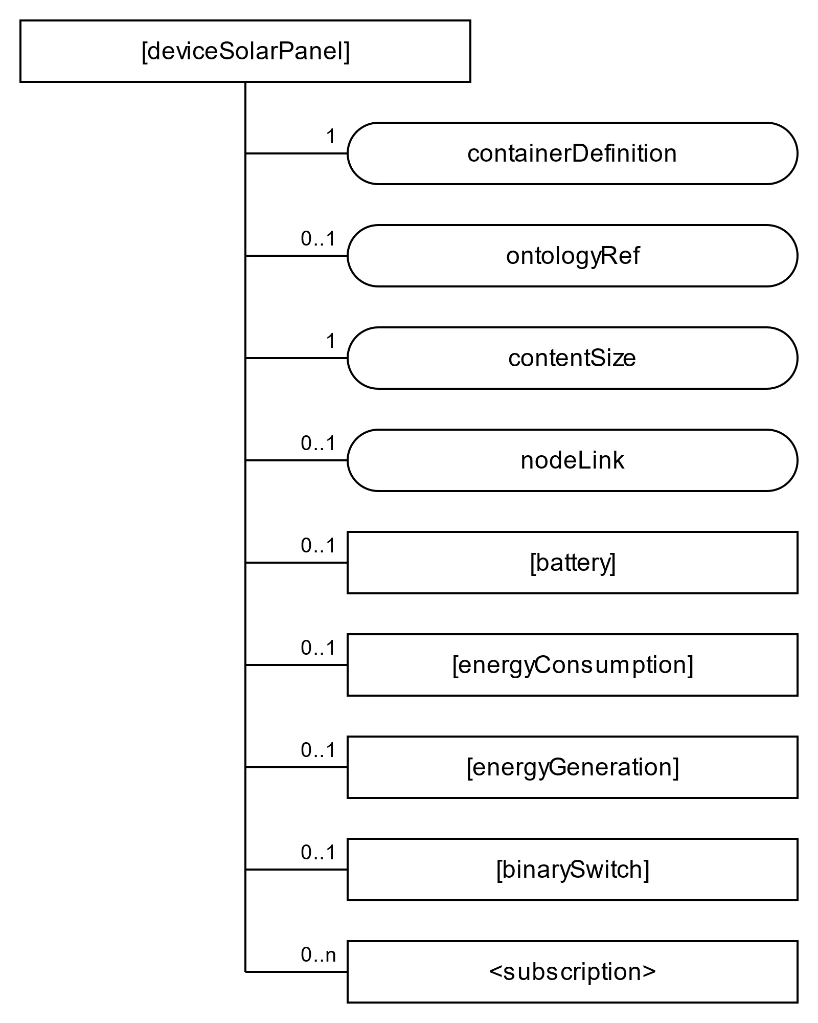
Smart Device Template (SDT) Devices
SDT “Device”
<flexContainer>
IPE_AE
SDT “Module Class”
<flexContainer>
0..1
[deviceSolarPanelA]
0..1
[deviceSolarPanelB]
0..n
[mod_battery]
<subscriptions>
[mod_energyConsumption]
Lookup table for device mapping to Modbus Slave ID
[mod_energyGen]
one M2M SDT Device name | Modbus Slave ID
deviceSolarPanelA | 01
deviceSolarPanelB | 02
[mod_binarySwitch]

Slide 13
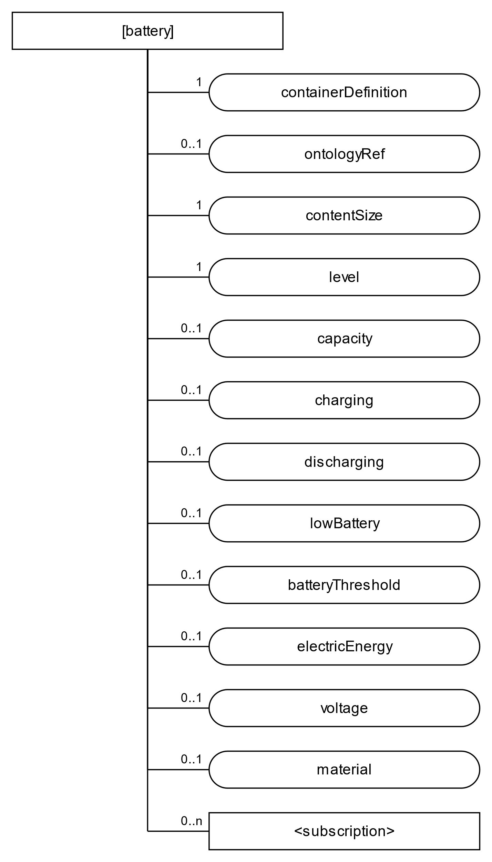
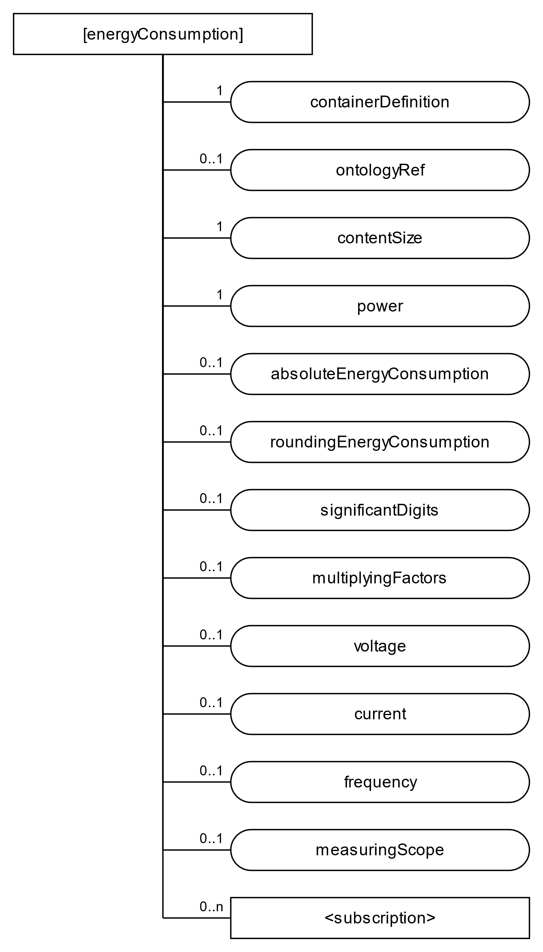
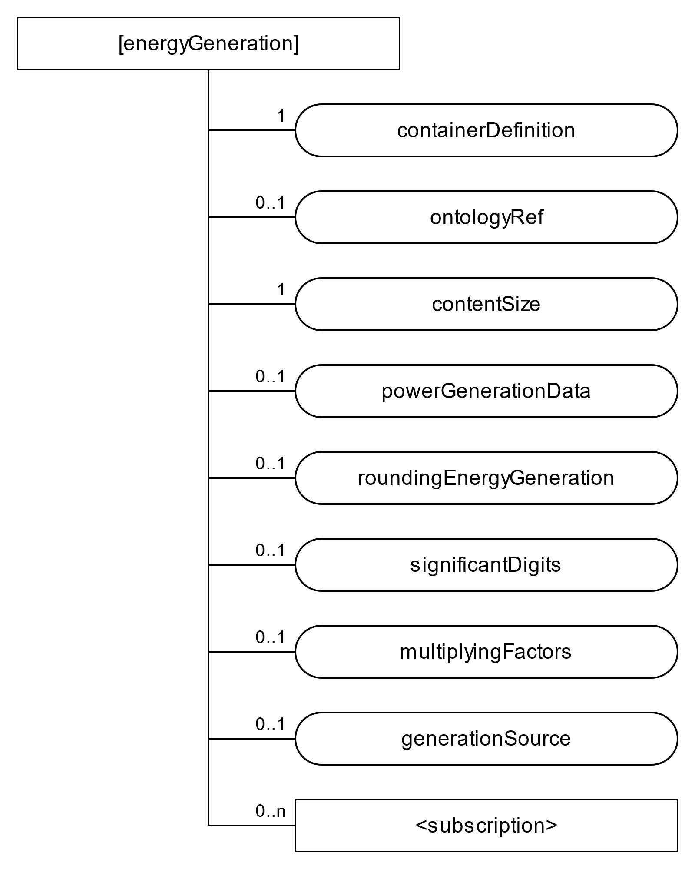
Smart Data Template (SDT) Modules
address
functionCode
slaveID
address
address
numberRegisters
functionCode
functionCode
< TS-0023 defined models for Home appliances information model & mapping >
slaveID
slaveID
numberRegisters
numberRegisters

Slide 14
Lookup table for “Battery Module” mapping to Modbus Object types
Mapping
Battery Resource name | Type | Readable | Writable
level | xs:integer | true | false
capacity | xs:integer | true | false
charging | xs:boolean | true | false
discharging | xs:boolean | true | false
lowBattery | xs:boolean | true | false
batteryThreshold | xs:integer | true | true
electricEnergy | xs:integer | true | false
voltage | xs:integer | true | false
material | xs:string | true | false
Modbus object type | Number of required registers | Address
Input Register (16-bit word), Read-Only | 2 (32bit) | 0x0001-0x0002
Input Register (16-bit word), Read-Only | 2 (32bit) | 0x0003-0x0004
Coil (Single bit), Read-Write | 1 (8 bit) | 0x0001
Coil (Single bit), Read-Write | 1 (8 bit) | 0x0002
Coil (Single bit) , Read-Write | 1 (8 bit) | 0x0003
Holding Register (16-bit word), Read-Write | 2 (32bit) | 0x0001-0x0002
Input Register (16-bit word) , Read-Only | 2 (32bit) | 0x0005-0x0006
Input Register (16-bit word) , Read-Only | 2 (32bit) | 0x0007-0x0008
Input Register (16-bit word) , Read-Only | 8 (128bit) | 0x0009-0x0018

Slide 15
Lookup table for “energyConsumption Module” mapping to Modbus Object types
Mapping
energyConsumption Resource name | Type | Readable | Writable
power | xs:float | true | false
absoluteEnergy Consumption | xs:float | true | false
roundingEnergy Consumption | xs: integer | true | false
significantDigits | xs:integer | true | false
multiplyingFactors | xs:float | true | false
voltage | xs:float | true | false
current | xs:float | true | false
frequency | xs:float | true | false
measuringScope | xs:string | true | true
Modbus object type | Number of required registers | Address
Input Register (16-bit word), Read-Only | 2 (32bit) | 0x0019-0x001A
Input Register (16-bit word), Read-Only | 2 (32bit) | 0x001B-0x001C
Input Register (16-bit word), Read-Only | 2 (32bit) | 0x001D-0x001E
Input Register (16-bit word), Read-Only | 2 (32bit) | 0x001F-0x0020
Input Register (16-bit word), Read-Only | 2 (32bit) | 0x0021-0x0022
Input Register (16-bit word), Read-Only | 2 (32bit) | 0x0023-0x0024
Input Register (16-bit word), Read-Only | 2 (32bit) | 0x0025-0x0026
Input Register (16-bit word), Read-Only | 2 (32bit) | 0x0027-0x0028
Holding Register (16-bit word), , Read-Write | 8 (128bit) | 0x0002-0x0011

Slide 16
Lookup table for “energyGeneration Module” mapping to Modbus Object types
Mapping
energyGeneration Resource name | Type | Readable | Writable
powerGenerationData | xs:float | true | false
roundingEnergy Generation | xs:integer | true | false
significantDigits | xs:integer | true | false
multiplyingFactors | xs:float | true | false
generationSource | xs:string | true | false
Modbus object type | Number of required registers | Address
Input Register (16-bit word), Read-Only | 2 (32bit) | 0x0029-0x002A
Input Register (16-bit word), Read-Only | 2 (32bit) | 0x002B-0x002C
Input Register (16-bit word), Read-Only | 2 (32bit) | 0x002D-0x002E
Input Register (16-bit word), Read-Only | 2 (32bit) | 0x002F-0x0030
Input Register (16-bit word), Read-Only | 7 (112bit) | 0x0031-0x0040

Slide 17
Monitoring: Constructing Modbus message(Read)
one M2M SDT Device name | Slave ID
deviceSolarPanelA | 01
deviceSolarPanelB | 02
Memory | Function Code | Action
Coil | 01 | Read
 | 05 | Write(Single)
 | 15 | Write(Multiple)
Discrete Inputs | 02 | Read
Holding Registers | 03 | Read
 | 06 | Write(Single)
 | 16 | Write(Multiple)
Input Register | 04 | Read
oneM2M Resource name | Modbus object type | Number of required registers | Address
level | Input Register (16-bit word), Read-Only | 2 (32bit) | 0x0001-0x0002
batteryThreshold | Holding Register (16-bit word), Read-Write | 2 (32bit) | 0x0001-0x0002
. . .
Slave ID | Function Code | Number of registers | Address | CRC (checksum)
01 | 04 | 0002 | 0001 | 200B
Read

Slide 18
Monitoring: Constructing Modbus message(Write)
one M2M SDT Device name | Slave ID
deviceSolarPanelA | 01
deviceSolarPanelB | 02
Memory | Function Code | Action
Coil | 01 | Read
 | 05 | Write(Single)
 | 15 | Write(Multiple)
Discrete Inputs | 02 | Read
Holding Registers | 03 | Read
 | 06 | Write(Single)
 | 16 | Write(Multiple)
Input Register | 04 | Read
oneM2M Resource name | Modbus object type | Number of required registers | Address
level | Input Register (16-bit word), Read-Only | 2 (32bit) | 0x0001-0x0002
batteryThreshold | Holding Register (16-bit word), Read-Write | 2 (32bit) | 0x0001-0x0002
. . .
Slave ID | Function Code | Number of registers | Address | Data | CRC (checksum)
01 | 05 | 0002 | 0001 | 40%(0x0028) | 200B
Write

Slide 19
Monitoring
Use case: In Solar Panel A when battery level decreases below threshold, a user should get a notification

Slide 20
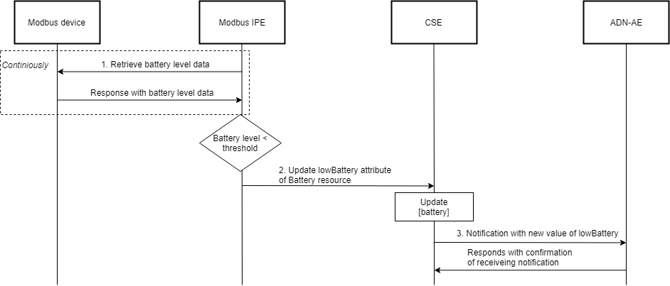
Monitoring

Slide 21
Monitoring
IPE continuously monitors Modbus device. Modbus message is constructed as following:
  Find slave ID for deviceSolarPanelA from device lookup table.
    Slave ID = 01
  Find Modbus object type and address from Battery module lookup table. Map Modbus object type (input register) & Action (read) to Modbus function code
    Function code = 04
    Address = 0001
    Number of registers to read = 2

Slide 22
Monitoring
When battery level below threshold IPE-AE sends a request to hosting CSE by updating [battery] resource and setting lowBattery attribute to 1
CSE updates [battery] resource and publishes a notification

Slide 23
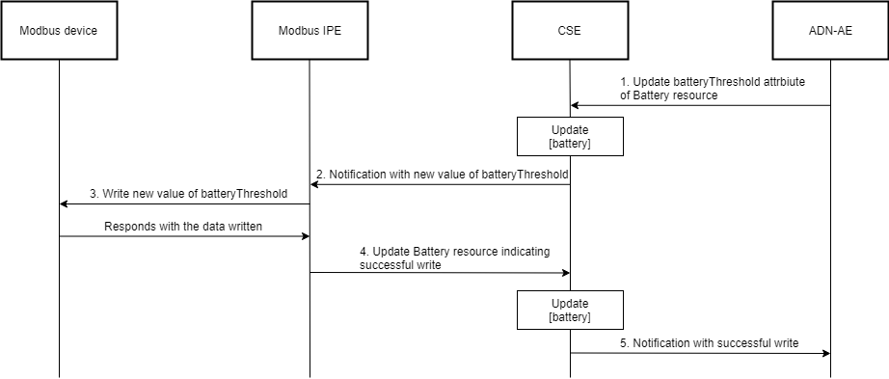
Updating data in Modbus device
Use case: User wants to change the low battery threshold value in Solar panel A

Slide 24
Updating data in Modbus device
ADN-AE sends a request to hosting CSE by updating [battery] resource and setting batteryThreshold attribute to a new value
CSE updates [battery] resource and publishes a notification
ADN-AE receives the notification and sends a Modbus message by constructing it as follows:
  From notification message extract device name (deviceSolarPanelA), module name (battery), value
  Find slave ID for deviceSolarPanelA from device lookup table.
    Slave ID = 01
  Find Modbus object type and address for batteryThreshold from Battery module lookup table. Map Modbus object type (holding register) & Action (write) to Modbus function code
    Function code = 10
    Address = 0001

Slide 25
Updating data in Modbus device
When new value of batteryThreshold is written IPE-AE sends a request to hosting CSE by updating [battery] resource with empty <flexContainer> that indicates successful update
Hosting CSE updates [battery] resource and publishes a notification about successful update

Slide 26
Status
oneM2M TS-0033 specifies general interworking concept
oneM2M TS-0023 defined models for Home appliances information model & mapping

Slide 27


Vision of Interworking
Open Standards
⬄ “Interworking Glue”

Slide 28
Thank You!

