Slide 1
Discussion on Next Steps for WI-0088 M2M/IoT Application and Component Configuration
Group Name: SDS
Source: mailto: Leila Le Brun (Orange)
Meeting Date: 2019-07-11
Agenda Item: TS-0003 and TS-0004 related

Slide 2
Agenda
1. Current Status of WI-0088
2. Next Steps of WI-0088

Slide 3
Current Status of WI-0088
Overview
• WI-0088 work item provides a framework to configure oneM2M nodes in the Field Domain by the oneM2M SP. The configuration may include:
- Creation of new management objects
- Configure the credential data that is required for accessing the resource. [e.g. reconfigurable to grant/revoke authorization]
- Establish necessary data required to perform these operations (e.g. App-ID, AE-ID, CSE-ID)
• Improvements and enhancements of configuration and security mechanism:
- TS-0022-Field_Device_Configuration-V4_0_1
- Latest change is on 2018-Oct-10 to add WiFiClient_management_object

Slide 4
Current Status of WI-0088
Orange Use Case
Scan the ecosystem controlled by the GW to retrieve metadata
All valid devices answers to the request from GW
Inform the Coordinator server on current situation
Coordinator contacts the concerned manufacturers
Manufacturer sends up to date information and OS
Coordinator retrieves the OS and sends it to all concerned GWs
GW launch installation to dedicated devices. GW could perform integrity on behalf the device (e.g. for Lightweight device)
Device A1
7
2
1
Device B1
1
Manufacturer A
2
4
Gateway
3
Updates’
Coordinator
5
FW update ModelA1
7
4
Manufacturer B
1
Object management inventory
5
Device C1
6
FW update ModelB1
2
4
5
Manufacturer C
1
7
FW update ModelC1
FW update ModelC2
Device C2
2

Slide 5
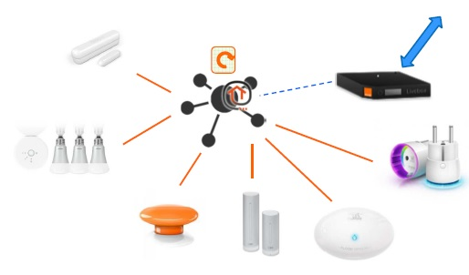
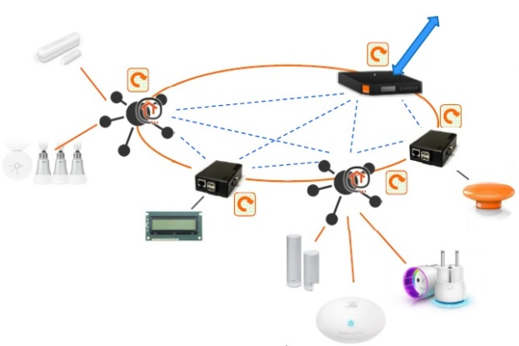
Current Status of WI-0088 Work performed by Orange 1/2
Technical Anticipation Project to :
Improve and enlarge the discovery of connected devices to collect the Firmware release
Store the firmware release on a centralize database
Provide APIs
to allow external suppliers to access all own devices
to allow external suppliers to add the last and up-to-date release version for all own devices
Centralized probe Decentralized probe

Slide 6
Current Status of WI-0088 Work performed by Orange 2/2
Technical Anticipation Project architecture
The probes
Probe
Big Data
API
1
Devices Probe Data FIles
2
The suppliers
Supplier PF
APIs exposed for Suppliers
Devices FW
4
Supplier Devices FW API
API
3
Devices FW Upgrades DataBase
Notes:
Patch the Digital Home is an Technical Anticipation Project
The main goals of the project are :
Improve and enlarge the discovery of connected devices to collect the Firmware release
Store the firmware release on a centralize database
Provide APIs
to allow external suppliers to access all own devices
to allow external suppliers to add the last and up-to-date release version for all own devices

Slide 7
Agenda
1. Current Status of WI-0088
2. Next Steps of WI-0088

Slide 8
Next Steps of WI-0088
Identify architecture impact for Firmware update mechanism used for Proof of Concept in Orange
Identify potential updates of oneM2M specifications

Slide 9
Thank you

