Slide 1
Device Connection Efficiency Plan How oneM2M implements GSMA TS.34
Group Name: SDS-2019-0552-TR0024_UE_Device_connection_efficiency
Source: Convida, Bob Flynn; Bob.Flynn@convidawirelesss.com
Meeting Date: 23 Sep 2019

Slide 2
Outline
What is TS 34? Why is it important?
What is done so far
Next steps

Slide 3
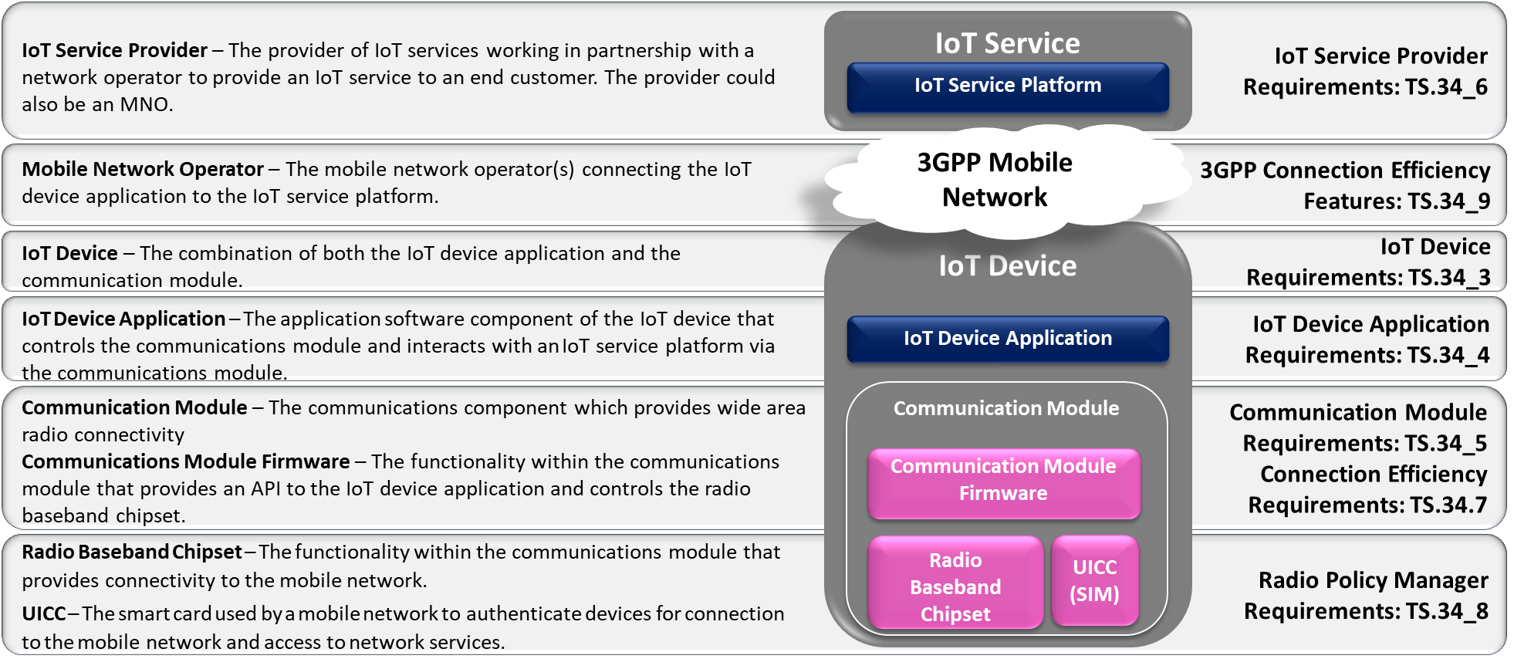
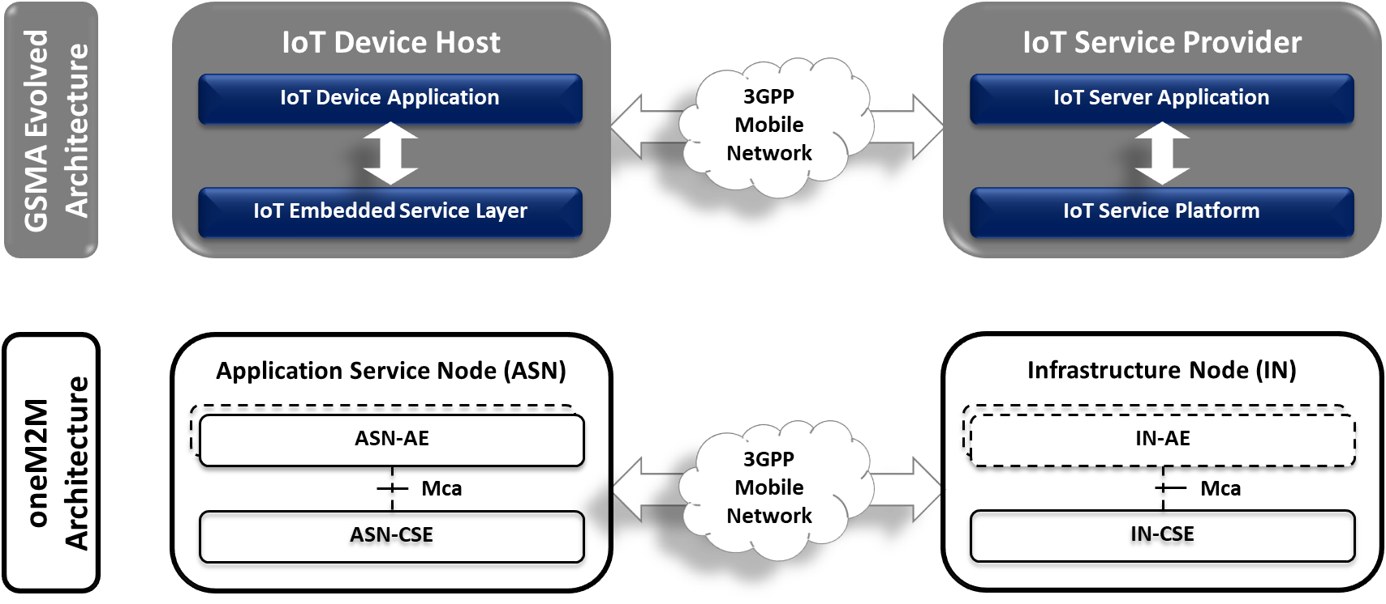
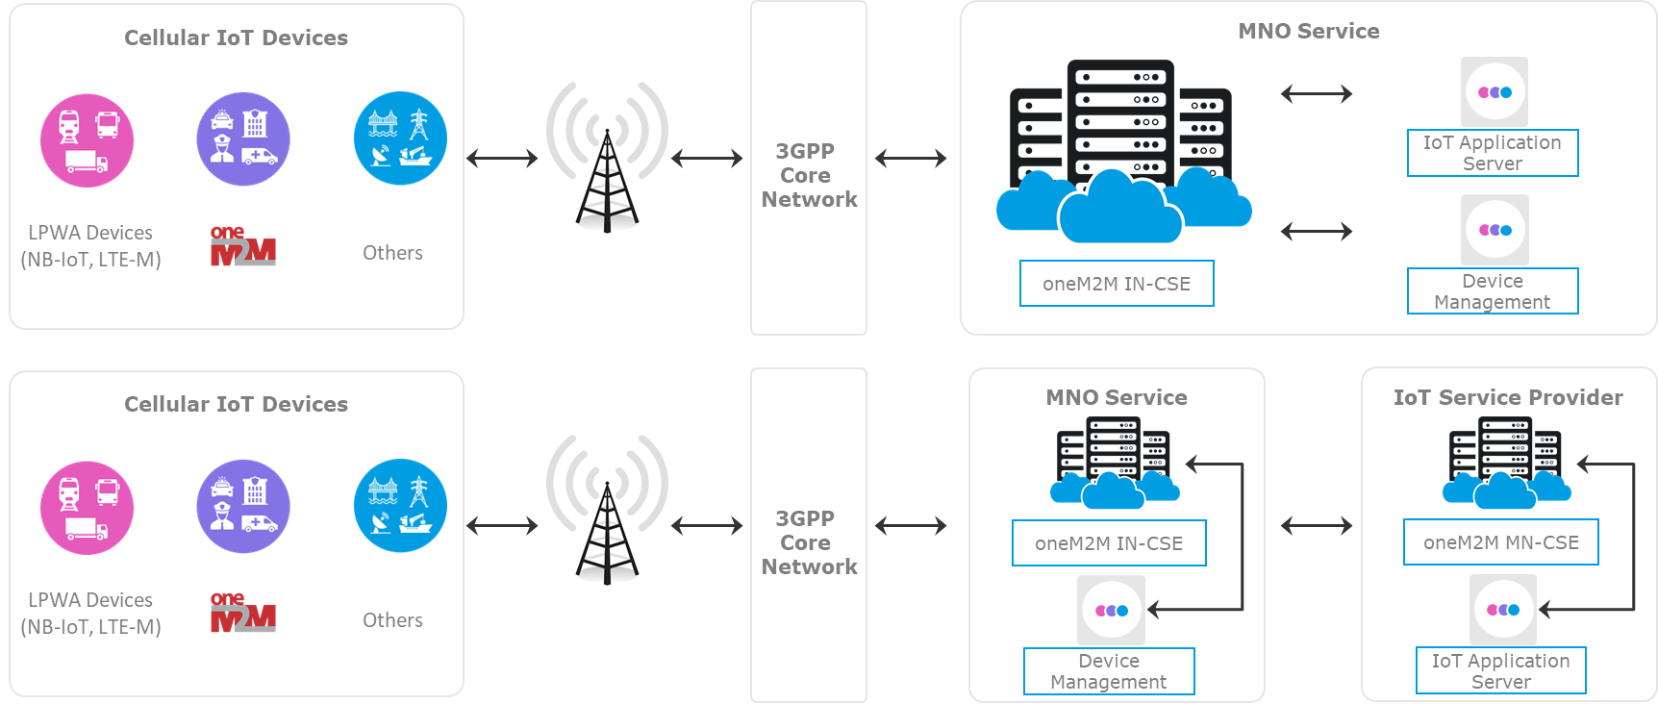
What is TS 34
Core oneM2M
CMDH
Device Management
Deployment requirements

Slide 4
Work done so far
Contributions to TR-0024 offering an analysis of requirements for discussion
Tracking spreadsheet to capture progress
SDS-2019-0xxx-TS34_solutions_tracking_spreadsheet

Slide 5
Next Steps
Review discussions
Generate solutions and record in appropriate specifications
TS-0026 3GPP Interworking
TS-0031 Feature Catalog
TS-0025 Profiles
TS-0018 Test Purposes

