Slide 1
System implementation on Edge X with oneM2M
oneM2M SDS#43
SeungMyeong Jeong
KETI

Slide 2
Harmony of Edge and Cloud
EdgeX provides Edge G/W, while oneM2M provides Cloud
EdgeX is open source implementation based on MSA
Microservices talks each other using REST
EdgeX – device services (layer) supports heterogeneous protocols/devices
Collected data can be used in the edge (e.g. analysis by supporting services
Also can be exported to the cloud
CSE

Slide 3
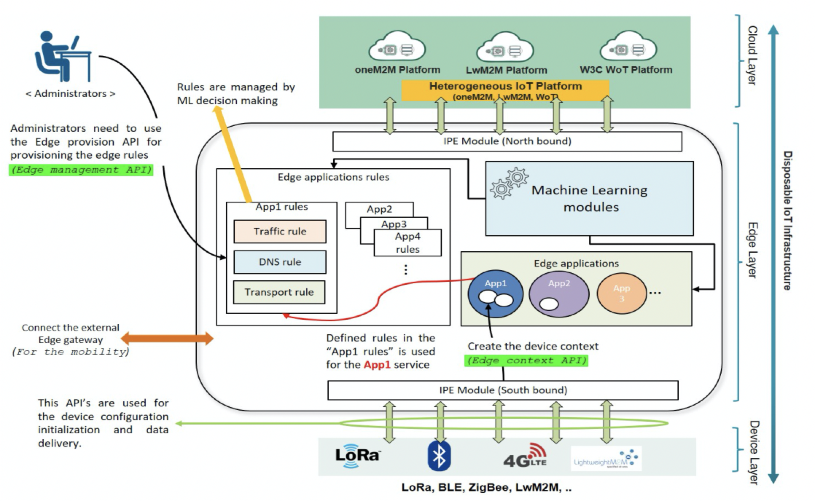
Edge gateway architecture
G/W architecture based on EdgeX
IPEs on northbound and southbound
Edge applications rules (e.g. Drools rule engine)
Machine learning modules

Slide 4
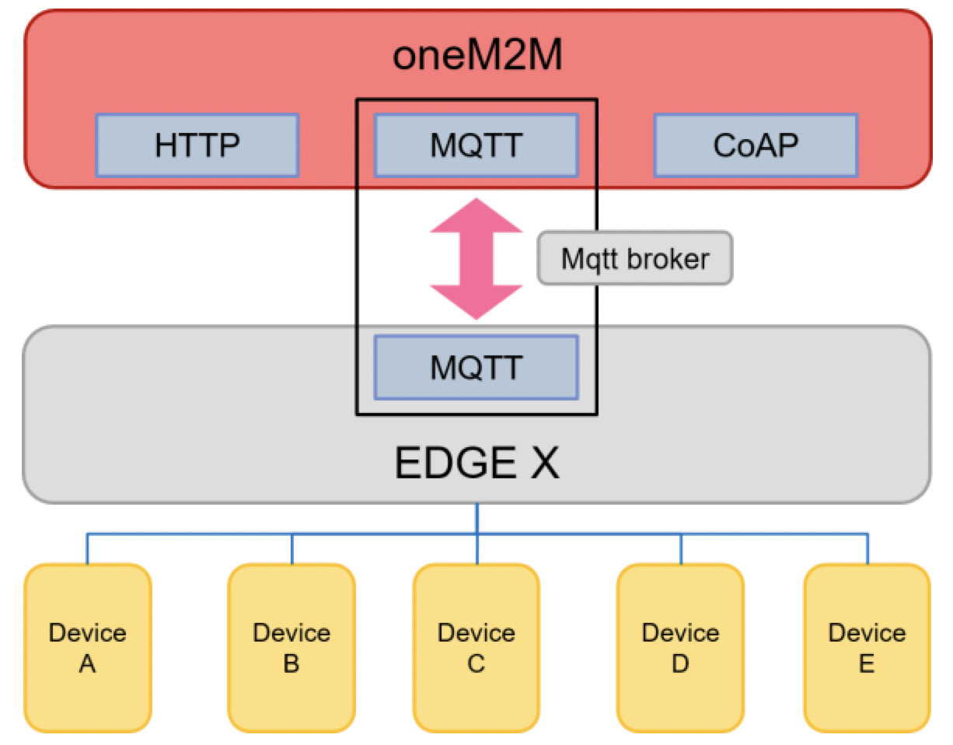
Implementations (1/2)
Edge G/W based on Edge X is served as AE
manages devices and collect/process data
communicates with CSE with the export services
uses MQTT binding as MQTT can be used as well for communications for Edge X micro services

Slide 5
Implementations (2/2)
Device management done by Edge G/W (possibly with ML) is exposed to oneM2M cloud
Devices list and/or hierarchy gets instantiated as oneM2M resources
Edge G/W maintains local DB and synchronize this to the oneM2M platform
Data measurements also gets populated in oneM2M platform

Slide 6
PoC Service
Wildfire alerting service
Disposable IoT sensors deployed in wide area
Sensors get registered to the Edge G/W
Edge G/W manages sensor registration as well as sensor readings
Collected data is processed (e.g. statistics, inference) and posted to the oneM2M platform with raw data
Task orchestration can also be performed via Edge G/W

