Slide 1
Synchronized Links between Node, AE, CSEBase, and flexContainer
Andreas Kraft, Deutsche Telekom, Andreas.Kraft@t-systems.com
Cyrille Bareau, Orange, cyrille.bareau@orange.com
Bob Flynn, Chordant, Bob.Flynn@chordant.io
Andreas Neubacher, Deutsche Telekom, Andreas.Neubacher@magenta.at

Slide 2
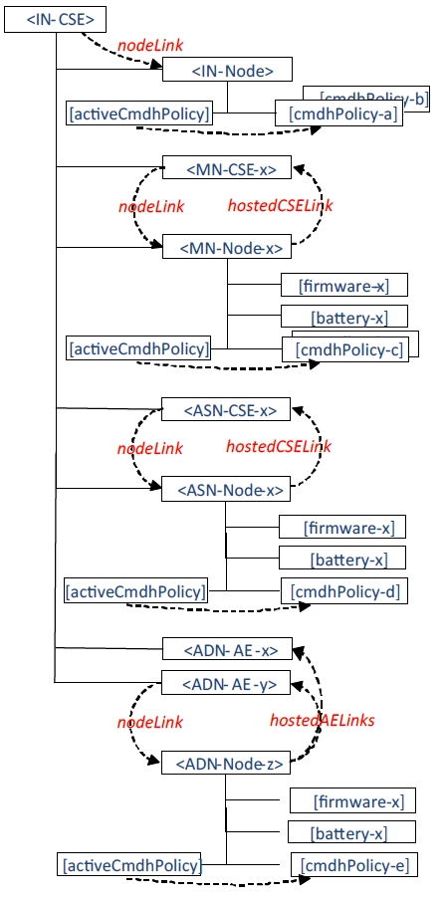
Problem Description
The synchronization of link relationships between <node> and hosted <AE>, <remoteCSE> and <flexContainer> resources is not clearly defined.
Both directions (nodeLink vs hostedAELink etc) are RW. This could lead to synchronization problems between linked resources and wrong implementations.
nodeLink in <CSEBase> is RO, though.
hostedCSELink | 0..1 | RW
hostedAELinks | 0..1(L) | RW
hostedServiceLinks | 0..1(L) | RW
nodeLink | 0..1 | RW
<remoteCSE>
<node>
nodeLink | 0..1 | RW
nodeLink | 0..1 | RW
<flexContainer>
<AE>
nodeLink | 0..1 | RO
Source: TS-0001-V4.1.0
<CSEBase>

Slide 3
Proposal
Make the link attributes of one side of the relation RO and let the CSE calculate/set those attributes:
Either make hostedXYZLinks RO, and the nodeLink attributes of the resources RW, and let the CSE set the respective hostedXYZLink attributes, or
Make the nodeLink attributes of the resource RO, and the hostedXYZLink attributes RW, and let the CSE set the respective nodeLink attributes.
Opinion
Proposal 1) is preferred. One reason is that, for example, the managing entity of an <AE> resource doesn‘t need write access to the resp <node> resource.

Slide 4
Thank you

