Slide 1
Advanced Semantic Discovery Description on the Suggested Solution
SeungMyeong JEONG (KETI)
On behalf of ETSI STF 589 Task 4
2021-06-17

Slide 2
Where to use ASD?
Distributed CSEs have their local semantic data (i.e. <semanticDescriptor> resources)
Ontologies are different for <semanticDescriptor> resources since it’s up to services/AEs' choices
Originator of ASD has no idea which CSE contains the interested semantic information
The Originator, hence, sends an ASD a CSE who can handle ASDs
The CSE selects the other CSEs as the target so they execute queries
ASD handling CSEs have Semantic Routing Tables (SRT)
The CSE fan-outs the ASD to the selected CSEs and send back the aggregated responses to the Originator
from the SDS-2021-0080-ETSI_STF_589_Task_4_progress

Slide 3
ASD at a Glance
SRT updates by sharing semantic resource summary updates among CSEs
AE requests ASD to a CSE
The CSE selects other CSEs to execute the query in the ASD by its SRT
Original query can be fragmented
The CSE fans-out the ASD to the CSEs
The CSE aggregates the results and sends back the aggregation to the Originator
SRT of CSE1
 | RDF Resource Summary
CSE2
CSE3
CSE2
/base/asd
3. ASD fan-out
CSE1
2. Original ASD request to CSE1
/base/asd
/base/srt
/base/asd
CSE3
AE1
1. update semantic data summary of CSE3 on CSE1’s SRT

Slide 4
Questions for ASD
Semantic Routing Table maintenance
which semantic data gets propagated into which SRTs?
how does the routing table looks like?
how to populate routing tables?
ASD handling
which type of queries are supported in ASDs?
what is the resource target resource (i.e. To param) for ASD request?
which type of results are returned?
what is the (topology) scope of ASD?
from the SDS-2021-0080-ETSI_STF_589_Task_4_progress

Slide 5
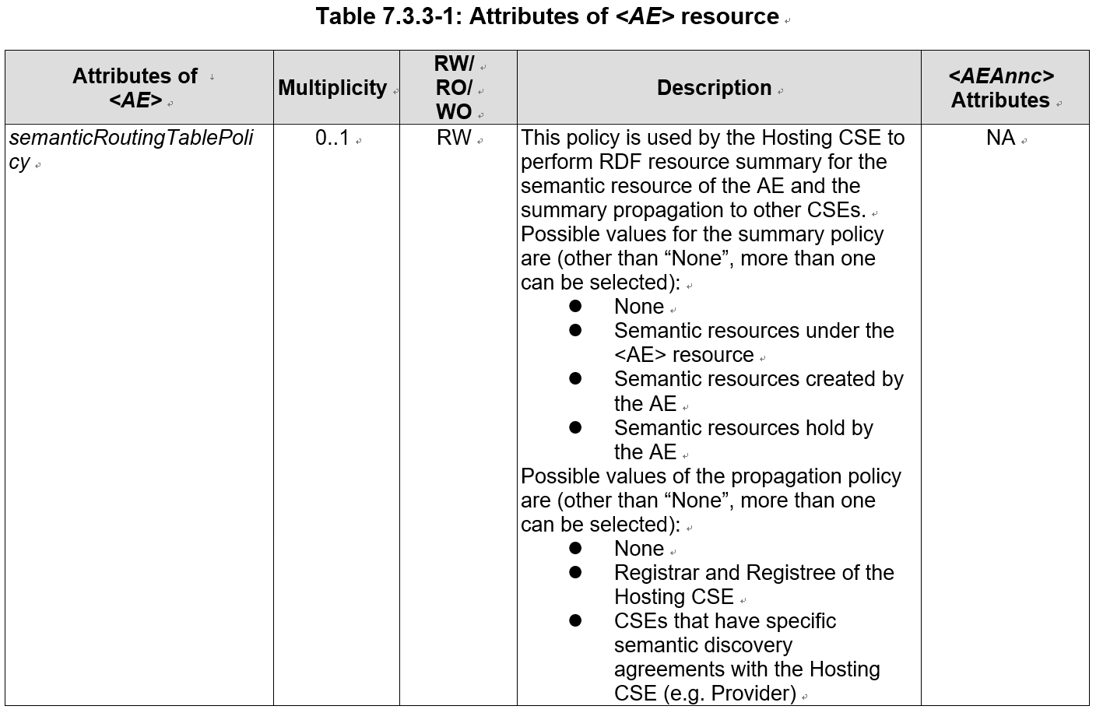
Answers to the Questions
Which semantic data gets propagated into which SRTs?
AE can select which semantic resources can be summarized, so they can be propagated to other CSEs’ SRTs
source: ETSI TR 103 717 (draft)

Slide 6
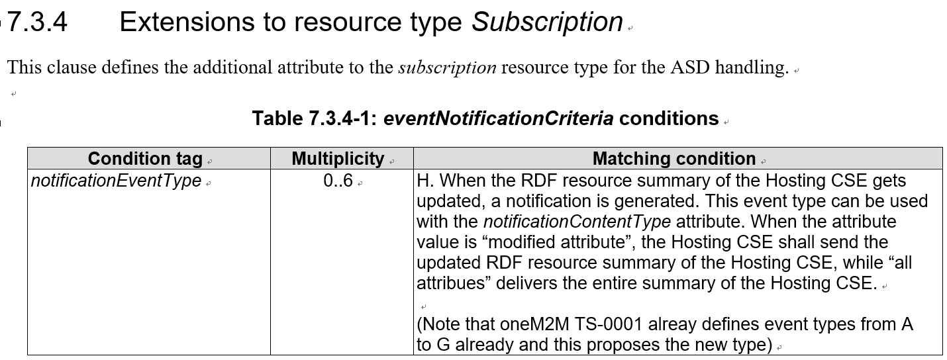
Answers to the Questions
How to populate routing tables?
CSE summarizes local semantic resources per AE’s policy (i.e. semanticRoutingTablePolicy) or AE provides summaries by <SRT> update request
CSE1 can provides its local summary to CSE2 by <SRT> update request
CSE2 can subscribe to CSE1’s <SRT> by creating a <subscription> resource
This is new to oneM2M, having a child for a virtual resource
SRT of CSE2
 | RDF Resource Summary
CSE2
CSE3
CSE1 | (updated)
semantic data summary
(notify)
CSE1
CSE2
SRT of CSE1
base/srt
semantic data summary
(update)
 | RDF Resource Summary
CSE1
CSE2 | (updated)
CSE3
source: ETSI TR 103 717 (draft)

Slide 7
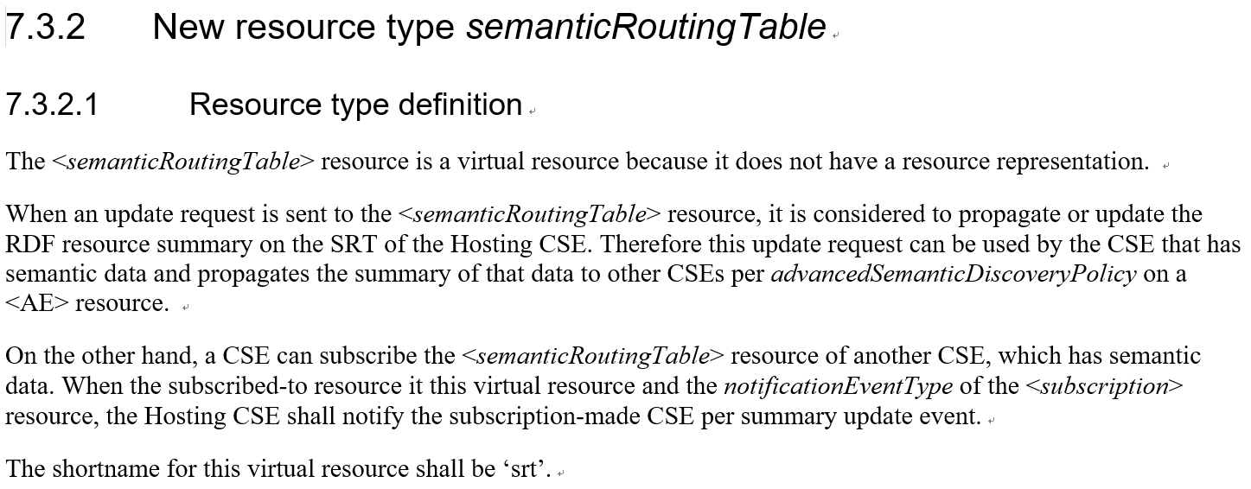
Answers to the Questions
How does the routing table looks like?
SRT is represented as the <semanticRoutingTable> virtual resource
For SRT updates and event notifications, define the data structure
CSE1 providing a set of semantic summary, by <SRT> update request, means routing record updates for CSE1 on the CSE2’s SRT
virtual resource simplifies the interface design
source: ETSI TR 103 717 (draft)

Slide 8
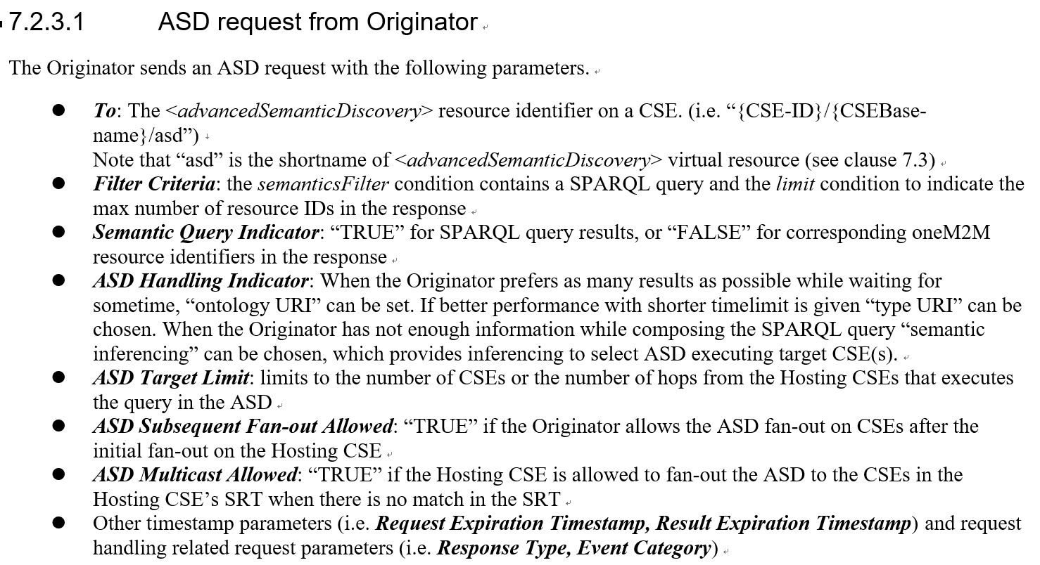
Answers to the Questions
Which type of queries are supported in ASDs?
Which type of results are returned?
SPARQL query is used so we still use the semanticsFilter condition of the Filter Criteria parameter and Semantic Query Indicator to get results as parent resource identifiers of the matching <semanticDescriptor> resources or SPARQL results
What is the (topology) scope of ASD?
Any CSEs listed in the SRT
Scope can be limited
ASD Target Limit, ASD Subsequent Fan-out Allowed, ASD Multicast Allowed parameter
source: ETSI TR 103 717 (draft)

Slide 9
Answers to the Questions
What is the target resource (i.e. To param) for ASD request?
<CSEBase> resource has the virtual <advancedSemanticDiscovery> resource
ASD targets unknown CSEs and their unkown semantic resources
target CSEs are dynamically selected by <ASD> Hosting CSE and the target resources are all semantic resources of the selected CSEs
c.f. existing semantic discovery or query targets any resource or <semanticFanOutPoint> of <group> resource
a resource of the Hosting CSE ➔ descendant semantic resources are the target
<semanticFanOutPoint> resource ➔ member semantic resources of the group
source: ETSI TR 103 717 (draft)

Slide 10
Answers to the Questions
Which semantic data gets propagated into which SRTs?
AE can select which semantic resources can be summarized, so they can be propagated to other CSEs’ SRTs
source: ETSI TR 103 717 (draft)

Slide 11
Answers to the Questions
Which semantic data gets propagated into which SRTs?
AE can select which semantic resources can be summarized, so they can be propagated to other CSEs’ SRTs
source: ETSI TR 103 717 (draft)

Slide 12
SRT Updates
CSE-ID | Summary of RDF triples
CSE4 | http://www.cityhub.org/ontology/city-v1#Device http://www.cityhub.org/ontology/base-v1#Function http://www.cityhub.org/ontology/base-v1#Location http://www.cityhub.org/ontology/base-v1#SmartWatch http://www.onem2m.org/ontology/base-v1#Device
CSE3 | http://www.cityhub.org/ontology/base-v1#SmartDevice http://www.cityhub.org/ontology/base-v1#Location
Routing table
Triple Store (any domain ontology)
IN-CSE
CSE2
extended oneM2M Base ontology
CSE4
SAREF building ontology
Routing table updates/propagations
CSE1
from: CSE4
to: CSE1/-/srt
operation: update
subscription
from: CSE3
to: CSE1/myBase/srt
operation: notify
CSE3
Originator
AE1
AE3
AE4
modified from the SDS-2021-0080-ETSI_STF_589_Task_4_progress

Slide 13
ASD Fragmentation
SPARQL in ASD from Originator
PREFIX base : <http://www.onem2m.org/ontology/base-v1>
PREFIX xyz : <http://www.xyz.org/ontology/city-v1> PREFIX abc : <http://www.abc.org/ontology/base-v1> SELECT ?device GRAPH ..........
WHERE {
{ ?device a base:Device. ?device xyz:location city:Seongnam. } UNION
{ ?device a xyz:Device. ?device xyz:location xyz:KETIHQ. }
UNION
{
?device a abc:Device. ?device abc:manufacturer ?manufacturer ?manufacturer abc:name company:Samsung
}
}
CSE-ID | RDF Resource URI
CSE1 | http://www.xyz.org/ontology/city-v1#Device http://www.xyz.org/ontology/base-v1#Serivce http://www.xyz.org/ontology/base-v1#Location
CSE5 | http://www.abc.org/ontology/city-v1#Device http://www.abc.org/ontology/base-v1#Function http://www.abc.org/ontology/city-v1#Manufacturer
CSE3 | http://www.onem2m.org/ontology/base-v1#Device http://www.xyz.org/ontology/base-v1#Location

Slide 14
ASD Fragmentation
PREFIX xyz : <http://www.xyz.org/ontology/city-v1> SELECT ?device GRAPH ..........
WHERE { ?device a xyz:Device. ?device xyz:location xyz:KETIHQ.
}
subsequent ASD to CSE1
CSE-ID | RDF Resource URI
CSE1 | http://www.xyz.org/ontology/city-v1#Device http://www.xyz.org/ontology/base-v1#Serivce http://www.xyz.org/ontology/base-v1#Location
CSE5 | http://www.abc.org/ontology/city-v1#Device http://www.abc.org/ontology/base-v1#Function http://www.abc.org/ontology/city-v1#Manufacturer
CSE3 | http://www.onem2m.org/ontology/base-v1#Device http://www.xyz.org/ontology/base-v1#Location
PREFIX abc : <http://www.abc.org/ontology/base-v1> SELECT ?device GRAPH ..........
WHERE {
?device a abc:Device. ?device abc:manufacturer ?manufacturer ?manufacturer abc:name company:Samsung
}
subsequent ASD to CSE5
PREFIX base : <http://www.onem2m.org/ontology/base-v1>
PREFIX xyz : <http://www.xyz.org/ontology/city-v1> SELECT ?device GRAPH ..........
WHERE { ?device a base:Device. ?device xyz:location city:Seongnam. }
subsequent ASD to CSE3

Slide 15
CSE Selection with SRT
# | CSE-ID | RDF Resource URI
1 | CSE2 | http://www.xyz.org/ontology/city-v1#Device http://www.xyz.org/ontology/base-v1#Serivce http://www.xyz.org/ontology/base-v1#location
2 | CSE3 | http://www.abc.org/ontology/city-v1#Device http://www.abc.org/ontology/base-v1#Function http://www.abc.org/ontology/city-v1#manufacturer
3 | CSE4 | http://www.onem2m.org/ontology/base-v1#Device http://www.xyz.org/ontology/base-v1#location
Initial Query by the Originator
PREFIX base : <http://www.onem2m.org/ontology/base-v1>
PREFIX xyz : <http://www.xyz.org/ontology/city-v1> PREFIX abc : <http://www.abc.org/ontology/base-v1> SELECT ?device GRAPH ..........
WHERE {
{ ?device a base:Device. ?device xyz:location city:Seongnam. } UNION
{ ?device a xyz:Device. ?device xyz:location xyz:KETIHQ. }
UNION
{
?device a abc:Device. ?device abc:manufacturer ?manufacturer ?manufacturer abc:name company:Samsung
}
}
Routing table
IN-CSE
CSE2
CSE4
lookup table
CSE1
original ASD
CSE3
Originator
AE1
from: AE1
to: CSE1/asdPoint
asdResultType: 3

Slide 16
CSE Selection with SRT
# | CSE-ID | RDF Resource URI
1 | CSE2 | http://www.xyz.org/ontology/city-v1#Device http://www.xyz.org/ontology/base-v1#Serivce http://www.xyz.org/ontology/base-v1#location
2 | CSE3 | http://www.abc.org/ontology/city-v1#Device http://www.abc.org/ontology/base-v1#Function http://www.abc.org/ontology/city-v1#manufacturer
3 | CSE4 | http://www.onem2m.org/ontology/base-v1#Device http://www.xyz.org/ontology/base-v1#location
PREFIX xyz : <http://www.xyz.org/ontology/city-v1> SELECT ?device GRAPH ..........
WHERE { ?device a xyz:Device. ?device xyz:location xyz:KETIHQ.
}
Routing table
PREFIX abc : <http://www.abc.org/ontology/base-v1> SELECT ?device GRAPH ..........
WHERE {
?device a abc:Device. ?device abc:manufacturer ?manufacturer ?manufacturer abc:name company:Samsung
}
IN-CSE
PREFIX base : <http://www.onem2m.org/ontology/base-v1>
PREFIX xyz : <http://www.xyz.org/ontology/city-v1> SELECT ?device GRAPH ..........
WHERE { ?device a base:Device. ?device xyz:location city:Seongnam. }
CSE2
CSE4
lookup table
CSE1
original ASD
CSE3
Query Splitting Example
Originator
AE1
from: AE1
to: CSE1/asdPoint
asdResultType: 3

Slide 17
CSE Selection with SRT
# | CSE-ID | RDF Resource URI
1 | CSE2 | http://www.xyz.org/ontology/city-v1#Device http://www.xyz.org/ontology/base-v1#Service http://www.xyz.org/ontology/base-v1#location
2 | CSE3 | http://www.abc.org/ontology/city-v1#Device http://www.abc.org/ontology/base-v1#Function http://www.abc.org/ontology/city-v1#manufacturer
3 | CSE4 | http://www.onem2m.org/ontology/base-v1#Device http://www.xyz.org/ontology/base-v1#location
Option 1: Choose CSEs which have matching ontologies
PREFIX xyz : <http://www.xyz.org/ontology/city-v1> SELECT ?device GRAPH ..........
WHERE { ?device a xyz:Device. ?device xyz:location xyz:KETIHQ.
}
PREFIX abc : <http://www.abc.org/ontology/base-v1> SELECT ?device GRAPH ..........
WHERE {
?device a abc:Device. ?device abc:manufacturer ?manufacturer ?manufacturer abc:name company:Samsung
}
IN-CSE
CSE2
CSE4
PREFIX base : <http://www.onem2m.org/ontology/base-v1>
PREFIX xyz : <http://www.xyz.org/ontology/city-v1> SELECT ?device GRAPH ..........
WHERE { ?device a base:Device. ?device xyz:location city:Seongnam. }
lookup table
CSE1
original ASD
Target CSEs to send the Sub-query
CSE3
Originator
AE1

Slide 18
CSE Selection with SRT
# | CSE-ID | RDF Resource URI
1 | CSE2 | http://www.xyz.org/ontology/city-v1#Device http://www.xyz.org/ontology/base-v1#Service http://www.xyz.org/ontology/base-v1#location
2 | CSE3 | http://www.abc.org/ontology/city-v1#Device http://www.abc.org/ontology/base-v1#Function http://www.abc.org/ontology/city-v1#manufacturer
3 | CSE4 | http://www.onem2m.org/ontology/base-v1#Device http://www.xyz.org/ontology/base-v1#location
Option 1: Choose CSEs which have matching ontologies
PREFIX xyz : <http://www.xyz.org/ontology/city-v1> SELECT ?device GRAPH ..........
WHERE { ?device a xyz:Device. ?device xyz:location xyz:KETIHQ.
}
PREFIX abc : <http://www.abc.org/ontology/base-v1> SELECT ?device GRAPH ..........
WHERE {
?device a abc:Device. ?device abc:manufacturer ?manufacturer ?manufacturer abc:name company:Samsung
}
IN-CSE
CSE2
CSE4
PREFIX base : <http://www.onem2m.org/ontology/base-v1>
PREFIX xyz : <http://www.xyz.org/ontology/city-v1> SELECT ?device GRAPH ..........
WHERE { ?device a base:Device. ?device xyz:location city:Seongnam. }
lookup table
CSE1
original ASD
CSE3
Originator
Target CSEs to send the Sub-query
AE1

Slide 19
CSE Selection with SRT
# | CSE-ID | RDF Resource URI
1 | CSE2 | http://www.xyz.org/ontology/city-v1#Device http://www.xyz.org/ontology/base-v1#Service http://www.xyz.org/ontology/base-v1#location
2 | CSE3 | http://www.abc.org/ontology/city-v1#Device http://www.abc.org/ontology/base-v1#Function http://www.abc.org/ontology/city-v1#manufacturer
3 | CSE4 | http://www.onem2m.org/ontology/base-v1#Device http://www.xyz.org/ontology/base-v1#location
Option 1: Choose CSEs which have matching ontologies
PREFIX xyz : <http://www.xyz.org/ontology/city-v1> SELECT ?device GRAPH ..........
WHERE { ?device a xyz:Device. ?device xyz:location xyz:KETIHQ.
}
PREFIX abc : <http://www.abc.org/ontology/base-v1> SELECT ?device GRAPH ..........
WHERE {
?device a abc:Device. ?device abc:manufacturer ?manufacturer ?manufacturer abc:name company:Samsung
}
IN-CSE
CSE2
CSE4
PREFIX base : <http://www.onem2m.org/ontology/base-v1>
PREFIX xyz : <http://www.xyz.org/ontology/city-v1> SELECT ?device GRAPH ..........
WHERE { ?device a base:Device. ?device xyz:location city:Seongnam. }
lookup table
CSE1
original ASD
Target CSEs to send the Sub-query
CSE3
Originator
AE1

Slide 20
CSE Selection with SRT
# | CSE-ID | RDF Resource URI
1 | CSE2 | http://www.xyz.org/ontology/city-v1#Device http://www.xyz.org/ontology/base-v1#Service http://www.xyz.org/ontology/base-v1#location
2 | CSE3 | http://www.abc.org/ontology/city-v1#Device http://www.abc.org/ontology/base-v1#Function http://www.abc.org/ontology/city-v1#manufacturer
3 | CSE4 | http://www.onem2m.org/ontology/base-v1#Device http://www.xyz.org/ontology/base-v1#location
Option 2: Choose CSEs which have matching summary (types)
PREFIX xyz : <http://www.xyz.org/ontology/city-v1> SELECT ?device GRAPH ..........
WHERE { ?device a xyz:Device. ?device xyz:location xyz:KETIHQ.
}
PREFIX abc : <http://www.abc.org/ontology/base-v1> SELECT ?device GRAPH ..........
WHERE {
?device a abc:Device. ?device abc:manufacturer ?manufacturer ?manufacturer abc:name company:Samsung
}
IN-CSE
CSE2
CSE4
PREFIX base : <http://www.onem2m.org/ontology/base-v1>
PREFIX xyz : <http://www.xyz.org/ontology/city-v1> SELECT ?device GRAPH ..........
WHERE { ?device a base:Device. ?device xyz:location city:Seongnam. }
lookup table
CSE1
original ASD
CSE3
Originator
AE1

Slide 21
CSE Selection with SRT
# | CSE-ID | RDF Resource URI
1 | CSE2 | http://www.xyz.org/ontology/city-v1#SmartDevice http://www.xyz.org/ontology/base-v1#Service http://www.xyz.org/ontology/base-v1#location
2 | CSE3 | http://www.abc.org/ontology/city-v1#Device http://www.abc.org/ontology/base-v1#Function http://www.abc.org/ontology/city-v1#manufacturer
3 | CSE4 | http://www.onem2m.org/ontology/base-v1#Device http://www.xyz.org/ontology/base-v1#location
Option 3: Matching summary with Inference
PREFIX xyz : <http://www.xyz.org/ontology/city-v1> SELECT ?device GRAPH ..........
WHERE { ?device a xyz:Device. ?device xyz:location xyz:KETIHQ.
}
XYZ Ontology on the Web
IN-CSE
xyz:Dervice
xyz:location
http://www.xyz.org/ontology/city-v1
CSE2
xyz:SmartDervice
CSE4
lookup table
CSE1
original ASD
CSE3
Originator
AE1
from: AE1
to: CSE1/asdPoint
asdResultType: 3

Slide 22
Query Execution
Triples matched by subsequent query in CSE2
http://www.xyz.org/ontology/base-v1#smartwatch_be236 | http://www.w3.org/1999/02/22-rdf-syntax-ns#type | http://www.xyz.org/ontology/base-v1#Device
http://www.xyz.org/ontology/base-v1#smartwatch_be236 | http://www.xyz.org/ontology/base-v1#location | xyz:KETIHQ
PREFIX xyz : <http://www.xyz.org/ontology/base-v1> SELECT ?device
WHERE { ?device a xyz:Device. ?device xyz:location xyz:KETIHQ.
}
Triples matched by subsequent query in CSE3
http://www.abc.org/ontology/city-v1#galaxyS21_4b85 | http://www.w3.org/1999/02/22-rdf-syntax-ns#type | http://www.abc.org/ontology/city-v1#Device
http://www.abc.org/ontology/city-v1#galaxyS21_4b85 | http://www.abc.org/ontology/city-v1#manufacturer | http://www.abc.org/ontology/city-v1#SamsungSouthKorea
http://www.abc.org/ontology/city-v1#SamsungSouthKorea | http://www.w3.org/1999/02/22-rdf-syntax-ns#type | http://www.abc.org/ontology/city-v1#Manufacturer
http://www.abc.org/ontology/city-v1#SamsungSouthKorea | http://www.abc.org/ontology/city-v1#name | company:Samsung
PREFIX abc : <http://www.abc.org/ontology/base-v1> SELECT ?device
WHERE {
?device a abc:Device. ?device abc:manufacturer ?manufacturer ?manufacturer abc:name company:Samsung
}
PREFIX base : <http://www.onem2m.org/ontology/base-v1>
PREFIX xyz : <http://www.xyz.org/ontology/base-v1> SELECT ?device
WHERE { ?device a base:Device. ?device xyz:location city:Seongnam. }
Triples matched by subsequent query in CSE4
http://www.onem2m.org/ontology/base-v1#thermometer_18gh0 | http://www.w3.org/1999/02/22-rdf-syntax-ns#type | http://www.onem2m.org/ontology/base-v1#Device
http://www.onem2m.org/ontology/base-v1#thermometer_18gh0 | http://www.xyz.org/ontology/base-v1#location | city:Seongnam

Slide 23
Result Aggregation
SPARQL Result
http://www.xyz.org/ontology/base-v1#smartwatch_be236
CSE2
IN-CSE
CSE4
SPARQL Result
http://www.onem2m.org/ontology/base-v1#thermometer_18gh0
CSE1
Aggregated Results
http://www.xyz.org/ontology/base-v1#smartwatch_be236
http://www.abc.org/ontology/city-v1#galaxyS21_4b85
http://www.onem2m.org/ontology/base-v1#thermometer_18gh0
CSE3
Originator
SPARQL Result
http://www.abc.org/ontology/city-v1#galaxyS21_4b85
AE1

