Slide 1
SDT PoC on Water Sensor
oneM2M SDS#52
SeungMyeong Jeong (KETI)
Il-Yeup Ahn (KETI), Sungchan Choi (KETI), Seongyun Kim (KETI)

Slide 2
Motivation
Define data models for water domain using SDT
PoC for water sensors (i.e. turbidity sensor) from industry with the SDT data models to show interoperability to water domain stakeholders (e.g. water resource authorities, water sensor manufacturers)

Slide 3
Data Model for Water Domain
Existing data models regarding water
deviceWaterPurifier for Home Domain
deviceWaterQualityMonitor for City Domain

Slide 4
Data Model for Water Domain
Existing data models regarding water
deviceSmartWaterMeter for City Domain

Slide 5
Data Model for Water Domain
New candidate data models for water domain using SDT
Draft modeling done with K-Water*
* governmental agency for comprehensive water resource development and providing both public and industrial water in South Korea (source: Wikipedia)
Module Instance Name | Module Class Name | Multiplicity | Description
wtqltGnrlMesureSetup | waterQualityMeasuringSetup | 1 | Measurement device setup/configurations
wtqltGnrlMesureEvent | waterQualityMeasuringEvent | 1 | Measurement events of general water quality
wtqltGnrlMesureItem | waterQualityGeneralMeasurementItem | 0…1 | Measurements for general water quality
wtqltIonMesureIem | waterQualityIonMeasurementItem | 0…1 | Measurements for water quality regarding ion
wtqltMtlMesureItem | waterQualityMetalMeasurementItem | 0…1 | Measurements for water quality regarding metal material
wtqltOrgMttrMesureItem | waterQualityOrganicMatterMeasurementItem | 0…1 | Measurements for water quality regarding organic matter
wtqltVtlOrgCompMesureItem | waterQualityVolatileOrganicCompoundsMeasurementItem | 0…1 | Measurements for water quality regarding volatile organic compounds
wtqltMcrbMesureItem | waterQualityMicrobeMeasurementItem | 0…1 | Measurements for water quality regarding microbe measurement
wtqltRunState | runState | 0...1 | Running status of the device

Slide 6
Data Model for Water Domain
Define data models for water domain using SDT
DataPoints of waterQualityMeasuringSetup ModuleClass
Name | Type | R/W | Optional | Unit | Description
maxValidNtu | xs:float | R | false | mg/L | Set the maximum measured value of the turbidity sensor set by the manufacturer.
minValidNtu | xs:float | R | false | mg/L | Set the minimum measured value of the turbidity sensor set by the manufacturer.
reportIntervl | xs:integer | RW | false | second | Change the measurement interval of turbidity value.
alarmActivity | xs:boolean | R | fase | - | Toggle to turn on and off user alarm when the sensor measurement is invalid per min and max setting by maxValidNtu and minValidNtu
reportActivity | xs:boolean | R | fase | - | Toggle to turn on and off whether sensor sends the measurement data.

Slide 7
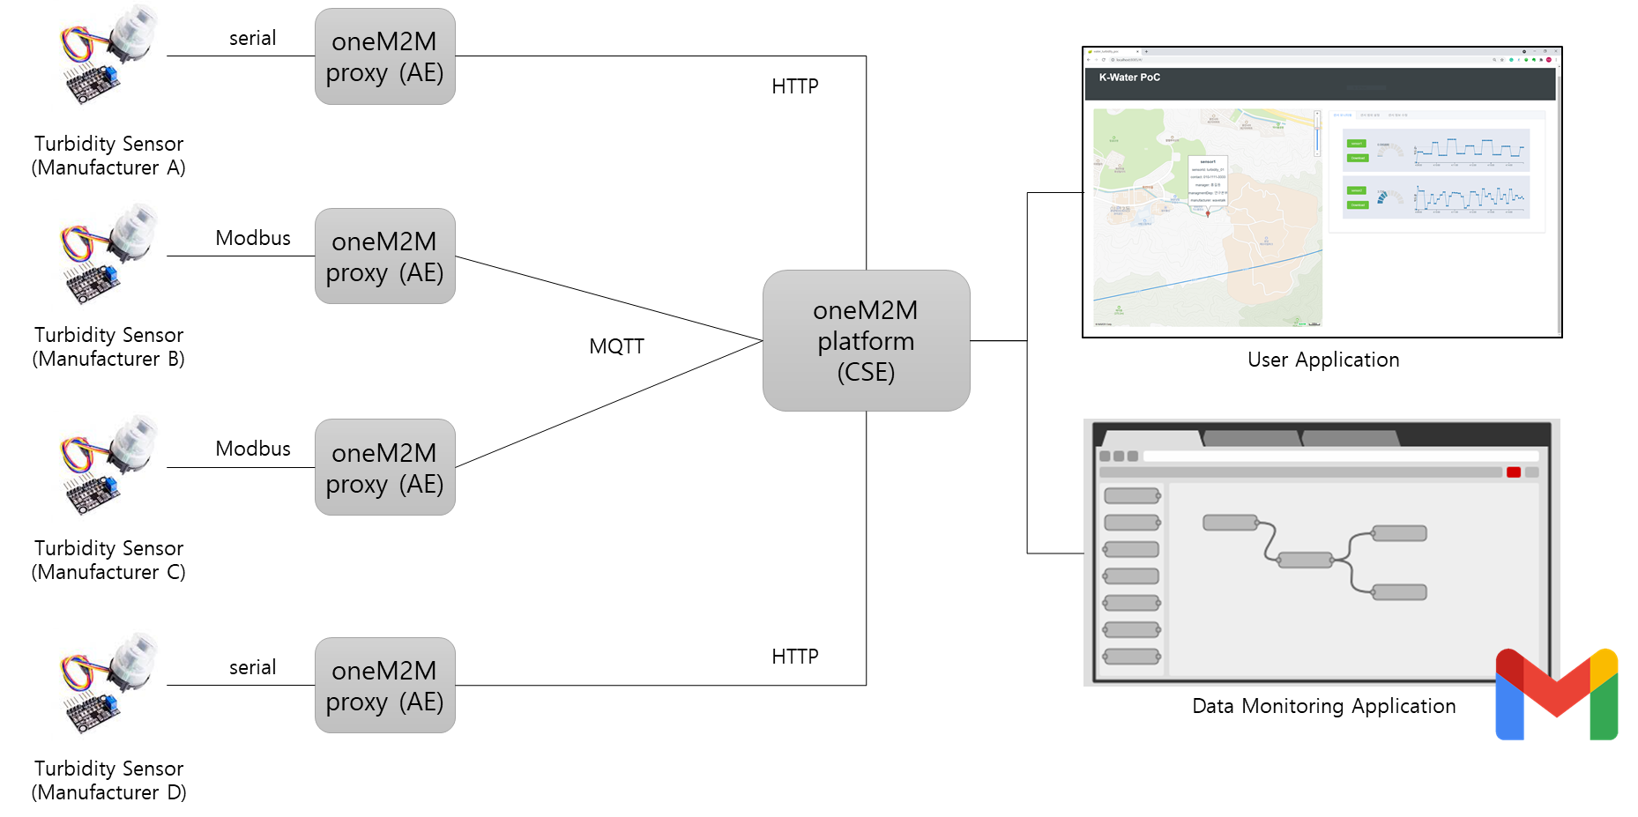
PoC System

Slide 8
PoC System
The proposed SDT-based data models for water domain were implemented on four turbidity sensors of different manufacturers
Proxy application (Node.js)
sends sensor readings to the CSE
receive notifications for remote control (e.g. change reporting interval)
User Application (Vue.js)
visualizes sensor data and other sensor information on the map
provides GUI to control devices
Data Monitoring Application (Node-RED)
receives notification events from the CSE and perform validity check
if detects invalid data per sensor setting, sends email alarm
logs sensor reading data into CSV so that can be also used for machine learning for example

Slide 9
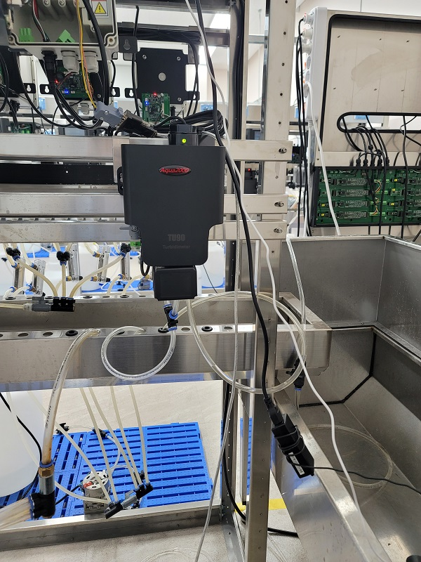
Device (Turbidity Sensor)
Device
Raspberry Pi 4
&Cube Thyme (from OCEAN)
Protocol: MQTT, HTTP binding
Device Proxy Application (Node.js)
performs registration with the oneM2M platform
uses the oneM2M protocol with the proposed data model
stores the data in the Mobius (oneM2M platform)
turbidity sensor
(commercial product)

Slide 10
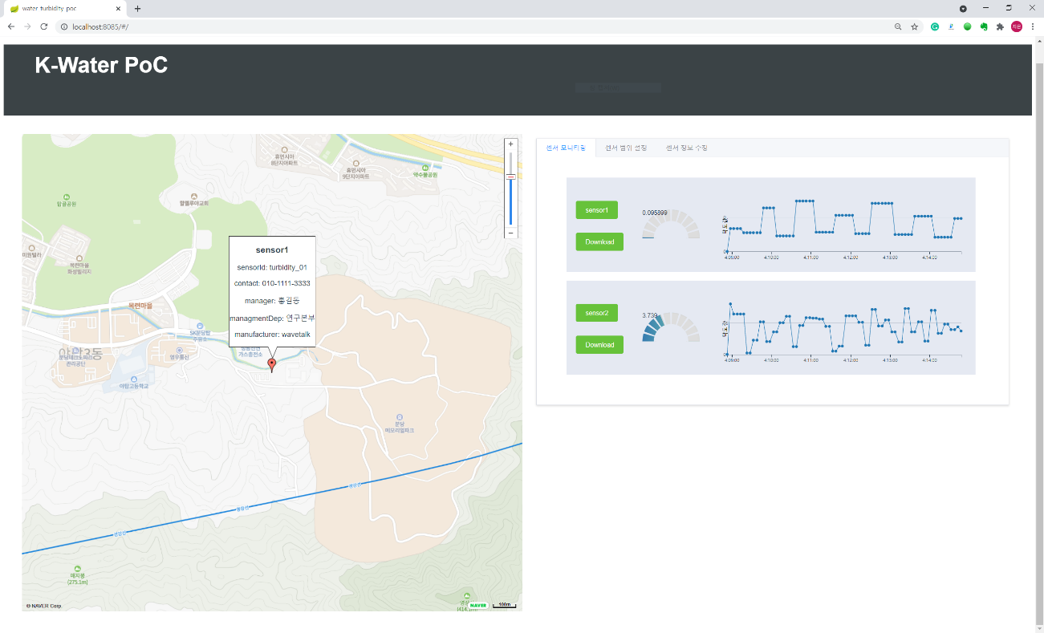
User Application
User Application (Vue.js)
displays the measurements provided by the turbidity sensors, stored on the CSE
displays the map, gauges, and line chart with historical data of the turbidity sensors
updates information of the sensors
sets the range of valid sensor readings per sensor
provides the CSV files that are sensor report logs
User application

Slide 11
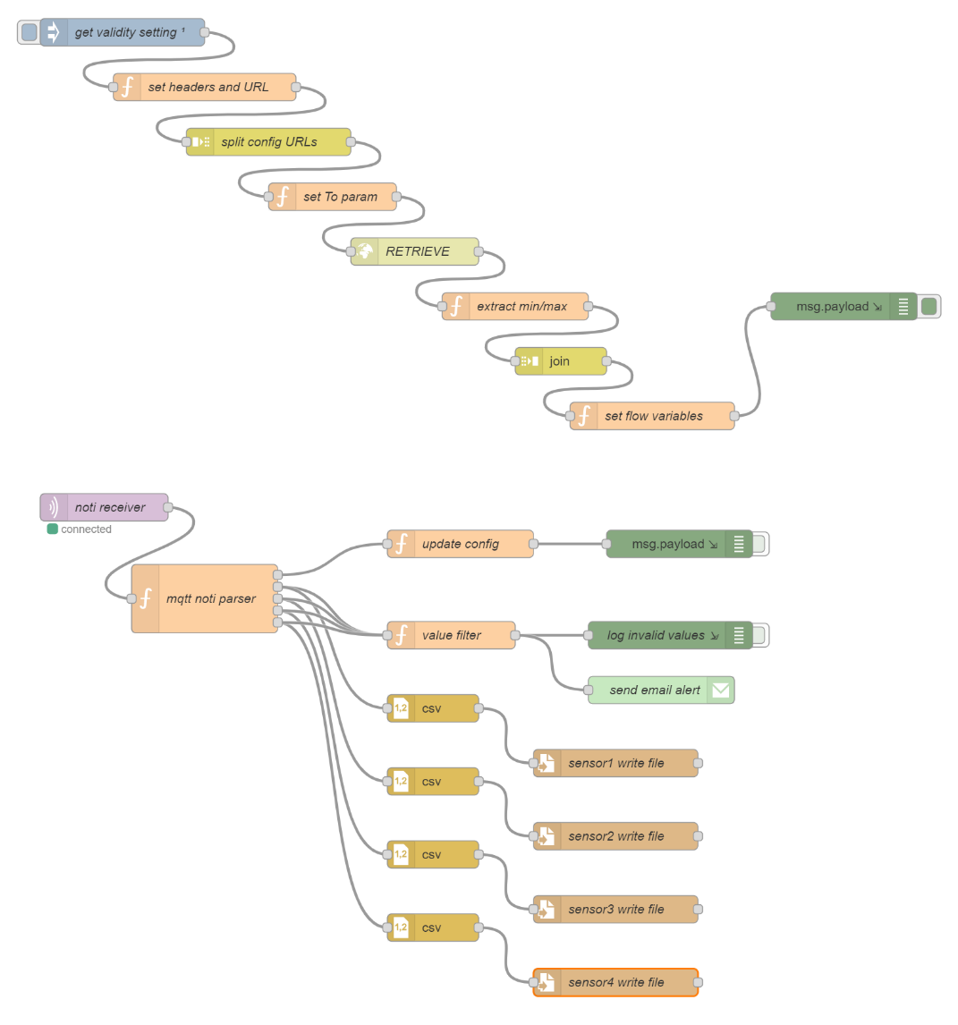
Data Monitoring Application
Data Monitoring Application
receives notification events from the CSE and perform validity check
if detects invalid data per sensor setting, sends email alarm
logs sensor reading data into CSV so that can be also used for machine learning for example
dashboard can be easily built with dashboard node feature

Slide 12
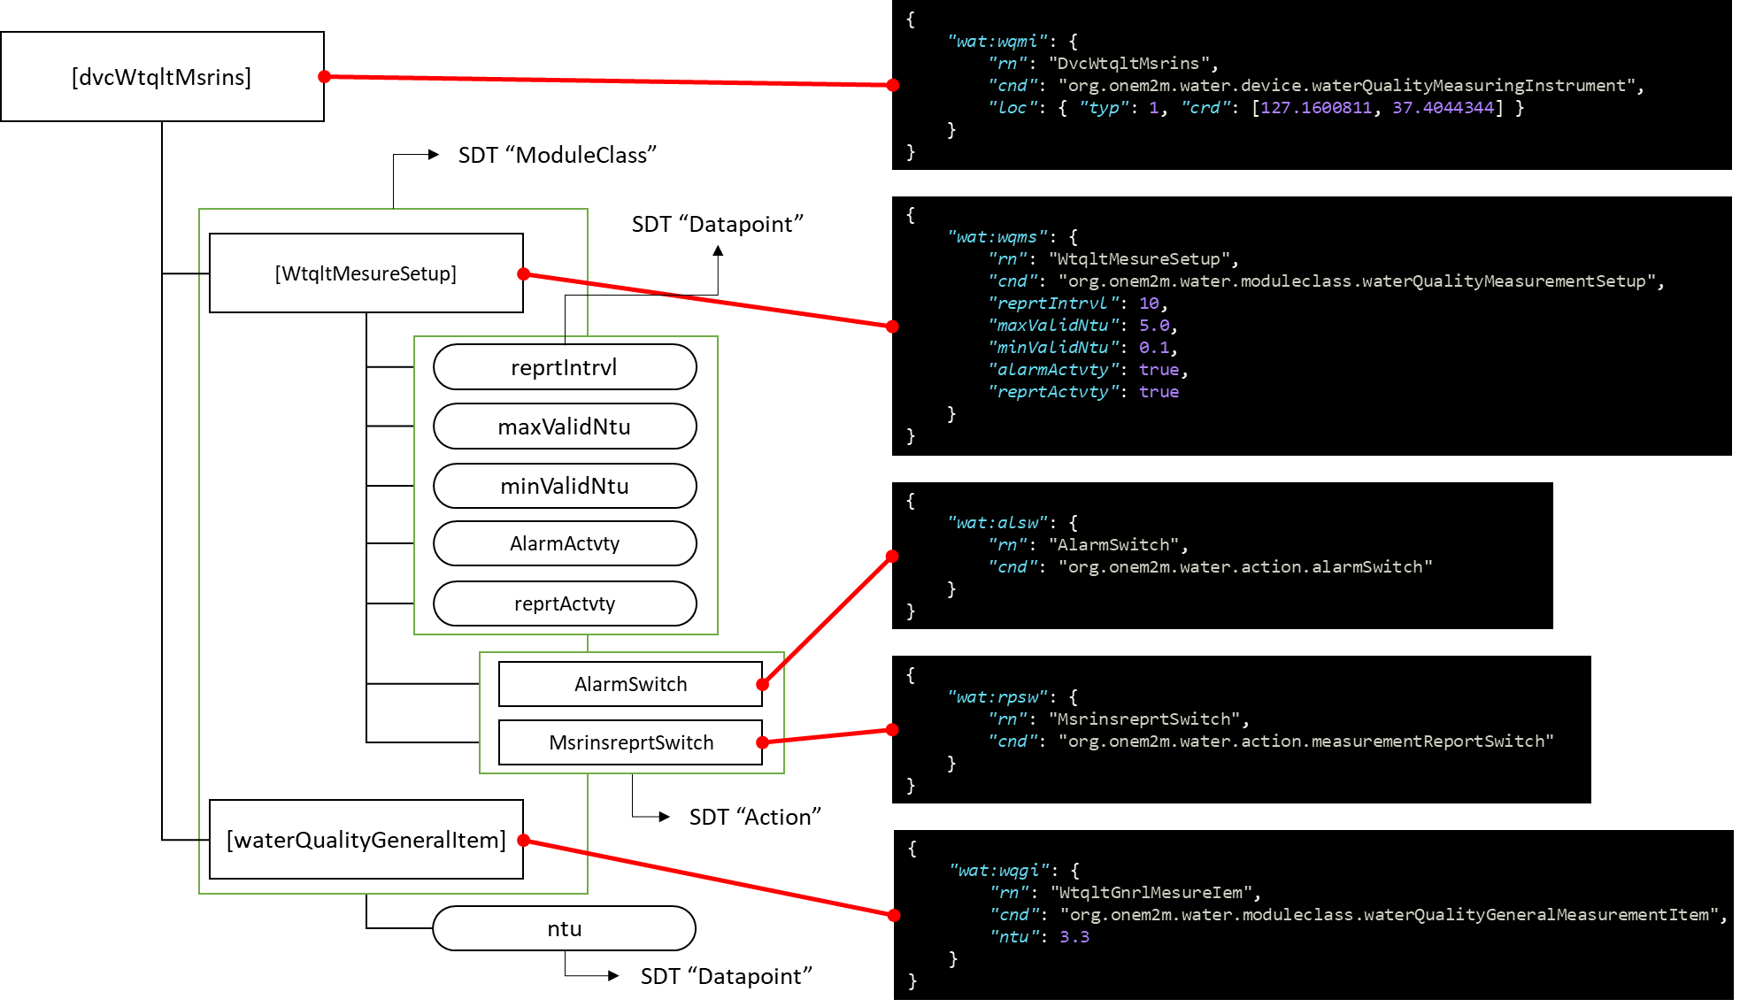
Resource Structure and Behavior
update on ‘AlarmSwitch” Action resource triggers “alarmActrivity” Data Point toggle internally
update on ‘MsringReprtSwitch” Action resource triggers “reprtActvty” Data Point toggle internally

