Slide 1
OneM2M Device management issues
Source: C-DOT ( Poornima)
Meeting Date: 10 Feb 2022
Agenda Item: TBD
Notes:
改一改Source和date

Slide 2
Device mgmt. ways
Currently, there are two ways to perform device management in specs
Device management using service layer
Device management using external mgmt. technologies

Slide 3
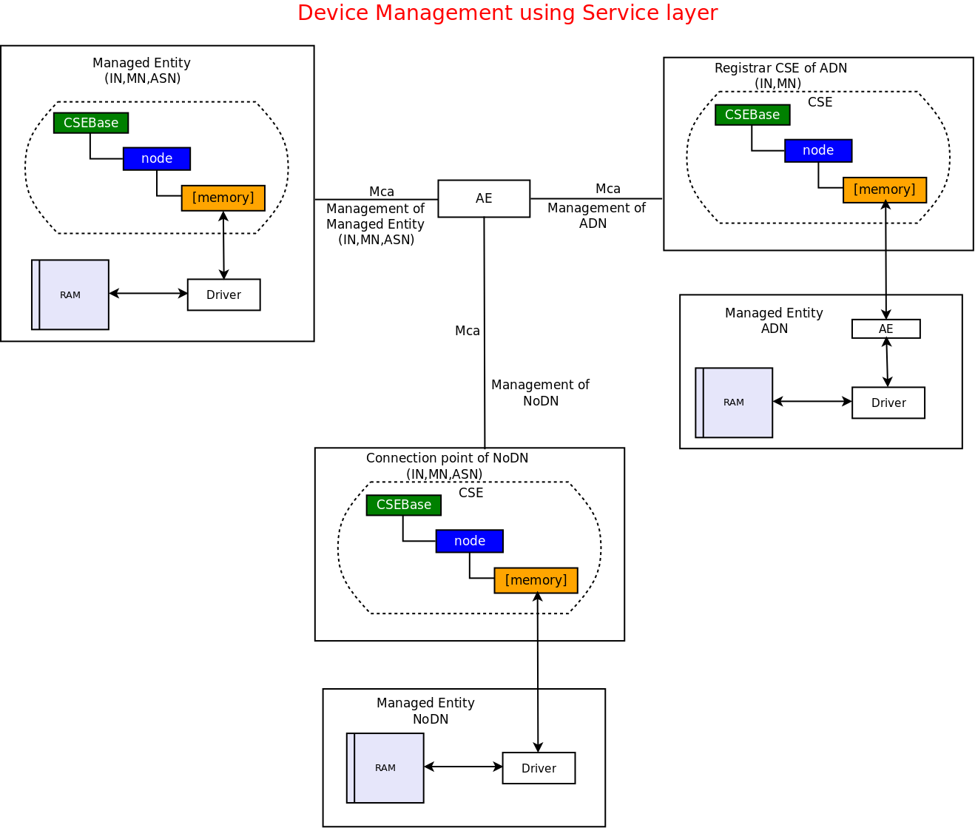
Device management using service layer

Slide 4
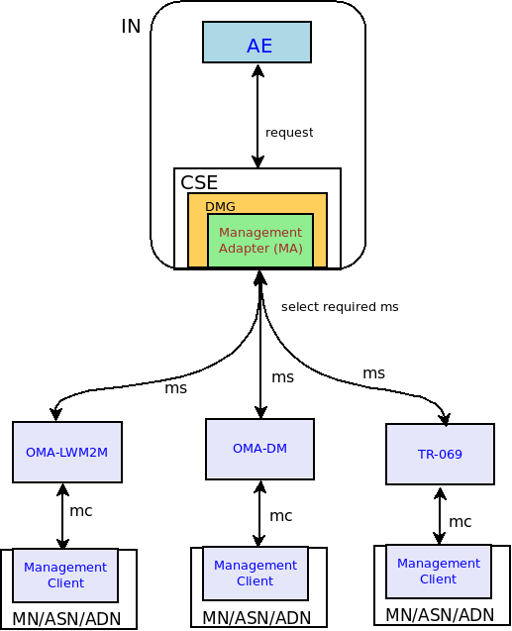
Device management using external mgmt. technologies

Slide 5
Problem
Clause 7.4.15.2 defines <mgmtObj> procedures when technology specific protocols are used.
TS-0004
This clause describes <mgmtObj> resource specific procedure on resource Hosting CSE for CRUD operations.
The procedures are defined for management when technology specific protocols are used.
When service layer management is performed,
generic procedures defined in clause 7.2.2 shall comply for resource creation, update, retrieval and deletion.
Procedures additional to resource manipulations to perform the management are further defined in Annex D.

Slide 6
Contd…
Currently all the references for <mgmtObj> procedures are given to this clause 7.4.15.2, which means that mapping in external mgmt. technologies need to be defined. Without a mapping in TR-069 or LWM2M, procedures given in 7.4.15.2 can’t be completed

Slide 7
Missing mapping in TS-0005 and TS-0006
Resource [OAuth2Authentication]
Resource [wifiClient]
Also field device resources mapping missing in TS-0005 LWM2M but it is present for OMA-DM in TS-0005
Is it feasible to provide mapping for all the new <mgmtObj>? If it is not being added then w

Slide 8
Problem
No specific clause present in TS-0004 for device mgmt. using service layer approach. If given, it could be used for referencing procedures for new <mgmtObj>
Service layer approach is assumed as generic CRUD procedure but is more than generic like it is missing in TS-0004 that <node> resource is present on each CSE unlike external mgmt. technologies.
This clause describes <mgmtObj> resource specific procedure on resource Hosting CSE for CRUD operations.
The procedures are defined for management when technology specific protocols are used.
When service layer management is performed,
generic procedures defined in clause 7.2.2 shall comply for resource creation, update, retrieval and deletion.
.

Slide 9
Solution
A separate clause should be defined in TS-0004 e.g. 7.4.15.3 for Device Management using service layer
New mgmtObj if not supported in TS-0005 and TS-0006 then should give reference to this clause.

Slide 10
Questions and comments

