Slide 1
Discussion on AI/ML dataset support
oneM2M SDS#54
SeungMyeong Jeong (KETI)

Slide 2
Introduction
Rel-5 WI: WI-0105-System enhancements to support AI capabilities
This contribution proposes draft resource design for the use case and requirements in
RDM-2022-0027-use_case_on_dataset_creation_for_AI_models
RDM-2022-0028-requirements_on_dataset_creation_for_AI_models
and continuation of
SDS-2021-0243-ML_Dataset_Preparation

Slide 3
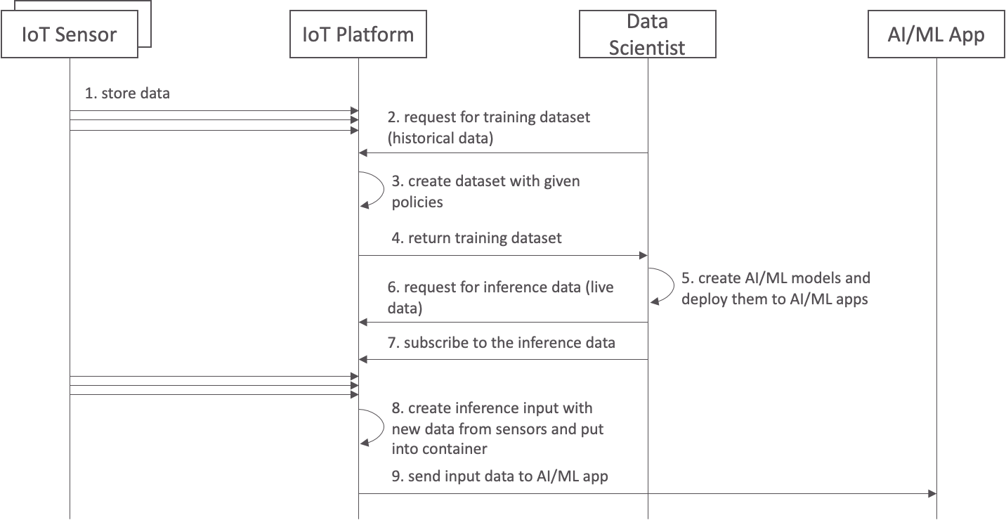
Example flow
Getting training dataset
(historical data)
Getting inference input data (live data)

Slide 4
Concept
Preparing ML model training dataset
t, flowrate
03:05, 20.2
03:45, 30.3
flow meter
give me training dataset for flowrate, temp and turbidity from 03:00 to 04:00
oneM2M
Platform
t, temp
03:00, 20.3
04:00, 18.7
weather API
ML app
t, turbidity
03:03, 2.3
03:13, 2.5
waterQuality sensor
t, flowrate, turbidity, temp
03:00, NaN, NaN, 20.3
03:03, NaN, 2.3, NaN
03:05, 20.2, NaN, NaN
03:13, NaN, 2.5, NaN
03:45, 30.3, NaN, NaN
04:00, NaN, NaN, 18.7
t, flowrate, turbidity, temp
03:00, NaN, NaN, 20.3
03:03, NaN, 2.3, 20.3
03:05, 20.2, 2.3, 20.3
03:13, 20.2, 2.5, 20.3
03:45, 30.3, 2.5, 20.3
04:00, 30.3, 2.5, 18.7
< simple join different data >
< fill up empty ones by policies >

Slide 5
Interface Design
Target resource
one of Data Sharing Resources (e.g. container) and provide other DSR list in the parameter
Might need to associate with Result Content param which is already too complex
<MLTrainingData> virtual resource and provide all DSRs to join
Might be preferable since each application would need different dataset. Virtual resource leaves no resource behind, it is volatile. Targeting a virtual resource and send back the created dataset seems good.
Only RETRIEVE operation is allowed

Slide 6
Interface Design
New parameters for dataset retrieval request
parameter | cardinality | description
joinKey | 1 | Join key for different data instances (e.g. “ct”)
nullValuePolicy | 0..1 | Policy to handle null value handling policy. Allowed values are: 1) leave empty, 2) fill it with latest data, 3) fill it with everage (during N hhmmss) Default is leave empty
serializationFormat | 1 | Serialization format for joined/merged dataset. Allowed values are: CSV, XML, JSON
CSV(text/csv) is new to oneM2M

Slide 7
Concept
Preparing inferencing dataset for a given ML model
t, flowrate
03:05, 20.2
03:45, 30.3
create inferencing dataset for flowrate, temp and turbidity then put it somewhere
flow meter
oneM2M Platform
t, temp
03:00, 20.3
04:00, 18.7
weather API
1. dataset request
3. subscribe cnt
ML app
(inferencing)
4. notify new cin
t, turbidity
03:03, 2.3
03:13, 2.5
waterQuality sensor
2. create a container
inferencingDataset <cnt>
{
"m2m:cin": {
"con": {
"t": "03:13",
“flowrate": 20.2,
“turbidity": 2.5,
"temp": 20.3
}
}
}
{
"m2m:cin": {
"con": {
"t": "03:45",
“flowrate": 30.2,
“turbidity": 2.5,
"temp": 20.3
}
}
}
…

Slide 8
Interface Design
new datasetPolicy resource type
CRUD operations are allowed
attribute | cardinality (access mode) | description
joinKey | 1 (WO) | Join key for different data instances (e.g. “ct”)
nullValuePolicy | 0..1 (RW) | Policy to handle null value handling policy. Allowed values are: 1) leave empty, 2) fill it with latest data, 3) fill it with everage (during N hhmmss) Default is leave empty
serializationFormat | 1 (RW) | Serialization format for joined/merged dataset. Allowed values are: CSV, XML, JSON
datasetContainer | 1 (RO) | <container> resource identifier that stores AI/ML dataset is created as <contentInstance> resources

