Slide 1
Access Control for Subscription Notifications
Andreas Kraft, Andreas Neubacher – Deutsche Telekom
Bob Flynn – Exacta GSS
Miguel Ortega – ETSI

Slide 2
Motivation
Currently, access control is specified for notification that are targeted to entities and resources, and that are NOT originated by the Hosting CSE.
Only minimal access control to entities and resources is defined for notifications that originate from within a hosting CSE.
E.g. TS-0001, 10.2.10.6 “Notification Procedures”, but this is not based on access control. This for the verification subscription notifications, and it is done by the notification target (a registree).
The hosting CSE (CSE-ID) is the originator for notifications that originate in a CSE, and not a subscription’s originator, e.g. for subscription notifications.
This missing access control allows for a couple of DoS attack schemes to IoT Devices.

Slide 3
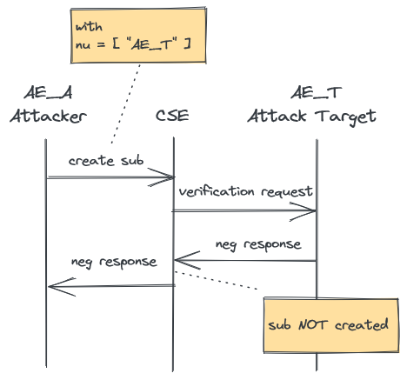
Attack Scenario 1
Subscription Creation
When the CSE does DO subscription verification (which is optional).
The procedure (figure right) is a normal verification procedure.
The attacker AE_A creates a <subscription> resource with a notificationURI attribute that targets the AE_T.
The CSE sends a verification notification to AE_T’s point-of-access . This includes the creator attribute of AE_A.
AE_T rejects the request, and the CSE doesn’t create the <subscription> resource.
Now, AE_A repeats the <subscription> resource creation a 1000 times.
AE_T must be able to detect the malicious reason (e.g. that AE_A is not allowed).

Slide 4
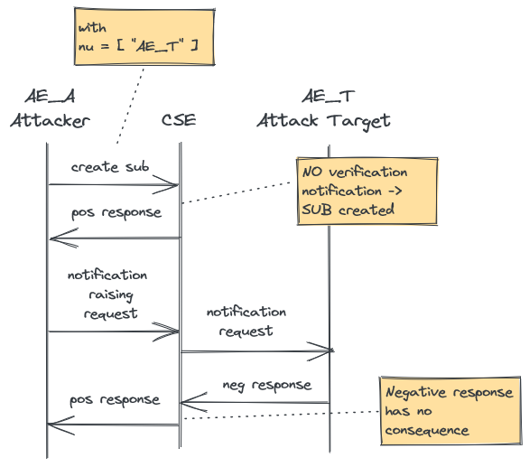
Attack Scenario 2
Subscription Notifications
When the CSE does NOT DO subscription verification (which is optional).
The procedure (figure right) is a normal subscription lifetime procedure.
The attacker AE_A creates a <subscription> resource with a notificationURI attribute that targets the AE_T.
The CSE creates the <subscription> resource without sending a verification notification,
AE_A sends any requests that causes the CSE to send a notification to AE_T
AE_T rejects the request, but this has no consequences.
Now, AE_A repeats the request a 1000 times.
AE_T must be able to detect the malicious reason (e.g. that AE_A is not allowed).
It can then unsubscribe itself from the notifications by setting the targetRemoval attribute in a response (if supported by the CSE).
The targetRemoval attribute procedure is described in TS-0001, Table 10.2.10.7-1, but not in TS-0004, TS-0009 (attribute-header mapping), etc !

Slide 5
Discussion
An attack is possible, no matter whether verification notifications are supported or not.
An attack target can remove itself from receiving notifications, but it must be able to determine what is an attacker, and what not.
Protecting a device is actually a task for the CSE and access control, not the device.
Both attacks could be prevented when applying access control (“NOTIFY” permission) also for subscription-related notifications that originate in the CSE.
Proposal 1)
Change the originator of notifications from the CSE to the original creator of a <subscription> resource.
Not all notifications? See CSE-originating notifications for, for example, nonBlockingAsync.
Proposal 2)
Add a new element in the notification (notificationTrigger) indicating who triggered the notification.
Changing the subscription verification and notification procedures by introducing access control would be a non-backward compatible change.
Only for R5?

Slide 6
Next Steps
???

Slide 7
Thank you

