Slide 1
Introducing no-response option (RFC 7967) to TS-0008
Abhijan Bhattacharyya, Madhurima Ganguly, Ashis Sau (TCS Research, Tata Consultancy Services, Kolkata, India)

Slide 2
Background
TS-0008 describes CoAP (RFC 7252) binding to OneM2M
CoAP has a ‘no-response’ option (RFC 7967) which enables a requesting end-point (client) to convey its disinterest in the response from the serving end-point
Helps reduce network overhead and resource consumption
This CR introduces how the ‘no-response’ option of CoAP can be used in OneM2M systems to avoid transmission of unnecessary responses
Presented in SDS 59.1 (16-May-2023)
This presentation describes the features of the option and exmeplary usecases.
The CR may particularly be useful in the context of lightweight OneM2M (TR 0053)

Slide 3
About no-response option
There can be machine-to-machine (M2M) scenarios where server responses to client requests are redundant.
Desired to minimize resource consumption in constrained systems
Example: Updating many resources simultaneously (multicast)
Examlpe: Performing high-frequency updates
Not to be confused with non-confirmable (NON) mode of CoAP
NON messages are not acknowledged by the ‘messaging layer’ of the recipient
But the request/response semantics still require the server to respond with a status code
NON message with ‘no-response’ option converts the request into ‘open-loop’
Confirmable (CON) messages are always ACKed by the messaging-layer
Responses may be piggybacked with the ACK or separately transmitted
CON messages with no-response option helps suppress the additional traffic due to the separate separate response (if considered unnecessary)
Useful for PUT and POST requests to update or create resources
Option number 258 (approved by IANA)

Slide 4
About no-response option (contd.)
Option description
Granular Control over Response Suppression
The bitmaps can be combined by XOR operation if more than one types of responses need to be suppressed
Example : Bitmap to suppress all types of responses: 00011010 → value: 26
Example: Bitmap to suppress all error responses (4.xx & 5.xx) responses: 00011000 →value: 24

Slide 5
Example applications
Example for consecutive PUT updates with NON message. For CON with separate response, ACK will be there, but response traffic will be suppressed
Suppress all responses while sending GPS updates in quick succession using PUT or POST
POST using query-string
POST assuming dedicated resource is already created

Slide 6
Example applications (contd.)
Suppress selective response as an aide to system-level debugging
Assume an IoT switch sending a ‘turn on’ state to several connected appliances (connected lights, etc.) through multicast
Appliances are servers in this case, and all sends responses simultaneously → Chances of clogging increases linearly
Idea: just use No-Response with value ‘2’ (bitmap : 00000010)
In usual scenario : only the resources unable to act on the request will respond back
Chances of clogging reduced
Helps identify which all appliances have problem
May be useful in enterprise level facility automation, smart metering, etc.

Slide 7
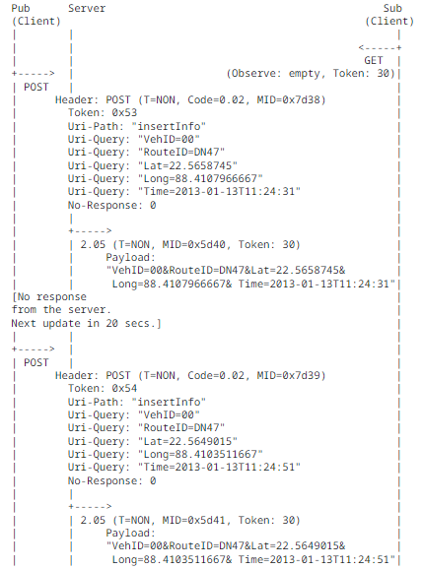
Example applications (contd.)
AE1
CSE
AE2
Reducing traffic in a pub/sub scenario
The Publisher (AE1) may be doing a frequent update while the subscriber is slower in polling
The publisher may not seek response from the broker/ CSE (server)
Subscriber (AE2) may check the ‘freshness’ of the resource-state and decide to fetch or not
Relevant for reducing overhead for the scenarios described in section 6.2 of TR-0053

Slide 8
Relevance to TR 0053 (Lightweight OneM2M)
RFC 7967 is relevant in the context of the objective to minimize request/response messages as specified in TR 0053
TR 0053 is also concerned about message size reduction and header compression
Note: RFC 7967 is already considered in Static Context Header Compression (SCHC) through RFC 9363
Note: RFC 7967 is also considered in Object Security for Constrained RESTful Environments (OSCORE), RFC 8613

Slide 9
Thank you
Sub text

