Slide 1
AI/ML model management interfaces
SDS#60
SeungMyeong Jeong (KETI)
2023.06.27

Slide 2
Background
From RDM#58 meeting, the use case and the requirements
RDM-2023-0005R01-TR-0068_ML_model_management_use_case
RDM-2023-0006R01-ML_model_management_requirements
Motivation of this contribution is to discuss the interfaces on AI/ML model management feature which should target the new TR
AI enablement Stage 2 TR skeleton
And then finally TS-0001 and TS-0004 for Rel-5

Slide 3
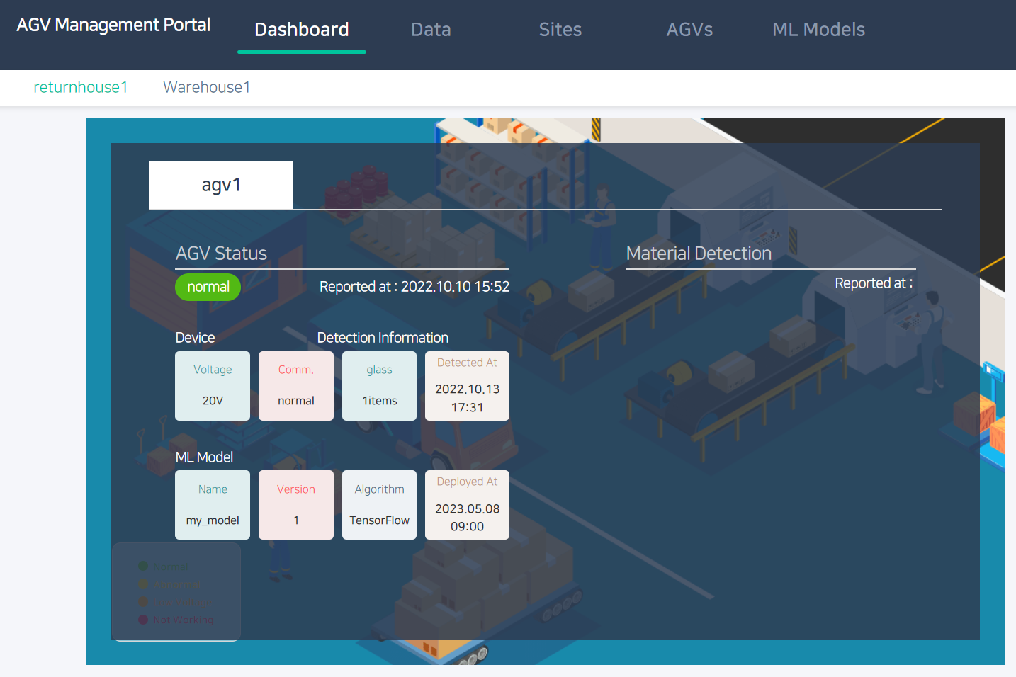
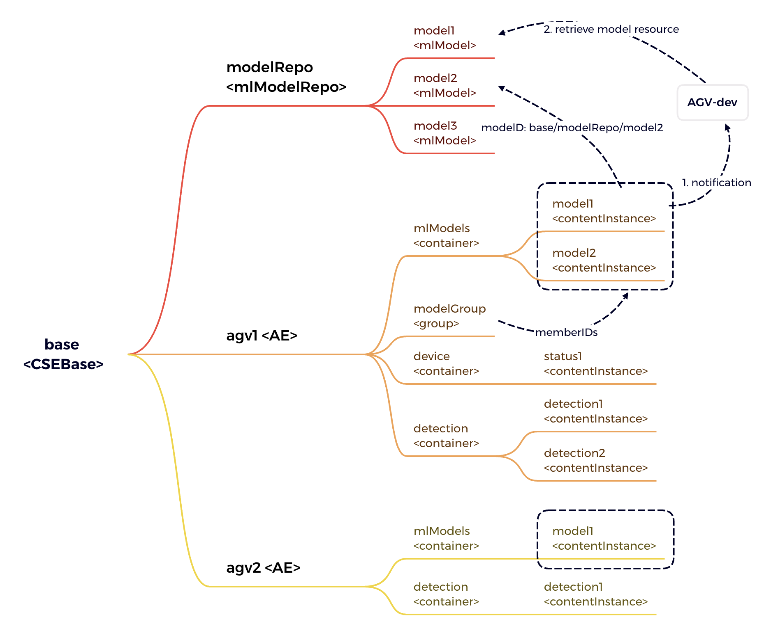
Deployment Example
Register and deploy an AI/ML model with oneM2M platform
AI modeler and service manager as the portal users manages AI/ML models to devices over oneM2M Platform
oneM2M Platform
Management Portal
1. Register a model
data scientists
(AI/ML modeler)
2. Deploy the model
service manager
AI-enabled device
3. Notify the deployment
oneM2M
APIs
4. Fetch the model
model inference environment
5. Store
inference result
sensor

Slide 4
Definitions of Resource Types
mlModelRepo is the repository/container of ML models
mlModel contains the model and its meta information
binary model can be included, or
(large) model can be uploaded somewhere else and the URI for that can be stored
no dedicated resource type for model deployment yet
ID of the <mlModel> resource is put in the content of <contentInstance> resource
<mlModel> resource (except common attributes)
attribute | description | sample data
name | model name | “material detection”
version | model version | 2
platform | ML platform | “tensorFlow”
description | model description | “counting model for radar sensor”
inputSample | Inference input data signature sample | "{\"keys\": [[11.0], [2.0]], \"features\": [[1, 1, 1, 1, 1, 1, 1, 1, 1], [1, 1, 1, 1, 1, 1, 1, 1, 1]]}"
model | model file | (base64 encoded binary file)
modelUrl | URL of a remote | http://mydomain/models/ model1

Slide 5
Procedures with Resource Tree
An AI modeler on the platform registers a model, then the portal creates an <mlModel> resource under “modelRepo” resource
An service manager deploys the model to an AGV, then the portal creates a <contentInstance> resource having ID of the <mlModel> resource
With the subscription created already, new deployment information is notified to the AGV
AGV gets the ID of the <mlModel> resource, and retrieves the model from the platform
Then serve and do the inference to detect material and count objects
Results are stored in ”detection” resource on the platform

