Slide 1
CoAP options discussion
Peter Niblett – IBM
Substantive changes since R01 are shown in green.

Slide 2
Background
There are 3 possible places that we could put oneM2M primitive parameters in a CoAP message:
In the Uri-Path and Uri-Query CoAP options (this is like the query string in an HTTP URL)
In custom CoAP options (these are the CoAP equivalent of HTTP headers)
In the payload itself
Today’s TS-0008 specifies that some parameters are serialized in the Uri-Path and Uri-Query and the remainder as custom CoAP options
CoAP options have numeric identifiers and to avoid conflict they should be registered with IANA.
We made an initial allocation of identifiers in TS-0008 v1 and have added new ones since then. TS-0008 was published with a note saying that the identifiers were subject to agreement with IANA and might change.
We attempted to register the identifiers we had chosen a few years ago but IANA raised concerns that these identifier values were not consistent with requirements of the CoAP specification.
We changed the values at SDS 56 (e.g. SDS-2020-0065R04) and resubmitted to IANA.
IANA experts are now concerned about the impact that our CoAP options could have on the overall message size.

Slide 3
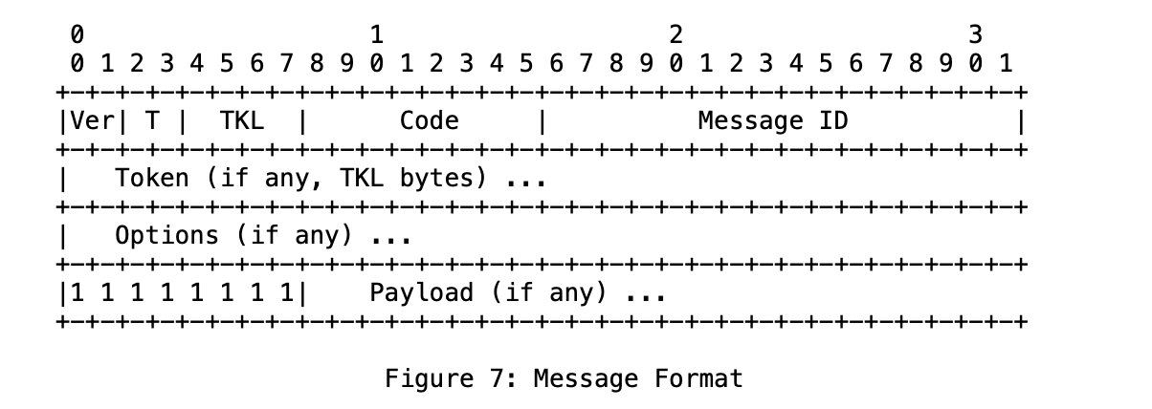
Background - CoAP message format and size
4 bytes fixed header
0 to 8 bytes Token
Each option has an overhead of between 1 and 5 bytes and a maximum length, specified as part of the option definition)
CoAP specification clause 4.6 says:
Messages larger than an IP packet result in undesirable packet fragmentation. A CoAP message, appropriately encapsulated, SHOULD fit within a single IP packet (i.e., avoid IP fragmentation) and (by fitting into one UDP payload) obviously needs to fit within a single IP datagram. If the Path MTU is not known for a destination, an IP MTU of 1280 bytes SHOULD be assumed; if nothing is known about the size of the headers, good upper bounds are 1152 bytes for the message size and 1024 bytes for the payload size.

Slide 4
Custom CoAP options and their lengths
No | C | U | N | R | Name | Format | Length | Default
279 | X | X |  |  | oneM2M-FR | string | 0-255 | (None)
283 | X | X |  |  | oneM2M-RQI | string | 0-255 | (None)
259 | X | X |  |  | oneM2M-OT | string | 15 | (None)
291 | X | X |  |  | oneM2M-RQET | string | 15 | (None)
295 | X | X |  |  | oneM2M-RSET | string | 15 | (None)
299 | X | X |  |  | oneM2M-OET | string | 15 | (None)
263 | X | X |  |  | oneM2M-RTURI | string | 0-255 | (None)
303 | X | X |  |  | oneM2M-EC | uint | 1 | (None)
307 | X | X |  |  | oneM2M-RSC | uint | 2 | (None)
311 | X | X |  |  | oneM2M-GID | string | 0-255 | (None)
267 | X | X |  |  | oneM2M-TY | uint | 2 | (None)
319 | X | X |  |  | oneM2M-CTO | uint | 2 | (None)
323 | X | X |  |  | oneM2M-CTS | uint | 2 | (None)
327 | X | X |  |  | oneM2M-ATI | string | 0-255 | (None)
271 | X | X |  |  | oneM2M-RVI | string | 1-2 | (None)
331 | X | X |  |  | oneM2M-VSI | string | 0-255 | (None)
335 | X | X |  |  | oneM2M-GTM | string | 0-512 | (None)
339 | X | X |  |  | oneM2M-AUS | string | 0-255 | (None)
275 | X | X |  |  | oneM2M-ASRI | string | 0-255 | (None)
343 | X | X |  |  | oneM2M-OMR | string | 0-255 | (None)
347 | X | X |  |  | oneM2M-PRPI | string | 0-255 | (None)
351 | X | X |  |  | oneM2M-MSU | string | 0-255 | (None)
NOTE 1: C, U, N, R means Critical, Unsafe, NoCacheKey and Repeatable respectively [1]. Table 6.2.2.4.0-1 follows the template used in clause 5.10 Option Definitions of CoAP specification [1]. NOTE 2: CoAP Option numbers specified in table 6.2.2.4.0-1 are subject to change after review by IANA registration.
If all these parameters were included and had their maximum lengths, we they would consume around 3,400 bytes.
In practice the amount consumed is much smaller

Slide 5
Discussion – CoAP lengths
IANA CoAP experts have explained the issues with sending large CoAP messages:
If the message size exceeds the IP MTU size you will get IP packet fragmentation.
In a multi-hop transmission it’s the smallest MTU size of all the hops that counts (for For IPv6 each MTU length must be at least 1280 byte and for IPv4 each MTU length must be at least 576 bytes)
You can get further fragmentation at the data link layer. Moreover some link layer implementations do not support fragmentation and so will refuse to transmit the packet at all.
As we are talking about unreliable networks the more fragments you have the more chance there is of losing the CoAP message and having to retransmit the whole thing. This leads leading to poor throughput and high latency.
To send bigger payloads you can use CoAP blockwise transfers to split the payload into multiple blocks and transmit each block in a separate CoAP message.
Allowable blocksizes are 16, 32, 64, 128, 256, 512 or 1024 bytes
However the CoAP options can’t be split into blocks – each CoAP message in the chain has to carry a copy of all the options.
The CoAP-defined options have the following length restrictions:
Uri-Host, Uri-Path and Uri-Query are limited to a maximum of 255 bytes each.
We map the To parameter to Uri-Path
We map 16 parameters into Uri-Query, though it unlikely that they will all be present in any given message
Many of the custom options defined in TS-0008 have a maximum of 255 bytes (one has a max of 512)
There’s a risk that we could exceed the 1152 bytes before we even get to the payload.

Slide 6
Options
Stick with the current approach of mapping parameters to Uri-Query and custom Options, using the revised option numbers.
IANA experts say that this is a valid approach, though they recommend against it
Change TS-0008 to serialize all the Primitive Parameters (except for To) into the payload, similar to the way we do in TS-0010 and TS-0020.
As the CoAP GET method does not have a payload, we would either have to
use CoAP FETCH (RFC 8132) instead of GET. [The FETCH method has a payload and was added to CoAP to allow complex queries to be specified via the payload instead of via Options.]
Use CoAP POST instead (we might then choose to use this for every request)
Use CoAP options for the primitive parameters that are numeric as in option 1(these are quite small) but serialize the String parameters in the payload, as in option 2.

Slide 7
Options – pros and cons
Stick with the approach of mapping parameters to Uri-Query and custom Options.
+ No change to implementations
+ Efficient encoding for small oneM2M messages (i.e. ones that have short option values and small payloads)
- Larger messages will encounter the fragmentation issues mentioned earlier
- Uri_Query option could exceed 255 bytes, leading to inability to send the oneM2M primitive
- One or more of the other Primitive Parameters could exceed the length defined for the corresponding option in TS-0008
Change TS-0008 to map all the Primitive Parameters (except for To) into the payload, as in TS-0010 / TS-0020.
+ No need for IANA registration, as no custom options are needed.
+ No risk of the Uri_Query limit being exceeded
+ No risk of CoAP options getting too big, allowing effective use of Block-wise transfer to keep messages smaller than the MTU size
- Changes to TS-0008 and implementations - we would have to switch from the CoAP GET to a different CoAP method.
- Use of POST for things that aren’t create operations runs counter to the spirit of CoAP.
- Use of FETCH requires the use of a CoAP extension RFC
- Small messages are likely to be slightly bigger than under option 1.
Use CoAP options for the primitive parameters that are numeric + Efficient encoding of numeric options, without the risk of the message size getting too big, or option limits being exceeded
+ Fewer options for us to register.
- Additional complexity in the specification and implementations and deviation from TS-0010 / TS-0020
- We would have to switch from the CoAP GET to a different CoAP method (as in 2) to carry the String parameters in the payload

