Slide 1
oneM2M Jupyter Notebooks
Andreas Kraft, Andreas Neubacher – Deutsche Telekom
Laurent Velez – ETSI
Ken Figueredo, Bob Flynn – Chordant

Slide 2
Educational Activities
The oneM2M Developer TR‘s provide an already good overview and practical examples.
The hackathons bring together groups of serious developers to teach them how to implement applications and connect devices with oneM2M.
What is currently missing are simple but practical hands-on tutorials that developers, enthusiasts etc can just run to start learning about oneM2M, teach themselves on a topic-by-topic basis, or refresh on specific features.
„Learning Snacks“
Especially during the CoVid-19 crisis learning from home becomes more and important

Slide 3
Enter Jupyter Notebook
Project Jupyter: „… interactive computing across dozens of programming languages”
Jupyter Notebook: „The Jupyter Notebook is an open-source web application that allows you to create and share documents that contain live code, equations, visualizations and narrative text.”
Very popular among data scientists to explain and experiment with complicated data analytic algorithms.
Can run on the Web or on a local PC.
https://jupyter.org/

Slide 4
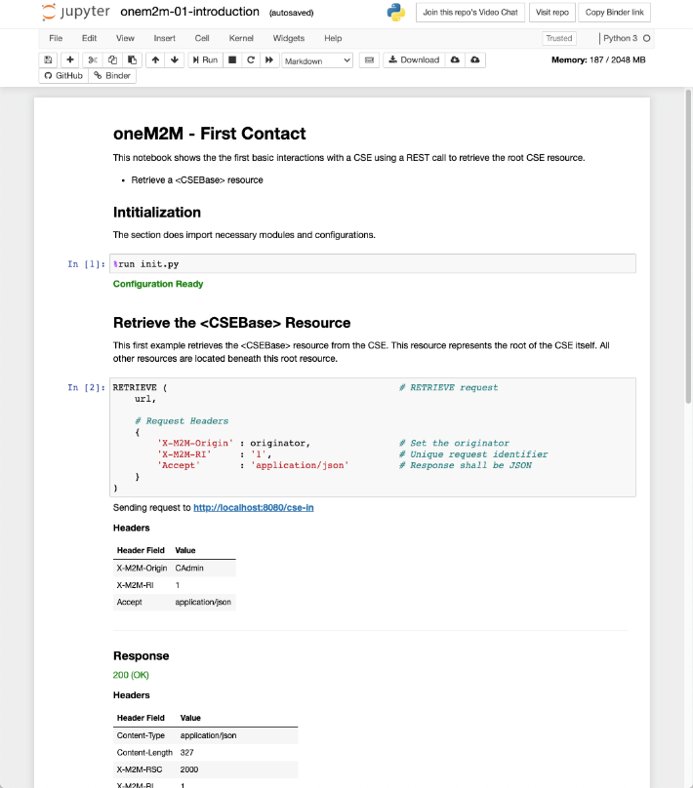
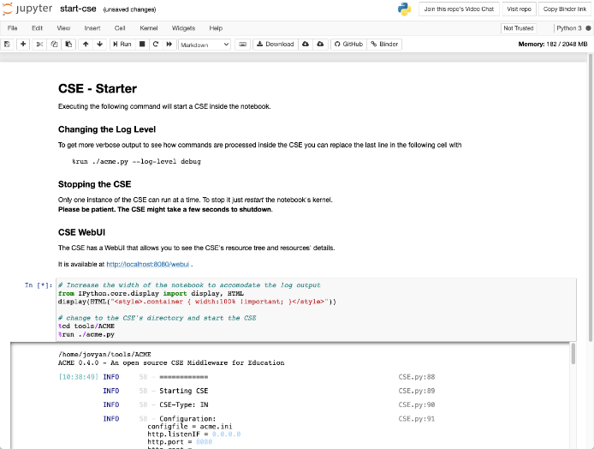
oneM2M Jupyter Notebooks
Goal: Provide interactive lectures for oneM2M features, and concepts that can run in a web browser.
Let‘s make oneM2M more approachable.
Provide, for example, the Developer Guides as Notebooks.
Better user experience.

Slide 5
Hands-On
Running on mybinder.org
https://mybinder.org/v2/gh/ankraft/onem2m-jupyter-notebooks/development
This includes a CSE and Notification Server running inside notebooks themselves.
Running as a Docker Image
https://hub.docker.com/repository/docker/ankraft/onem2m-notebooks
Will move to its own GitHub Account
Source Code
https://github.com/ankraft/onem2m-jupyter-notebooks/tree/development
Will move to its own GitHub Account

Slide 6
Next Steps
Create and update the Notebooks, and publish them via the web-site activity.
Make the notebooks publically available on GitHub via the oneM2M account.
Develop more Notebooks with further use cases from existing TR‘s,e.g. for smart city, industrial, and smart lifts.
Target: present to TP during TP#47.
Volunteers welcome to help to create additional Notebooks!

