Slide 1
Tool Support for oneM2M
Andreas Kraft, Andreas Neubacher
Andrew Min-gyu Han
1

Slide 2
Introduction
Besides of various oneM2M implementations (CSEs, AEs, code snippets etc) there are a couple of tools that are either help with the specification work or help developers in other ways.
Stand-alone tools, but also web-based tools
What about…
Point to and explain them on the oneM2M wiki?
Continued support and further developments?
Provide them via oneM2M‘s GitHub
Maintaining a toolset by oneM2M?

Slide 3
SDTTool
https://github.com/Homegateway/SDTTool
Python script to
check for correctness,
convert the SDT definition files to XSD, and other formats, and
generate the short names for SDT-related attributes
Originally maintained by HGI
Currently v4
Q: Move (or fork) to oneM2M GitHub?

Slide 4
oneM2M Extract Attributes
https://github.com/ankraft/onem2m-extract-attributes
Extract attributes, short and long names, categories, and more from the oneM2M specification documents.
Basis for other tools
Q: Fork to oneM2M GitHub?

Slide 5
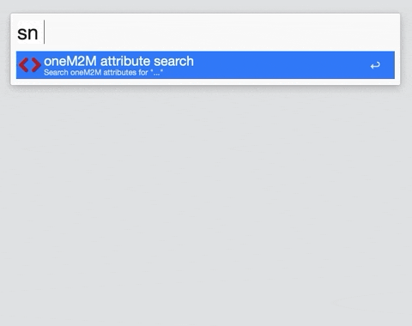
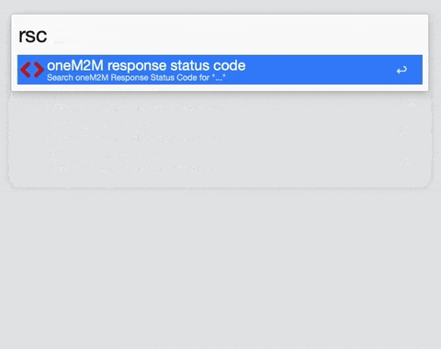
oneM2M Attribute Finder
https://github.com/ankraft/aw-oneM2M-short-names
Attribute – short-name mappings, response status codes, ACOP calculator, …
Currently only available for MacOS.
Looking for help with implementations for other platforms, plugins (e.g. VSCode, …)

Slide 6
oneM2M tools are supported by Unversity
Keeping an open source project for years is not an easy task for companies.
TDE is looking for university professors who will volunteer supporting oneM2M tools and forms a consortium with the university.
Hansung University(HSU) has an institute for supporting ICT standardization. (HIICST: Hansung Institute of ICT Convergence Standard & Technology)
The institute volunteers to take the project of oneM2M tools by open source project. (One or two teams with 1~2 professors and 3~4 graduate or undergraduate students for each. It depends on the scope and number of the project.)
oneM2M has university members!

Slide 7
Thank you

