Slide 1
Development of tinyIoT open source oneM2M platform
TDE-2022-0043-Development of tinyIoT open source oneM2M platform
JaeSeung Song (Sejong University)

Slide 2
Team Members
Name : Eom Kyeongho
E-mail : rudgh9242@gmail.com
Name : Park Minji
E-mail : iorw0224@gmail.com
Name : Kim Donghyun
E-mail : quri159@gmail.com
Name : Eom Yerim
E-mail : djadpfa1002@gmail.com

Slide 3
TinyIoT Concept
Sejong University starts developing a Tiny oneM2M server for embedded system
Main components
Tiny http server (open source)
Simple JSON parser (open source)
Micro database (open source)
Features:
Only support CRUD(N)
Max 10 devices
Zero configuration of oneM2M devices
Timeline:
Initial version will be ready by Sep. 2022
Plan to participate ETSI IoT week
Open source
Milestone:
MEC interworking
MQTT
ACP
Tiny IoT Server (ToS)
JSON Handler
(cJSON)
oneM2M
Msg Handler
Micro-DB
(Berkley DB)
mDNS server
(Avahi)
Payload (JSON)
Lightweight web server
(lighttpd, tinyWeb, etc)
oneM2M Device
mDNS Client

Slide 4
Current Progress
1
2
3
struct Object
*object
6
5
4
1. Client sends oneM2M standard http request to the server.
*http packet body includes json.
2. Create Object struct based on JSON value with json parser. and store the struct as a pointer format.
3. Store object struct data to DB.
4. Create object struct from stored data on DB.
5. Create JSON from object struct data.
6. Server sends http response to the client.

Slide 5
Resource Tree for Index
Node *sibling
Node *child
NULL
NULL
NULL
NULL
NULL
NULL
NULL

Slide 6
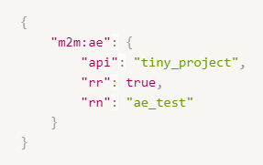
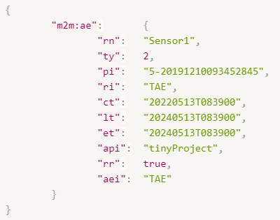
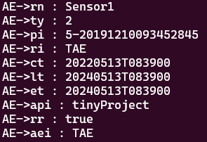
JSON Parser
Object* Json_to_Object(char *json_payload);
Convert the json payload to an Object with cJSON_Parse()
Example: AE* Json_to_AE(char *json_payload);
char* Object_to_json(Object* object);
Convert an Object into string with cJSON_Print()
Example: char* AE_to_json(AE* ae_object);
json_payload
json
AE* ae_object
AE* ae_object

Slide 7
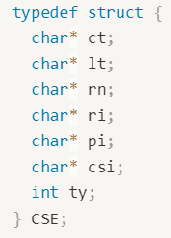
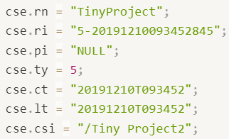
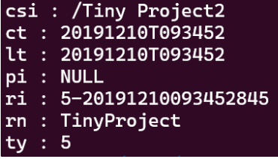
Database (Berkley DB)
Use Cursor - DB_KEYLAST : Create a new record, as the last of the duplicate records for the supplied key.
Set Flag - DB_DUP : Permit duplicate data items in the database. The ordering of duplicates in the database is determined by the order of insertion, unless the ordering is otherwise specified by use of a cursor operation or a duplicate sort function.
Struct CSE
CSE.db
Key
Value
Store_CSE(CSE* cse_object)
csi
ct
lt
pi
ri
rn
ty
/Tiny Project2
20191210T093452
20191210T093452
NULL
5-20191210093452845
TinyProject
5
Struct CSE
Get_CSE(char* ri)

Slide 8
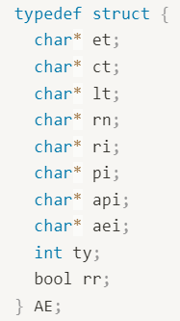
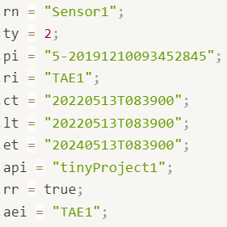
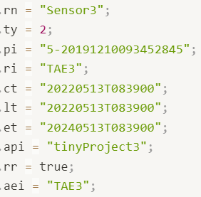
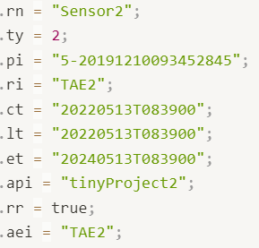
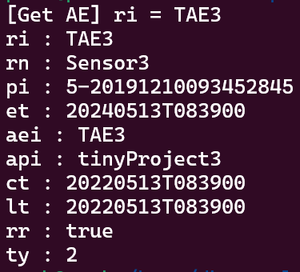
Database (Berkley DB)
AE.db
Struct AE
AE1
AE3
AE2
Key
Value
aei
aei
aei
api
api
api
ct
ct
ct
et
et
et
lt
lt
lt
pi
pi
pi
ri
ri
ri
rn
rn
rn
rr
rr
rr
ty
ty
ty
TAE1
TAE3
TAE2
tinyProject1
tinyProject3
tinyProject2
20220513T083900
20220513T083900
20220513T083900
20240513T083900
20240513T083900
20240513T083900
20220513T083900
20220513T083900
20220513T083900
5-20191210093452845
5-20191210093452845
5-20191210093452845
TAE1
TAE3
TAE2
Sensor1
Sensor3
Sensor2
true
true
true
2
2
2
Store_AE(AE* ae_object)
Struct AE3
Cursor
Find “TAE3”
Index[1]
Get_AE(char* ri)

Slide 9
oneM2M Zeroconf

Slide 10
Thank you

