Slide 1
oneM2M Architecture Icons
Bob Flynn

Slide 2
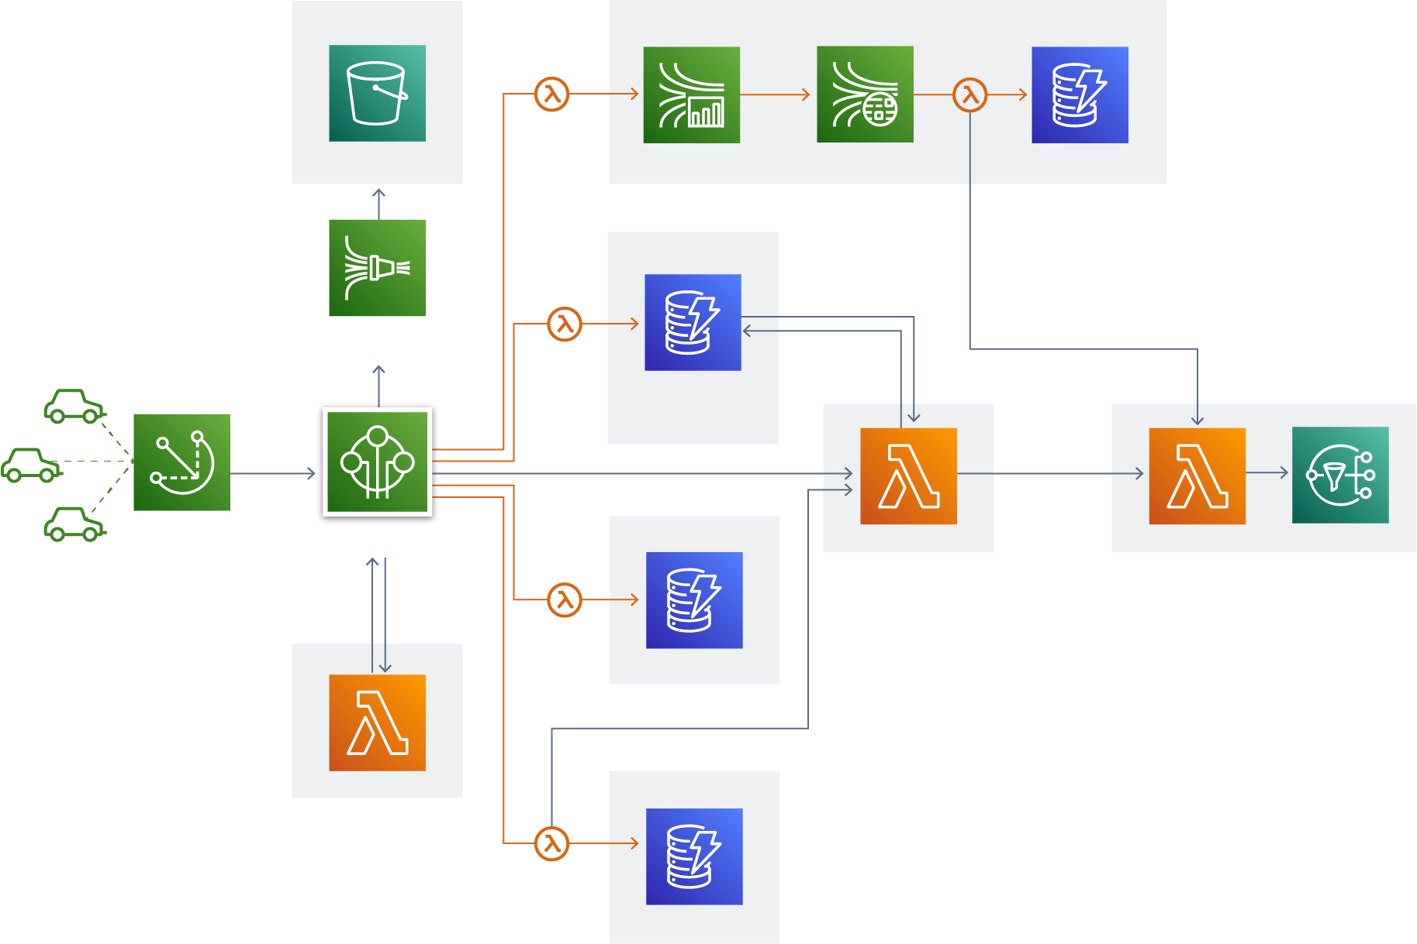
Consistent architecture drawings

Slide 3
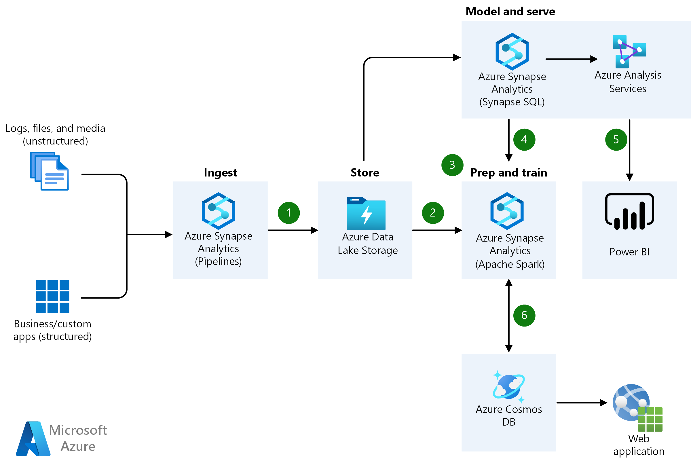
Consistent architecture drawings

Slide 4
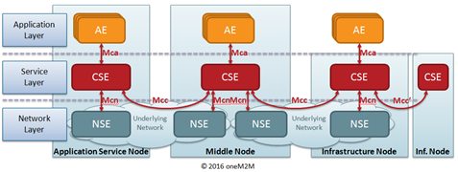
oneM2M Architecture drawings

Slide 5
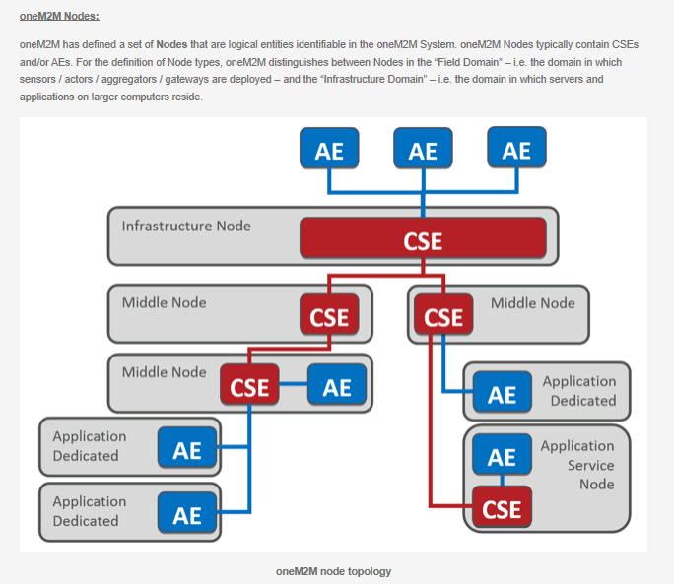
oneM2M Architecture drawings

Slide 6
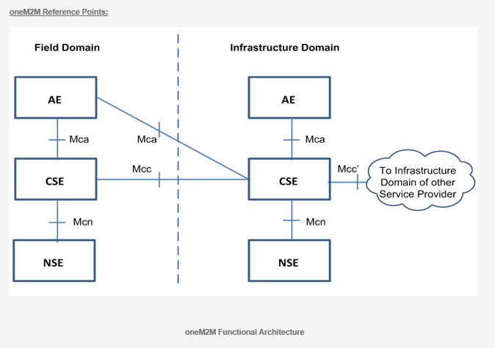
oneM2M Architecture drawings

Slide 7
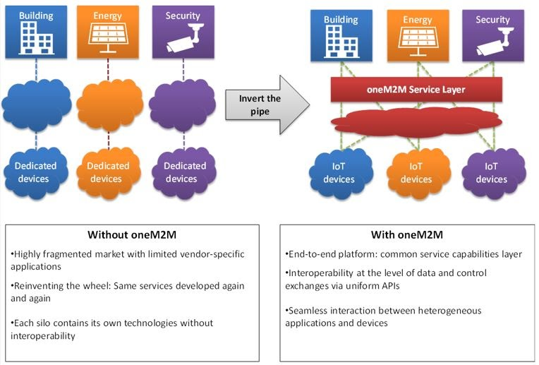
oneM2M Architecture drawings

Slide 8
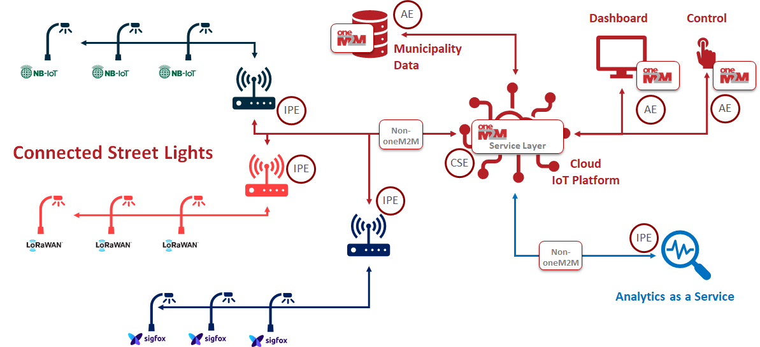
oneM2M Architecture drawings

Slide 9
Proposal
Define a set of icons that we can use to create architecture diagrams for any deployment of oneM2M
These icons should fit within cloud service provider icons sets; for example, running an IN-CSE in an AWS EC2 instance

Slide 10
Starting the discussion
oneM2M Entities
CSE
Application Entity
Interworking Proxy Entity
Network Services Entity
Non-oneM2M entity
Interfaces
Mca
Mcc/Mcc’
Mcn
Hierarchy
Infrastructure Node
Middle Node
Application Service Node
Application Dedicated Node
Other concepts
Sensor
Actuator
Application
Other external services
Profile ID
Shapes
Colors
Images
Text

Slide 11
Colors
Primary font: Myriad Pro
Primary Corporate Colors (80% of design)
Cool Gray 8
Pantone 1807C
Please note that Powerpoint templates may default to a corporation’s template depending on their IT structure and firewalls. When creating oneM2M materials, please ensure these colors and fonts are used. Full branding guidelines can be found on the oneM2M website.
CMYK: 0 1 0 43
RGB: 160 160 163
#a0a0a3
CMYK: 20 99 99 11
RGB: 180 32 37
#b42025
Accent Color Group #1 (20% of design)
Pantone 1375
Pantone
667
Pantone 647
Cool gray 11
Pantone
5483
CMYK: 1 51 99 0
RGB: 246 146 30
# f6921e
CMYK: 63 63 18 2
RGB: 113 104 150
# f6921e
CMYK: 100 25 0 50
RGB: 0 84 128
# 005480
CMYK: 0 5 0 82
RGB: 84 80 84
# f6921e
CMYK: 60 30 30 10
RGB: 102 140 151
# 668c97

