Slide 1
SesLab2023
Introducing an elevator digital twin system using oneM2M
Lee Jungmin
SesLab

Slide 2
Table of Contents
Overview
Digitial Twin Server
Data Obtain Method
Data RETRIEVE Method
oneM2M Resource Tree
Visualization
Energy Calculation

Slide 3
OVERVIEW

Slide 5
Data Obtain Method

Slide 6
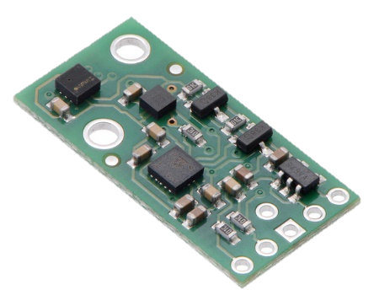
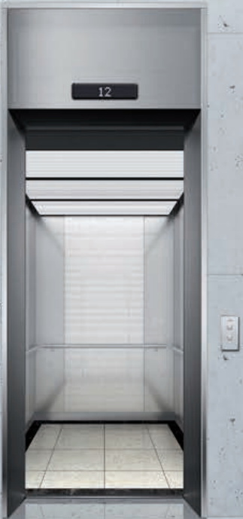
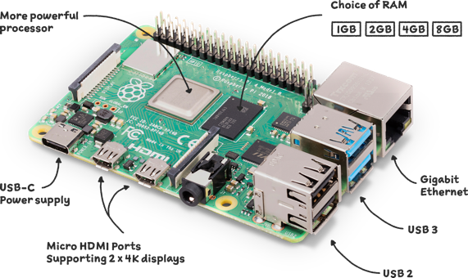
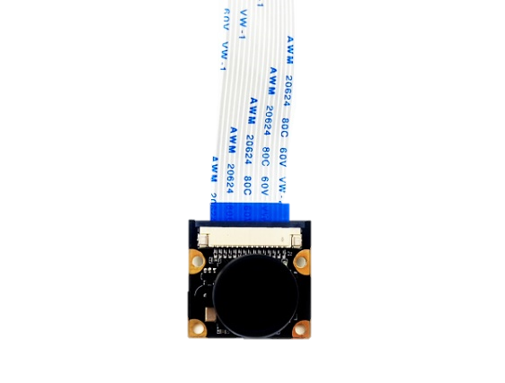
Gryo, and Pressure Sensor
Gyro
Sensor Library Code
Altimeter
Temperature
Image
Camera Sensor
OpenCV
Image Detection
Detected Button List

Slide 7
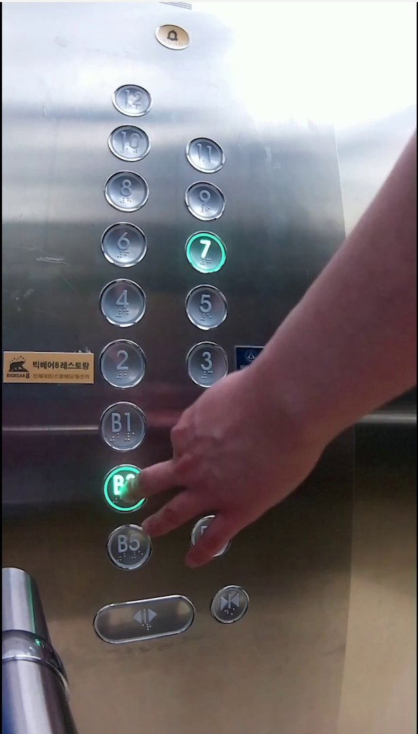
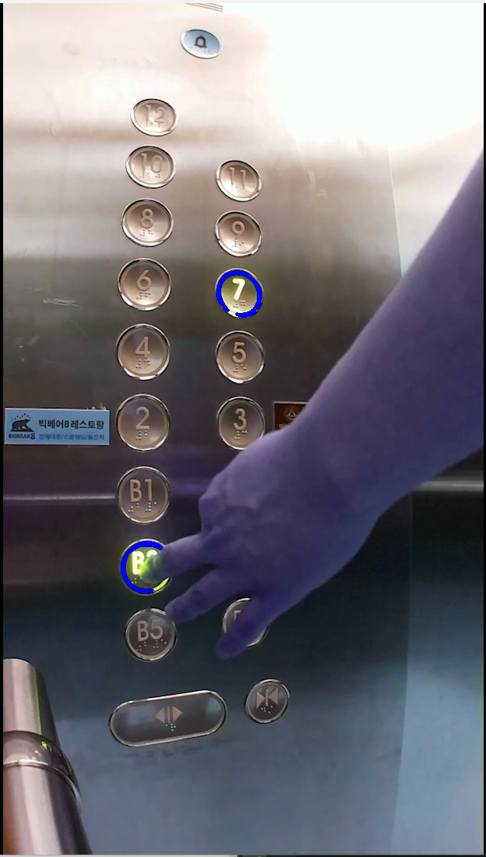

Slide 8
Make URI for destination address
/~/id-mn/buildingSAI/Elevator1/UserInput
Send Data
Make Request Header, and Body
Resource Tree
Build Server
Choose protocol to communicate

Slide 9
oneM2M
Resource Tree

Slide 10
oneM2M Service Server
(IN-CSE)
MN-CSE
Digital Twin Service Server
(IN-AE)
Bldg. SAI
ADN-AE
Elevator1
flexContainer
Resource Tree Build Server
(IN-AE)
UserInput
SensorOutput
Elevator2
Raspberry PI 4
UserInput
Sensors
Out of Scope
SensorOutput
Child Resource
Actuators
Group
Group Member
…
SAI/Elevator1
Bldg. GunJa
SAI/Elevator2

Slide 11
flexContainer Attributes
Attributes
ADN-AE
<resourceName>
<Altimeter>
Elevator1
Elevator1UI2
Altimeter
float32
flexContainer
<Acceleration>
<Temperature>
User Input
[X, Y, Z]
Temperature
float32
<Gyro>
Sensor Output
<Button Panel Status>
[X, Y, Z]
<Timstamp>
[B1, 1, 5..]
Datetime.datetime

Slide 12
Digital Twins Server

Slide 13
RETRIEVE from oneM2M Resource Tree
The Digital Twin Server periodically collects flexConatiner data from the oneM2M resource tree
Digital Twin Server
Simulation
The Digital Twin Server runs a simulation based on the data
Energy Consumption
ML
Feedback
Visualization
(UE5, Plotly)
As the simulation runs, the Digital Twin measures the energy consumption of the elevator.
USER

Slide 14
Data RETRIEVE

Slide 15
oneM2M Service Server
(IN-CSE)
MN-CSE
Digital Twin Service Server
(IN-AE)
Bldg. SAI
ADN-AE
Elevator1
flexContainer
Resource Tree Build Server
(IN-AE)
UserInput
SensorOutput
Elevator2
Raspberry PI 4
UserInput
Sensors
Out of Scope
SensorOutput
Child Resource
Actuators
Group
Group Member
…
SAI/Elevator1
Bldg. GunJa
SAI/Elevator2

Slide 16
Visualization

Slide 17
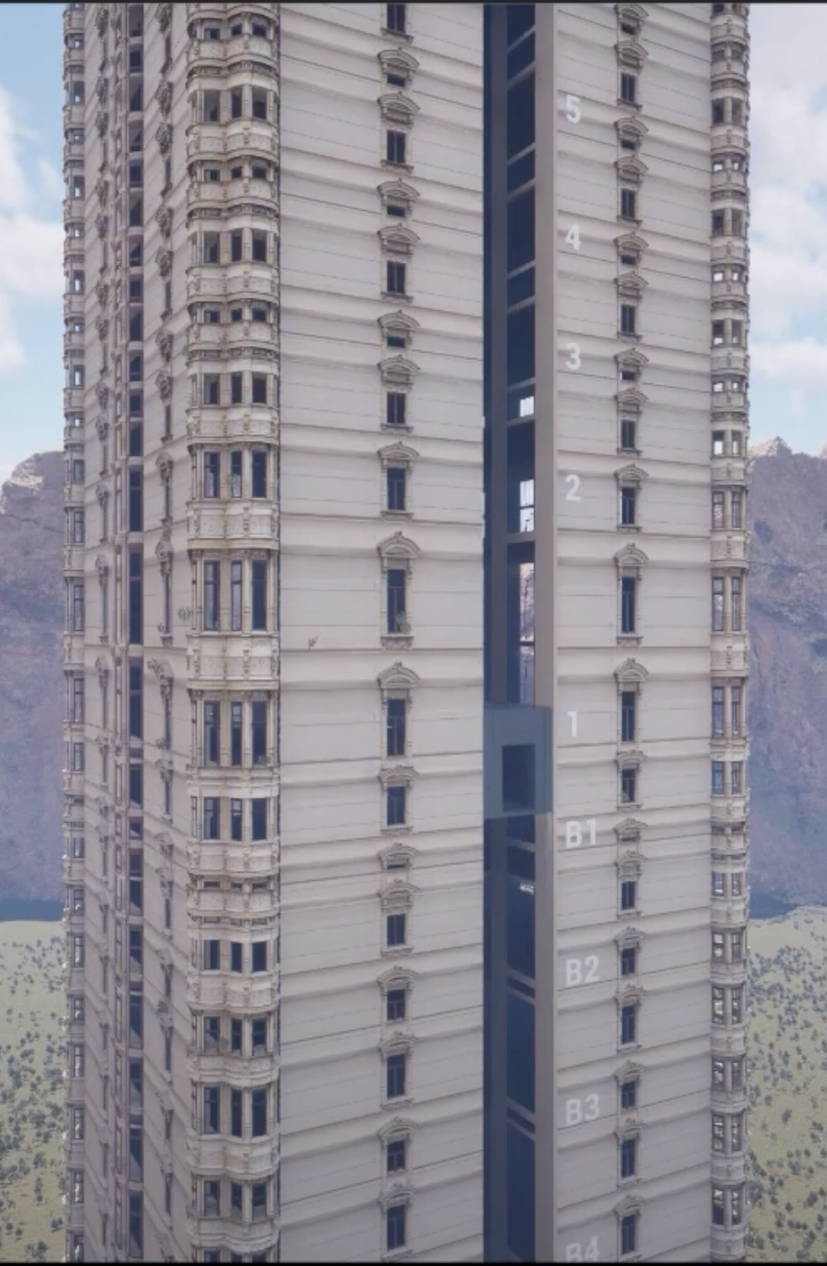
<Button>
3
Elevator
Moving Algorithm
<Direction>
up
<Button>
Digital Twin Service Server
(IN-AE)
10
<Direction>
up
<Button>
1
<Direction>
down

Slide 18
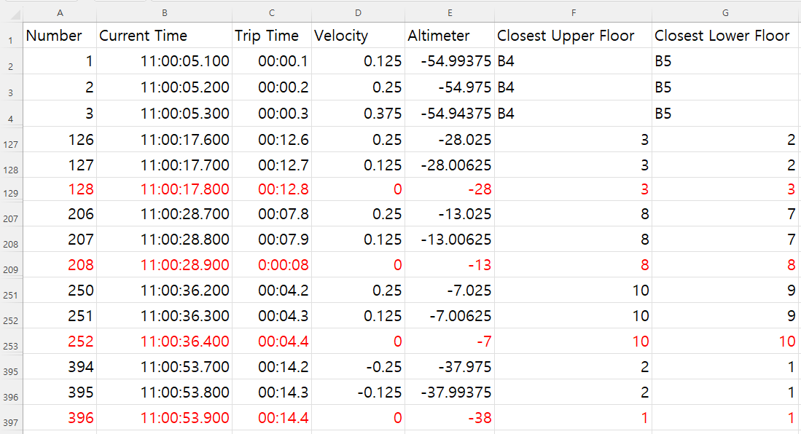

Slide 20
Energy Consumption

Slide 21
By referring to ISO-25745, we can calculate the following energy consumption.
Energy Consumption of Average Elevator Trip Distance
Energy Consumption when depart, and landing
Daily Energy Consumption when operating
Daily Energy Consumption when IDLE

Slide 22
Thank You

