Slide 1
Status of oneM2M deployment to MEC platforms
TDE-2024-0012-Status_of_oneM2M_deployment_to_MEC_platforms
JeongHun Shin, Jieun Lee, JaeSeung Song
Sejong University
2024-02-26

Slide 2
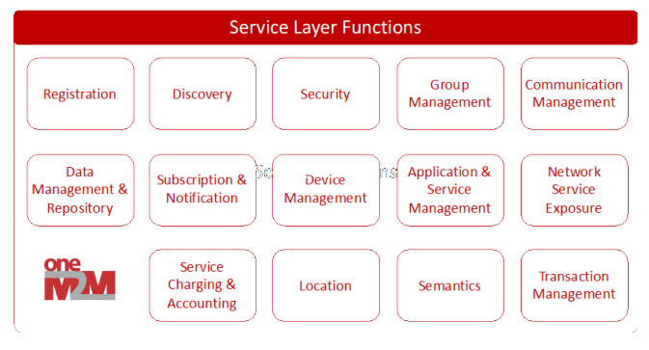
Configuration for the deployment
IoT UE
Edge Cloud
Cloud IoT Server
oneM2M IoT Service Platform
oneM2M
Edge Instance
oneM2M
Client
MEC
platform
MEC
Client
Radio Access Network
Edge configuration server

Slide 3
Available MEC platforms
Consider available MEC open sources
oneM2M platform will be deployed as an MEC App
MEC App, MEC platform and Mp1 interface must be supported
Name | Connected Vehicle Blueprint (Akraino) | EALTEdge (Akraino) | Multi-access Edge Computing Platform (Eurecom) | i-MEC (ITALTEL)
Description | CVB provides a V2X focused MEC platform, which offers services to connected vehicles | Lightweight telco edge platform, enabling Enterprise applications on telco edge | MEC platform (MEP) allows different MEC applications to discover MEP hosted services and register their own service. | Italtel MEC platform i-MEC brings high value in the network enabling a wide set of services
Support MEC components | MEC Platform(s) MEC Platform Manager | MEC Platform(s) MEC Platform Manager | MEC app MEC platform | MEC Platform
Support MEC API | MEC 011 Mp1 & Mm5 | MEC 011 Mp1 & Mm3 | MEC 011 Mp1, MEC 10-2, MEC 012 RNIS | MEC011 Mp1, Mm5 proprietary API, Mp2 proprietary API
We select these two opensource platforms

Slide 4
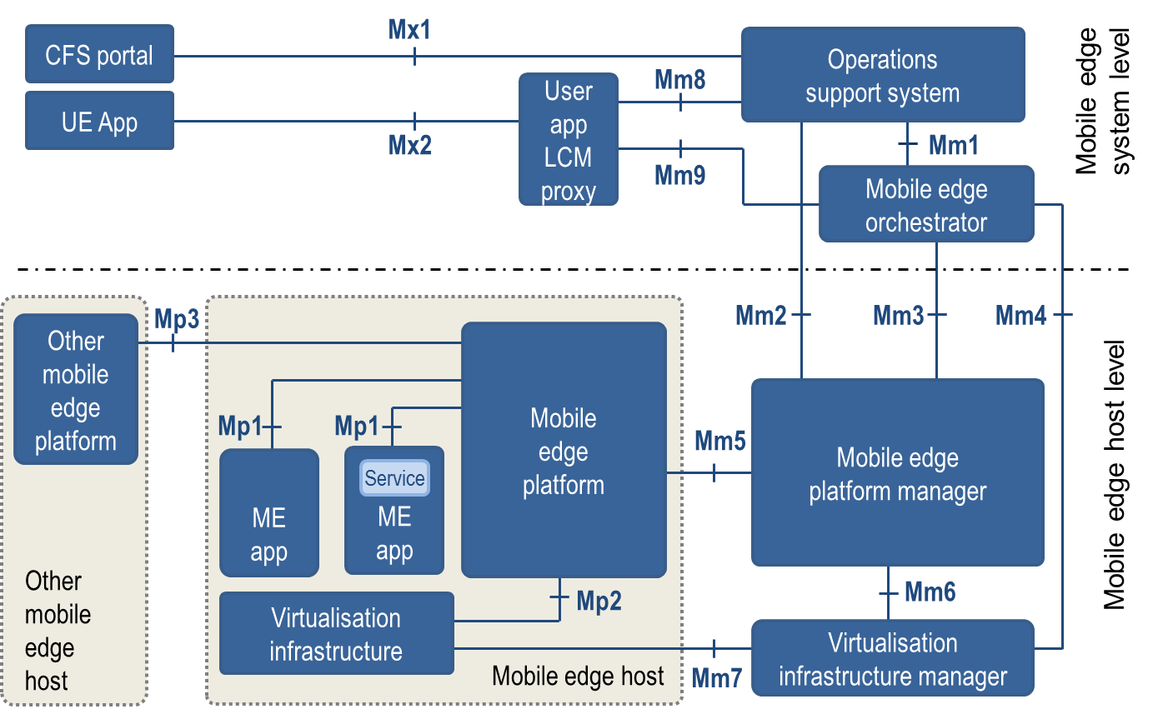
Available MEC platforms
oneM2M
Edge
Instance
(tinyIoT)
Mp1

Slide 5
Current Progress
In order to register tinyIoT with MEC Host, we first searched for open sources that support the MEC platform, Mp1 interface, and MEC App.
AKRAINO's EALTEdge and EURECOM's Multi-access Edge Computing Platform were adopted.
The final goal is to install these two open sources to deploy tinyIoT at the location of the MEC App and then perform its function as oneM2M platform.
Currently looking for ways to send MEC app instance requests to install mec app.
MEC App must go through the instantiate process in order to register, which is not implemented in current open sources such as OSS(Operation Support System) and MEPM(MEC Edge platform Management).
When the tinyIoT deployment is completed, we plan to perform basic oneM2M operations
Register oneM2M sensor and actuator to oneM2M platform in MEC
Register oneM2M edge platform to oneM2M Cloud
Control oneM2M actuator registered to the oneM2M edge platform via oneM2M application

Slide 6
Thank You

