Slide 1






Status of Smart Lift Digital Twin using oneM2M
TDE-2024-0013
Jungmin Lee, Jieun Lee, JaeSeung Song
Sejong University
2024-02-22

Slide 2
Smart Lift Digital Twin System
Smart elevator and sensors
  Send data to Digital Twin server
Digital Twin Server
  Creates oneM2M resources for Digital Twin data
  Notifies Data with oneM2M Notification
  Calculates Elevator Route with Elevator Algorithms
  Calculates energy consumption (use Discovery)
oneM2M CSE server (tested with ACME and tinyIoT)
Visualization server (Unreal Engine 5.3)
  Visualizes Digital Twin Elevator, and Logs with UI
Application Server (TBD)

Slide 3
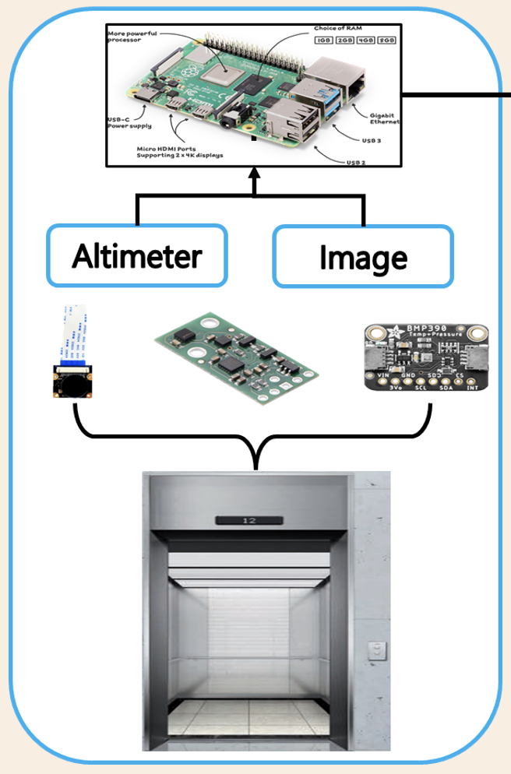
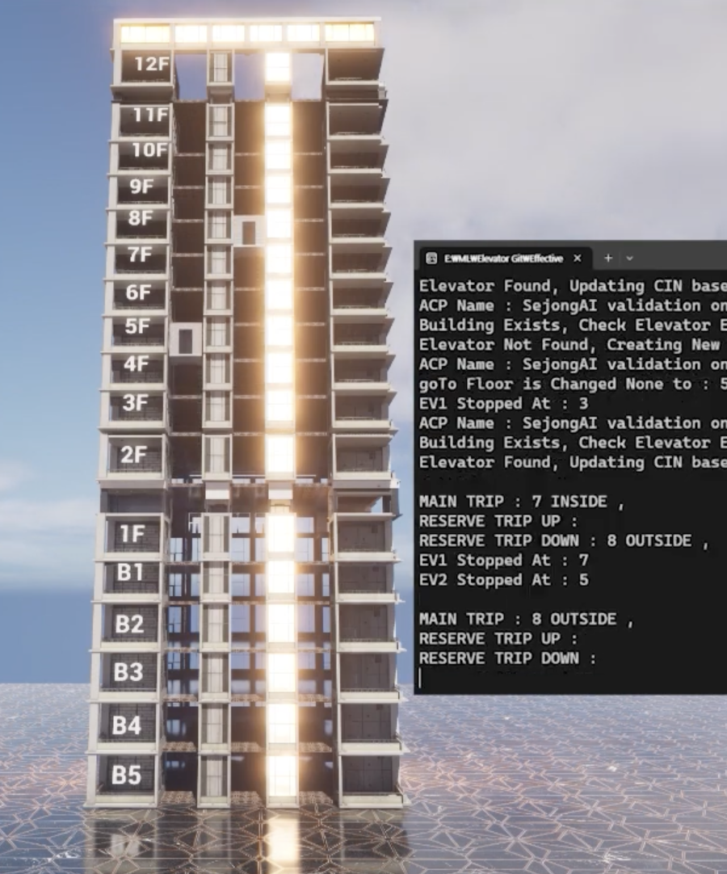
Smart Lift Digital Twin System
Digital Twin Server
(AE)
Visualisation
Mca
oneM2M
IoT Platform
(IN-CSE)
Mca

Slide 4
oneM2M resource tree for Smart Lift DT

Slide 5
Current Demo
https://youtu.be/IkXSsgiz770
Working on Making Building, Elevator, Environment Assets

Slide 6
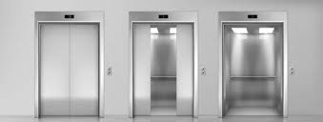
Next Steps
Prepare a data set for smart lift DT
Develop equations for energy usage
Develop two algorithms operating a lift based on the input data
Energy consumption
Energy consumption
Energy consumption
Algorithm 1
Algorithm 2
Algorithm 3
Dataset

Slide 7
Thank You

