Slide 1
Status of tinyIoT Open Source
TDE-2024-0014
JooSung Kim, Hyun Jun Kim, Jieun Lee, JaeSeung Song, TP Vice Chair
Sejong University
2024-02-22

Slide 2
tinyIoT
Light weight oneM2M CSE server
Written in C for fast execution and minimum memory usage
Protocol supported : HTTP, MQTT, COAP (recently added)
Supports
ACP, AE, CNT, CIN, SUB, GRP, CSR, CBA, AEA, CNTA, CINA
Discovery
lim, cra, crb, exa, exb, ms, us, sza, szb, sts, stb, lbl, ty, ops, pty, palb, chty, clbl, ofst

Slide 3
CoAP binding
CoAP library
LibCoAP (written in C)
Updated to handle oneM2M options
Handling process
Req_handler: parse a CoAP packet and process messages
Supports NOTIFY and FOWARDING
Support options to activate CoAP binding at the compile stage
server
mqttClient.c
httpd.c
ENABLE_MQTT
server
mqttClient.c
coap.c
httpd.c
ENABLE_MQTT
ENABLE_COAP
Req_hanldler
NOTIFY
Forwarding
Parse, Process
and Respond

Slide 4
CoAP binding
According to the TS-0008, the following contents have been implemented.
Primitive Mapping to CoAP Message
Header, Token, Payload, Response Codes Mapping
Options → From, Request Identifier, Response Status Code, Resource Type, Content Offset, Content Status, Release Version Indicator (tinyIoT supported options)
Usage of Blockwise Transfers
Mapping rules of caching
In the future, the following contents will implement.
Security Consideration → DTLS
Implement an option to activate binding protocols (HTTP, MQTT, and CoAP) when server runs
LibCoAP, server_addr, context, endpoint
initialize
oneM2M Options
Register Opts
GET, POST, PUT, DELTE
Register Handler
hnd_unknown()
Access to undefined resource URI
CRUDN
Process resource URI PATH in above request packet
hnd_coap_req()
Respond
route()
NOTIFY
If the resource is modified, notify the subscribed client.

Slide 5
Current Progress
AE, CNT, CIN
ACP, GRP, SUB
Discovery
remoteCSE
register
Announcement
rcn, drt
…
Current

Slide 6
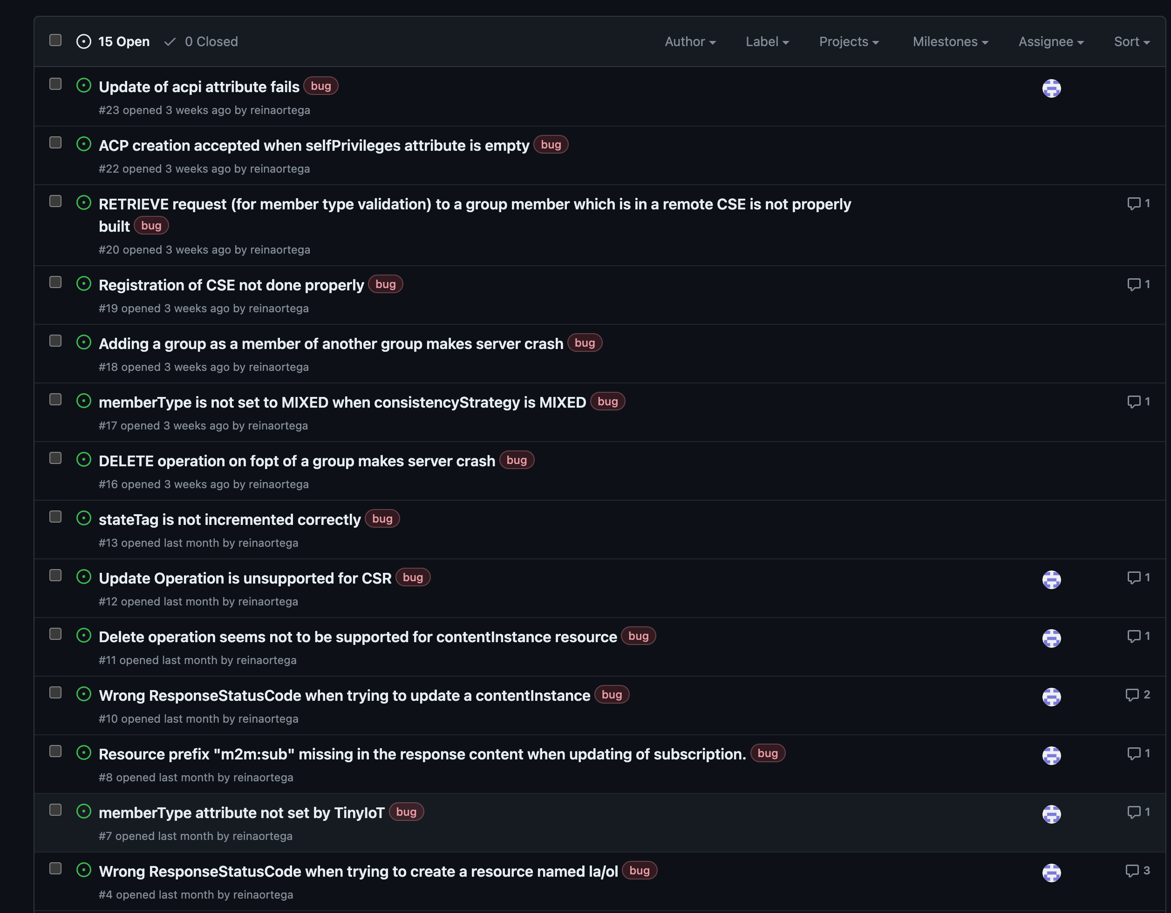
Conformance Testing
Under conformance testing
Get error reports via Git
Fixing behavior mentioned on github
Thank you, Miguel!

Slide 7
Thank You

