Slide 1
oneM2M Int’l Hackathons
SeungMyeong Jeong (KETI)
TDE#66
2024.09.12

Slide 2
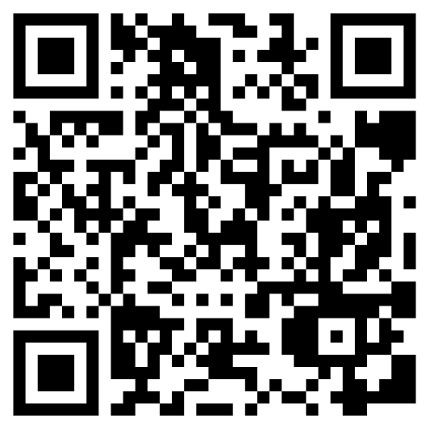
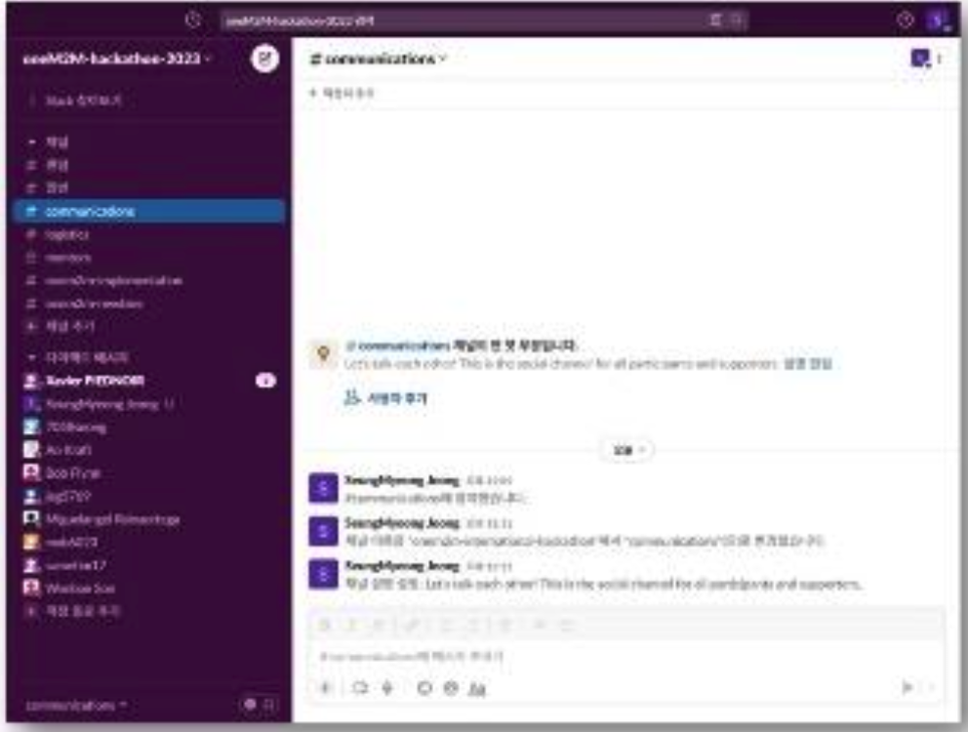
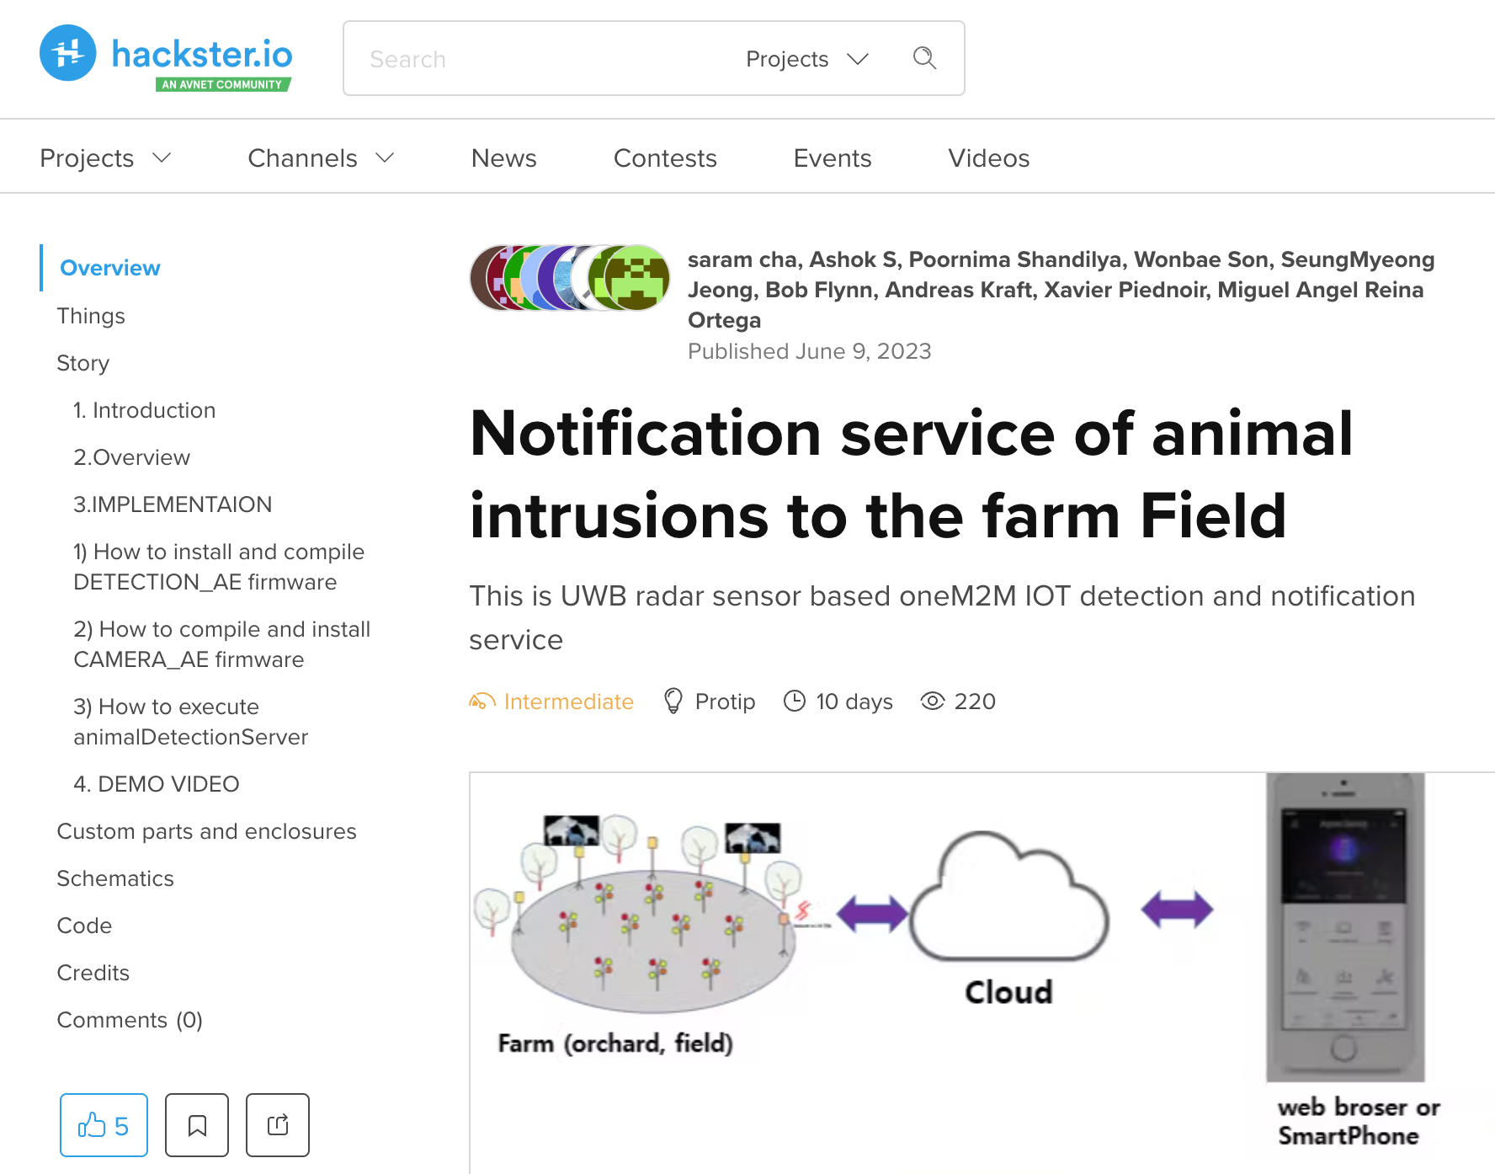
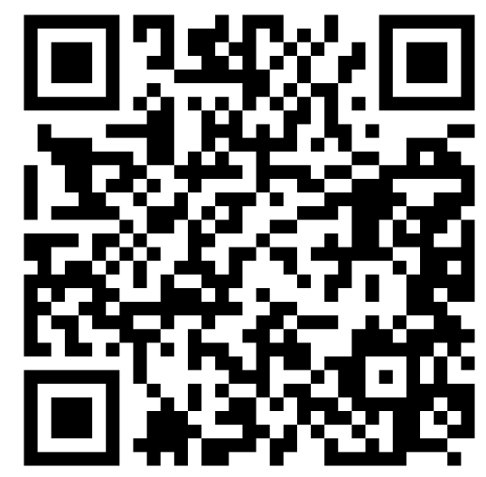
Previous int’l hackathon milestones
teams finalization
(KOR + int’l)
implementation
+ mentoring
deliverables
submission
awards ceremony
(online & offline)
announcement
applications
(KOR)
selection
(KOR)
kick-off
(online)
progress check
(online, offline)
project review
(presentation + QnA)
(online)

Slide 3
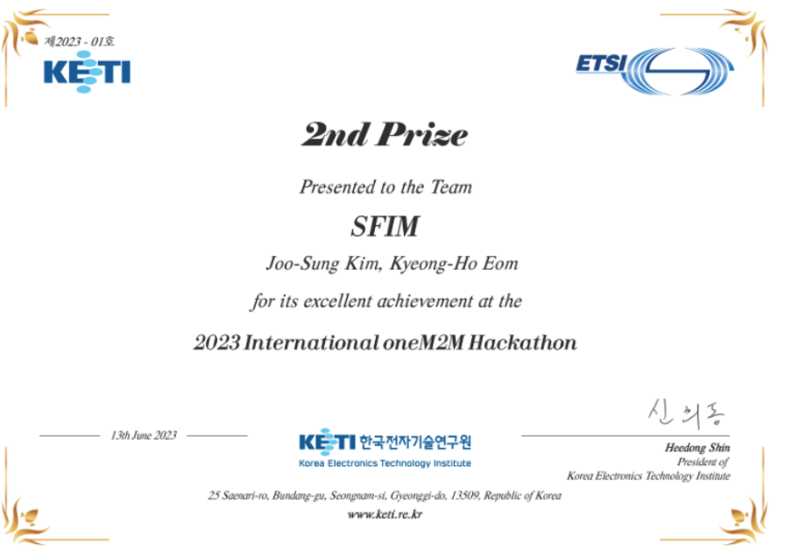
Next hackathon what/how-to
Item | Previous time | Next time
applications / selection (KOR) | Participants build-up with Korean and non-Korean teams | Omit this
announcement | Promoted over oneM2M SNS, via SDOs, networks of delegates Promoted over web & run hackathon website | Free promotions only
teams finalization | Total no. of teams are limited considering funding, human resources | TBD
kick-off | Offline studio + online streaming | Online meeting
implementation + mentoring | Provided H/W kits Communication tool (e.g. slack) | No kits provided, free comm. tool
progress check | Online for int’l team and offline for KOR teams | Online meeting
deliverables submission | Documentation on hackster.io, demo on youtube | Do the same
project review | Online review with reviewers (← mentors) | Do the same
awards ceremony | Offline studio + online streaming Rewards in cash | Online meeting, prizes w/o rewards

