Slide 1
oneM2M Int’l Hackathon 2024
TDE Chair (TDE)
TP#66, 2024.09.13
TP-2024-0076-oneM2M_international_hackathon_2024

Slide 2
2024 oneM2M Hackathon Plan
What | How | Who
applications / selection | Registration process via ETSI website, alternatively via DISCORD registration | Miguel (probably Yes)
announcement | Promoted over oneM2M SNS, via SDOs, networks of delegates | MARCOM (Bindoo), Partners (ETSI, TIA, TSDSI, TTA), oneM2M Delegates
teams finalization | Total no. of teams are limited considering human resources | TDE - Mentors
kick-off | oneM2M Teams or GTM | TDE
mentoring | Communication tool – Discord (Andreas) | TDE – SeungMyeong, Bob, Andreas K, Andreas N, Miguel, Poornima, Akash (Volunteers)
progress check | Online meetings | Mentors
deliverables submission | Documentation on hackster.io, demo on youtube | Mentors
project review | Online review with reviewers (Rubric) | Mentors
awards ceremony | Certificates from oneM2M | Miguel

Slide 3
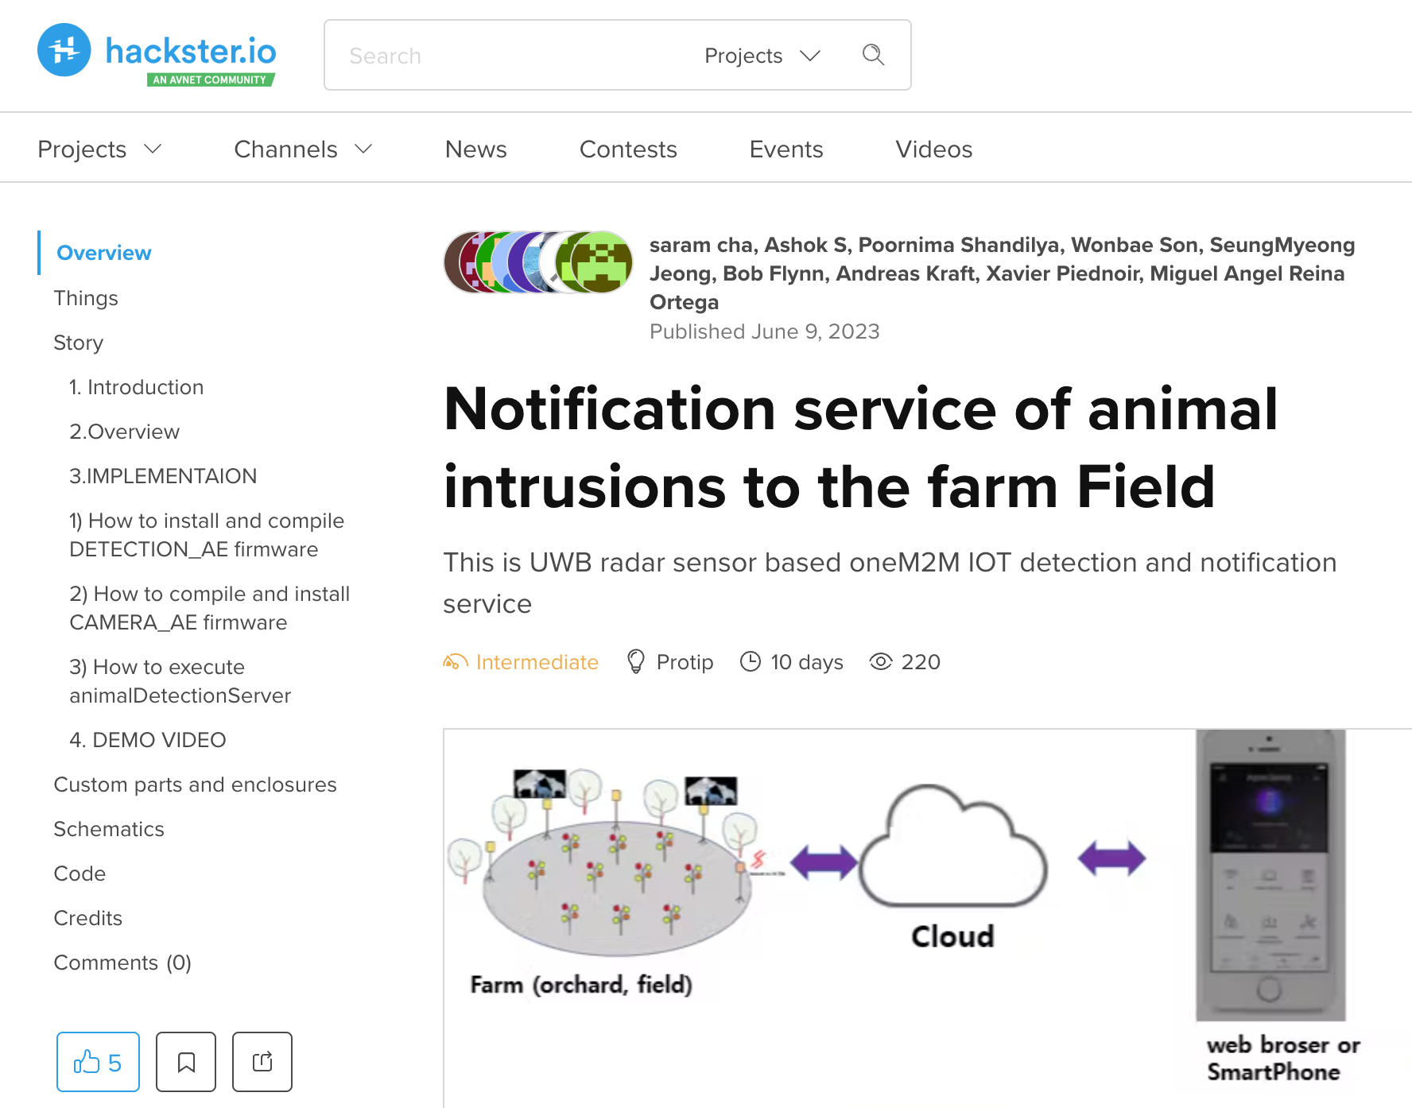
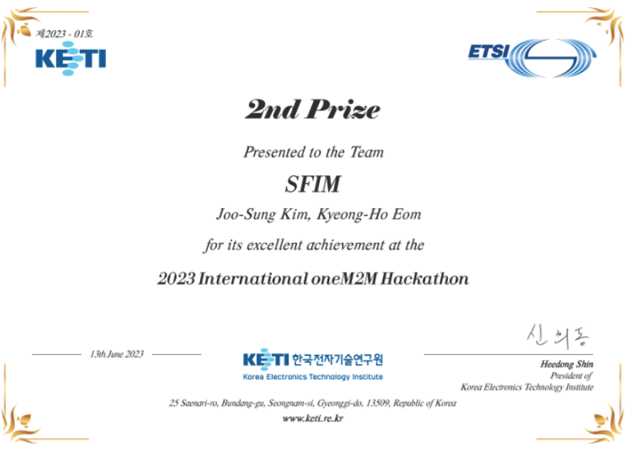
2024 oneM2M Hackathon Schedule
Immediately
MARCOM & Partners
announcement
NLT 5 Oct
TDE
teams finalization
TDE
implementation
+ mentoring
17 Nov
deliverables
submission
2 Dec
awards
Applications
Selection
TDE
kick-off
7 Oct
1PM CET
progress check
TDE
project review
(presentation + QnA)
TDE
25-29 Nov
Top 10(?)

Slide 4
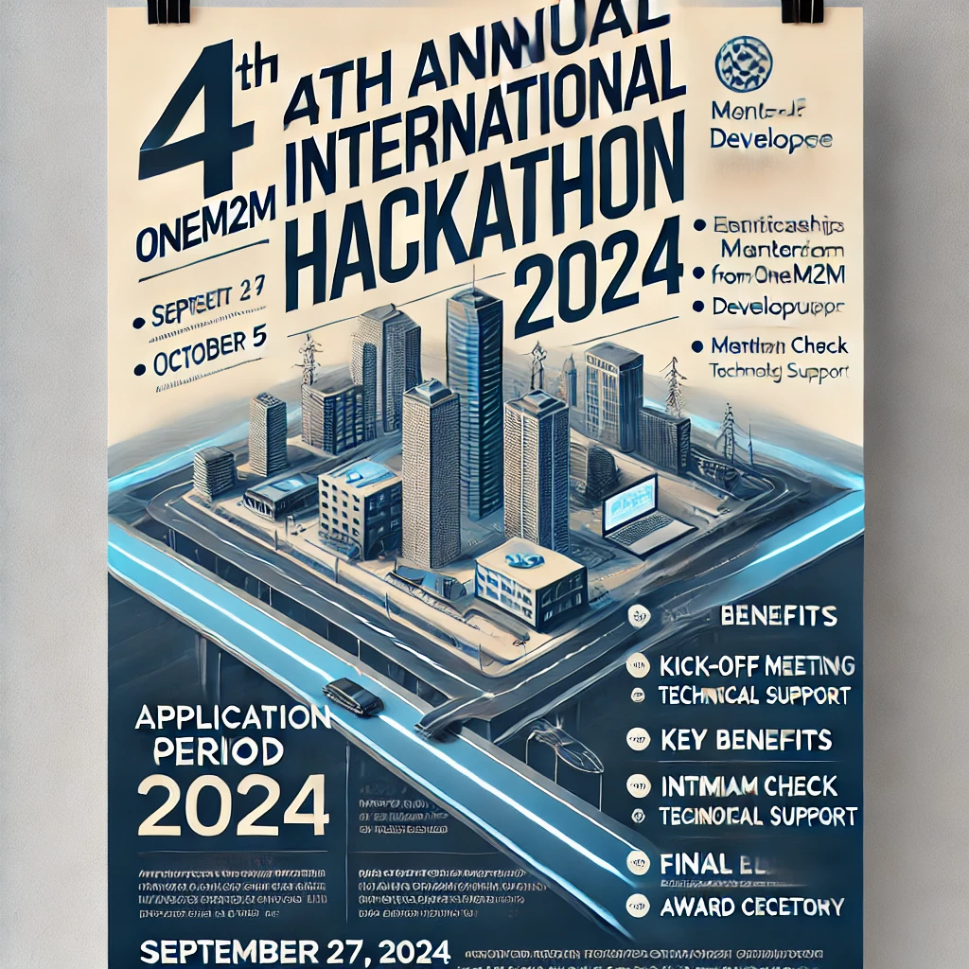
Chat GPT generated poster

