Slide 1
Release 1 Primer What’s in there, and why is it important?
Dr. Josef J. Blanz
Principal Engineer, Qualcomm
jblanz@qti.qualcomm.com
oneM2M www.oneM2M.org

Slide 2
Outline:
What?
Why?
How?
What?
Next?
Where?

Slide 3
Outline:
What is oneM2M about?
Why is it important?
How does it work?
What is covered?
Next steps in oneM2M?
Where to find info?

Slide 4
What is oneM2M about?

Slide 5
What is oneM2M about?
M2M IoT IoE

Slide 6
What is oneM2M about?
M2M IoT IoE …???

Slide 7
Short Recap

Slide 8
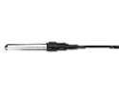
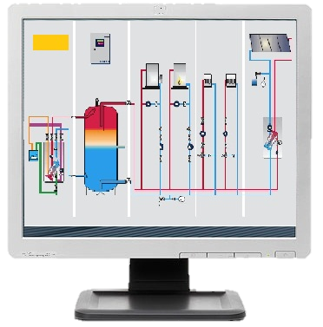
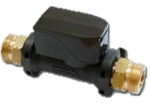
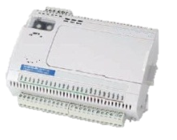
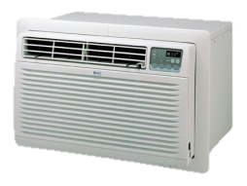
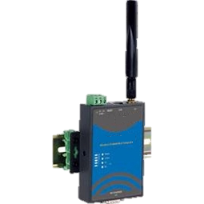
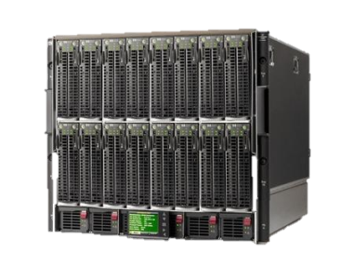
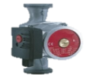
HAV
temp
flow
I/O
heat
A/C
valve
pump

Slide 9
HAV
temp
flow
I/O
heat
A/C
valve
pump
LAN
WWAN
WAN

Slide 10
HAV
temp
App
App
App
App
App
App
heat
I/O
heat
I/O
A/C
flow
A/C
valve
pump
LAN
WWAN
WAN

Slide 11
HAV
temp
App
App
App
App
App
App
heat
I/O
heat
I/O
A/C
flow
A/C
valve
MW
MW
pump
LAN
WWAN
WAN

Slide 12
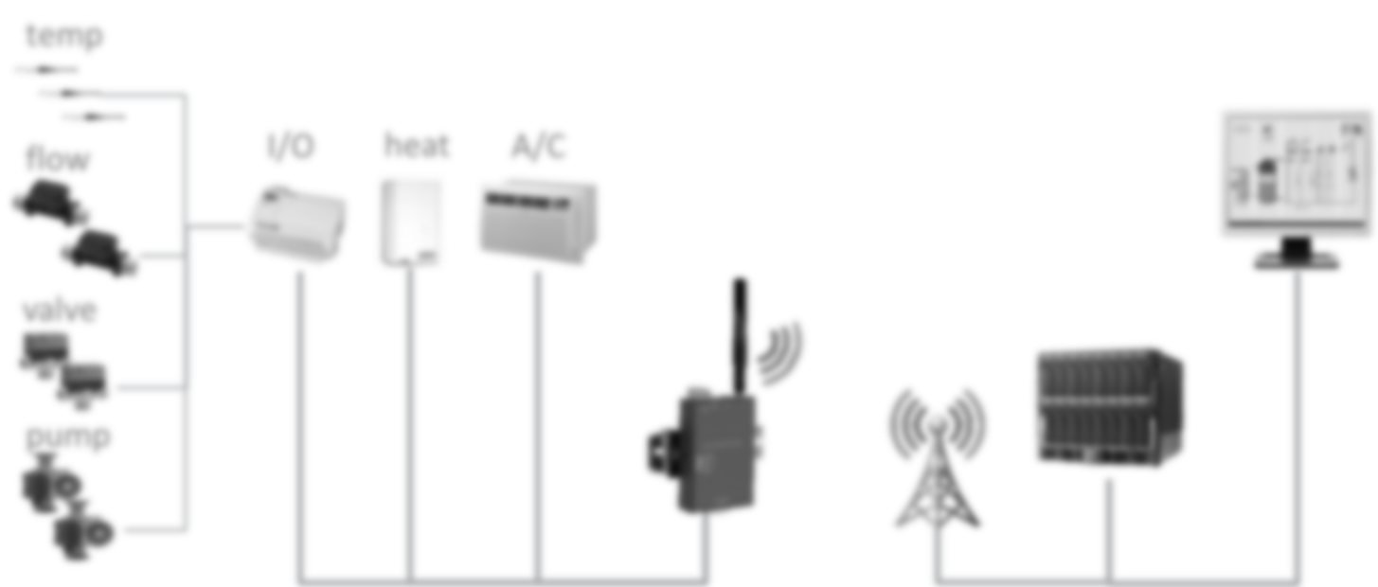
HAV
App
App
App
App
App
App
I/O
heat
A/C
MW
MW
LAN
WWAN
WAN

Slide 13
HAV
App
App
App
App
App
App
I/O
heat
A/C
MW
MW
Communication Network(s)

Slide 14
HAV
App
App
App
App
App
App
I/O
heat
A/C
MW
MW
Communication Network(s)

Slide 15
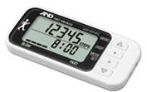
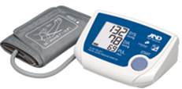
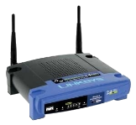
eHealth
Doctor

Slide 16
eHealth
Doctor
WLAN
WAN

Slide 17
eHealth
App
App
App
App
App
I/O
heat
A/C
Doctor
WLAN
WAN

Slide 18
eHealth
App
App
App
App
App
I/O
heat
A/C
Doctor
MW
MW
WLAN
WAN

Slide 19
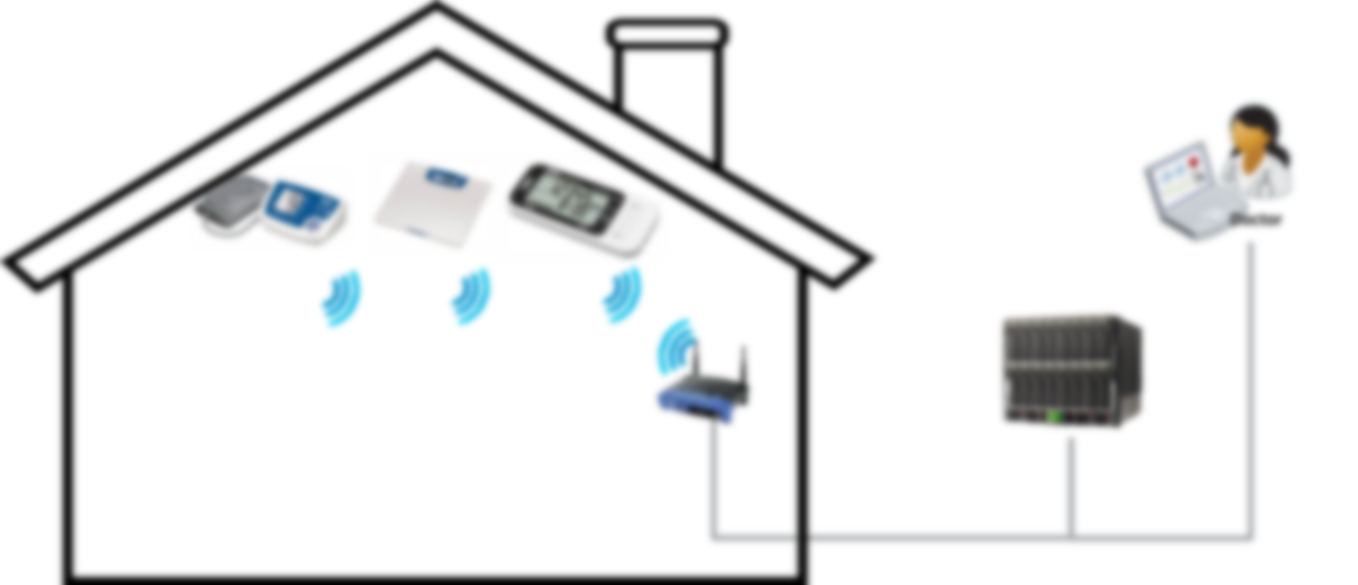
eHealth
App
App
App
App
App
I/O
heat
A/C
MW
MW
WLAN
WAN

Slide 20
eHealth
App
App
App
App
App
I/O
heat
A/C
MW
MW
Communication Network(s)

Slide 21
eHealth
App
App
App
App
App
I/O
heat
A/C
MW
MW
Communication Network(s)

Slide 22
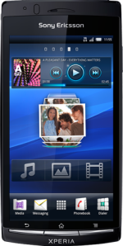
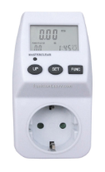
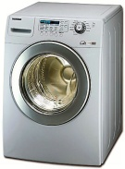
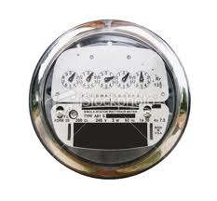
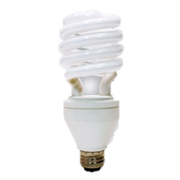
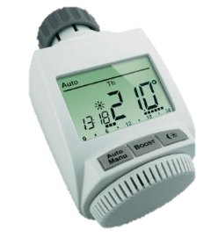
Smart Home

Slide 23
Smart Home
LAN/WLAN
WAN

Slide 24
Smart Home
App
App
App
App
App
App
App
I/O
heat
A/C
LAN/WLAN
WAN

Slide 25
Smart Home
App
App
App
App
App
App
App
I/O
heat
A/C
MW
MW
LAN/WLAN
WAN

Slide 26
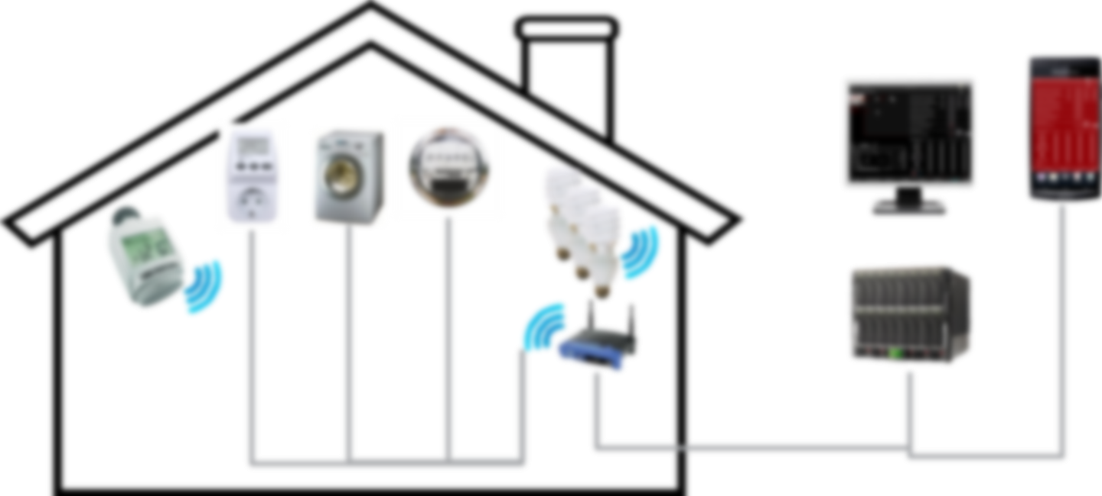
Smart Home
App
App
App
App
App
App
App
I/O
heat
A/C
MW
MW
LAN/WLAN
WAN

Slide 27
Smart Home
App
App
App
App
App
App
App
I/O
heat
A/C
MW
MW
Communication Network(s)

Slide 28
Automotive
App
App
App
App
App
App
I/O
A/C
MW
MW
Communication Network(s)

Slide 29
Metering
App
App
App
App
App
heat
MW
MW
Communication Network(s)

Slide 30
Asset Monitoring
App
App
App
App
App
A/C
MW
MW
Communication Network(s)

Slide 31
XYZ
App
App
App
App
MW
MW
Communication Network(s)

Slide 32
It all looks similar

Slide 33
It is all one…

Slide 34
It is all oneM2M

Slide 35
oneM2M
Application Layer
AE
AE
AE
AE
AE
I/O
heat
A/C
Service Layer
CSE
CSE
CSE
Network Layer
Communication Network(s)
AE: Application Entity
CSE: Common Services Entity

Slide 36
oneM2M
It is Software/Middleware
It sits between applications and data processing & communication HW
Integrated into devices/gateways/servers e.g. sensors, actors, things, routers, cloud
Connects data producers and consumers in secure manner
Hides complexity of NW usage from apps
Controls when communication happens
Increases efficiency of data transport
Stores and shares data
Supports access control
Notifies about events
Talks to groups of things
Manages devices on large scale
Application Layer
Service Layer
Network Layer

Slide 37
oneM2M
…
HAV Apps
Home Apps
Asset Apps
eHealth Apps
Simple APIs via Standardized Reference Points
Service Layer
Data Processing Resources & Protocols (selection) & Communication HW
Communication Network(s)
Horizontal layer of functions commonly needed across different segments Similar: Generic OS versus use case-specific application

Slide 38
Interworking
Home Apps
eHealth Apps
…
HAV Apps
Standard X
Asset Apps
Standard Y
Simple APIs via Standardized Reference Points & Interworking
Service Layer
Data Processing Resources & Protocols (selection) & Communication HW
Communication Network(s)
Horizontal layer of functions commonly needed across different segments Similar: Generic OS versus use case-specific application

Slide 39
Check out last webinar for…
Taking a Look Inside
by Nicolas Damour
Senior Manager for Business and Innovation Development, Sierra Wireless and Chair of Architecture Working Group
Held on October 30th 2014
http://www.onem2m.org/technical/webinars

Slide 40
Why is it important?

Slide 41
Why is it important?
Cost ↓ Fragmentation ↓
Opportunities ↑

Slide 42
Why is it important?
Cost ↓ Fragmentation ↓ Opportunities ↑ …???

Slide 43
Reduced CAPEX
Lower complexity of development
Functions provided by the M2M SL do not need to be developed in a proprietary way, think “library”
Programmer does not need to be a communications expert
Standardized protocols & APIs
simplifies application development, testing and interworking of components
Horizontal SL reduces deployment cost
No need for vertical/segment-specific platforms
Shared infrastructure, still isolated well and secure
Allows for scaling; same components in different industries
Higher component volumes
Faster Time to Market

Slide 44
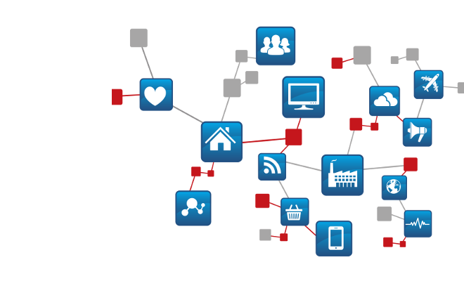
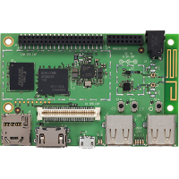
CAPEX Impact
Application Development
Service Deployment
Simple APIs
General Purpose Volume ↑
Unified Platform
CSE
M2M/IoT Service Provider
e.g. Library
e.g. Modules or Gateways
Server
Developer:
CSE functions ready to use
No module/network expert needed
App development independent of underlying transport
Standard message exchanges
Focus on use case logic
Faster development process
Only one platform
Serves commonly needed functions to different use cases and applications
Shared infrastructure & core service across different customers / verticals
AE
AE
AE
Lower CAPEX
CSE
NW

Slide 45
Reduced OPEX
Communication Efficiency
Policy-Driven Communication
Store-and-forward with Scheduling and Access Selection
Allows to adjust to cost / efficiency needs
Event Communication
Only send information when relevant events happen
Sensor/Actor/Data Sharing
Produce once, consume multiple times Share sensors / actors across use cases
Flexibility
Utilize best transport network to meet business needs
Applications do not need to be aware of connectivity options supported by devices
Same service layer for different verticals / segments
Reduces cost of operation
Possibility to share infrastructure with other verticals and only pay for service used

Slide 46
OPEX Impact
NW Efficiency & Protection
Sensor/Actor/Data Sharing
alarm
producer
Consumers
log
consumer
polling
Producer
Windows Sensors: Security Service HAV-System Home GUI
t
t
Access Control
Storage
Access Control
Policies
Sensor or Data Source
alarm
producer
events
log
consumer
Producers
t
t
Consumer
Door Locks: Security Service Control Panel Home GUI
Communication Cost↓
Access Control
Access Control
Actor or Data Sink
Storage
Flexible Choices
Single Platform
Minimize maintenance expenses
Shared infrastructure
Scalable to volume/processing needed
AE
AE
Lower OPEX
CSE
CSE
CSE
Access 1
Access 1&2
NW

Slide 47
Horizontal Opportunities
Share sensors/actors/events/data across applications or verticals
Allows for new business models / added value
Governed by access control
Unified horizontal M2M/IoT data & event communication and sharing platform
Streamlined communication and sharing functions
Easy interworking with vertical/application-specific standards
Developer can just focus on application logic
Does not need to implement communications / data sharing details
Address new markets and products
Due to reduction in CAPEX/OPEX and complexity, M2M & IoT solutions can be addressing use cases where development cost and time was prohibitive so far

Slide 48
Motivation for Transition
Vertical Silos
Interconnected Silos
Intra-Vertical or Intra-Use Case
Lower cost
CAPEX & OPEX impact as explained, easier to maintain, focus only on Apps
Larger eco system: More choices
Transition from one SP to another SP using same standard
Chose from different SW/HW vendors that offer standard compliant products
Select products that match with individual requirements, minimize cost for customization
Inter-Vertical or Inter-Use Case
All of the motivators above, plus:
New opportunities
Shared access to sensors/actors/events/data allows for new business models / added value
X-access allows for synergies between so-far isolated silos

Slide 49
How does it work?

Slide 50
Request / Response Paradigm
Entities communicate with each other via pairs of requests and responses
A request-message triggers a response message
Request/Response pattern allows for robust data transport when needed
Request/Response pattern allows for subscribe/notify mechanisms
Request / Response pattern is quite flexible as it can be used to accommodate other message passing patterns as well.
Originators: AEs or CSEs Receivers: CSEs, AE (optional)

Slide 51
Resource oriented approach in oneM2M
REST = Representational State Transfer
Dissertation by Thomas Roy Fielding, 2000 {HTTP contributor}
Architectural style for distributed applications
State information is residing in hosted resources only
Interfaces between entities use stateless communication
Requests can be processed based on resource state and request itself => idempotent
State transition is done by manipulation of resources
Simple and uniform interfaces are used to access resources
Create, Retrieve, Update, Delete
All services offered via addressable resources with access control
Idempotency is key for scalability (caches, proxies, drops, repetitions)
oneM2M not strictly REST but RESTful / resource oriented
Also added notifications

Slide 52
Simplified Event Flow
Secure Remote Provisioning
Supports legacy Device Management protocols
Roll-out of Security Credentials, Registration Targets, Entity-IDs etc.
Establish Secure Communication *
Hop by hop between neighboring oneM2M entities
Data Sharing governed by Access Control *
Discovery of resources (special form of Retrieve)
CRUD access to data sharing resources (e.g. containers, groups)
Establishment of subscriptions
Execution of Notifications when subscriptions trigger
Policy-driven communications
CMDH: Communication Management and Delivery Handling
Device Management
Application life cycle management, diagnostics etc.
* Some more details on following slides

Slide 53
10,000 foot view
1
2
3
4
M2M Service Activation & Initial Device Provisioning
Secure M2M Communication & M2M Service Registration
‘Normal’ M2M Service Operation,
CRUD & N exchanges
Device Management Actions

Slide 54
Secure Communication
From “Facing the Challenges of M2M Security and Privacy” Webinar by Phil Hawkes
Hop-by-Hop
TLS/DTLS v1.2
AE-CSE
AE: TLS Client (C)
CSE: TLS Server (S)
CSE-CSE
CSE1: TLS Client (C)
CSE2: TLS Server (S)
Field Domain
Sensor
Gateway
C
S
AE1
CSE1
C
S
C
S
AE2
CSE2
M2M SP’s Server
Web App
Server
Infrastructure
Domain
Check out : https://www.brighttalk.com/webcast/11949/133367 for details on authentication options etc.

Slide 55
Example: Data Sharing
Infrastructure
Cloud AE3
CSE
Gateway
Cellular Network
Cloud AE2
Device
CSE
C
Local Connectivity
Cloud AE1
Sensor AE
subscribed
CMDH
CMDH

Slide 56
Example: Data Sharing
Infrastructure
Cloud AE3
CSE
Gateway
Cellular Network
Cloud AE2
Device
CSE
C
Local Connectivity
Cloud AE1
Sensor AE
subscribed
CMDH
CMDH
New measurement #1 taken Originator: Sensor AE; Receiver: CSE on Gateway; Target: CSE in cloud Create //SL-Cloud/C, not urgent, complete by 4:00 am
Policies on MN say: For “not urgent” => only from 2 am to 5 am
CSE on Gateway accepts and buffers request in CMDH
10:00 pm
Container Resource

Slide 57
Example: Data Sharing
Infrastructure
Cloud AE3
CSE
Gateway
Cellular Network
Cloud AE2
Device
CSE
C
Local Connectivity
Cloud AE1
Sensor AE
subscribed
CMDH
CMDH
New measurement #1 taken Originator: Sensor AE; Receiver: CSE on Gateway; Target: CSE in cloud Create //SL-Cloud/C, not urgent, complete by 4:00 am
Policies on MN say: For “not urgent” => only from 2 am to 5 am
CSE on Gateway accepts and buffers request in CMDH
10:00 pm

Slide 58
Example: Data Sharing
Infrastructure
Cloud AE3
CSE
Gateway
Cellular Network
Cloud AE2
Device
CSE
C
Local Connectivity
Cloud AE1
Sensor AE
subscribed
CMDH
CMDH
New measurement #1 taken Originator: Sensor AE; Receiver: CSE on Gateway; Target: CSE in cloud Create //SL-Cloud/C, not urgent, complete by 4:00 am
Policies on MN say: For “not urgent” => only from 2 am to 5 am
CSE on Gateway accepts and buffers request in CMDH
10:00 pm

Slide 59
Example: Data Sharing
Infrastructure
Cloud AE3
CSE
Gateway
Cellular Network
Cloud AE2
Device
CSE
C
Local Connectivity
Cloud AE1
Sensor AE
subscribed
CMDH
CMDH
New measurement #2 taken Originator: Sensor AE; Receiver: CSE on Gateway; Target: CSE in cloud Create //SL-Cloud/C, not urgent, complete by 4:00 am
Policies on MN say: For “not urgent” => only from 2 am to 5 am
CSE on Gateway accepts and buffers request in CMDH
10:05 pm

Slide 60
Example: Data Sharing
Infrastructure
Cloud AE3
CSE
Gateway
Cellular Network
Cloud AE2
Device
CSE
C
Local Connectivity
Cloud AE1
Sensor AE
subscribed
CMDH
CMDH
New measurement #2 taken Originator: Sensor AE; Receiver: CSE on Gateway; Target: CSE in cloud Create //SL-Cloud/C, not urgent, complete by 4:00 am
Policies on MN say: For “not urgent” => only from 2 am to 5 am
CSE on Gateway accepts and buffers request in CMDH
10:05 pm

Slide 61
Example: Data Sharing
Infrastructure
Cloud AE3
CSE
Gateway
Cellular Network
Cloud AE2
Device
CSE
C
Local Connectivity
Cloud AE1
Sensor AE
subscribed
CMDH
CMDH
New measurement #2 taken Originator: Sensor AE; Receiver: CSE on Gateway; Target: CSE in cloud Create //SL-Cloud/C, not urgent, complete by 4:00 am
Policies on MN say: For “not urgent” => only from 2 am to 5 am
CSE on Gateway accepts and buffers request in CMDH
10:05 pm

Slide 62
Example: Data Sharing
Infrastructure
Cloud AE3
CSE
Gateway
Cellular Network
Cloud AE2
Device
CSE
C
Local Connectivity
Cloud AE1
Sensor AE
subscribed
CMDH
CMDH
New measurement #24 taken Originator: Sensor AE; Receiver: CSE on Gateway; Target: CSE in cloud Create //SL-Cloud/C, not urgent, complete by 4:00 am
Policies on MN say: For “not urgent” => only from 2 am to 5 am
CSE on Gateway accepts and buffers request in CMDH
11:55 pm

Slide 63
Example: Data Sharing
Infrastructure
Cloud AE3
CSE
Gateway
Cellular Network
Cloud AE2
Device
CSE
C
Local Connectivity
Cloud AE1
Sensor AE
subscribed
CMDH
CMDH
New measurement #24 taken Originator: Sensor AE; Receiver: CSE on Gateway; Target: CSE in cloud Create //SL-Cloud/C, not urgent, complete by 4:00 am
Policies on MN say: For “not urgent” => only from 2 am to 5 am
CSE on Gateway accepts and buffers request in CMDH
11:55 pm

Slide 64
Example: Data Sharing
Infrastructure
Cloud AE3
CSE
Gateway
Cellular Network
Cloud AE2
Device
CSE
C
Local Connectivity
Cloud AE1
Sensor AE
subscribed
CMDH
CMDH
New measurement #24 taken Originator: Sensor AE; Receiver: CSE on Gateway; Target: CSE in cloud Create //SL-Cloud/C, not urgent, complete by 4:00 am
Policies on MN say: For “not urgent” => only from 2 am to 5 am
CSE on Gateway accepts and buffers request in CMDH
11:55 pm

Slide 65
Example: Data Sharing
Infrastructure
Cloud AE3
CSE
Gateway
Cellular Network
Cloud AE2
Device
CSE
C
Local Connectivity
Cloud AE1
Sensor AE
subscribed
CMDH
CMDH
CMDH in Gateway decides to forward buffered requests.
Bundles them in a single payload, sends Request to cloud.
CREATE <delivery>, event category=“not urgent”, lifespan={soonest of all buffered}
CSE in cloud finds out it is the final target. Accepts the request
02:00 am

Slide 66
Example: Data Sharing
Infrastructure
Cloud AE3
CSE
Gateway
Cellular Network
Cloud AE2
Device
CSE
C
Local Connectivity
Cloud AE1
Sensor AE
subscribed
CMDH
CMDH
CMDH in Gateway decides to forward buffered requests.
Bundles them in a single payload, sends Request to cloud.
CREATE <delivery>, event category=“not urgent”, lifespan={soonest of all buffered}
CSE in cloud finds out it is the final target. Accepts the request
02:00 am

Slide 67
Example: Data Sharing
Infrastructure
Cloud AE3
CSE
Gateway
Cellular Network
Cloud AE2
Device
CSE
C
Local Connectivity
Cloud AE1
Sensor AE
subscribed
CMDH
CMDH
CMDH in Gateway decides to forward buffered requests.
Bundles them in a single payload, sends Request to cloud.
CREATE <delivery>, event category=“not urgent”, lifespan={soonest of all buffered}
CSE in cloud finds out it is the final target. Accepts the request
02:00 am

Slide 68
Example: Data Sharing
Infrastructure
Cloud AE3
CSE
Gateway
Cellular Network
Cloud AE2
Device
CSE
C
Local Connectivity
Cloud AE1
Sensor AE
subscribed
CMDH
CMDH
CMDH in Gateway decides to forward buffered requests.
Bundles them in a single payload, sends Request to cloud.
CREATE <delivery>, event category=“not urgent”, lifespan={soonest of all buffered}
CSE in cloud finds out it is the final target. Accepts the request
02:00 am

Slide 69
Example: Data Sharing
Infrastructure
Cloud AE3
CSE
Gateway
Cellular Network
Cloud AE2
Device
CSE
C
Local Connectivity
Cloud AE1
Sensor AE
subscribed
CMDH
CMDH
CMDH in Gateway decides to forward buffered requests.
Bundles them in a single payload, sends Request to cloud.
CREATE <delivery>, event category=“not urgent”, lifespan={soonest of all buffered}
CSE in cloud finds out it is the final target. Accepts the request
02:00 am

Slide 70
Example: Data Sharing
Infrastructure
Cloud AE3
CSE
Gateway
Cellular Network
Cloud AE2
Device
CSE
C
Local Connectivity
Cloud AE1
Sensor AE
subscribed
CMDH
CMDH
CMDH in cloud unwraps the contained requests, CSE in cloud produces all the requested Creates to C
02:00 am

Slide 71
Example: Data Sharing
Infrastructure
Cloud AE3
CSE
Gateway
Cellular Network
Cloud AE2
Device
CSE
C
Local Connectivity
Cloud AE1
Sensor AE
subscribed
CMDH
CMDH
CMDH in cloud unwraps the contained requests, CSE in cloud produces all the requested Creates to C
02:00 am

Slide 72
Example: Data Sharing
Infrastructure
Cloud AE3
CSE
Gateway
Cellular Network
Cloud AE2
Device
CSE
C
Local Connectivity
Cloud AE1
Sensor AE
subscribed
CMDH
CMDH
CMDH in cloud unwraps the contained requests, CSE in cloud produces all the requested Creates to C
02:00 am

Slide 73
Example: Data Sharing
Infrastructure
Cloud AE3
CSE
Gateway
Cellular Network
Cloud AE2
Device
CSE
C
Local Connectivity
Cloud AE1
Sensor AE
subscribed
CMDH
CMDH
CSE in cloud notifies M2M Customer’s Application “Cloud AE1” about new data in C
02:00 am

Slide 74
Example: Data Sharing
Infrastructure
Cloud AE3
CSE
Gateway
Cellular Network
Cloud AE2
Device
CSE
C
Local Connectivity
Cloud AE1
Sensor AE
subscribed
CMDH
CMDH
CSE in cloud notifies M2M Customer’s Application “Cloud AE1” about new data in C
02:00 am

Slide 75
Example: Data Sharing
Infrastructure
Cloud AE3
CSE
Gateway
Cellular Network
Cloud AE2
Device
CSE
C
Local Connectivity
Cloud AE1
Sensor AE
subscribed
CMDH
CMDH
“Cloud AE1” fetches new data in C
02:00 am

Slide 76
Example: Data Sharing
Infrastructure
Cloud AE3
CSE
Gateway
Cellular Network
Cloud AE2
Device
CSE
C
Local Connectivity
Cloud AE1
Sensor AE
subscribed
CMDH
CMDH
“Cloud AE1” fetches new data in C
02:00 am

Slide 77
Example: Data Sharing
Infrastructure
Cloud AE3
CSE
Gateway
Cellular Network
Cloud AE2
Device
CSE
C
Local Connectivity
Cloud AE1
Sensor AE
subscribed
CMDH
CMDH
“Cloud AE2” fetches data in C once a day at 3:00 am.
Got Access Privileges => OK
03:00 am

Slide 78
Example: Data Sharing
Infrastructure
Cloud AE3
CSE
Gateway
Cellular Network
Cloud AE2
Device
CSE
C
Local Connectivity
Cloud AE1
Sensor AE
subscribed
CMDH
CMDH
“Cloud AE3” tries to fetch data in C at 4:00 am.
No Access Privileges => Denied!
04:00 am

Slide 79
What is covered?
From “TAKING A LOOK INSIDE” Webinar by Nicolas Damour,
Requirements TS-0002 (WI-0001)
Functional
Architecture
TS-0001 (WI-0002)
Definitions & Acronyms
TS-0011 (WI-0003)
Service Layer
Core Protocols
TS-0004 (WI-0009)
HTTP Protocol Binding TS-0009 (WI-0013)
CoAP Protocol Binding TS-0008 (WI-0012)
Management Enabl^{nt} - OMA TS-0005 (WI-0010)
Management Enabl^{nt} - BBF TS-0006 (WI-0010)
MQTT Protocol Binding TS-0010 (WI-0014)
Security Solutions TS-0003 (WI-0007)
See webinar at https://www.brighttalk.com/webcast/11949/129553
Work program at http://ftp.onem2m.org/Work Programme/

Slide 80
Next steps in oneM2M
The Work Program for Release 2 of oneM2M Specifications includes the following areas:
Architecture enhancements
Advanced interworking with other systems: AllJoyn interworking, OMA LWM2M interworking
Improvement of communications efficiency
Optimized group-based operations
API description for programmers
Support of Time Series Data, Support of Event Descriptors / Conditional Action Triggers
Interworking with 3GPP Rel-13 MTC features
Protocol enhancements
New binding: Support of Websockets as a transport
Abstraction and Semantics
Analysis of device and data models used in Home and Industrial Domains
Development of semantic support for M2M data: E.g. Ontologies for smart appliances

Slide 81
Next steps in oneM2M
Continued…
Security enhancements
Securing communication traversing multiple oneM2M hops
Authorization enhancements: Distributed authorization functions, dynamic authorization with tokens
Enhancements to remote configuration of security parameters
Secure Environment Abstraction: Access functions in secure environments using a common API.
Interoperability and Conformance Testing
Development of interoperability and conformance testing methodologies and test specifications
It is planned to establish a public email reflector for technical Q&A Possibly also an online forum

Slide 82
Where to find info?
Web Site http://www.oneM2M.org
YouTube Channel
https://www.youtube.com/c/onem2morg
Webinars www.onem2m.org/technical/webinars
Published Specifications
http://www.onem2m.org/technical/published-documents
Events
http://www.onem2m.org/news-events/events
Documents developed in oneM2M: TRs, candidate TSs, ratified TSs
http://ftp.onem2m.org/Deliverables
Meeting documents & contributions
http://ftp.onem2m.org/Meetings

Slide 83
Join us at the oneM2M Showcase & Workshop
Live Demonstrations of oneM2M implementations
Keynotes and Panel discussions on hot M2M and IoT topics
1-2 June 2015, Dallas, TX, USA
http://www.tia2015.org/workshop-3-onem2m-showcase-and-workshop
In conjunction with TIA’s “Network of the Future” Conference 2015 http://www.tia2015.org

Slide 84
Thank You!
Q&A

Slide 85
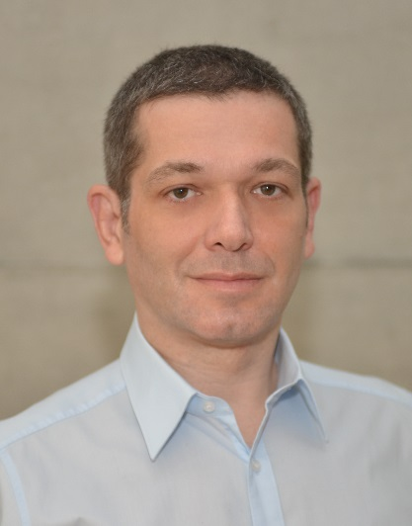
Contact Information
Dr. Josef J. Blanz
Principal Engineer
Qualcomm Standards & Industry Organizations
+49 6326 701230
jblanz@qti.qualcomm.com

Slide 86
Backup Material

Slide 87
Supported Configurations

Slide 88
Topologies
AE
AE
AE
Infrastructure Node
IN-CSE
Middle Node
Middle Node
CSE
CSE
Middle Node
Application Dedicated Node
CSE
AE
AE
Application Dedicated Node
Application Service Node
AE
AE
Application Dedicated Node
CSE
AE
CSE

