Slide 1
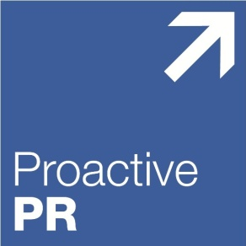
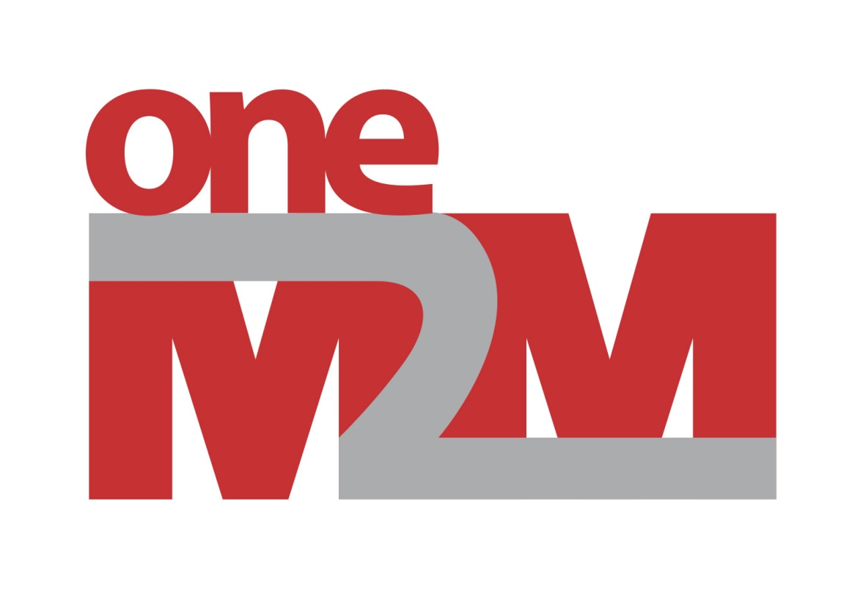
Statistics Report 1st February - 16th July 2015
Proactive International PR

Slide 2
Good News for oneM2M
Excellent relationship with M2Mnow publication has been established and as a result have covered all 3 oneM2M releases and a further 2 TIA announcements (previous coverage was sporadic, now every oneM2M mention is published)
First 2015 webinar a great success, due to a joined up PR and marketing outreach. 150 live listeners with a further 400 expected to visit the playback
As a result of our targeted webinar outreach, Eric Goodness from Gartner Magazine got in touch to express an interest in writing a piece about oneM2M. He registered for the webinar and we are in weekly contact with him, assisting with his enquires re content. He hopes to have the finished piece ready for oneM2M approval by the end of June
Eric Goodness - To highlight oneM2M within his Magic Quadrant piece for Gartner – he would like a direct quote from oneM2M around CSP’S and MVNO’s.
PPR have approached both OMA and HGI who have both agreed to host the next 2 webinars
Nancy Bartels article in Control Design came from interview with oneM2M after pitching ‘Rise of the Machines’ article to her in Feb 2015
PPR arranged an interview off the back of a media outreach campaign for the IoT event in San Francisco in May, between Richard Brennan and David Essex, Executive Editor from TechTarget. David wrote an online piece to accompany the podcast interview
We filmed 2 fantastic case studies with Hewlett Packard and Interdigital at the Mobile World Congress in Barcelona in March 2015
Activity tracker established to assist with Proactive PR and oneM2M actions and momentum
GTB 1600 word article submitted (for free) which will be a key feature within its M2M August supplement
Notes:
I have added a M2M Now slide (3) to show snips of coverage. Hidden until required
I had added a snip of the Activity Tracker to slide 5 however have left as hidden, in case no one asks to see it!

Slide 3
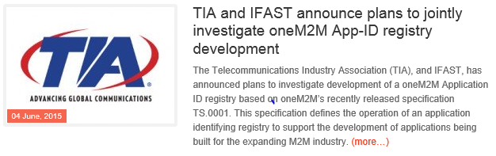
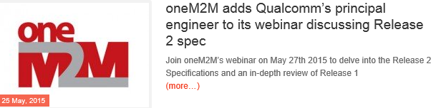
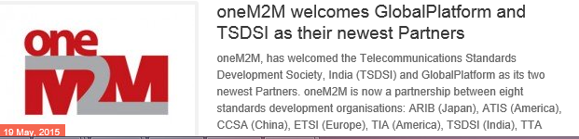
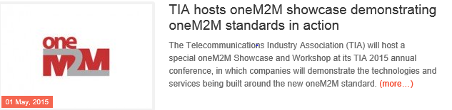

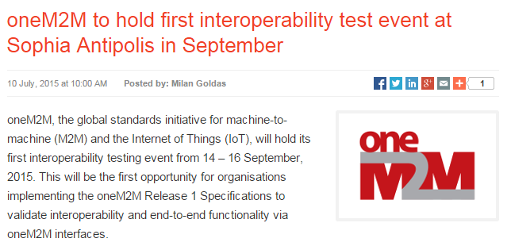
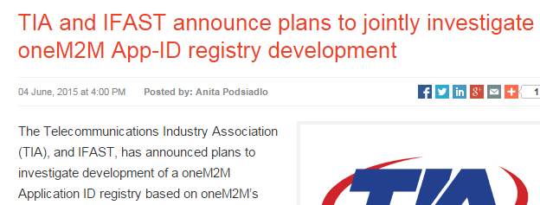
M2M Now Coverage Success

Slide 4
“Proactive” Activity: The Synchronised Trackers
PPR Activity Tracker
**Weekly actions tracker to be shared between PPR and oneM2M
**To ensure activity for both PPR and oneM2M is sustained / increased
**Assists with the Interconnection between existing members, such as TIA
**Formulate media invites/alerts from oneM2M news
oneM2M MARCOM Events List
**To manage and move forward with contra opportunities
**Obtaining speaking opportunities within approved events to promote oneM2M’s work
**Synchronise press releases around events & new members
Notes:
There is a hidden slide on slide 5 with a snip of the tracker – just in case you get asked for it

Slide 5
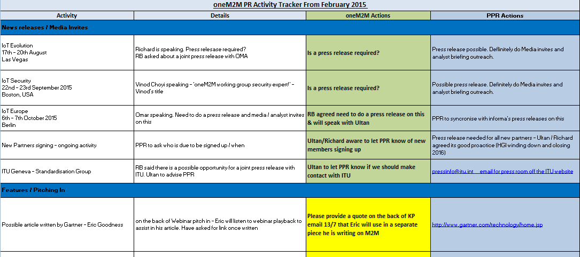
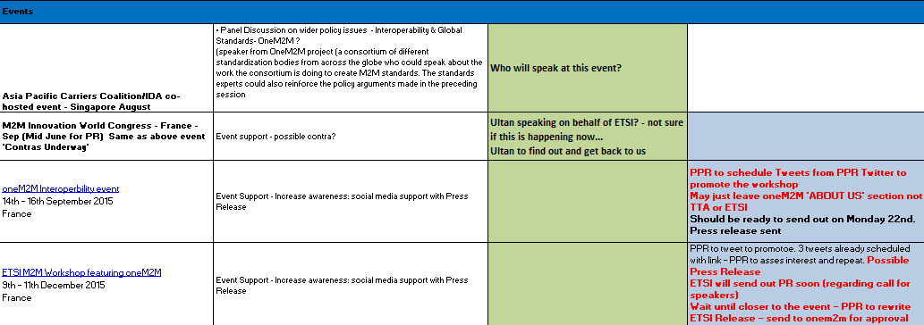
Proactive PR Activity Tracker for oneM2M

Slide 6
oneM2M Media Coverage
Month | February | March | April | May | June | July | Total
Coverage | 138 | 40 | 33 | 61 | 13 | 45 | 330
News Releases / Articles Issued | 1 | 0 | 1 | 1 | 0 | 1 | 4
Top Media: Obtained coverage in Sat News, Bloomberg, M2M Now, Fierce Markets, and Connect World, Sat PR News, Telecom Paper

Slide 7
oneM2M Contra Agreements
Contras | Speaker opportunity spotted / booked | Complete | Underway | Future
IoT Europe
IoT Security
Location Based Services
M2M Innovation World
IoT Evolution
IoT World Forum
M2M Summit
TU Automotive Europe
Telematics West Coast

Slide 8
Top Tier Media Impact:
Coverage received with Reach and Value
Publication | Advertising Value Equivalent (AVE) for Feb – July 2015 | Circulation / Reach figures
Capacity Magazine | £145,500 | 4k monthly subscribers over 127 countries
RCR Wireless | £137,450 | 37,924 daily website views
Connect World | £155,112 | 22,000 copies per month
Total Telecom | £29,273 | 6409 daily website views
Mobile Europe | £119,853 | 14,723 monthly website views
Wireless magazine | £15,199 | 534 daily website views
Wireless 2020 | £151,888 | 12,285 daily website views
Bloomberg Business | £973,711 | 4,711,141 daily website views
M2M Now | £201,115 | 9,000 daily website views
Wireless Developer Network | £58,622 | 534 daily website views
Fierce Markets | £387,669 | 740, 000 website views per month
TOTAL AVE | £2,375,392
Notes:
This shows the true value of PR. The Advertising Equivalent Value (AVE) calculation (column inches X ad rate / cost) is an indicative cost generated by coverage levels. It shows the value of the space you occupied within their publications. Essentially, this is how much you would have had to pay the publishers to gain the same coverage space.

Slide 9









Proactive Pitching in for oneM2M
Press Releases and Articles

Slide 10





TIA event: Press Release Pitching in Success
Proactive Pitching in for TIA
Articles and Releases

Slide 11
Proactive PR Future Activities : July – Dec
Increased content writing
Article: What does an IoT future look like? – Pitch in to top 20 media
GTB Article: There’s Big, There’s Huge then there’s M2M - PPR to re-write and pitch in further
Article for Satellite Evolution – PPR to write
Continue with Activity Tracker to maintain PR momentum
Event, contra and speaker support. PPR to continue to research opportunities for both oneM2M and members
PPR to continue to adopt successful ways of working by cross referencing existing members clients working methods
Continue with promoting webinar series and encouraging members with an existing PPR relationship to host
Continue to research forthcoming industry events
Monthly media coverage
Vertical sector research in line with oneM2M objectives
Ongoing social Media support
Continue with reaching out to analyst community

Slide 12

Social Media Recommendations – How Can We Help?
@oneM2M
PPR to increase activity to min 2 tweets per day using industry news, press coverage and events. PPR to set themselves follower targets and actively follow members of oneM2M
Link Twitter and press coverage by using Key words such as #standards #IoT #M2M #tech making the tweet drop into online forum conversations
Benefits
Increased relevant followers, more likely to read & share
Targeted content, increased visibility & can accurately monitor follower reactions with social media reports
Results
Greater Global reach & increased Brand and standards awareness. increased visibility could equal more members
Future social media and press campaigns will have a greater strategic impact to build on time and time again
Actions

Slide 13
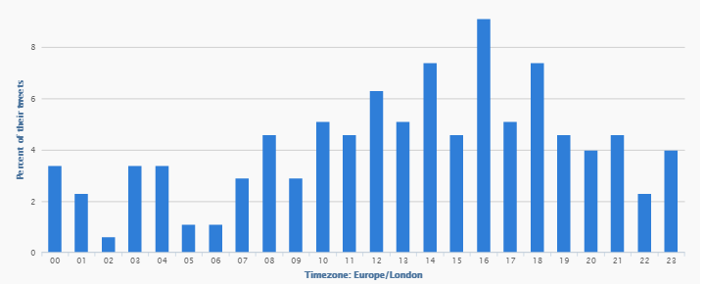
A Little Science Behind Tweet Scheduling
This is an example of the data we can get from our Social Media reporting software. This tells us when your followers are most active, therefore when the best time is to tweet your content. This changes regularly and we would keep up with trends and adapt accordingly to maximise your reach.

Slide 14
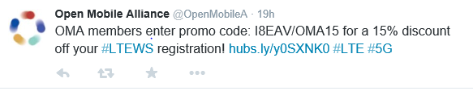
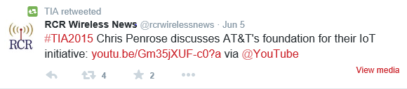
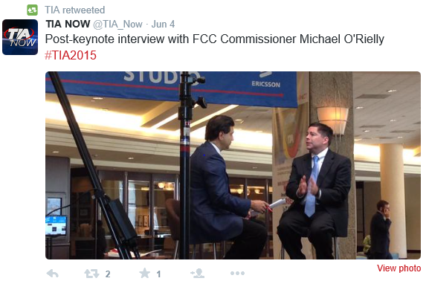
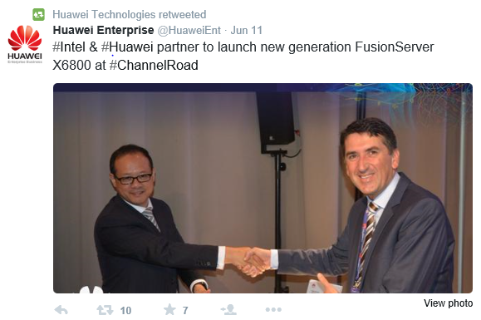
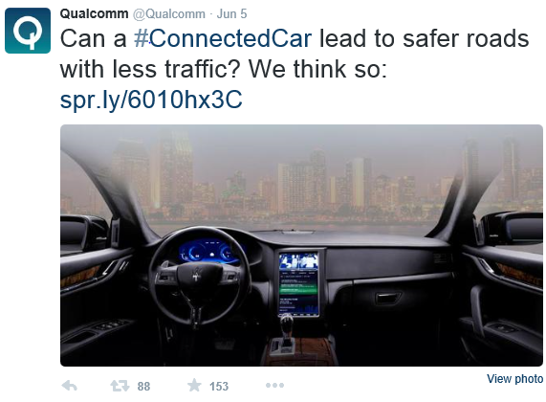
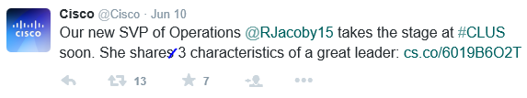
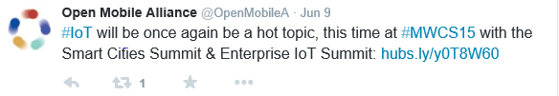
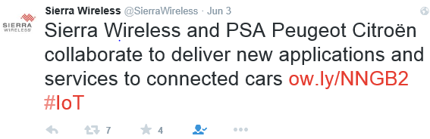
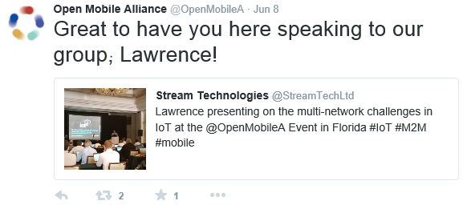
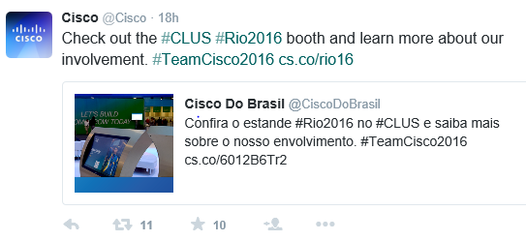

Examples of How Others do Twitter

