Slide 1
Overview
onem2m.org

Slide 2
What is oneM2M?
Global initiative to drive IoT interoperability
through the
development and implementation
of standards
Requirements
Architecture
API specifications
Security
Interoperability
covers
Mission
Facilitate, implement and promote IoT standardization and interoperability
Purpose
To specify, promote and maintain a Common IoT Services Layer
Deliverables
Technical Reports & Technical Specifications

Slide 3
Why Now?
The Internet of Things (IoT) ecosystem promises tremendous opportunity but only if everything works as one.
Optimum solution: A common service layer so applications and devices can communicate.
oneM2M is facilitating, implementing and promoting IoT standardization and interoperability.
oneM2M
Beyond
initial release

Slide 4
Overview
Created in 2012 by 8 ICT standards organizations on 3 continents
Working in concert with 7 industry organizations
200+ Members
Standard Bodies
ARIB (Japan)
ATIS (N. America)
CCSA (China)
ETSI (Europe)
TIA (N. America)
TSDSI (India)
TTA (Korea)
TTC (Japan)
Industry Organizations
Broadband Forum
CEN
CENELEC
GlobalPlatform
Next Generation M2M Consortium
OMA

Slide 5
Growing Implementation Base
Industry-driven Open Source Implementations
Examples of Commercial implementations / Demos
Industry-driven Open Source Implementations
Industry-driven Open Source Implementations

Slide 6
Benefits
Lower Costs
CAPEX
Lower cost of deployment (library of functions)
Programmers can focus on applications (not on underlying communications)
Scale economies of horizontal service layer (common functions for diverse use-cases)
OPEX
Efficient communications (policy-driven and event triggered)
Sensor data sharing (produce once, consume many times)
Transport economics (use best transport network for business needs)
Simplifies the development of applications
Common services layer for different verticals and segments eliminates the need for application-specific platforms
Creates mass-market economies of scale
Accelerates IoT adoption

Slide 7
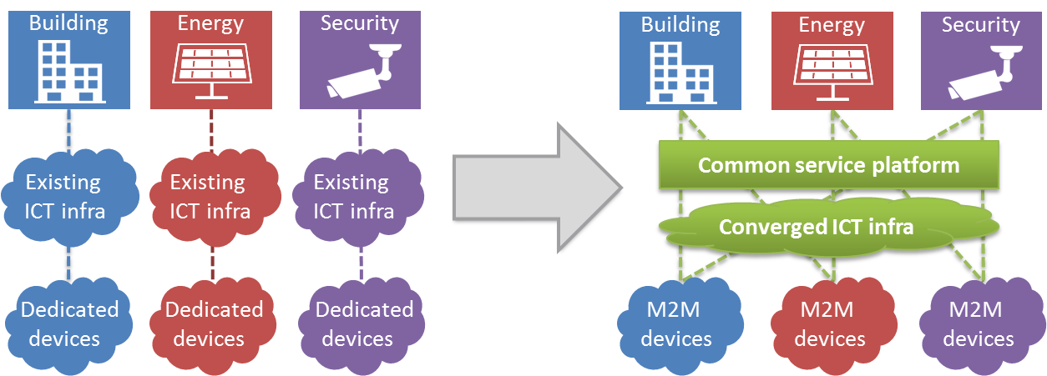
Ultimate Goal: IoT cross-domain interoperability
Without oneM2M
With oneM2M
Highly fragmented market with limited vendor-specific applications
Reinventing the wheel: Same services developed again and again
Each silo contains its own technologies without interop
End-to-end platform: common service capabilities layer
Interoperability at the level of communications and data
Seamless interaction between heterogeneous applications and devices

Slide 8
Technical/Product Backup

Slide 9
IoT Service Layer
Middleware - supporting secure end-to-end data/control exchange between IoT devices and customer applications by providing functions for remote provisioning & activation, authentication, encryption, connectivity setup, buffering, synchronization, aggregation and device management
- software layer
- sits between IoT applications and communication elements that provides data transport
- normally rides on top of IP
- provides commonly needed functions for IoT applications across different industry segments

Slide 10
Common oneM2M
Service Functions
Registration
Discovery
Security
Group Management
Data Management & Repository
Subscription & Notification
Device Management
Application & Service Management
Communication Management
Network Service Exposure
Location
Service Charging & Accounting

Slide 11
Release 1 Specifications
Requirements TS-0002 (WI-0001)
Functional
Architecture
TS-0001 (WI-0002)
Definitions & Acronyms
TS-0011 (WI-0003)
Service Layer
Core Protocols
TS-0004 (WI-0009)
HTTP Protocol Binding TS-0009 (WI-0013)
CoAP Protocol Binding TS-0008 (WI-0012)
Management Enabl^{nt} - OMA TS-0005 (WI-0010)
Management Enabl^{nt} - BBF TS-0006 (WI-0010)
MQTT Protocol Binding TS-0010 (WI-0014)
Security Solutions TS-0003 (WI-0007)
www.onem2m.org/release1

Slide 12
oneM2M Release 2
Home domain enablement
Home appliance information models
Industrial domain enablement
Time series, etc.
In conjunction with a TR
oneM2M Application Identification Registry established
oneM2M
Beyond
initial release
Semantic interoperability
base ontology
semantic discovery
semantic descriptions
oneM2M interworking framework
Generic interworking
AllJoyn/AllSeen and/or
OIC and/or
OMA LightWeight M2M (OMA LWM2M) and/or
3GPP Rel.13 Interworking
Advanced protocol binding
WebSocket
Security
Enhancement for authorization (?)
privacy support
e2e security

Slide 13
Conceptual Architecture View
Application Dedicated Node
Infrastructure Node
Middle Node
AE
AE
AE
Things:
Sensors,
Devices,
MEMS
AE
API
Apps Cloud Services,
BSS
Application Service Node
CSE
API
CSE
AE
API
CSE
Gateways
Network
AE: Application Entity CSE: Common Services Entity NSE: Network Services Entity
NSE
NSE
NSE
Sensor Areas
Cloud

Slide 14
oneM2M is reaching out
Collaborations
SG20
WG10
P2413
collaborates with
MQTT
OCF
DM
uses
interworks with
LWM2M
HTTP CoAP TLS DTLS
AllJoyn
DDS
New work

Slide 15
Alternate Slides

Slide 16
Partnership Project

Slide 17
Membership
Over 200 member organizations in oneM2M

Slide 18
Over 200 member organizations in oneM2M

Slide 19
Sample Slides

Slide 20
Sample Title
Introduction to oneM2M
The role of oneM2M as a frontend for IoT big data systems
A blue-print for IoT enabled smart cities
Relationship to Big Data
Data vs. metadata in oneM2M
Survey of open source initiatives applicable for cloud backends for massive IoT data processing
A possible application of DPM in IoT: IoT Data Fault Detection
Recommendations to FG DPM work program

Slide 21
Sample Title
Sample text
Sample text

Slide 23
Title of Presentation
Speaker Name and Date

Slide 24
Section Header
Sub text

Slide 25
Sample Title
Sub Title Goes Here
Sub Title Goes Here
Sub Title Goes Here
Sub Title Goes Here

Slide 26
Sample Title
Sub Title Goes Here
Sub Title Goes Here
Sub Title Goes Here
Sub Title Goes Here
Sub Title Goes Here
Sub Title Goes Here

Slide 27
Sample Title
text
Text goes here
text
Text goes here
text
Text goes here

Slide 28
Sample Title
Text goes here
text
Text goes here
text
Text goes here
text

Slide 29
Sample Title
text
Text goes here

Slide 30
Sample Title
text
Text goes here

Slide 31
Sample Title
Text goes here
Text goes here
text
Text goes here
Text goes here

Slide 33
Primary Corporate Colors (80% of design)
Cool Gray 8
Pantone 1807C
CMYK: 0 1 0 43
RGB: 160 160 163
#a0a0a3
CMYK: 20 99 99 11
RGB: 180 32 37
#b42025
Accent Color Group #1 (20% of design)
Pantone 1375
Pantone
667
Pantone 647
Cool gray 11
Pantone
5483
CMYK: 1 51 99 0
RGB: 246 146 30
f6921e
CMYK: 63 63 18 2
RGB: 113 104 150
f6921e
CMYK: 100 25 0 50
RGB: 0 84 128
005480
CMYK: 0 5 0 82
RGB: 84 80 84
f6921e
CMYK: 60 30 30 10
RGB: 102 140 151
668c97

