Slide 1
Overview
onem2m.org

Slide 2
What is oneM2M?
Global initiative
to drive
IoT interoperability
through the
development and implementation
of standards
  Requirements
  Architecture
  API specifications
  Security
  Interoperability
covers
Mission
Facilitate, implement and promote IoT standardization and interoperability
Purpose
To specify, promote and maintain a Common IoT Services Layer
Deliverables
Technical Reports & Technical Specifications

Slide 3





Why Now?
The Internet of Things (IoT) ecosystem promises tremendous opportunity but only if everything works as one.
Optimum solution: A common service layer so applications and devices can communicate.
oneM2M is facilitating, implementing and promoting IoT standardization and interoperability.
oneM2M
Beyond
initial release

Slide 4
Overview
Created in 2012 by
8 ICT standards organizations on 3 continents
Working in concert with
7 industry organizations
200+ Members
Standard Bodies
ARIB (Japan)
ATIS (N. America)
CCSA (China)
ETSI (Europe)
TIA (N. America)
TSDSI (India)
TTA (Korea)
TTC (Japan)
Industry Organizations
Broadband Forum
CEN
CENELEC
GlobalPlatform
Next Generation M2M Consortium
OMA

Slide 5
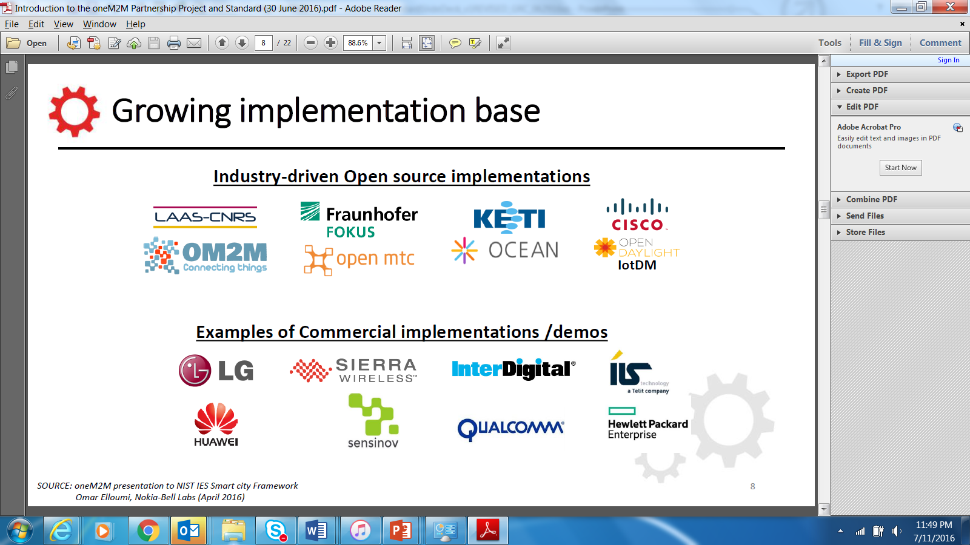
Growing Implementation Base
Industry-driven Open Source Implementations
Examples of Commercial implementations / Demos
Industry-driven Open Source Implementations
Industry-driven Open Source Implementations

Slide 6


































Ongoing Collaborations
  Collaboration is important to reach common understanding, avoid overlap and build interoperable IoT ecosystems globally.
Sharing/Reference
(Liaison, workshop, …)
P2413
MIoT
ref. arch, OHTP
Certification
Interworking
SCP, SmartM2M
JTC1 WG10
OCF
SG20
OSGi/DAL
Endorsement
(adoption)
SCEF/CIoT
WoT
WG3
TR-069/ TR-181
AllJoyn
DDS
OPC-UA
OMA DM/ LWM2M
HTTP/ CoAP/
(D)TLS/
WebSocket
MQTT
Partnership
Source: Huawei

Slide 7
Benefits
Lower Costs
CAPEX
  Lower cost of deployment (library of functions)
  Programmers can focus on applications (not on underlying communications)
  Scale economies of horizontal service layer (common functions for diverse use-cases)
OPEX
  Efficient communications (policy-driven and event triggered)
  Sensor data sharing (produce once, consume many times)
  Transport economics (use best transport network for business needs)
Simplifies the development of applications
  Common services layer for different verticals and segments eliminates the need for application-specific platforms
Creates mass-market economies of scale
Accelerates IoT adoption

Slide 8
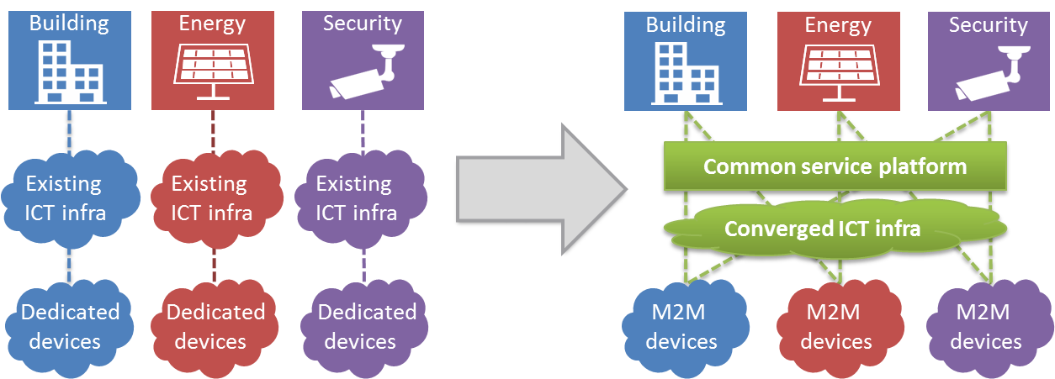
Ultimate Goal:
IoT cross-domain interoperability
Without oneM2M
With oneM2M
Highly fragmented market with limited vendor-specific applications
Reinventing the wheel: Same services developed again and again
Each silo contains its own technologies without interop
End-to-end platform: common service capabilities layer
Interoperability at the level of communications and data
Seamless interaction between heterogeneous applications and devices

Slide 9
Technical/Product Backup

Slide 10
IoT Service Layer
Middleware - supporting secure end-to-end data/control exchange between IoT devices and customer applications by providing functions for remote provisioning & activation, authentication, encryption, connectivity setup, buffering, synchronization, aggregation and device management
  - software layer
  - sits between IoT applications and
  communication elements that provides data transport
  - normally rides on top of IP
  - provides commonly needed functions for IoT applications across different industry segments

Slide 11
Common oneM2M
Service Functions
Registration
Discovery
Security
Group Management
Data Management & Repository
Subscription & Notification
Device Management
Application & Service Management
Communication Management
Network Service Exposure
Location
Service Charging & Accounting

Slide 12
Release 1 Specifications
Requirements
TS-0002
(WI-0001)
Functional
Architecture
TS-0001
(WI-0002)
Definitions
& Acronyms
TS-0011
(WI-0003)
Service Layer
Core Protocols
TS-0004
(WI-0009)
HTTP Protocol
Binding
TS-0009
(WI-0013)
CoAP Protocol
Binding
TS-0008
(WI-0012)
Management
Enabl^{nt} - OMA
TS-0005
(WI-0010)
Management
Enabl^{nt} - BBF
TS-0006
(WI-0010)
MQTT Protocol
Binding
TS-0010
(WI-0014)
Security
Solutions
TS-0003
(WI-0007)
www.onem2m.org/release1

Slide 13
oneM2M Release 2
Home domain enablement
  Home appliance information models
Industrial domain enablement
  Time series, etc.
  In conjunction with a TR
oneM2M Application Identification Registry established
oneM2M
Beyond
initial release
Semantic interoperability
  base ontology
  semantic discovery
  semantic descriptions
oneM2M interworking framework
  Generic interworking
  AllJoyn/AllSeen and/or
  OIC and/or
  OMA LightWeight M2M (OMA LWM2M)
  and/or
  3GPP Rel.13 Interworking
Advanced protocol binding
  WebSocket
Security
  Enhancement for authorization (?)
  privacy support
  e2e security

Slide 14
Conceptual Architecture View
Application Dedicated Node
Infrastructure Node
Middle Node
AE
AE
AE
Things:
Sensors,
Devices,
MEMS
AE
API
Apps
Cloud
Services,
BSS
Application Service Node
CSE
API
CSE
AE
API
CSE
Gateways
Network
AE: Application Entity
CSE: Common Services Entity
NSE: Network Services Entity
NSE
NSE
NSE
Sensor Areas
Cloud

Slide 15
Alternate Slides

Slide 16
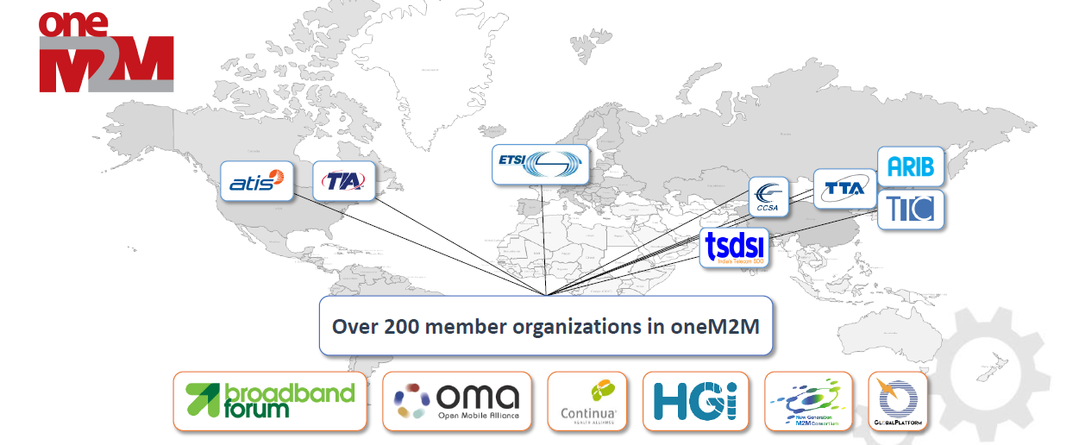


Partnership Project

Slide 17













Membership
Over 200 member organizations in oneM2M

Slide 18

Over 200 member organizations in oneM2M

Slide 19
Sample Slides

Slide 20
Sample Title
Introduction to oneM2M
The role of oneM2M as a frontend for IoT big data systems
  A blue-print for IoT enabled smart cities
  Relationship to Big Data
Data vs. metadata in oneM2M
Survey of open source initiatives applicable for cloud backends for massive IoT data processing
A possible application of DPM in IoT: IoT Data Fault Detection
Recommendations to FG DPM work program

Slide 21
Sample Title
Sample text
Sample text

Slide 23
Title of Presentation
Speaker Name and Date

Slide 24
Section Header
Sub text

Slide 25
Sample Title
Sub Title Goes Here
Sub Title Goes Here
Sub Title Goes Here
Sub Title Goes Here

Slide 26
Sample Title
Sub Title Goes Here
Sub Title Goes Here
Sub Title Goes Here
Sub Title Goes Here
Sub Title Goes Here
Sub Title Goes Here

Slide 27
Sample Title
text
Text goes here
text
Text goes here
text
Text goes here

Slide 28
Sample Title
Text goes here
text
Text goes here
text
Text goes here
text

Slide 29
Sample Title
text
Text goes here

Slide 30
Sample Title
text
Text goes here

Slide 31
Sample Title
Text goes here
Text goes here
text
Text goes here
Text goes here

Slide 33
Primary Corporate Colors (80% of design)
Cool Gray 8
Pantone 1807C
CMYK: 0 1 0 43
RGB: 160 160 163
#a0a0a3
CMYK: 20 99 99 11
RGB: 180 32 37
#b42025
Accent Color Group #1 (20% of design)
Pantone 1375
Pantone
667
Pantone 647
Cool gray 11
Pantone
5483
CMYK: 1 51 99 0
RGB: 246 146 30
f6921e
CMYK: 63 63 18 2
RGB: 113 104 150
f6921e
CMYK: 100 25 0 50
RGB: 0 84 128
005480
CMYK: 0 5 0 82
RGB: 84 80 84
f6921e
CMYK: 60 30 30 10
RGB: 102 140 151
668c97

