Slide 1
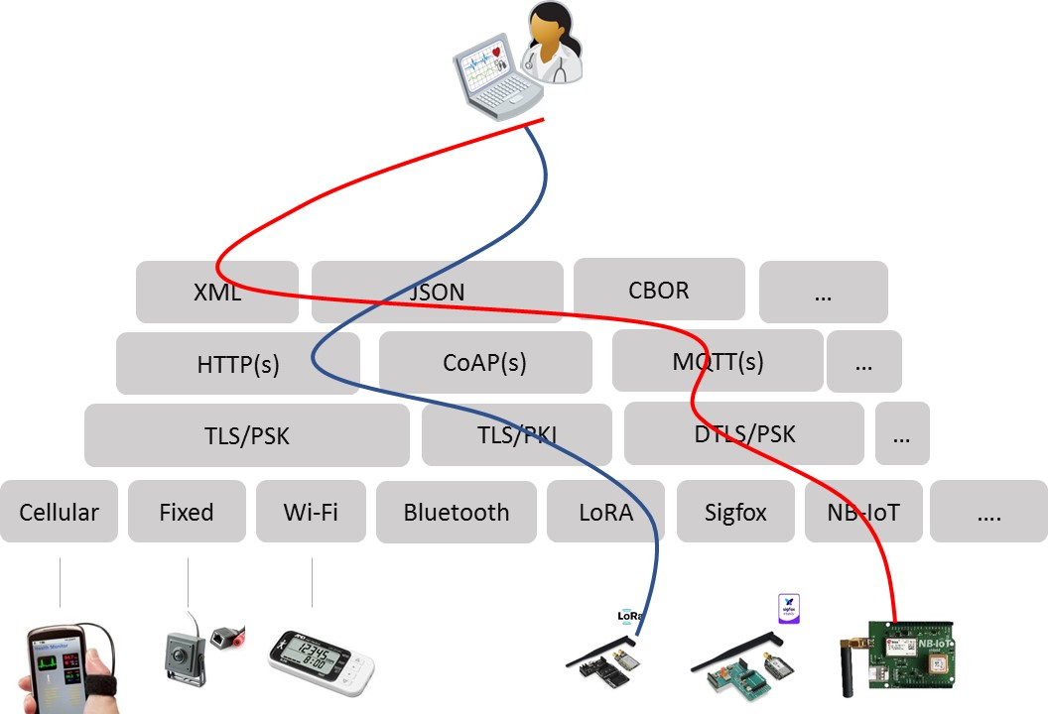
Today a developer is exposed to many different technology choices to build an LPWA connection. This leads to complexity and hampers interoperability.
By implementing oneM2M CSL, at the device and the infrastructure side, the developer only uses the globally specified oneM2M APIs to push data from the device into the cloud.

