Slide 1
Website Redesign

Slide 2
Current website
Content is generally quite good
Design is outdated
Navigation difficult
Need to prioritize what is on the home page

Slide 3
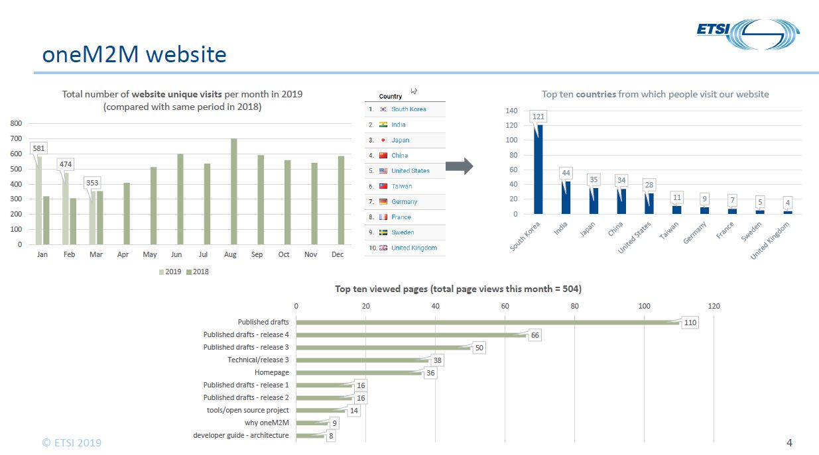
Web hits 2019
In January
oneM2M had 581 hits.
3GPP had 187,061

Slide 4
Quote for new website design
I contacted ProActive PR agency following our meeting in Malaga
Received a questionnaire from the agency they deal with
Filled in the questionnaire with Roland & Laurent
Basically it was asking what we do, who our competition is, etc
Quote sent back was £20,000
Approx $26,000
Marcom budget for 2019 gives us $20,000
Do we try to negotiate down?
Contact other designers?
Ask oneM2M partners for more money?
…

