Slide 1
2019 MARCOM action proposal
Nadja Rachow
Communication Director ETSI

Slide 2
First steps: Communication plan, messages and budget
Need to develop the Communication 2020 plan to define and validate actions, budget and responsibilities deadline beginning July
Audit of existing communication tools (website , brochures, social media..)
Need to define clear key messages and value propositions
Need to find more regional Vice chairs

Slide 3
Media & press relations
Driving Coms agency to get out the best value of it
media plan & journalist database
conference plan
media monitoring service
Need of central point of contact for journalist/analyst
Establish validation flow for press releases and news to improve responsiveness time
Identify oneM2M spokespersons
Invite targeted journalists to oneM2M key events such as IoT week or Interop events , developer days or hackathons.

Slide 4
Events & speaker presence on confernces
Improve planning (forecast) and communication of key conferences (agency) and speaker participation
Solution to be found to facilitate speaker participation to conferences (the reimbursement of expenses)
Improve promotion of own oneM2M events (Interop events, hackathons)
Support events organisation through COMS expertise

Slide 5
Enhanced Leadership content
Writing articles about specific topics and publish in selected media
Executive view point
Interviews with journalist and analysts (use of ETSI and partner’s journalist database and media list)
Increase publishing in social media accounts by members!

Slide 6
Enhanced Leadership content - Webinars
webinars continue to be a success, being popular both with viewers and with our group. They are a key part of a content-based communications strategy, ensuring OneM2M is perceived as a thought leader in IOT and M2M. We now have over 2,880 subscribers followers registered on our webinar channel hosted by BrightTalk. We need to strongly promote the concept of webinars to our committees
Improve identification process of potential topics for webinars
Content of physical conference presentation can be easily duplicated on the webinar channel
Continue reporting on the success of webinars to in order to attract more speakers and viewers

Slide 7
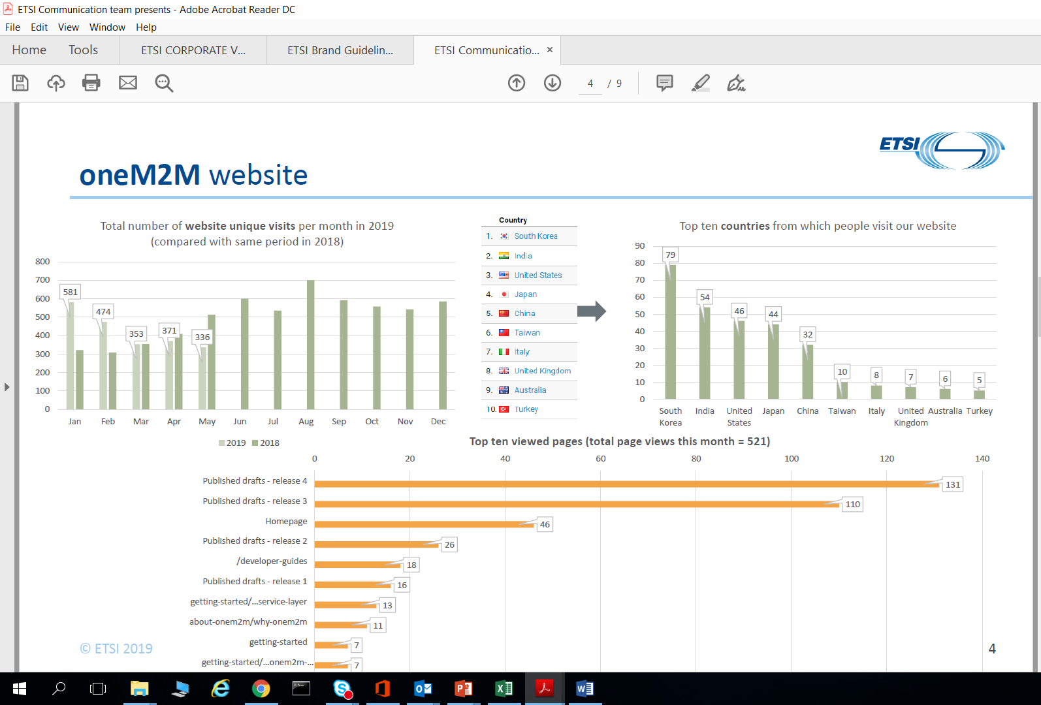
Website performance May 2019
OneM2M website has a quite poor and decreasing performance !

Slide 8
Website redesign
Revamp the OneM2M website according latest web design trends and improved user experience, fully responsive website (smartphones tablets..)
Upgrade to new Joomla version and secured domain address (https) Compliant with WCAG* 2.0 preferably level A
Change homepage to increase visibility and promotion of news and events
Improve visibility on partners website for oneM2M promotion
Develop SEO (search engine optimization). Further improve our analytics and experiment with data-driven updates and improvements to our website, based on analytics. Use the results from our 2018 Google Adwords experiment, and our Google search results analysis, to improve individual page ranking by tailoring specific pages

Slide 9
Social media
Develop LinkedIn as a publications channel, driving content to audiences on the platform: Continue the posting of thought leadership articles on LinkedIn (from personal accounts) and cross post to oneM2M LinkedIn sites
Join and engage (and encourage our officials to join and engage) in LinkedIn groups on subjects related to M2M/IoT
Encourage stakeholder to live tweet during events
Continue to collect and analyse key performance indicators on each of our social media channels and their usefulness in driving traffic to our website

Slide 10
Promotion material and distribution of news
Update of existing brochure(s) ?
Need to find solution for information push and improved managing of subscription & distribution (storage, ownership and format of distribution, solution: campaign monitor
Videos for website and social media

Slide 11
..and more
Need to improve information sharing within the network (ex. consolidation of presence to conferences and feedback, report of activities etc.)
Measure COMS performance to progress

